Slide 1
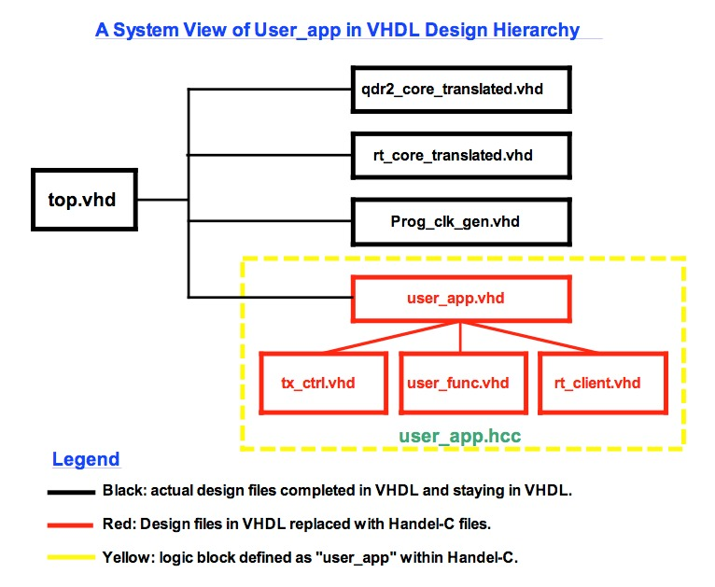
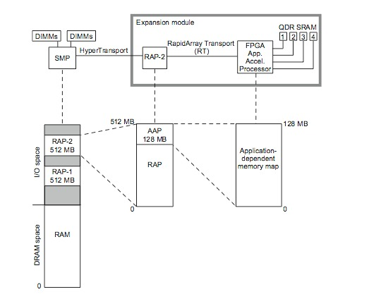
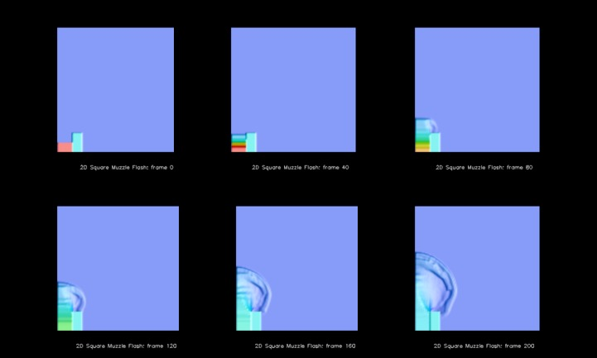
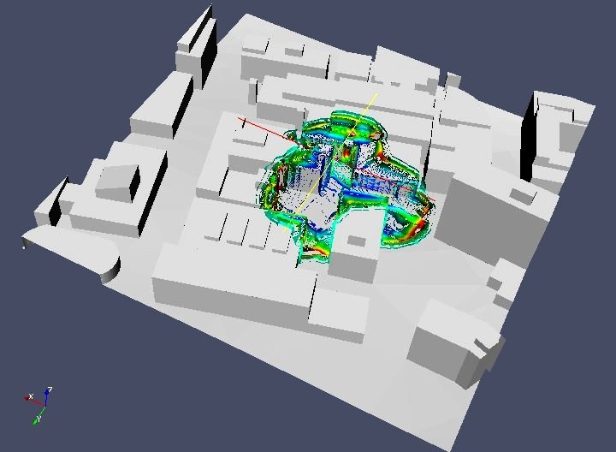
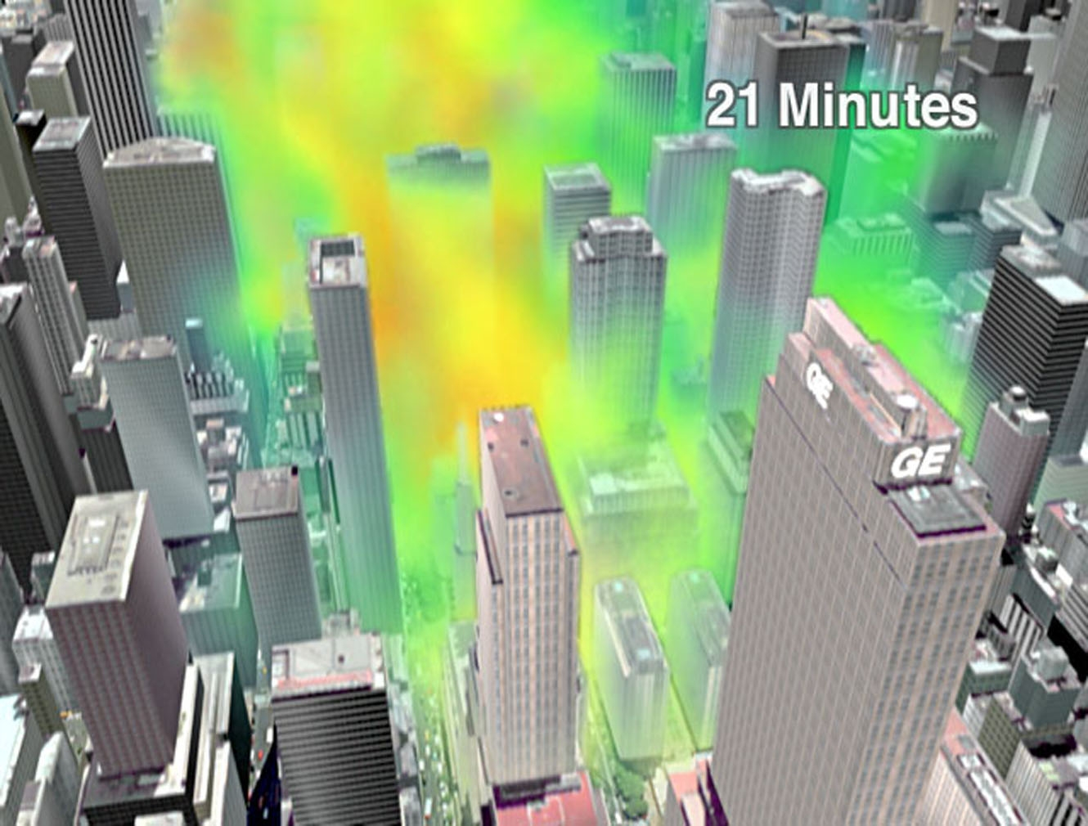
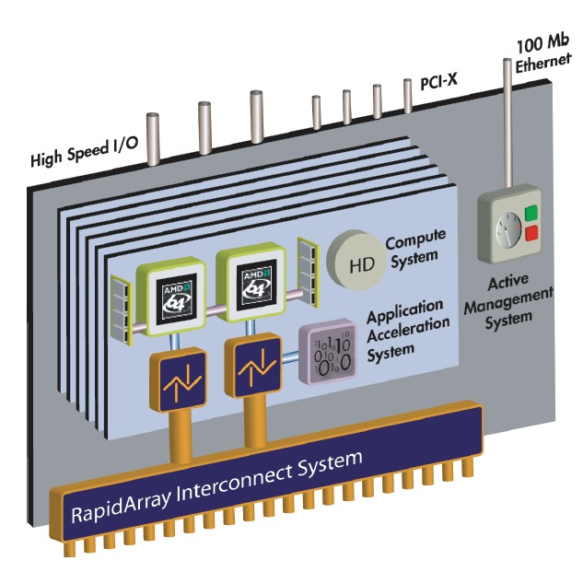
Mabel Xu
Quince Orchard High School
June 2007 – August 2007
Center for Computational Science
Code 5593
Mentor: Dr. Robert Rosenberg
Porting LCPFCT onto an FPGA
LCPFCT
Flux-Corrected Transport Algorithm – calculates fluid dynamics using generalized continuity equations from CFD (Computational Fluid Dynamics)
Treats fluid as a grid of cells that each have data computed at their centers
Generally, the finer the grid, the more accurate the results
Employs variable time steps – each Δt is calculated using approximate maximums for particle velocity, energy, and density
Calculates cells in the problem one-dimension at a time
Can be used in conjunction with various coordinate systems, including Cartesian, Cylindrical, Spherical, or Custom-defined
Currently being tested using the Muzzle Flash problem, but has applications in Contaminant Transport and Blast problems
Originally written in FORTRAN 77, converted to C for ease of porting to either Handel-C or Mitrion-C
Cray API
API created by Cray to help interface with the Cray XD1 supercomputer
Specific file structure of VHDL files to generate binary files that can be used to reconfigure the FPGA
Also provides way for Opteron processor and AAP processor to access each other’s memory
VHDL
One of the native languages to work in for FPGAs
Explicitly defines all hardware (example of AND gate):
    -- (this is a VHDL comment)
    -- import std_logic from the IEEE library
    library IEEE;
    use IEEE.std_logic_1164.all;
    -- this is the entity
    entity ANDGATE is
    port (
    IN1 : in std_logic;
    IN2 : in std_logic;
    OUT1: out std_logic);
    end ANDGATE;
    architecture RTL of ANDGATE is
    begin
    OUT1 <= IN1 and IN2;
    end RTL;
Very difficult to work with, but user-written VHDL more efficient
Support for Cray API written in VHDL
Handel-C and Mitrion-C synthesizers generate user_app.vhd from C, user_app.vhd hooks into existing Cray API
Handel-C
C-like language with special constructs for parallism
Extreme similarity to C makes porting from C to Handel-C relatively easy
Utilizes a par{} structure for explicit parallelism
Programs are inherently sequential
Less than ideal utilization of FPGAs parallel processing powers without careful optimization
Probably less powerful performance-wise than Mitrion C
Only Windows Development Kit works, Linux DK has problems
Problems with the Development Kit prevented debugging of sample code provided
The Muzzle Flash Problem
Describes half of a cylindrical-coordinate-system based muzzle flash
Consists of an ideal solid wall as one of the boundaries for a high-pressure high-density gas
Upon diaphragm rupture, program calculates density, energy, and velocity of gas as a function of time
Possible applications include contaminant transport problems and blast simulations
Mitrion-C
C-like language that is completely rewritten to inherently utilize parallelism
Stricter language syntax and logic-wise than Handel-C, more difficult to write and get used to
More difficult to port from C to Mitrion-C (than from C to Handel-C), but resulting code takes better advantages of features of the FPGA
All memory only written to once to ensure parallelism will not disturb correct program operation
Memory management much clearer than in Handel-C
Example programs and user-written test programs get up and running more easily
Mitrion Integrated Development Environment works as expected
Xilinx Virtex II Pro FPGA
AAP (Applied Application Processor) actually has slower clock speeds than AMD Opteron Processors
Increases speed and performance by performing actions in parallel
Customized board based on logic gates and flip-flops
Can be reconfigured to fit the needs of the user of the program being run
Increase cooling costs for more heat generated by faster clock speeds in regular CPUs have justified exploration of the FPGA
Executing in parallel requires careful attention to timing and memory access order
(left)
Simulation of Muzzle Flash Problem at time steps 0, 40, 60, 120, 160, and 200
(bottom left)
Simulation of Contaminant Transport within a city setting, 21 minutes after blast
(bottom)
Simulation of an explosive blast on a base-like setting, overhead view
Cray XD1
Super Cluster built by Cray from commodity and proprietary parts
Uses Xilinx Virtex II Pro FPGAs, AMD Opteron processors, and their own RapidArray Interconnect interface
My Contributions
Convert original LCPFCT from FORTRAN 77 to C
  Performance only suffer slight decrease due to substitute methods that fill-in for functionality provided by inherent functions available in FORTRAN 77
Wrote sample programs that test several important aspects necessary to correct operation of LCPFCT on the FPGA:
  Memory access
  Data transfer between Opteron memory and FPGA memory
  Arithmetic operations between data in different structures, including vectors and variables with different data widths
  Started porting of program to both Handel-C and Mitrion-C
    (Handel-C didn’t work, Mitrion-C still in progress)

