Slide 1


(*) Design (VHDL) (*) Verification (System Verilog)
The SPI Project
Presented by:
Omer Shaked
Beeri Schreiber
27.09.2011

Slide 2
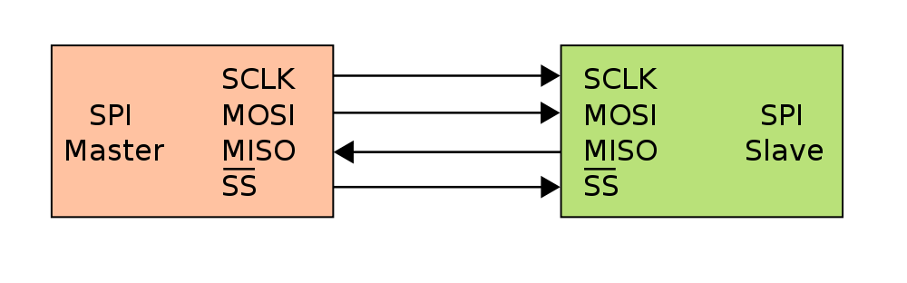
Background - SPI
Asynchronous serial data link standard
Operates in full duplex mode
Devices communicate in master/slave mode
the master device initiates the data frame.

Slide 3
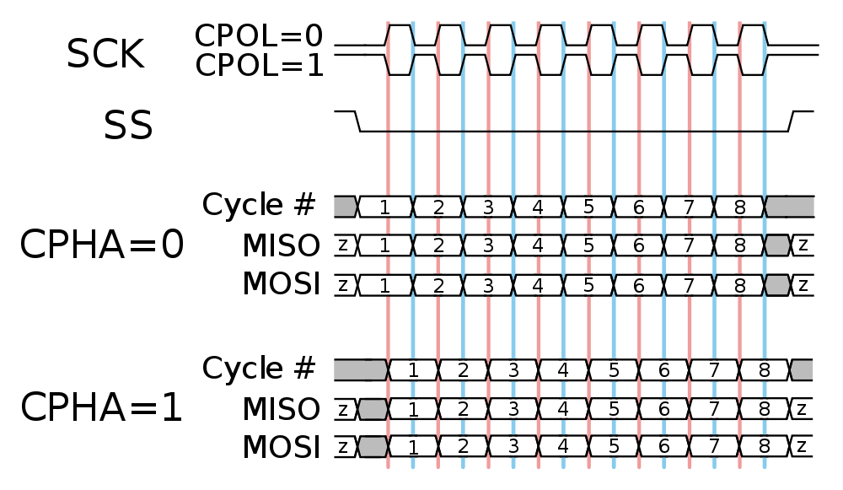
Protocol - SPI
The master configure the clock polarity and phase with respect to the data

Slide 4
Project Goals
Implement SPI Master and SPI Slave
Implement SPI Master and Slave Hosts
Build Test Benches in System Verilog:
Individual TB for SPI Master and SPI Slave
Top TB for the entire system

Slide 5
Implementation Main Problem
SPI Clock’s frequency and Polarity may change during runtime.
Therefore – SPI Clock cannot be placed in the global nets.

Slide 6
Solution
SPI Master and Slave works with the System Clock.
Master:
SPI Clock is generated from the System Clock, using counter.
Slave:
SPI Clock (spi_clk) is derivate.
SPI Clock Event
(MSB = ‘1’)

Slide 7
Top Architecture
Master
Host
Slave
Host
RAM
Wishbone
Slave
Interface
SPI
Master
Interface
SPI
Slave
Interface
RAM
Interface

Slide 8
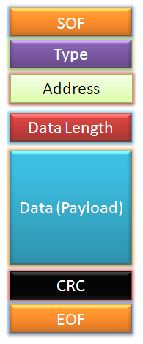
Master Architecture
Master Host
Checksum
Wishbone Slave
Controller
Dec. RAM
M.P. Decoder
SPI
Master
‘0’
Implementation for all components is done!
SPI Interface
Wishbone Interface
FIFO
Checksum
MUX
Enc. RAM
M.P. Encoder

Slide 9
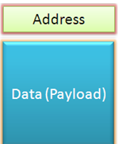

Slave Architecture
Not implemented yet
Slave Host
Message Pack Decoder
DEC
SPI
Slave
RAM
Controller
SPI Interface
Type
Register
RAM Interface
RAM
Message Pack Encoder
FIFO
MUX
Internal
Registers
CPOL, CPHA

Slide 10
Simulations
VHDL TB has been performed on RAM, FIFO, Checksum, Message Packs, SPI Master
System Verilog TB should be written for the following:
Individual TB for SPI Master and Slave
Whole System (Including Wishbone Interface)

Slide 11
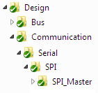


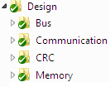
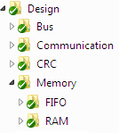
Directory Structure
All project files are saved to SVN.

Slide 12
Schedule
SPI Slave – 24.10.2011
Slave RAM Controller – 24.10.2011
Master Host and Slave Connection – 24.10.2011
Verification schedule is unknown yet.

Slide 13
Verification Plan (1)
SPI Master:
Run with all 4 possible options of CPOL and CPHA.
Validate that clock is divided correct for minimum and maximum register value.
FIFO empty (should stop SPI Master transaction).
Register change during active transaction (Should cause error)
Operation with single / multiple slaves
During RESET, change inputs. Validate outputs are in their default value.

Slide 14
Verification Plan (2)
SPI Slave:
Run with all 4 possible options of CPOL and CPHA.
Negate SPI_SS in the middle of the transaction.
SPI_CLK stops for a long time (time out).
Data from RAM is not valid when it should be.
Register change during active transaction (Should influence after transaction only)
During RESET, change inputs. Validate outputs are in their default value.

Slide 15
Verification Plan (3)
Top Test Bench:
Run with all 4 possible options of CPOL and CPHA.
Run with different SPI_CLK frequencies.
Write data to random address in RAM, then read from it. Validate data match.
Perform “Write-write-read-write-read”.
Perform “Write-read-read-write-read”.
Write Single (burst size of 1), and Burst.
Write / read to / from non-existing register address.
Write to valid address, but burst length exceeds from valid address.
Stop transaction in the middle (Negate WBM_CYC).
Perform RESET in the middle of the transaction.

