Slide 1


Serial Peripheral Interface
Final Project Presentation
27.12.2011
Presented by:
Omer Shaked
Beeri Schreiber
Supervised by:
Tal Yahav
Leon Polishuk

Slide 2
Project Requirements
Implement SPI Master and SPI Slave cores (VHDL)
Implement Master and Slave hosts (VHDL)
Verify the entire design (SystemVerilog)

Slide 3
SPI Protocol Description
Serial data link standard
Operates in full duplex mode
Devices communicate in master/slave mode
Single master, multiple slaves
The master initiates the data frame

Slide 4
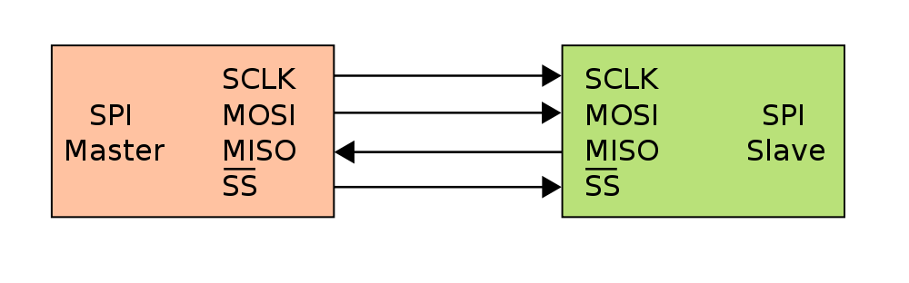
SPI Interface Description
The interface is consumed of four signals:
SPI_CLK: Serial Clock (output from master)
SPI_MOSI: Master Output, Slave Input
SPI_MISO: Master Input, Slave Output
SPI_SS: Slave Select (output from master).

Slide 5
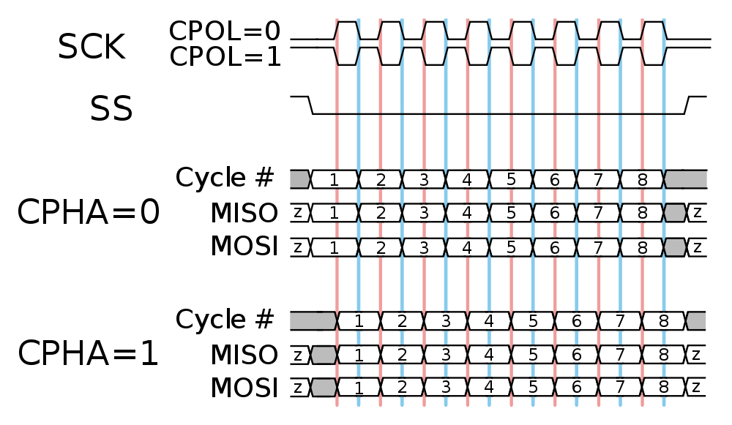
SPI Clock Configuration
The master configures the clock polarity and phase

Slide 6
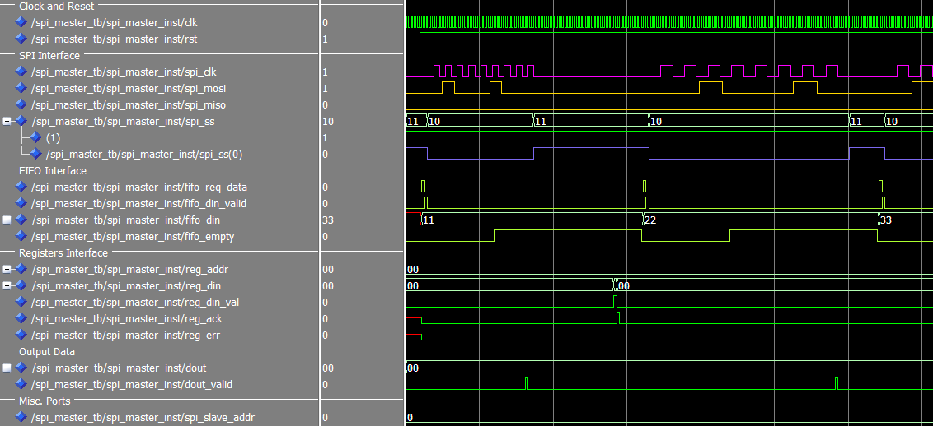
SPI Master Burst Waveform
3
Enable
SPI Slave
5
1
End of Reset
Disable
SPI Slave
4
SPI_CLK
Divide Factor : 2
8
SPI_CLK
Divide Factor : 4
a
b
2
FIFO:
Request for data
Data is Valid
6
Write to Registers:
Data (0x4) + data_valid
7
SPI Response:
Register acknowledge
9
Output data from
SPI Slave is valid

Slide 7
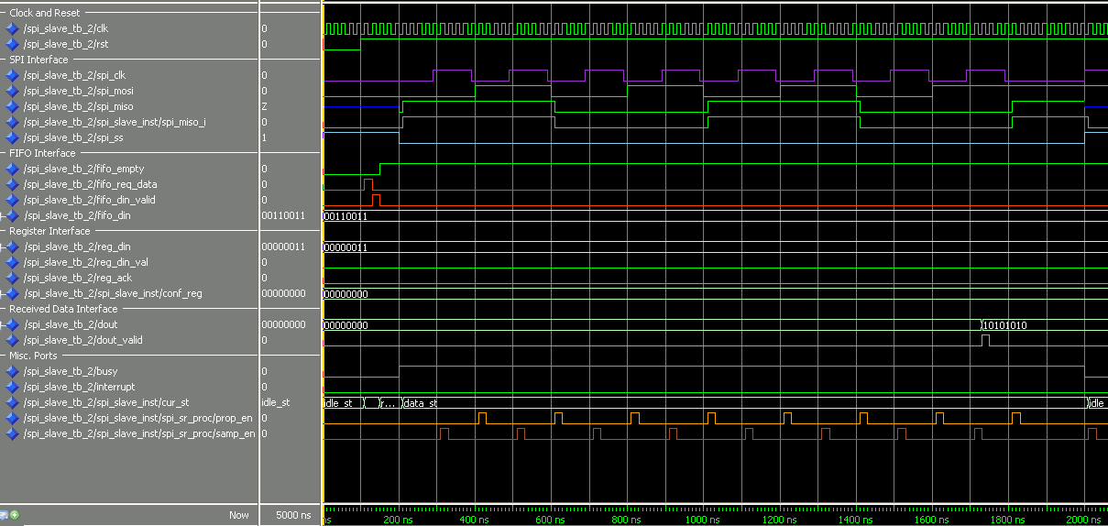
SPI Slave Burst Waveform
1
3
SPI_SS is
Activated
6
SPI_SS is
De-activated
End of Reset
a
b
2
FIFO:
Request for data
Data is Valid
4
Data is sampled after
SPI_CLK rising edge
Data is propagated after
SPI_CLK falling edge
5
End of Transaction
Dout is valid

Slide 8
Wishbone Description
Wishbone: Flexible design methodology for use with semiconductor IP cores
Wishbone Interface is used, in this project, to read and write data.

Slide 9
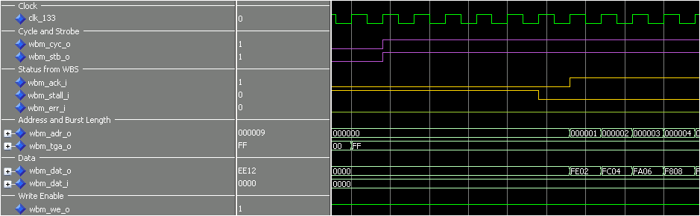
Wishbone Description: Write Burst
Start of Cycle
Data Acknowledged
Address
Repeat last transaction
Burst Length
Output Data
Writing
New Input Data

Slide 10
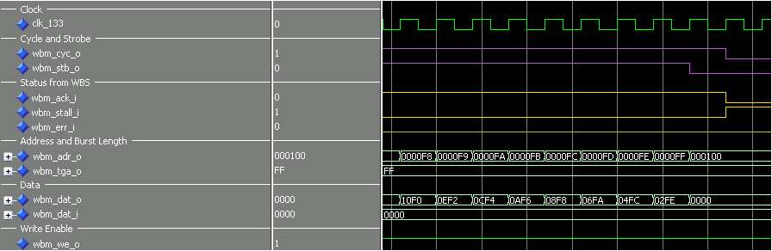
Wishbone Description: End of Write Burst
End of Cycle
Last Strobe
Address
Burst Length
Input Data
Writing
New Input Data
Data with no
strobe (Ignored)

Slide 11
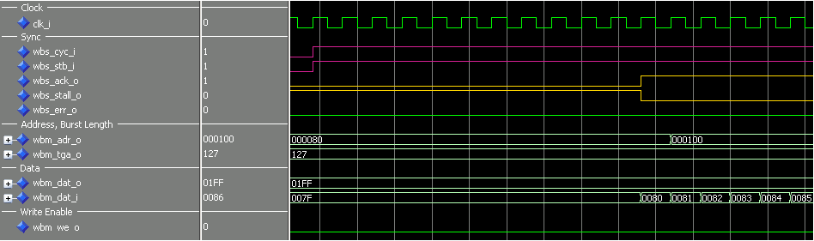
Wishbone Description: Read Burst
Start of Cycle
Data Valid
Address
Repeat last transaction
Burst Length
Continue to
next transaction
Output Data
Reading
New Output Data

Slide 12
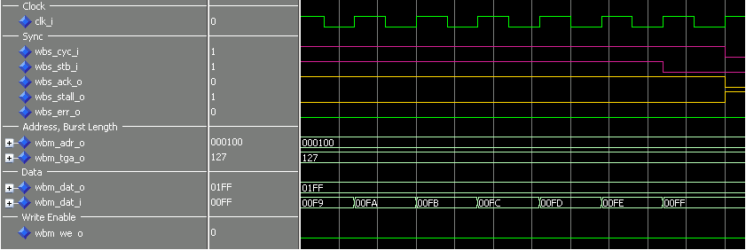
Wishbone Description: End of Read Burst
End of Cycle
Last Strobe
Address
Continue to next transaction
Burst Length
Output Data
Reading
New Output Data

Slide 13
Implementation Stages Unit Level
Design of SPI Master and SPI Slave cores
Design internal blocks of master and slave hosts
SPI Master and SPI Slave individual Test Benches

Slide 14
Implementation Stages Top Level
Integration of SPI cores
Integration of master and slave hosts
SPI top test bench (SPI Slave ←→ SPI Master)
Top architecture test bench (Whole system)

Slide 15
SPI Core Design
Four main interfaces:
Received Data Interface
SPI Core
FIFO Interface
SPI Interface
Configuration interface
Generic word length
Generic number of slaves

Slide 16
Top Architecture Design
Master
Host
Slave
Host
RAM
Wishbone
Slave
Interface
SPI
Master
Interface
SPI
Slave
Interface
RAM
Interface
Master host implements Wishbone slave interface
Hosts communicate via SPI
Slave host implements RAM interface

Slide 17
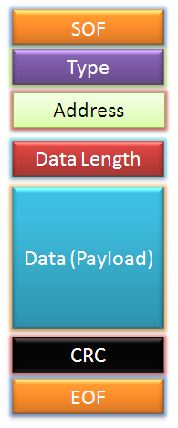
Master Host Design
Master Host
Checksum
Wishbone Slave
Controller
Dec. RAM
M.P. Decoder
SPI
Master
‘0’
SPI Interface
Wishbone Interface
FIFO
Checksum
MUX
Enc. RAM
M.P. Encoder

Slide 18
Slave Host Design
Slave Host
Slave Host Controller
Checksum
M.P. Decoder
Dec. RAM
Read MUX
RAM
SPI
Slave
RAM
Controller
SPI Interface
Registers
RAM Interface
Checksum
M.P. Encoder
Enc. RAM
FIFO

Slide 19
Verification Plan
Basic block-level VHDL TBs for SPI cores during design stage
SystemVerilog TBs
SPI Master
SPI Slave
Top: SPI Master + Slave
Top Architecture (Whole system)
Not part of the original verification plan

Slide 20
Verification Guidelines
Main verification principles
Randomly generated values
Functional Coverage collection
Automatic scoreboarding
SPI cores – includes possible edge cases
Top architecture – only basic functionality

Slide 21
SPI Master Test Bench
Status | Test Name
Passed | Simple burst
Passed | All CPOL, CPHA configurations
Passed | All SPI clock frequencies
Passed | Reset drives outputs to default values
Passed | Forbidden Configuration
Passed | FIFO Error (Not responding)
Passed | Illegal SPI Clock Frequencies
5
Scoreboard
1
7
3
Generator
and
Driver
SPI Master
(DUT)
Generator
and
Driver
FIFOI interface
SPI Interface
2
4
Receiver
Receiver
CFG interface
6
CFG_DUT

Slide 22
SPI Slave Test Bench
Status | Test Name
Passed | Simple burst
Passed | All CPOL, CPHA configurations
Passed | Max SPI clock frequency
Passed | Reset drives outputs to default values
Passed | Configuration during active transmission
Passed | Timeout
Passed | Interrupt
6
Scoreboard
1
8
Generator
and
Driver
SPI Slave
(DUT)
4
3
SPI Master
BFM
Generator
FIFOI interface
SPI Interface
2
5
Receiver
Receiver
CFG interface
7
CFG_DUT

Slide 23
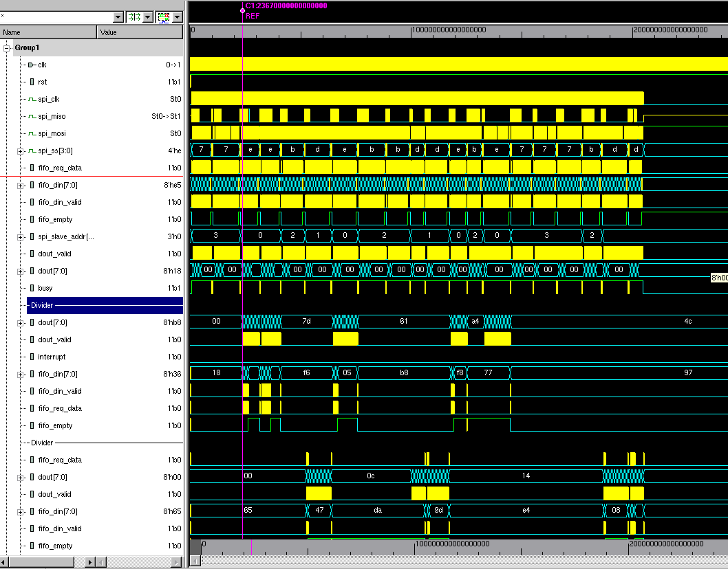
SPI Top Test Bench
Status | Test Name
Passed | Simple burst
Passed | All CPOL, CPHA configurations
Passed | Different SPI clock frequencies
Passed | Max SPI clock frequency
Passed | Generics
5
Scoreboard
7
DUT
1
3
Generator
and
Driver
SPI Master
SPI Slave0
Generator
and
Driver
SPI Slave1
FIFOI interface
SPI Interface
FIFOI interface
SPI Interface
SPI Slave2
2
4
Receiver
Receiver
SPI Slave3
CFG interface
CFG interface
6
CFG_DUT

Slide 24
Top Test Bench (UVM 1.1)
UVM_TEST
UVM_ENV
Agent
DUT
Sequencer
SPI
I/F
Master
Host
Slave
Host
External
RAM
WBS
Monitor
Driver
Scoreboard

Slide 25
Top Test Bench (UVM 1.1)
Status | Test Name
Passed | All burst lengths
Passed | All CPOL, CPHA configurations
Passed | All SPI clock frequencies
Removed. Not relevant. | Burst length exceeds RAM address
Removed. Not relevant. | Transaction interrupted
Removed. | Reset in middle of transaction

Slide 26
SV Verification Summary
COVERGROUP COVERAGE: ---------------------------------------------------------------------------------------------------- Covergroup Metric Goal/ Status At Least ---------------------------------------------------------------------------------------------------- TYPE /top/master_host_monitor/cov_trans 100.0% 100 Covered Coverpoint cov_trans::length 100.0% 100 Covered Coverpoint cov_trans::init_addr 100.0% 100 Covered Coverpoint cov_trans::div_factor 100.0% 100 Covered Coverpoint cov_trans::cpol_cpha 100.0% 100 Covered CLASS master_host_monitor TOTAL COVERGROUP COVERAGE: 100.0% COVERGROUP TYPES: 1
Total of 7 major bugs were found and fixed:
SPI Master – 2
SPI Slave – 3
Top – 2
Reached 100 % functional coverage for all TBs

Slide 27
Summary & Conclusions
A lot more than the original project
Design:
Master and Slave host implementation, instead of only SPI Master and Slave
Verification:
Implemented 4 TBs instead of 3 TBs
All major SystemVerilog features have been used
Usage of UVM 1.1

Slide 28
Summary & Conclusions
A lot more than the original project
Well-organized development methodology
Relatively fast completion of the project
Very enjoyable and fruitful

Slide 29
The End
Thanks to both of our supervisors !
Comments
&
Questions

