Slide 1


Serial Peripheral Interface
Final Project Presentation
27.12.2011
Presented by:
Omer Shaked
Beeri Schreiber

Slide 2
Project Requirements
Implement SPI Master and SPI Slave cores (VHDL)
Implement Master and Slave hosts (VHDL)
Verify the entire design (SystemVerilog)

Slide 3
SPI In General
Serial data link standard
Operates in full duplex mode
Devices communicate in master/slave mode
Single master, multiple slaves
The master initiates the data frame

Slide 4
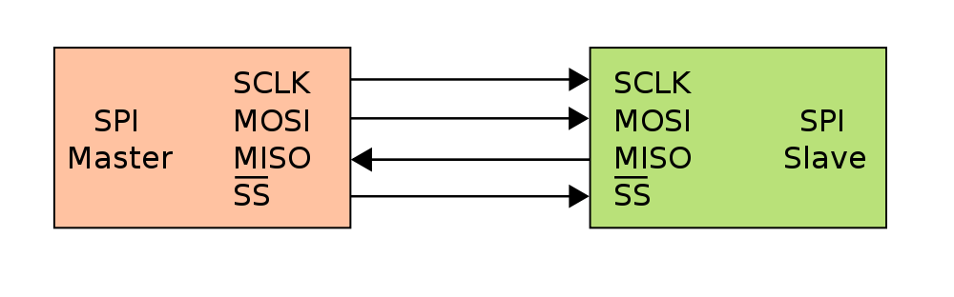
SPI In General (Cont.)
The interface is consumed of four signals:
SPI_CLK: Serial Clock (output from master)
SPI_MOSI: Master Output, Slave Input
SPI_MISO: Master Input, Slave Output
SPI_SS: Slave Select (output from master).

Slide 5
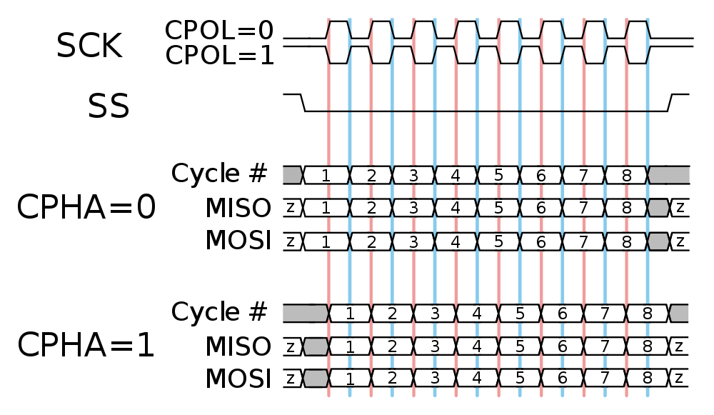
SPI In General (Cont.)
The master configures the clock polarity and phase

Slide 6
Wishbone In General
Please add general description of WB

Slide 7
Implementation Stages Unit Level
Design of SPI Master and SPI Slave cores
Design internal blocks of master and slave hosts
SPI Master and SPI Slave individual Test Benches

Slide 8
Implementation Stages Top Level
Integration of SPI cores
Integration of master and slave hosts
SPI top test bench
Top architecture test bench

Slide 9
SPI Core Design
Four main interfaces:
Received Data Interface
SPI Core
FIFO Interface
SPI Interface
CFG interface
Generic word length
Generic number of slaves

Slide 10
Top Architecture Design
Master
Host
Slave
Host
RAM
Wishbone
Slave
Interface
SPI
Master
Interface
SPI
Slave
Interface
RAM
Interface
Master host implements Wishbone slave interface
Hosts communicate via SPI
Slave host implements RAM interface

Slide 11
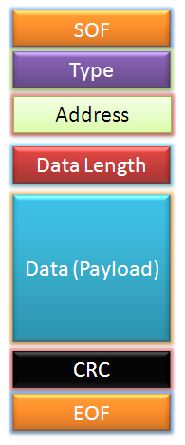
Master Host Design
Master Host
Checksum
Wishbone Slave
Controller
Dec. RAM
M.P. Decoder
SPI
Master
‘0’
SPI Interface
Wishbone Interface
FIFO
Checksum
MUX
Enc. RAM
M.P. Encoder

Slide 12
Slave Host Design
Slave Host
Slave Host Controller
Checksum
M.P. Decoder
Dec. RAM
Read MUX
RAM
SPI
Slave
RAM
Controller
SPI Interface
Registers
RAM Interface
Checksum
M.P. Encoder
Enc. RAM
FIFO

Slide 13
Verification Plan
Basic block-level VHDL TBs during design stage
SystemVerilog TBs
SPI Master
SPI Slave
SPI Top
Architecture Top

Slide 14
Verification Plan (Cont.)
Main verification principles
Use of randomly generated values
Coverage collection
Automatic scoreboarding
SPI cores – include possible edge cases
Top architecture – only basic functionality

Slide 15
SPI Master Test Bench
Status | Test Name
 | Normal burst
 | All CPOL, CPHA configurations
 | All SPI clock frequencies
 | Reset
 | Forbidden Configuration
+ | FIFO Error
+ | Illegal SPI Clock Frequencies
5
Scoreboard
1
7
3
Generator
and
Driver
SPI Master
(DUT)
Generator
and
Driver
FIFOI interface
SPI Interface
2
4
Receiver
Receiver
CFG interface
6
CFG_DUT

Slide 16
SPI Slave Test Bench
Status | Test Name
 | Normal burst
 | All CPOL, CPHA configurations
 | Max SPI clock frequency
 | Reset
 | Configuration during transmission
 | Timeout
 | Interrupt
6
Scoreboard
1
8
Generator
and
Driver
SPI Slave
(DUT)
4
3
SPI Master
BFM
Generator
FIFOI interface
SPI Interface
2
5
Receiver
Receiver
CFG interface
7
CFG_DUT

Slide 17
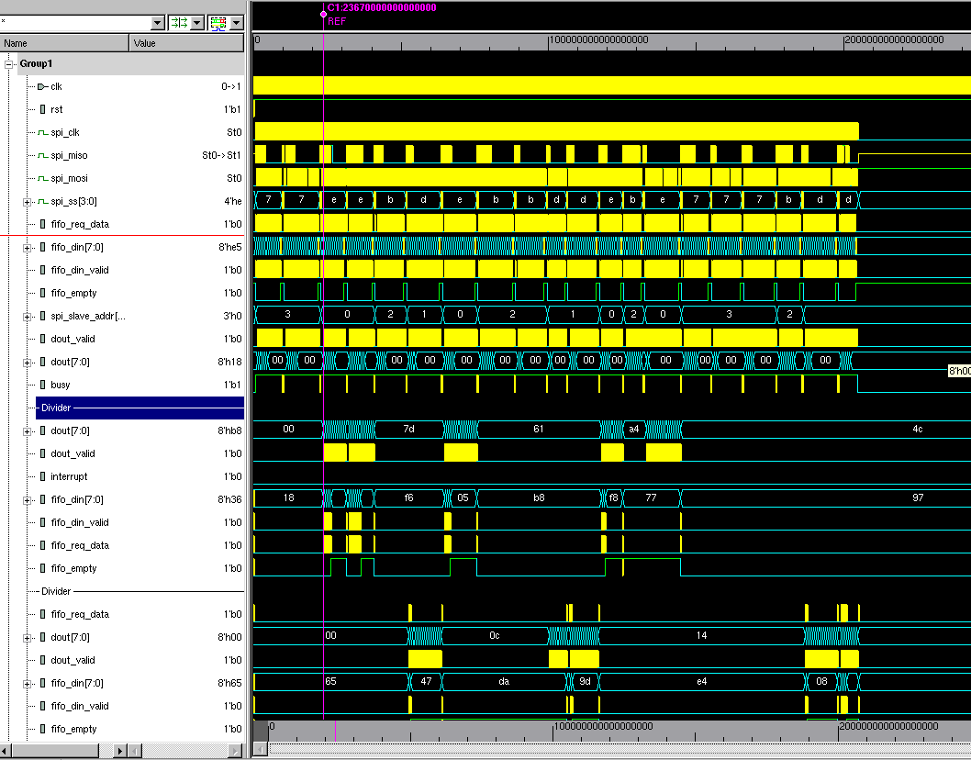
SPI Top Test Bench
Status | Test Name
+ | Normal burst
+ | All CPOL, CPHA configurations
+ | Different SPI clock frequencies
+ | Max SPI clock frequency
+ | Generics
5
Scoreboard
7
DUT
1
3
Generator
and
Driver
SPI Master
SPI Slave0
Generator
and
Driver
SPI Slave1
FIFOI interface
SPI Interface
FIFOI interface
SPI Interface
SPI Slave2
2
4
Receiver
Receiver
SPI Slave3
CFG interface
CFG interface
6
CFG_DUT

Slide 18
Top Test Bench (UVM 1.1)
UVM_TEST
Status | Test Name
 | All burst lengths
 | All CPOL, CPHA configurations
 | All SPI clock frequencies
 | Burst length exceeds RAM address
 | Transaction interrupted
 | Reset in middle of transaction
UVM_ENV
5
Agent
DUT
1
Sequencer
SPI
I/F
Master
Host
Slave
Host
External
RAM
WBS
3
Monitor
2
Driver
4
Scoreboard

Slide 19
SV Verification Summary
COVERGROUP COVERAGE: ---------------------------------------------------------------------------------------------------- Covergroup Metric Goal/ Status At Least ---------------------------------------------------------------------------------------------------- TYPE /top/master_host_monitor/cov_trans 100.0% 100 Covered Coverpoint cov_trans::length 100.0% 100 Covered Coverpoint cov_trans::init_addr 100.0% 100 Covered Coverpoint cov_trans::div_factor 100.0% 100 Covered Coverpoint cov_trans::cpol_cpha 100.0% 100 Covered CLASS master_host_monitor TOTAL COVERGROUP COVERAGE: 100.0% COVERGROUP TYPES: 1
Total of 8 bugs were found
SPI Master – 2
SPI Slave – 3
Top – 2
Reached 100 % coverage rate for all TBs

Slide 20
Summary & Conclusions
A lot more than the original project
Well-organized development methodology
Relatively fast completion of the project
Very enjoyable and fruitful

Slide 21
The End
Thanks to both of our supervisors !
Comments
&
Questions

