Slide 1


(*) Design (VHDL) (*) Verification (System Verilog)
The SPI Project
Presented by:
Omer Shaked
Beeri Schreiber
27.09.2011

Slide 2
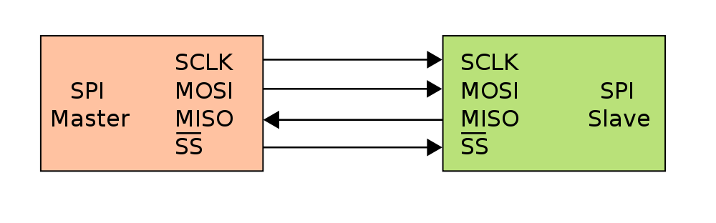
Background - SPI
Asynchronous serial data link standard
Operates in full duplex mode
Devices communicate in master/slave mode
the master device initiates the data frame.

Slide 3
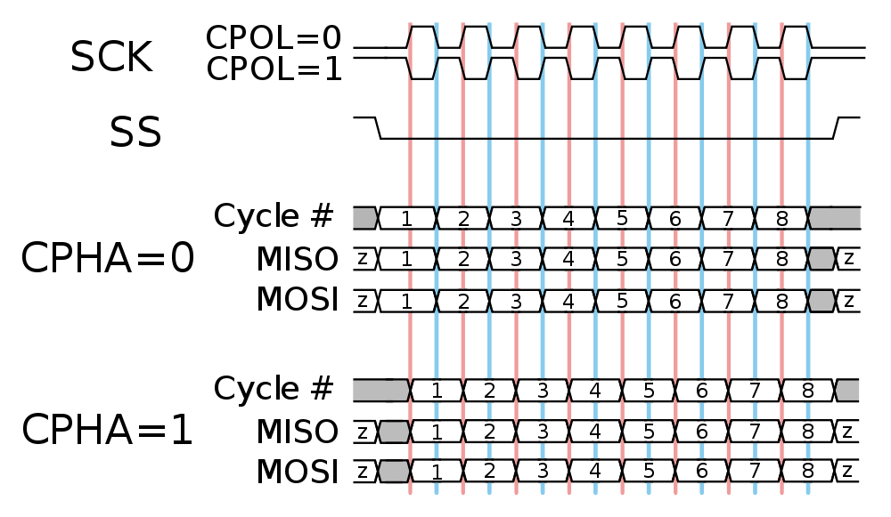
Protocol - SPI
The master configure the clock polarity and phase with respect to the data

Slide 4
Project Goals
Implement SPI Master and SPI Slave
Implement SPI Master and Slave Hosts
Build Test Benches in System Verilog:
Individual TB for SPI Master and Slave
Top TB for the entire system

Slide 5
Implementation Main Problem
SPI Clock’s frequency and Polarity may change during runtime.
Therefore – SPI Clock cannot be placed in the global nets.

Slide 6
Solution
SPI Master and Slave works with the System Clock.
Master:
SPI Clock is derived from the System Clock, using counter.
Slave:
SPI Clock is derivate.
SPI Clock Event

Slide 7
Top Architecture
Master
Host
Slave
Host
RAM
Wishbone
Slave
Interface
SPI
Master
Interface
SPI
Slave
Interface
RAM
Interface

Slide 8
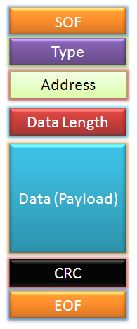
Master Architecture
Master Host
Checksum
Wishbone Slave
Controller
Dec. RAM
M.P. Decoder
SPI
Master
‘0’
Implementation for all components is done!
SPI Interface
Wishbone Interface
FIFO
Checksum
MUX
Enc. RAM
M.P. Encoder

Slide 9
Slave Architecture
Slave Host
Message Pack Decoder
SPI
Slave
RAM
Controller
SPI Interface
Type
Register
RAM Interface
RAM
Message Pack Encoder
MUX
Internal
Registers
Not implemented yet

Slide 10
Simulations
VHDL TB has been performed on RAM, FIFO, Checksum, Message Packs, SPI Master
System Verilog TB should be written for the following:
Individual TB for SPI Master and Slave
Whole System (Including Wishbone Interface)

Slide 11
Schedule
SPI Slave – 24.10.2011
Slave RAM Controller – 24.10.2011
Master and Slave Host Connection – 24.10.2011
Verification schedule is unknown yet.

