Slide 1


Foundation Models for Visual Place Recognition
Name: Avneesh Mishra
Roll. No: 2021701032
Guide: Prof. K Madhava Krishna (RRC)

Slide 2
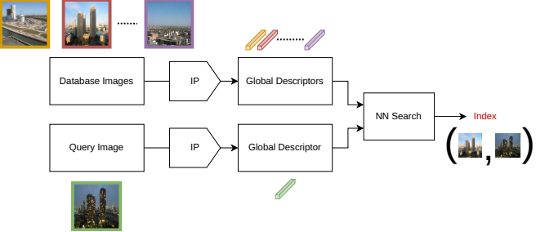
What is Visual Place Recognition (VPR)?
Answer the question “Where am I in this recorded map?” using visual means only.
Map (offline)
Query (online)

Slide 3
Layout
Introduction: ViT, FM (DINO, iBOT, DINOv2)
Main Theory (AnyLoc, Feature Aggregation)
Results
Conclusion

Slide 4
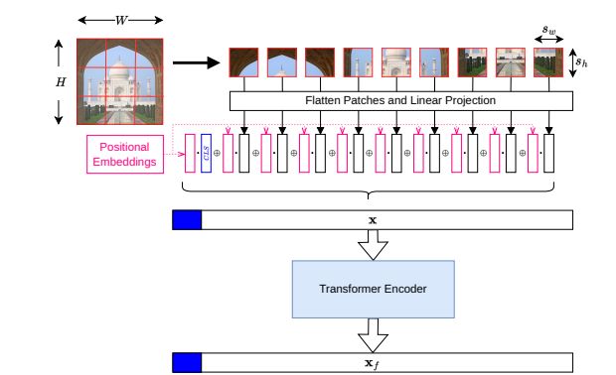
Basics of ViT
Patchify an image
Prefix CLS token
Add position embeddings
Concatenate
Feature Transformer

Slide 5
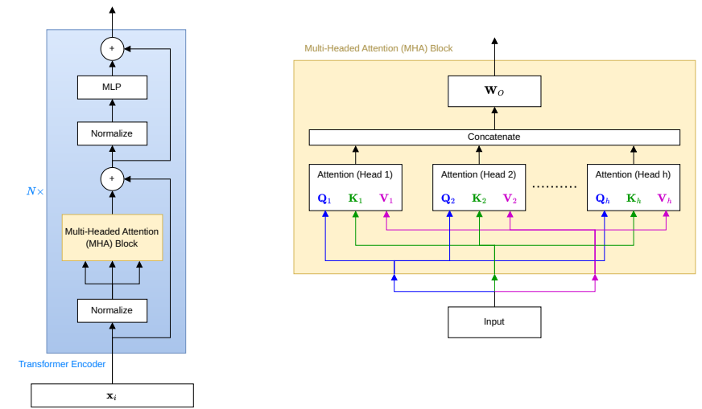

Transformer Encoder
Attention is differentiable lookup!

Slide 6
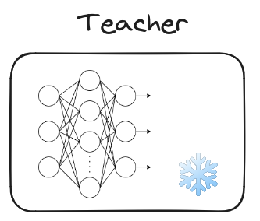


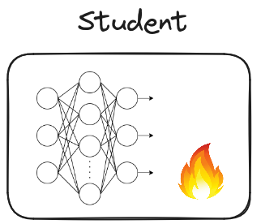


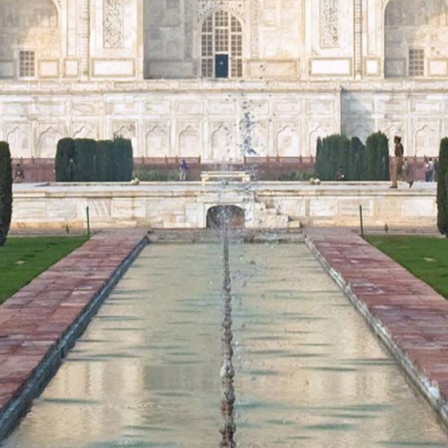



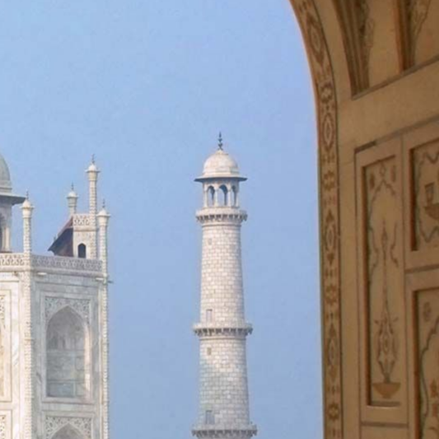
DINO (Distillation with no Labels)
Exponential Moving Average
Mulit-crop (sizes)

Slide 7
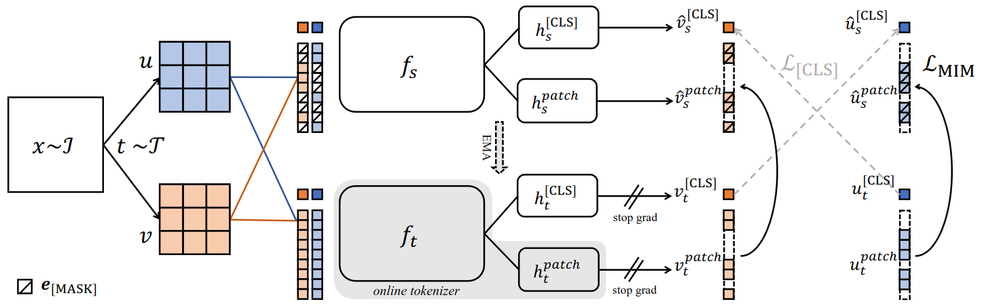
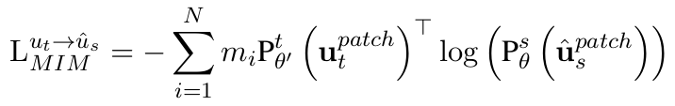



iBOT (Image BERT pre-training with Online Tokenizer)

Slide 8
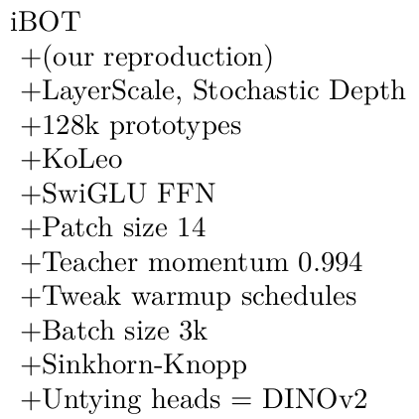
DINOv2 (iBOT + improvements)
Regularization
Activation
Training changes
Different centering

Slide 9
Layout
Introduction: ViT, FM (DINO, iBOT, DINOv2)
Main Theory (AnyLoc, Feature Aggregation)
Results
Conclusion

Slide 10
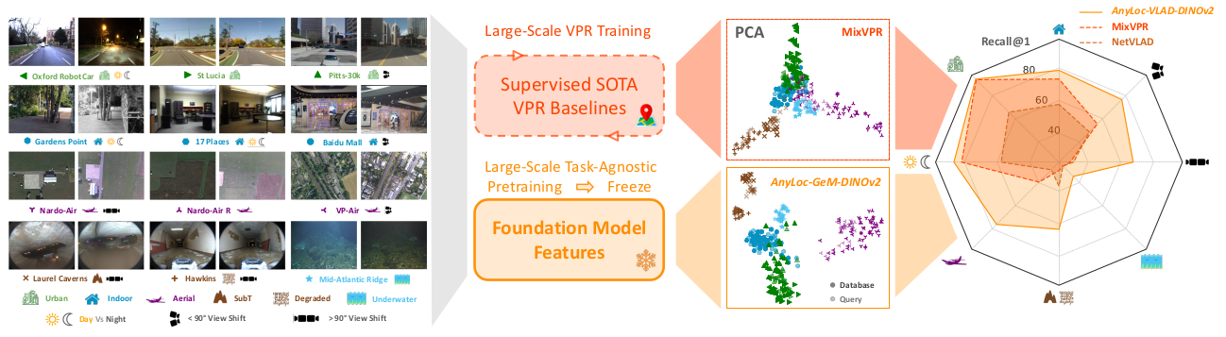
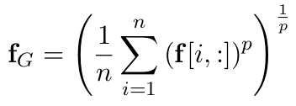

AnyLoc
PCA
GeM pooling is good; What about intermediate features?
Image
DINOv2 features

Slide 11




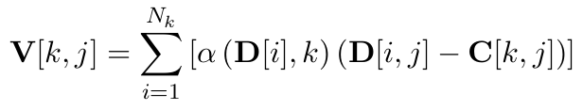



VLAD (Vector of Locally Aggregated Descriptors)
Image
Descriptors
Clustering
Residual Matrix
VLAD Vector
Normalize, concatenate (flatten), normalize again
Q) How to get descriptors from DINO?
A) Use the latent patch representations (Q, K, V are all learned projections of patches)

Slide 12
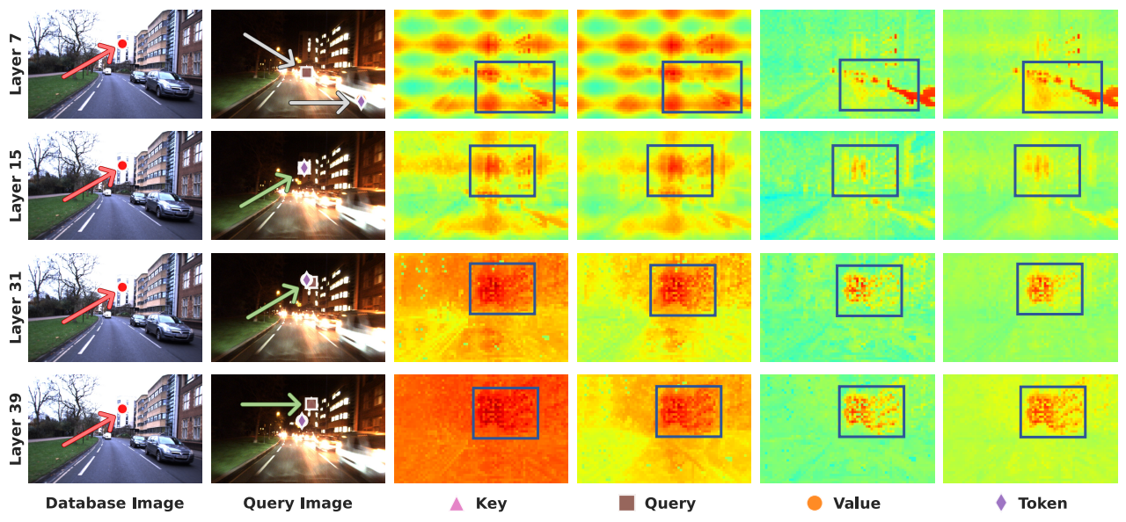
Layer Selection
ViT-G/14 – DINOv2 – Layer selection: Notice L31, value and token facet

Slide 13
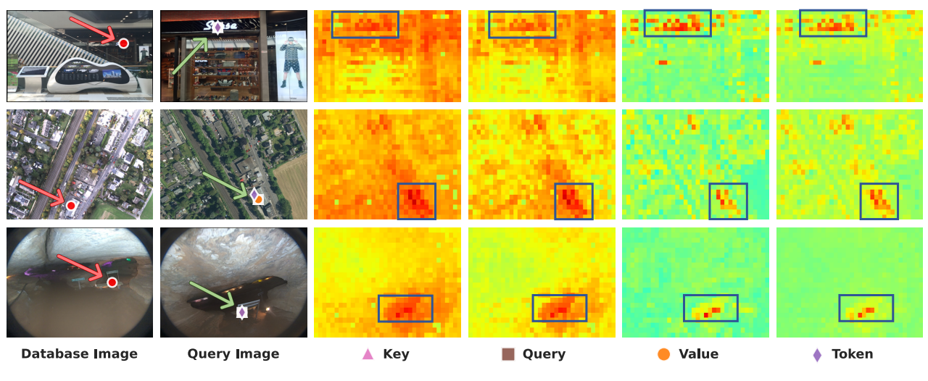
Facet Selection
ViT-G/14 – DINOv2 – Facet selection (layer 31 chosen): value facet has best contrast

Slide 14
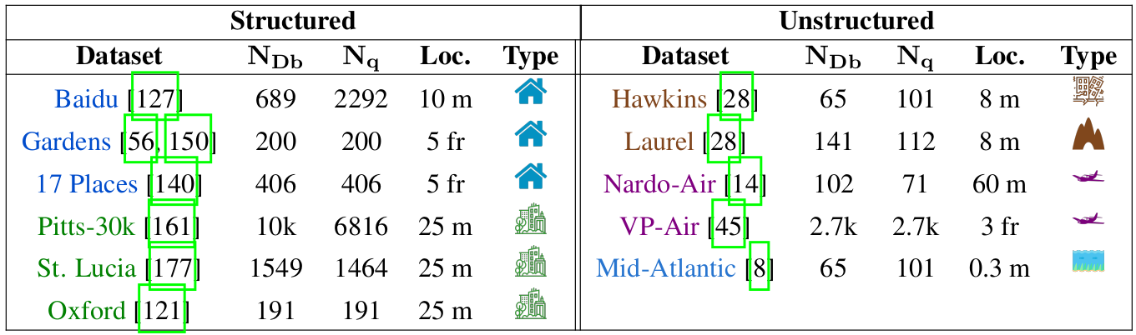
Choice of Database
2. Structured
1. Global: All DB
3. Unstructured
4. Map: Particular dataset
5. Domain: Type

Slide 15
Model Choices
DINOv2: ViT-G/14, Layer 31, Value Facet
AnyLoc-GeM-DINOv2
32 clusters
AnyLoc-VLAD-DINOv2
1536 x 32 = 49152 to 512 (PCA)
AnyLoc-VLAD-DINOv2-PCA
96x reduction in PCA!
DINO: ViT-S/8, Layer 9, Key Facet + 128 clusters
AnyLoc-VLAD-DINO
384 x 128 = 49152 to 512 (PCA)
AnyLoc-VLAD-DINO-PCA
ours
baselines
NetVLAD: Soft VLAD
CosPlace
MixVPR
CLIP: OpenCLIP ViT-BigG/14

Slide 16
Layout
Introduction: ViT, FM (DINO, iBOT, DINOv2)
Main Theory (AnyLoc, Feature Aggregation)
Results (Structured: indoor, outdoor; Unstructured: aerial, others)
Conclusion

Slide 17
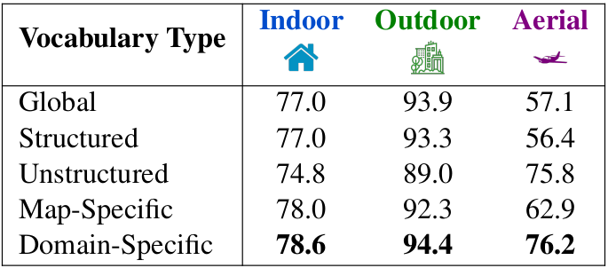
Which Vocabulary to use?
AnyLoc-VLAD-DINOv2 average on different vocabularies
Use domain-specific for portability (unknown dataset but known setting)!

Slide 18
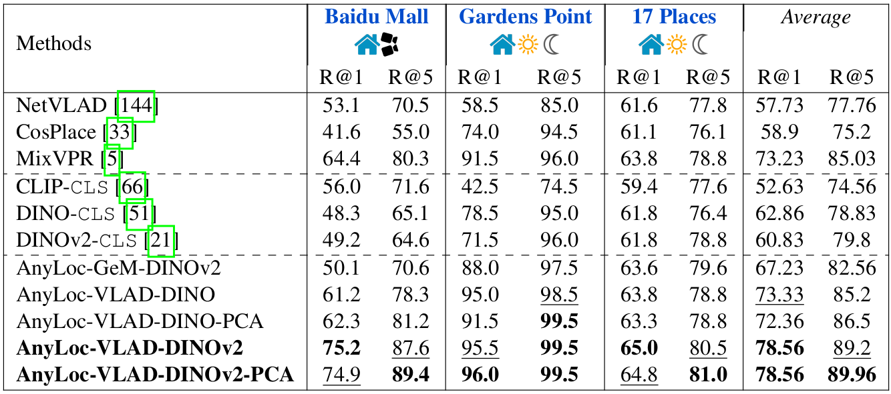
Indoor

Slide 19
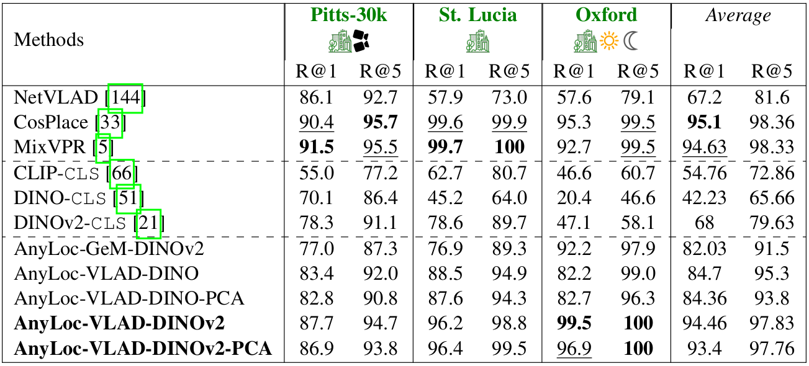
Outdoor

Slide 20
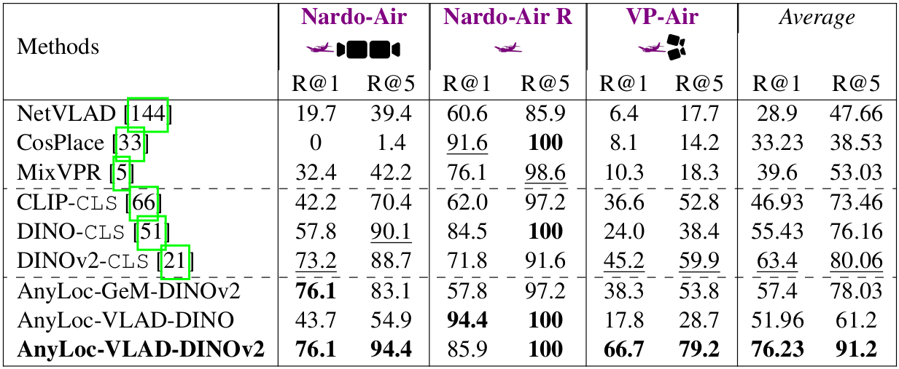
Aerial
Too few database images to do PCA!

Slide 21
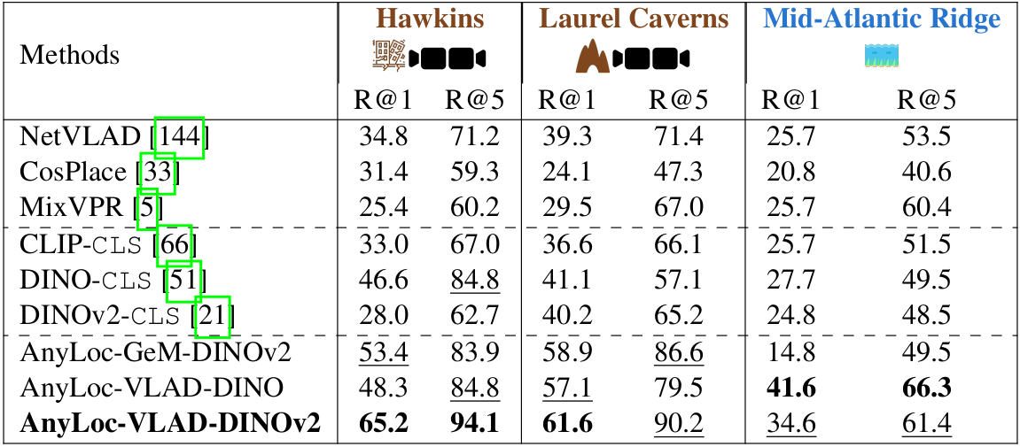
Unstructured (others)

Slide 22
Layout
Introduction: ViT, FM (DINO, iBOT, DINOv2)
Main Theory (AnyLoc, Feature Aggregation)
Results (Structured: indoor, outdoor; Unstructured: aerial, others)
Conclusion

Slide 23
What next?
Good for offline, too slow for offline: Make it portable with TensorRT and try distillation with smaller models (ViT-G has 1B+ parameters!)
Register tokens: remove/hide noise in latent activations
AM-RADIO, GPT-4V, Google Gemini
Other forms of aggregation

Slide 24
Thank You

