Slide 1





Group A
Demo Electronic Student REcord

Slide 2
Sprint 17/12/19 – 14/12/19

Slide 3
Definition of Done
Code review
Unit testing
Performance testing
E2E testing
Verification of accessibility

Slide 4
Completed Stories
5 - Parent
2 - Administrator
9 - Teacher

Slide 5

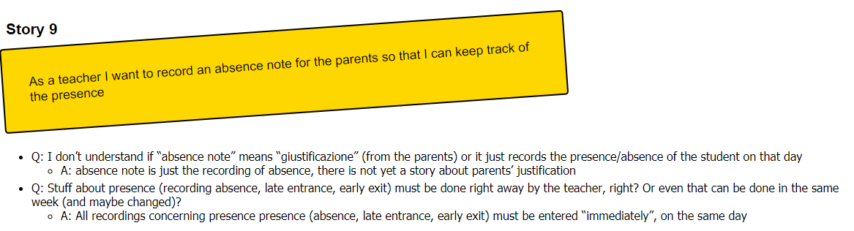

Slide 6
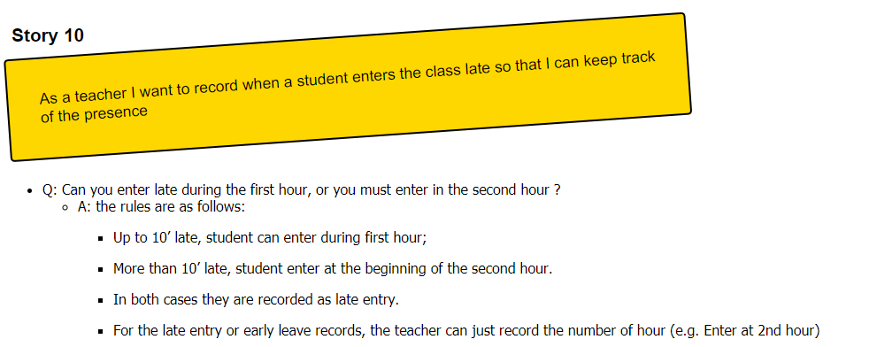

Slide 7
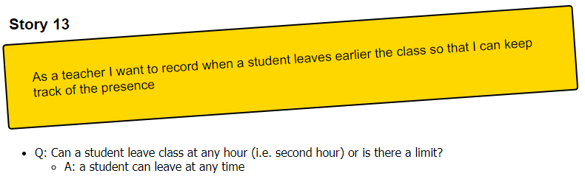

Slide 8
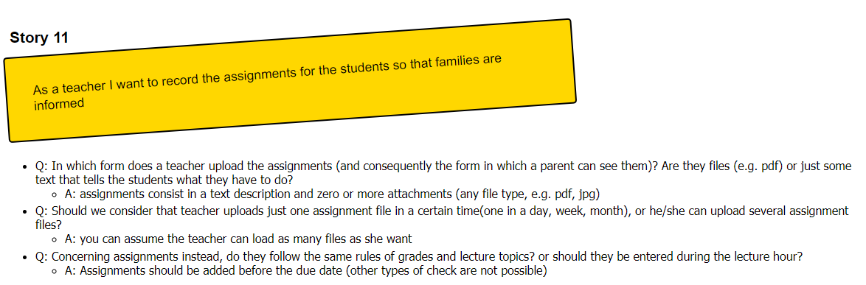

Slide 9
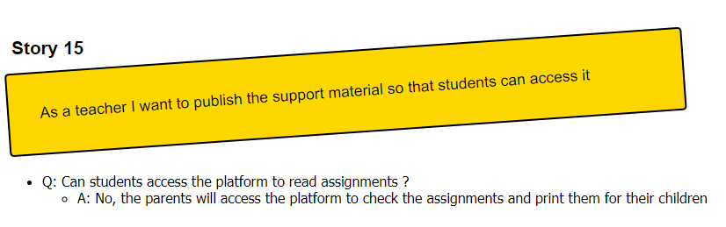

Slide 10
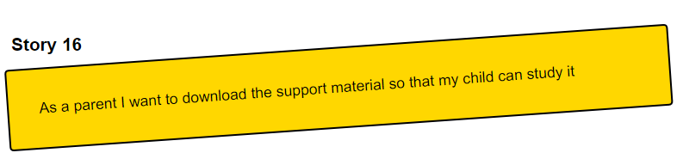

Slide 11
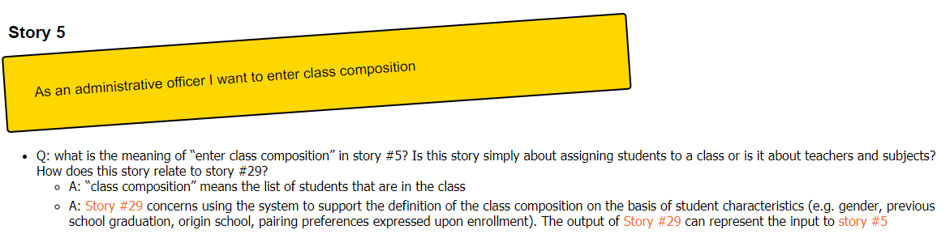

Slide 12
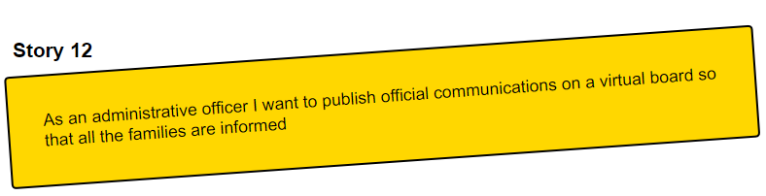

Slide 13
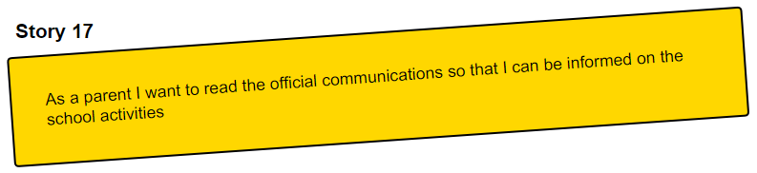

Slide 14
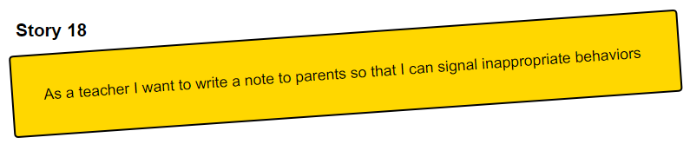

Slide 15
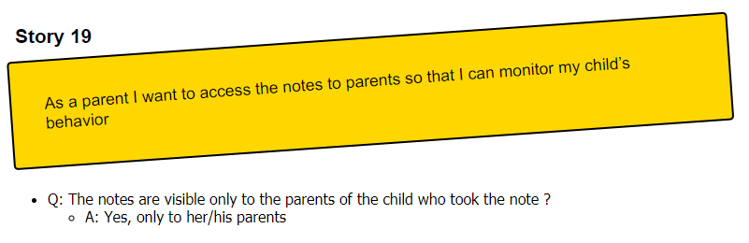

Slide 16
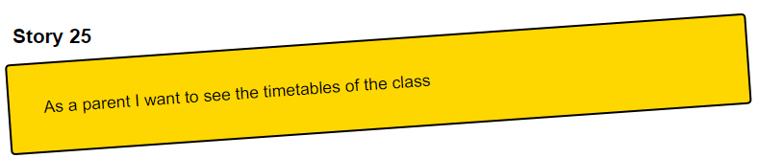

Slide 17
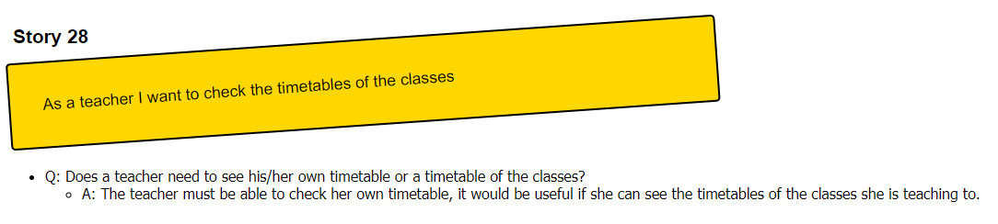

Slide 18
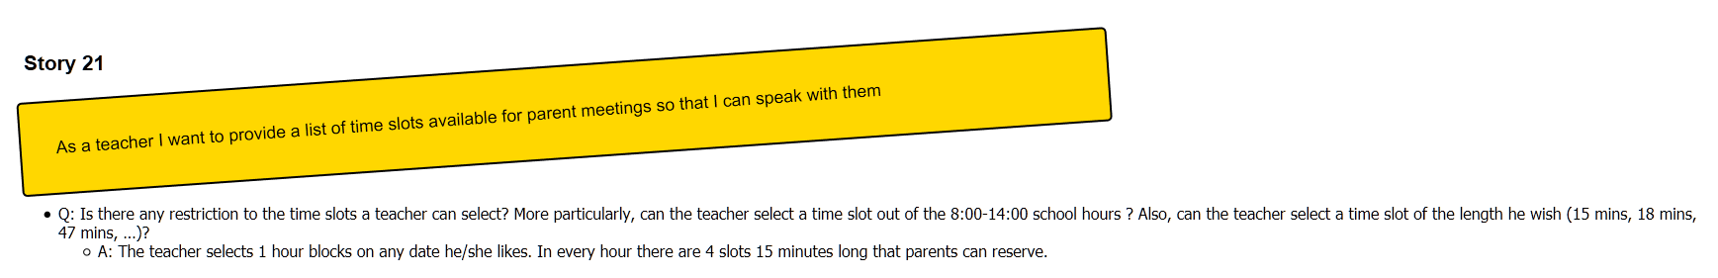

Slide 19
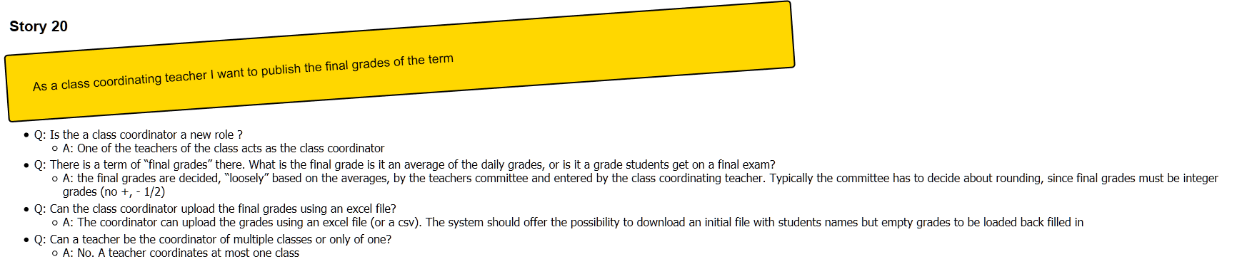

Slide 20
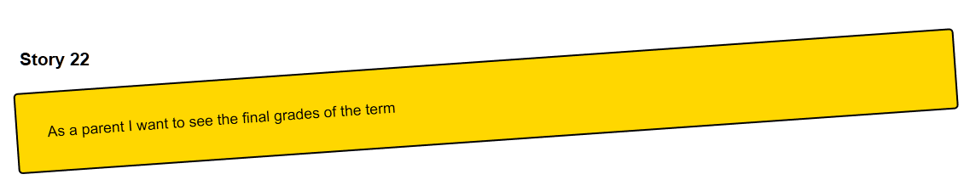

Slide 21
Burndown Chart

Slide 22
Technical Debt and SonarCloud
https://sonarcloud.io/dashboard?id=ThePseudo_GroupA_SE2_2019

Slide 23
Questions?

Slide 24
THANK YOU!

