Slide 1





Group A
Demo Electronic Student REcord

Slide 2
Sprint 4/12 – 17/12

Slide 3
Completed Stories
Lecture topics - Parent
Assigned homework – Parent
Attendance to lecture of a child - Parent
Setup internal account - Administrator
Assign grade to a student - Teacher

Slide 4
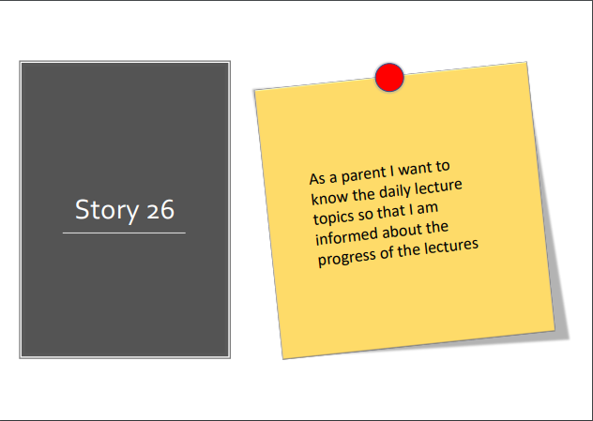

Slide 5
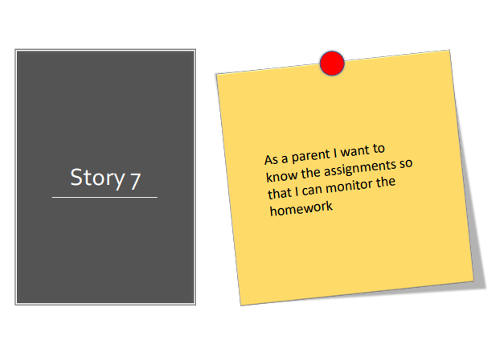

Slide 6
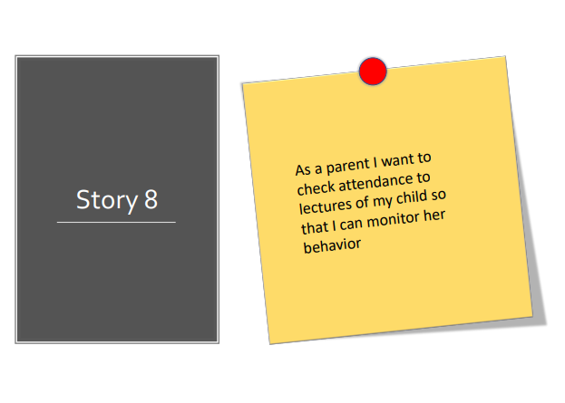

Slide 7
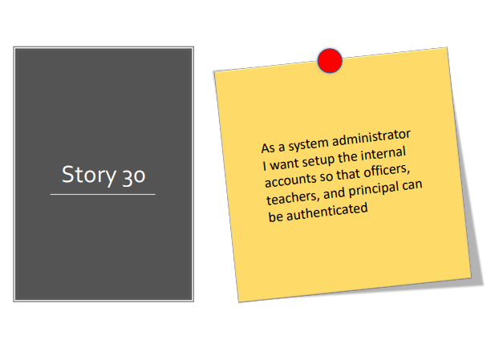

Slide 8


Slide 9
Burndown Chart

Slide 10
Technical Debt and SonarCloud
https://sonarcloud.io/dashboard?id=ThePseudo_GroupA_SE2_2019

Slide 11
Questions?

Slide 12
Uncompleted Stories
Upload File
Class Composition

