Slide 1





Group A
Demo Electronic Student REcord

Slide 2
Sprint 17/12/19 – 14/12/19

Slide 3
Completed Stories
4 - Parent
2 - Administrator
7 - Teacher

Slide 4

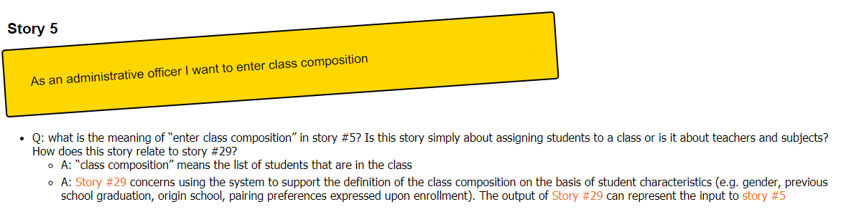

Slide 5
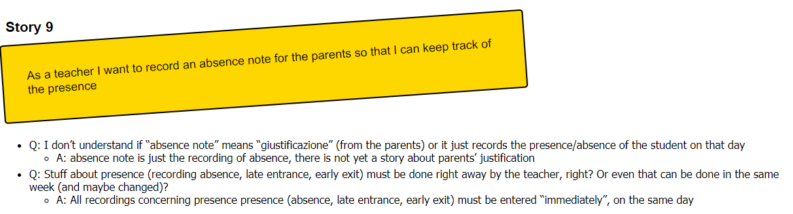

Slide 6
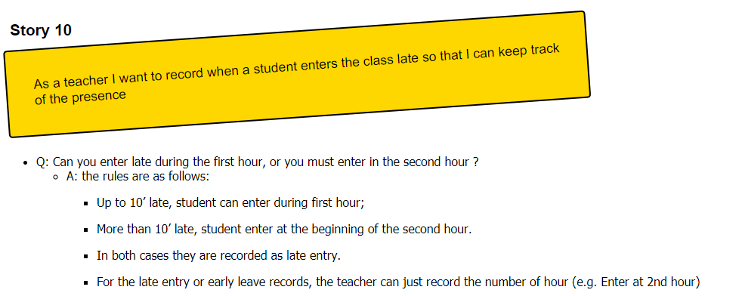

Slide 7
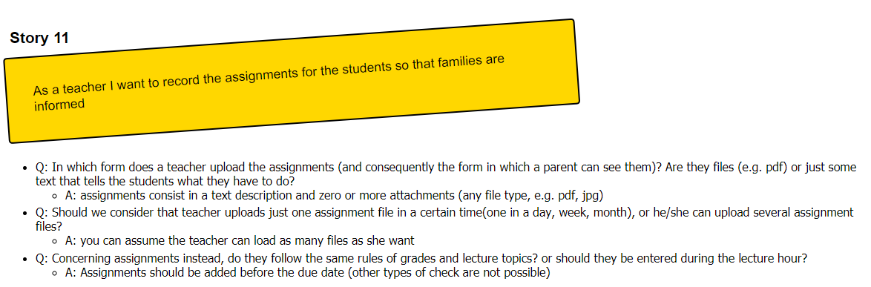

Slide 8
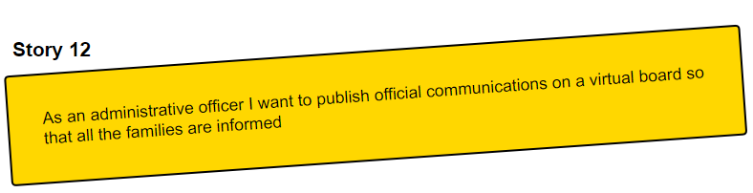

Slide 9
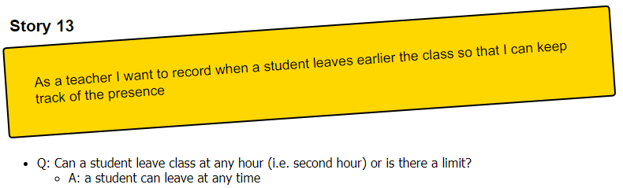

Slide 10
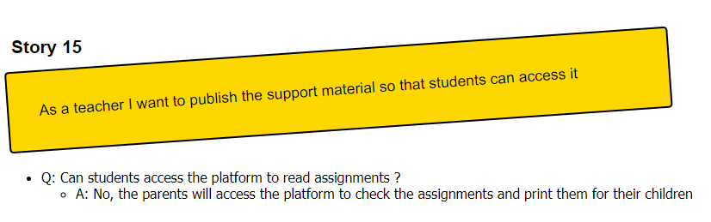

Slide 11
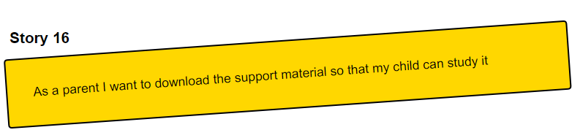

Slide 12
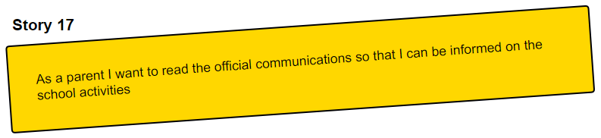

Slide 13
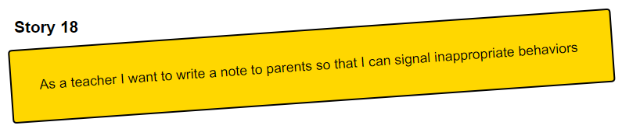

Slide 14
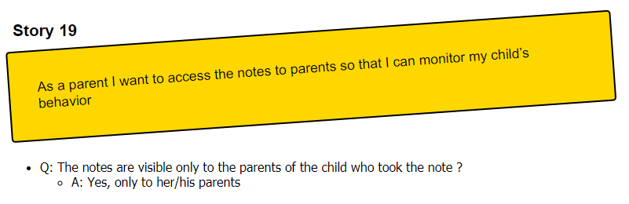

Slide 15
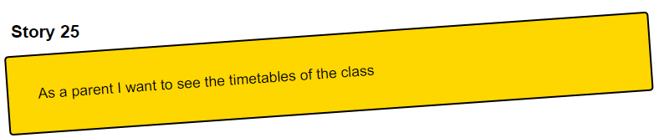

Slide 16
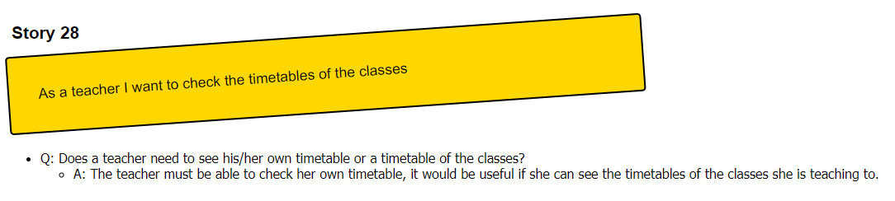

Slide 17
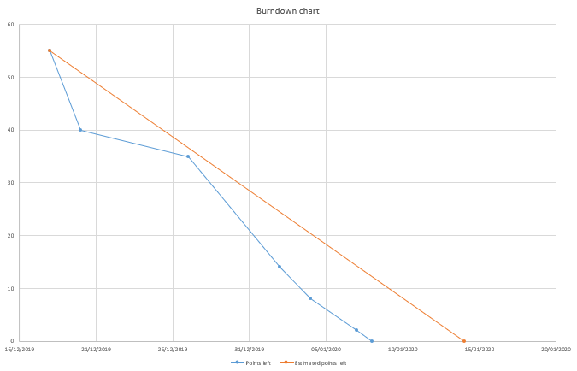
Burndown Chart

Slide 18
Technical Debt and SonarCloud
https://sonarcloud.io/dashboard?id=ThePseudo_GroupA_SE2_2019

Slide 19
Questions?

