Slide 1



phyton
Simplifying physics a ton, one at a time
Notes:
Hello everyone. Today, I will be presenting on my project, phyton, a DC circuit simulator. So… what is phyton?

Slide 2
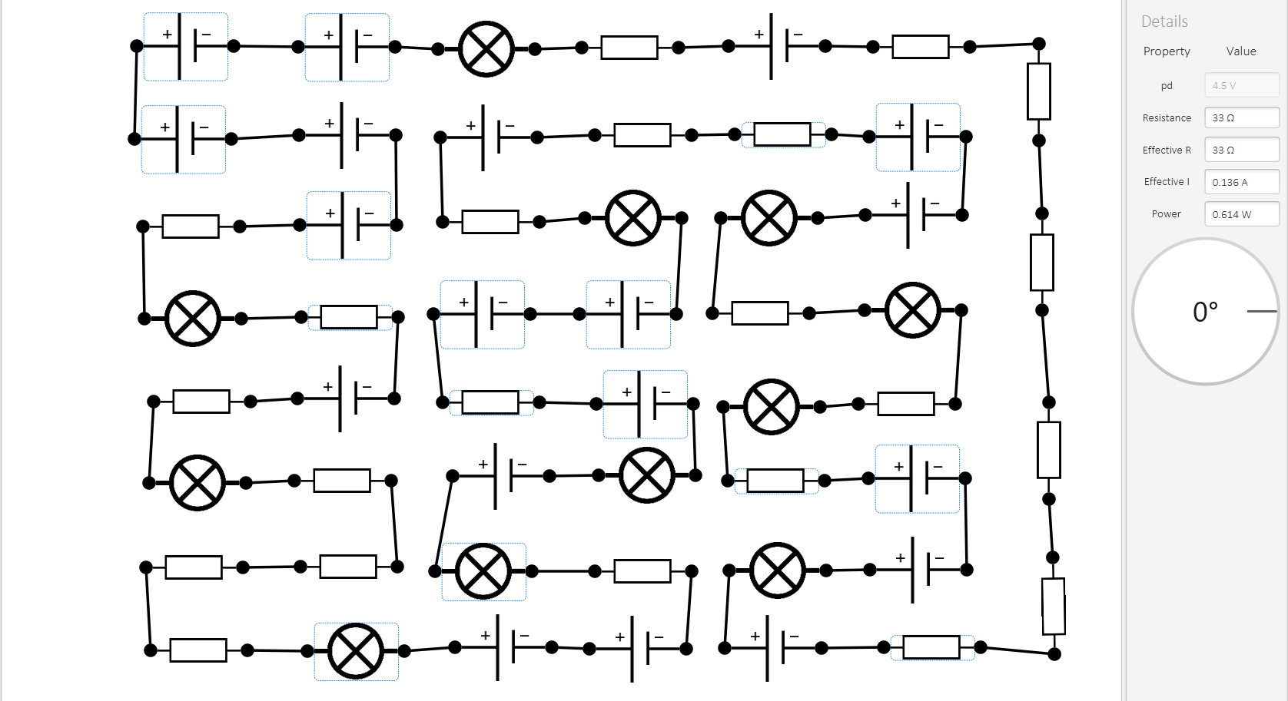
Notes:
It’s this. Yeah, I’m sure this looks pretty complicated, so let’s start small. In fact, let’s start from the beginning.

Slide 3
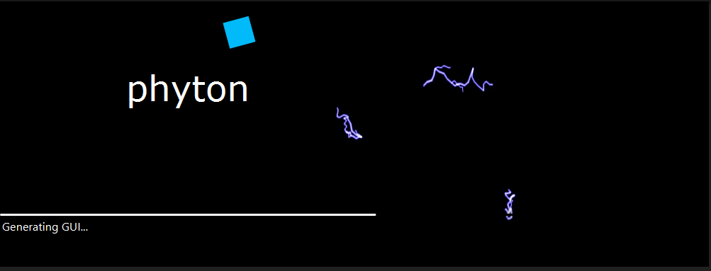
Splash Screen
Notes:
The splash screen. The messages in the progressbar are all related to physics or related to the GUI.

Slide 4
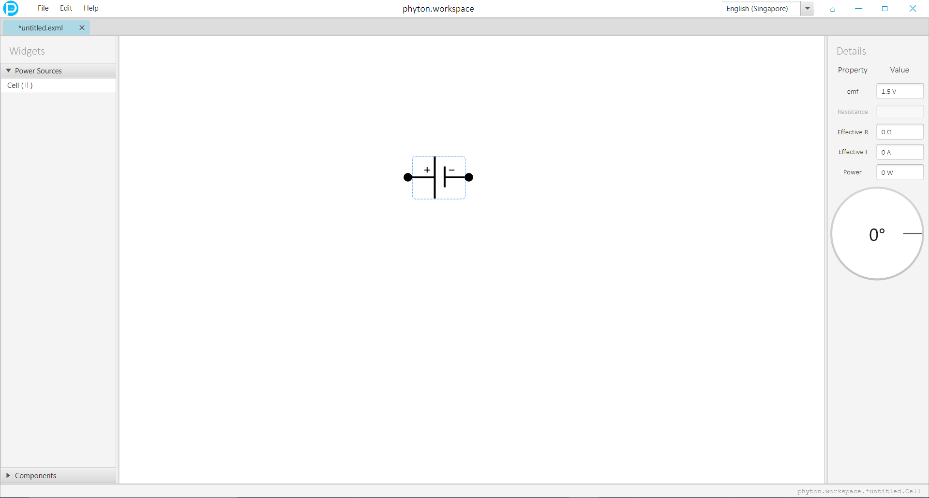
Basic Layout
Notes:
Here is the basic layout of the application. Basically, how it works is that you go to the widgets bar and here, you see an accordion containing Power Sources and Components. Unfortunately, due to the complexity of my program, I was unable to implement more than a cell, bulb and resistor in time. You can drag any of these 3 and it will produce a new widget based on the component selected. Anyways, the details bar shows the information about every widget, and also their specific rotation. The circles next to each component are its nodes, from which you can draw a wire to another such node. Yeah, it is not that complex.

Slide 5
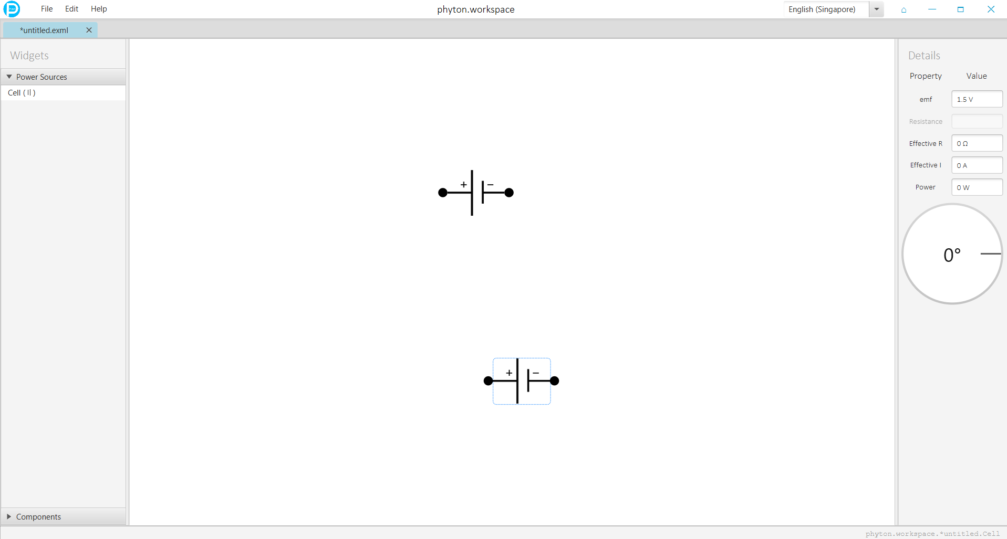
Notes:
Another cool thing that you can do is that you can cut, copy, paste, duplicate and delete any widget. Upon cutting or copying, the text copied is basically just the XML markup of the widget, which brings me to my next point.

Slide 6
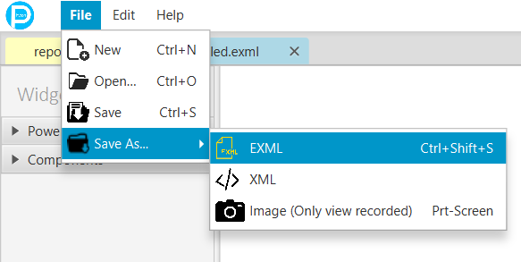
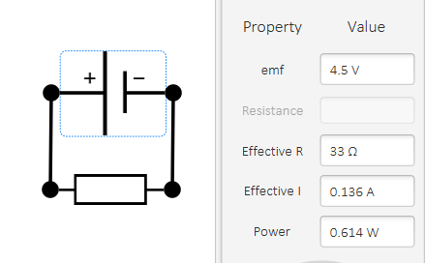
The file management system
<Series current="0.136A" effectiveR="33Ω" isClosed="true">
<Cell P="0.614W" emf="4.5V" x="989.5703125" y="-715.2890625" angle="360.0" prev="c1" />
<Resistor R="33Ω" I="0.136A" x="988.4263392854773" y="-829.5781249999854" angle="360.0" prev="c1" />
</Series>
Notes:
This is a sample of an EXML markup. What is EXML? Well, EXML, or Electric XML (yes, I know that is a terrible name), is a XML-based filetype that involves a mark-up similar to that of XML, as is clear by the numerous tags. Here, as you can see, is a markup of a series circuit that is closed and as an effective resistance of 33 ohms, from a resistor of such, and a cell of emf 4. 5V. This is the diagram that this EXML portrays.
So, to use this you have the file menu, where you can create a new tab that represents a new EXML, or open a EXML, or save a EXML. Saving an EXML is simply the same as that of IDLE. You can save a tab as a exml or xml, and you can also snapshot the view. If the tab has been saved (but not snapshotted), saving will just write to the file again.

Slide 7
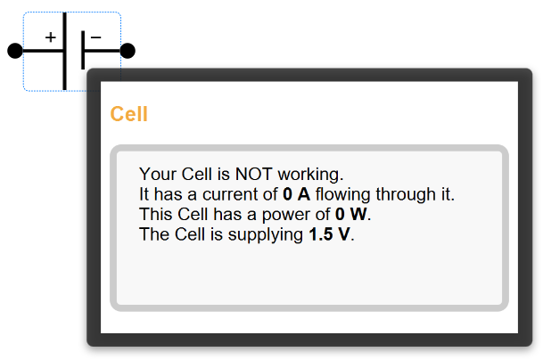
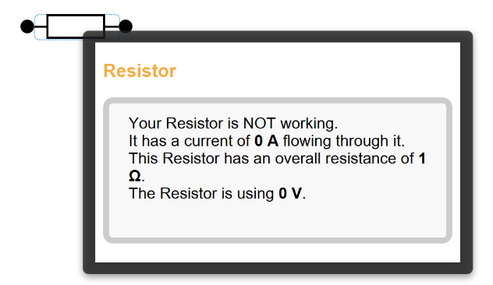
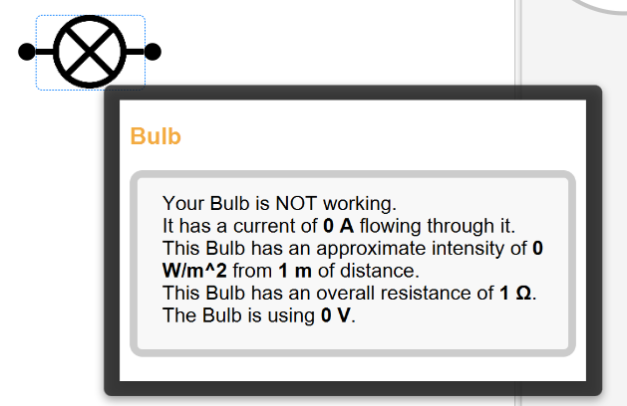
Tooltips
Notes:
Nuff said.

Slide 8
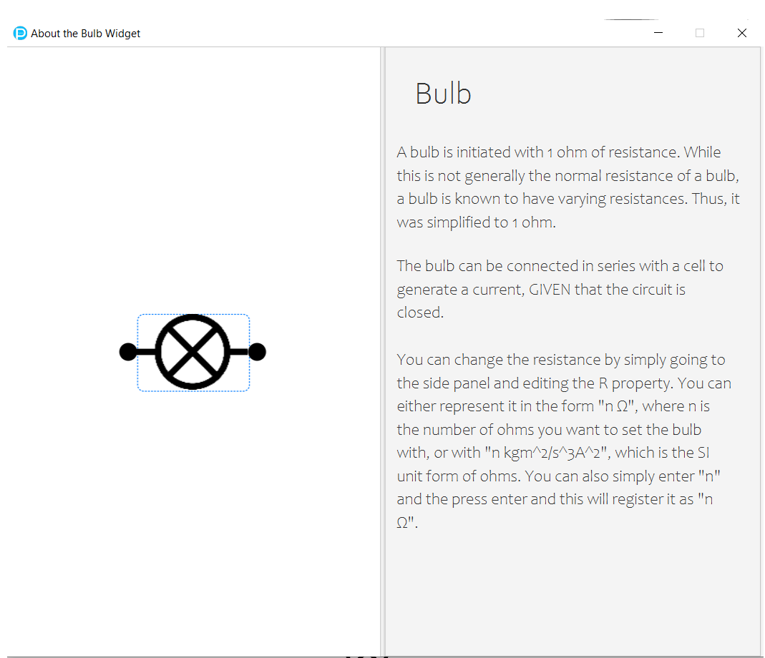
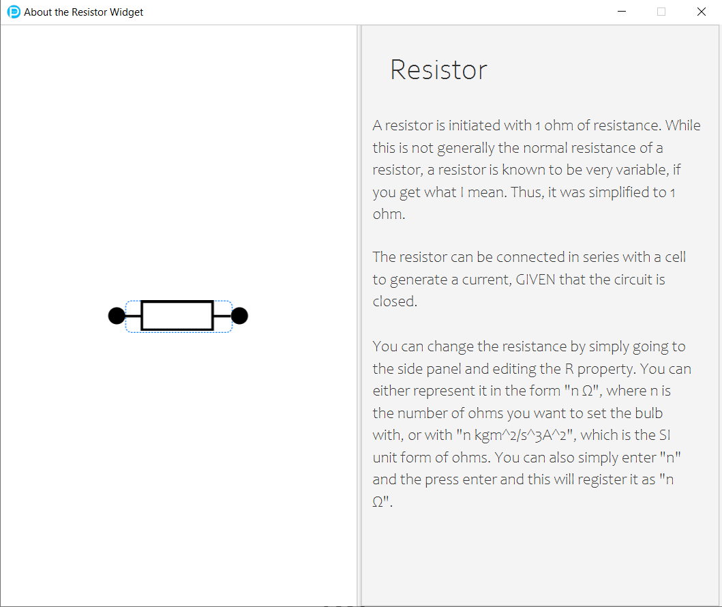
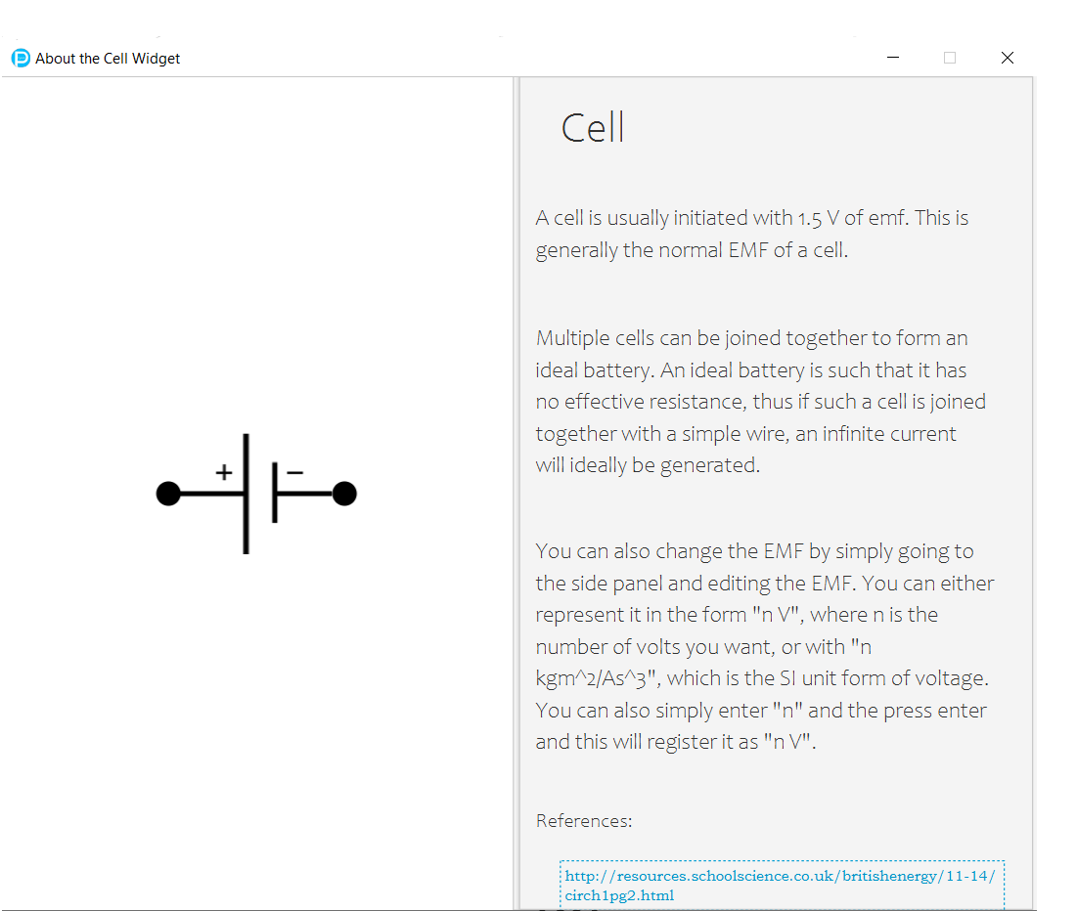
Documentation
Notes:
So there’s also documentation for each widget.

Slide 9
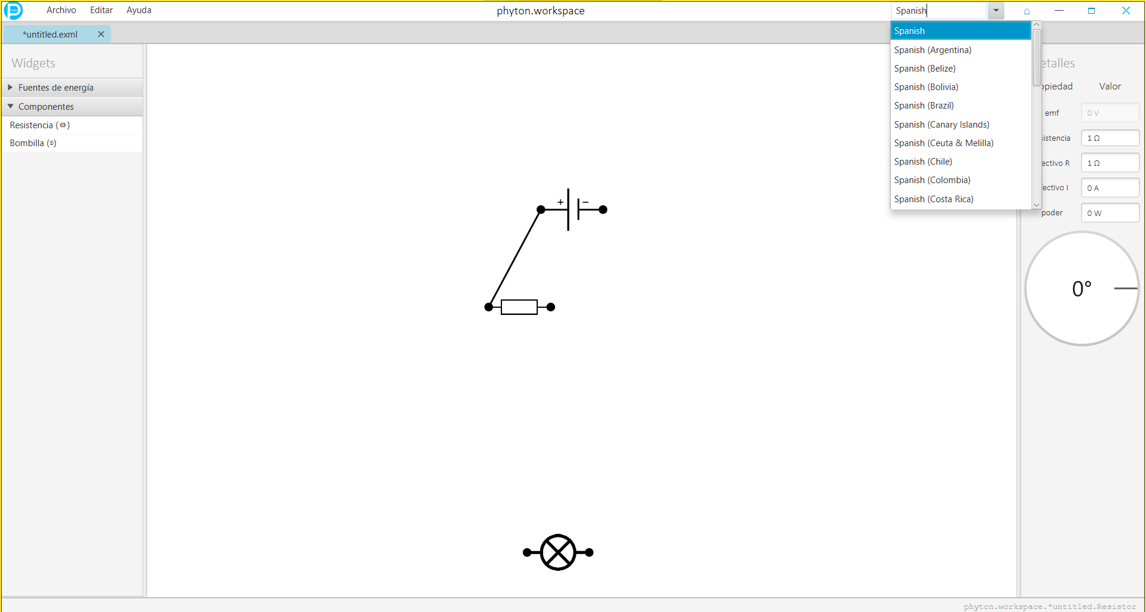
Notes:
I also implemented internationalization. This is the Spanish UI.

Slide 10
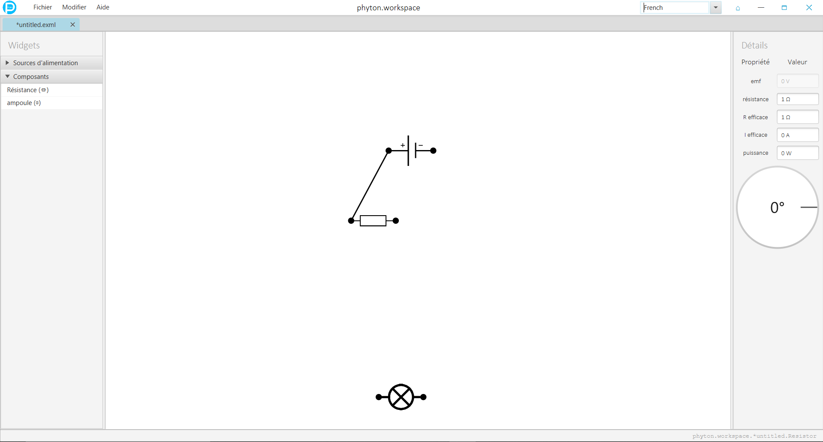
Notes:
This is the French UI.

Slide 11
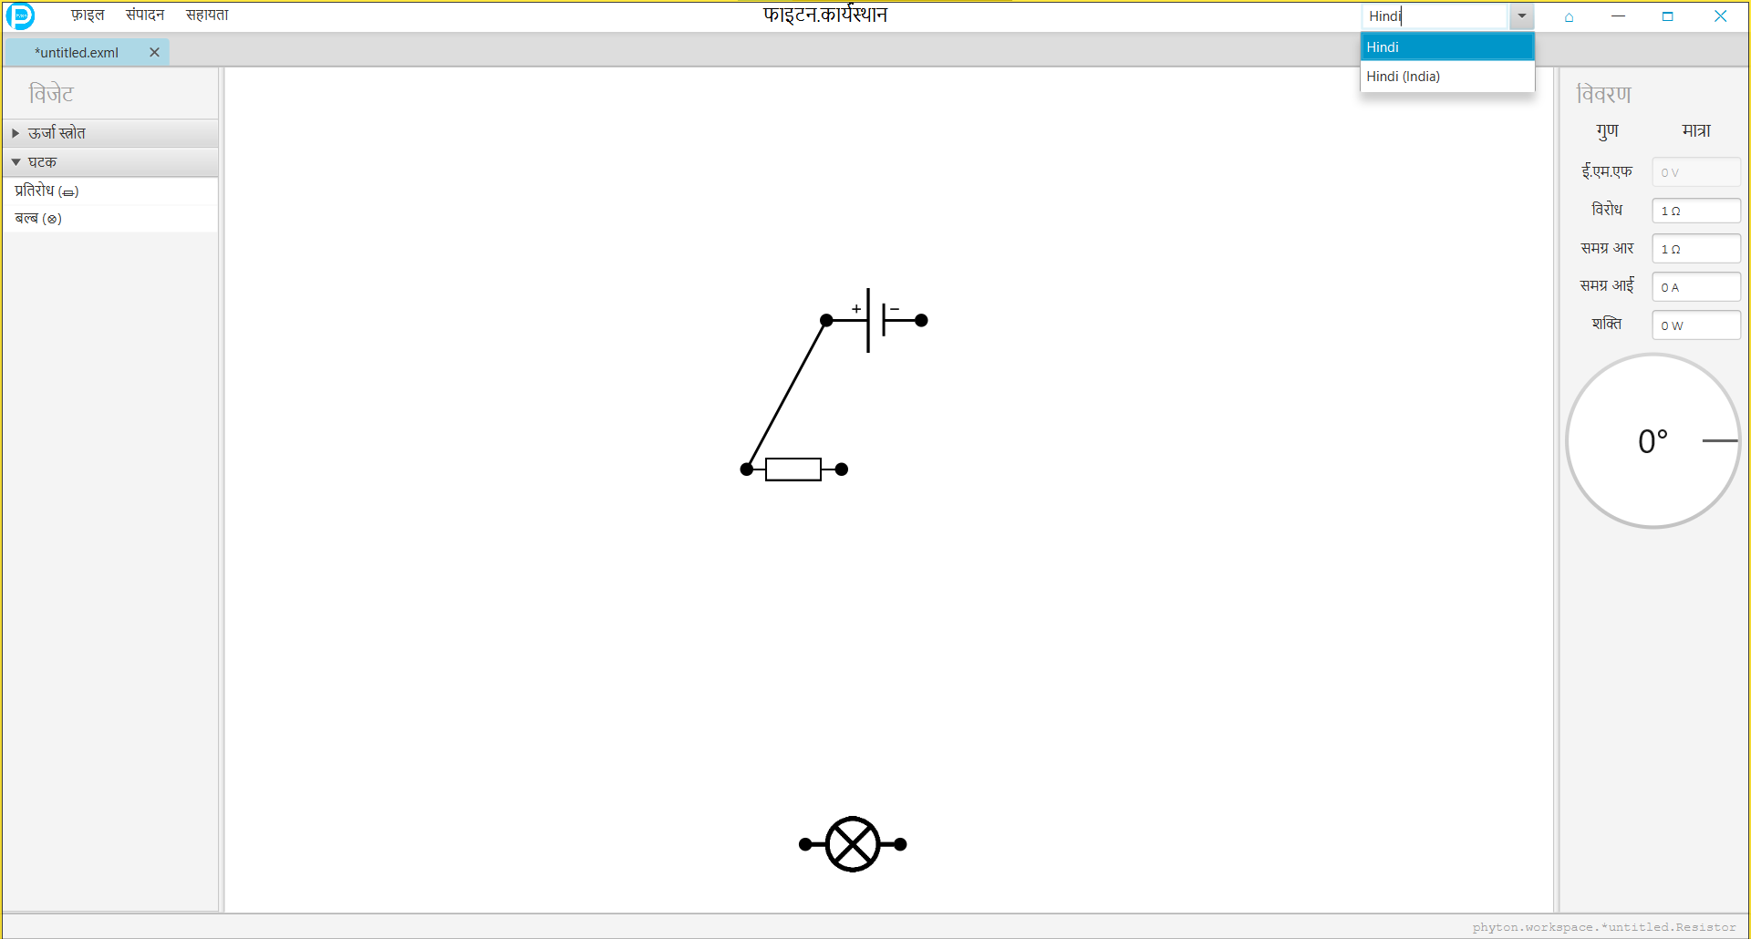
Notes:
And this is the Hindi UI.

Slide 12
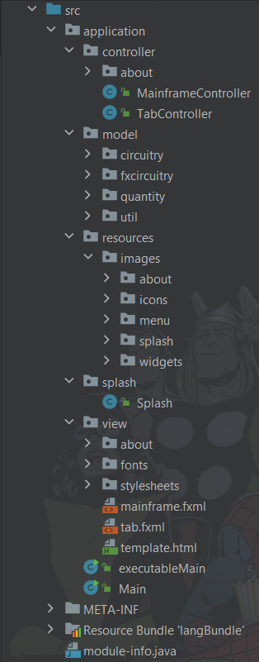
The MVC Structure
7 Classes in controller subpackage
55 Classes in model subpackage
13 Classes in circuitry subpackage
11 Classes in fxcircuitry subpackage
16 Classes in quantity subpackage
10 Classes in util.fxtools subpackage
6 other Classes in util subpackage
1 Class in splash subpacakage
2 other standalone Classes in application
→ Compounds to 65 Classes
Notes:
So onto my directory structure.

Slide 13
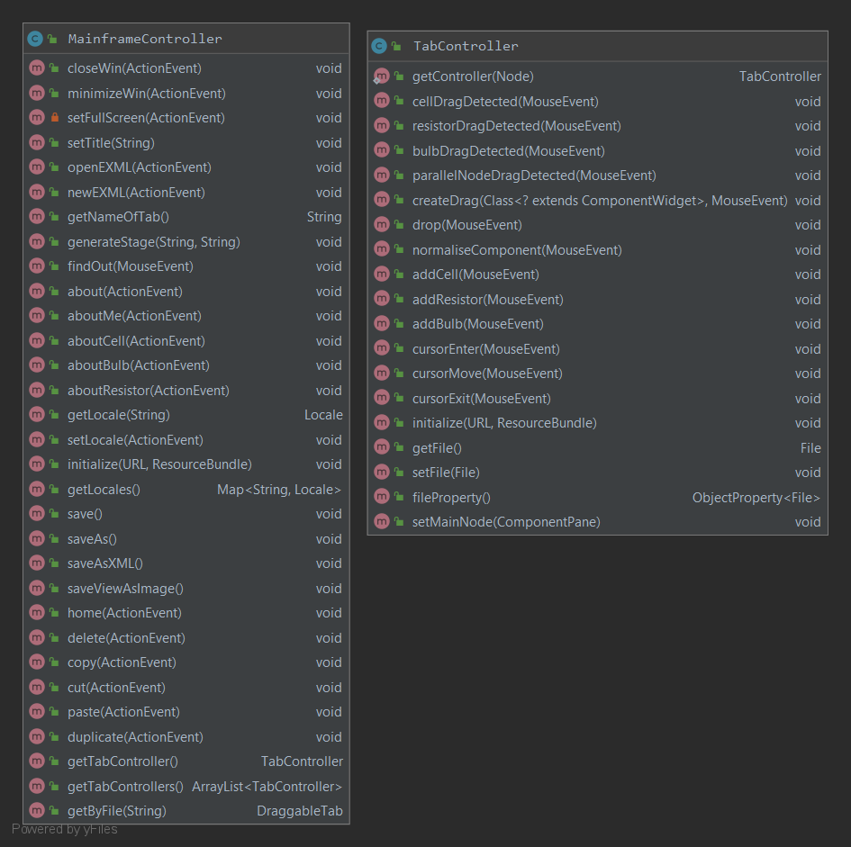
The Directory Structure - Controller
7 Classes in controller subpackage
5 in about subpackage → controllers for about pages
TypingAnimation
2 other standalone Classes → the important controllers
TabController → Manages tab.fxml i.e. the tabs
MainframeController → Manages mainframe.fxml i.e. menubar
Handles cut, copy, paste, delete, duplicate, new, open, save, save as and also opens the about page

Slide 14
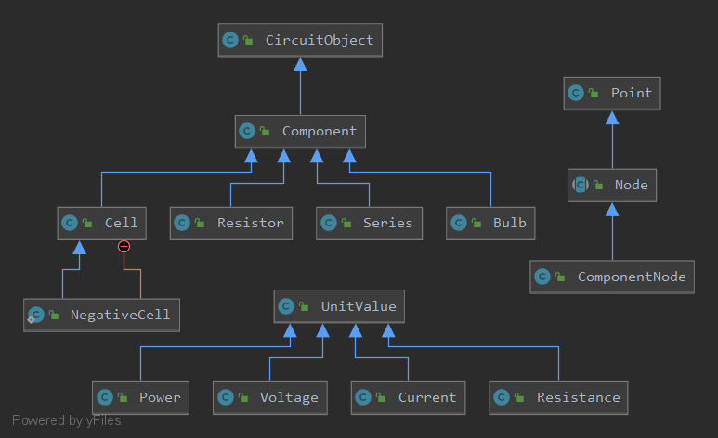
The Directory Structure – Model
quantity subpackage
UnitValue class
uses regex to parse units
circuitry subpackage
CircuitObject class
fields for voltage, current, power and resistance
Node abstract class
manages connections to other components
Component class
ComponentNode instances for both sides of a widget
Series class
Manages Series (the math part)

Slide 15
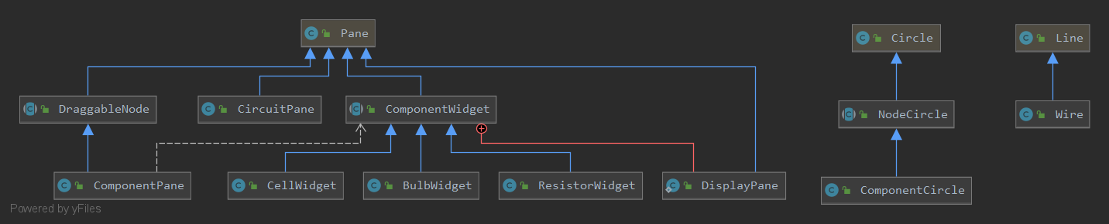
The Directory Structure - Model
ComponentWidget class
Wrapper for circuitry.Component class
NodeCircle abstract class
Wrapper for circuitry.Node class
ComponentPane class
Connection between both wrappers
CircuitPane class
Pane used in every tab
fxcircuitry subpackage

Slide 16
The capability of phyton
Able to accurately calculate current, effective resistance and power
With some slow points, it is working properly

Slide 17
Testing
Component-by-component testing
Rotation was difficult to test
I made a lot of editing
A lot of debugging was required

Slide 18
Reflection - Obstacles
No experience with XML before this
No available API → code from scratch
Unable to make parallel circuit
Program was very large

Slide 19
Reflection – What I learnt
Real-life development of an application
Learnt XML with EXML
Time management – I was spending to much time on the project
Importance of comments → code was very complicated

Slide 20
Reflection – Improvements
Parallel circuits
Other components
Potentiometer
Capacitor
Program very basic, could have worked on making it more detailed
Proper documentation
Solenoid
Electrolytic Cell or a Diode

Slide 21
Thank You

