Slide 1
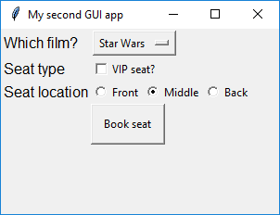
Films: Mission Impossible, Star Wars, Eureka, The Lonely Valley

