Slide 1

Logging
By Keenan Moukarzel

Slide 2

Agenda for Today
Resizable windows
Adding images
Themes and BG colors
Logging
Page 1
All rights reserved, The Python Academy

Slide 3
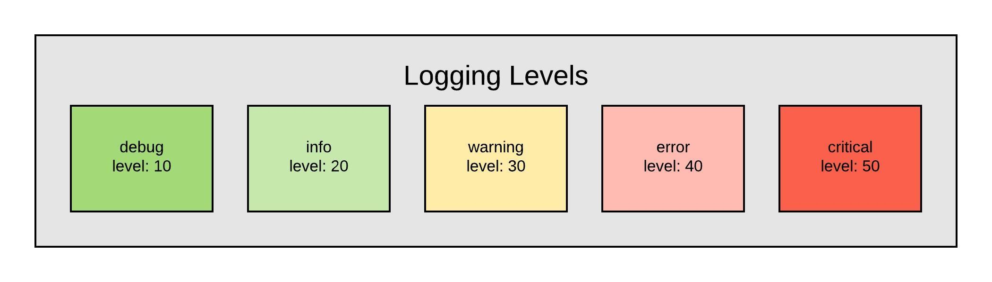
Concepts
Purpose: Record progress and problems
All errors happen in runtime
Testing can never be 100%
Levels: Debug, Info, Warning, Error, Critical
Page 1
All rights reserved, The Python Academy

Slide 4
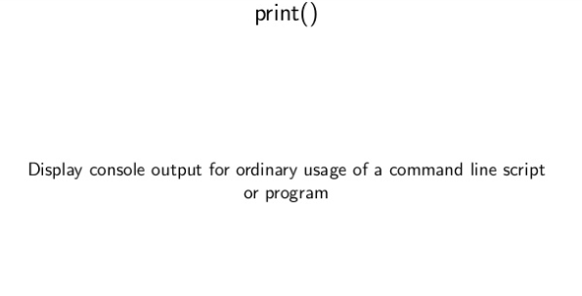
Concepts
Page 1
All rights reserved, The Python Academy

Slide 5
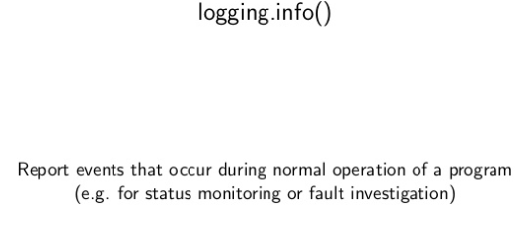
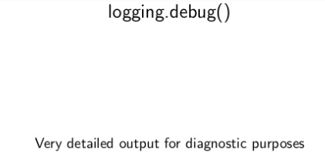
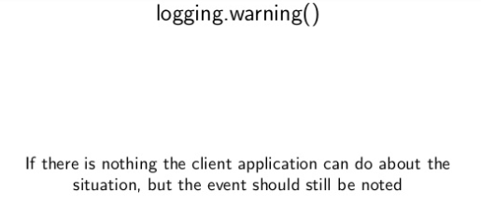
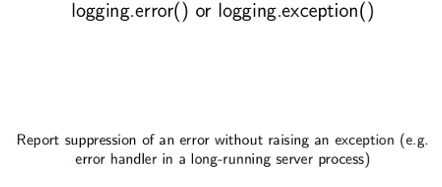
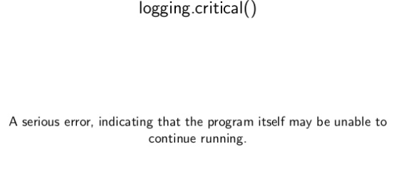
Concepts
Page 1
All rights reserved, The Python Academy

Slide 6
Concepts
Python automated a lot of the logging for us!
https://docs.python.org/3/library/logging.html
Page 1
All rights reserved, The Python Academy

