Slide 1
BOMBOCLOT PACKING SYSTEM
David Sánchez Zugarramurdi
Nicolás Pérez Fernández
Roger Rovira Muñoz
Mario García Nieto

Slide 2
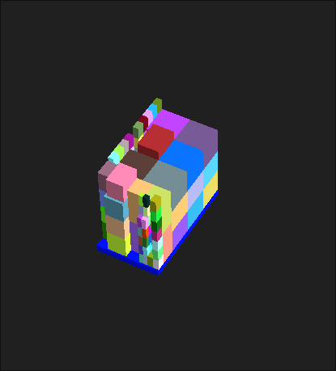


Slide 3
What’s Next?

Slide 4
BOMBOCLOT PACKING SYSTEM
David Sánchez Zugarramurdi
Nicolás Pérez Fernández
Roger Rovira Muñoz
Mario García Nieto

