Slide 1

Shiny App for NFL Statistics
Quinlin Gregg

Slide 2
Overview
Originally, this project was aimed to find a way to predict a team’s record against-the-spread (ATS) based on team stats
However, every model performed poorly
I wanted an easier way to simply and visually browse NFL stats
Data was scraped from Pro Football Reference
Added detrended and ranks versions of scoring columns

Slide 3
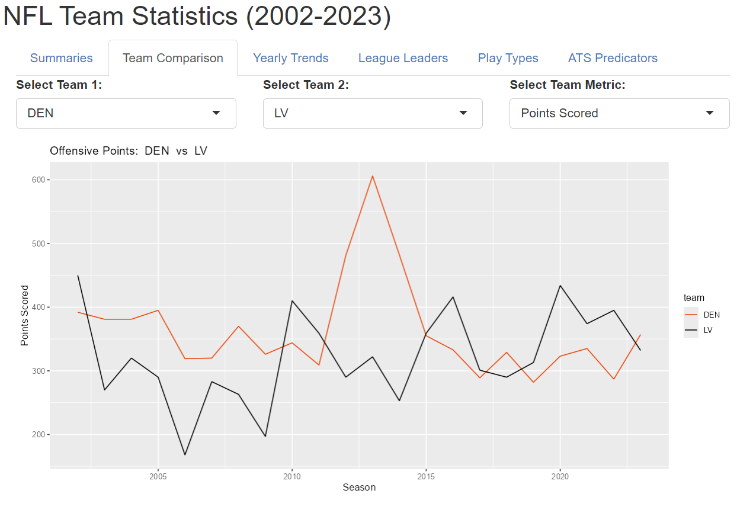

Slide 4
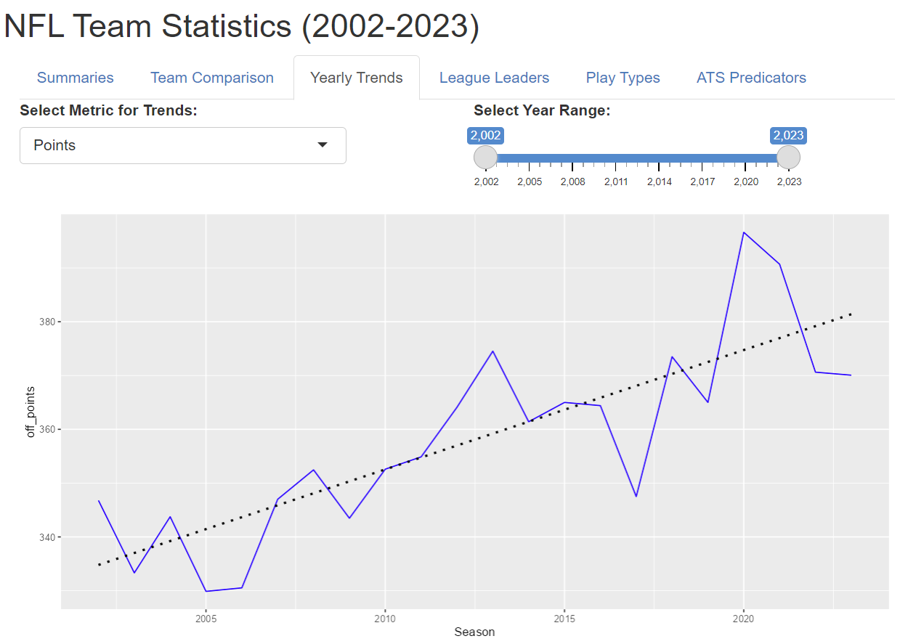

Slide 5
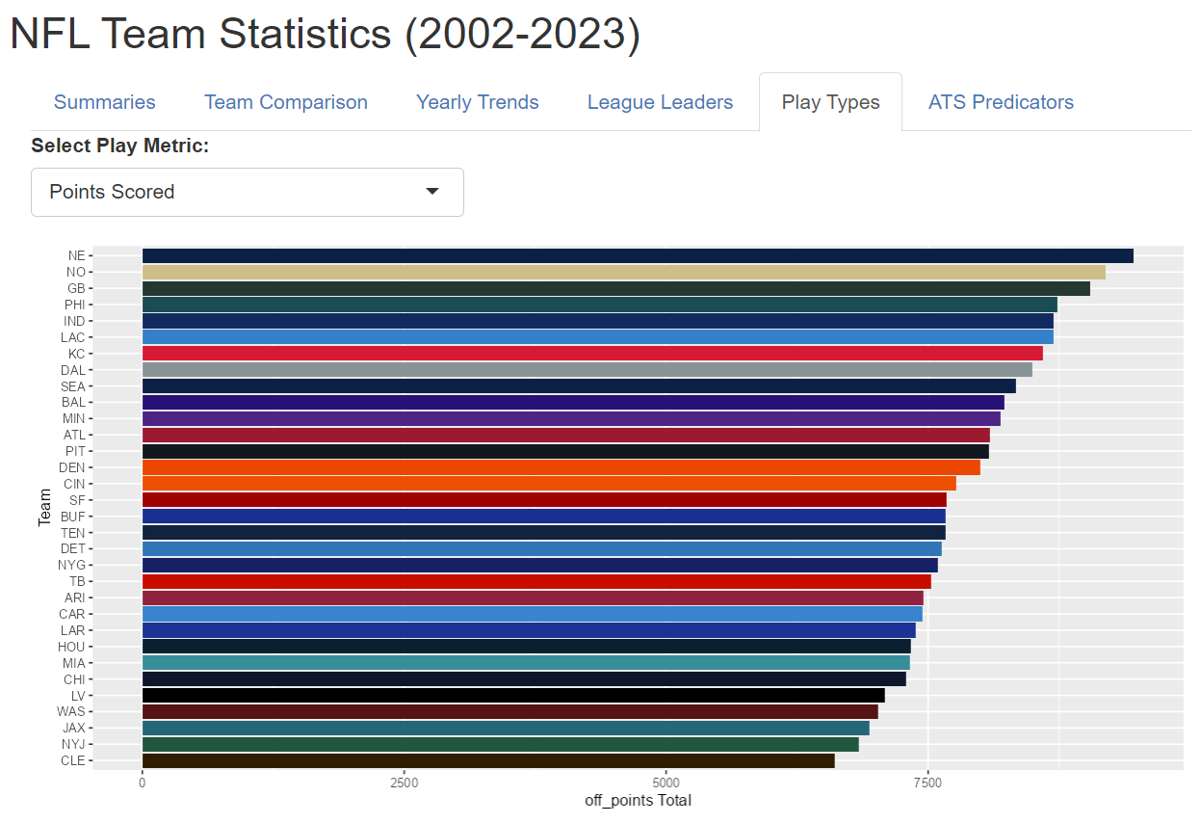

Slide 6
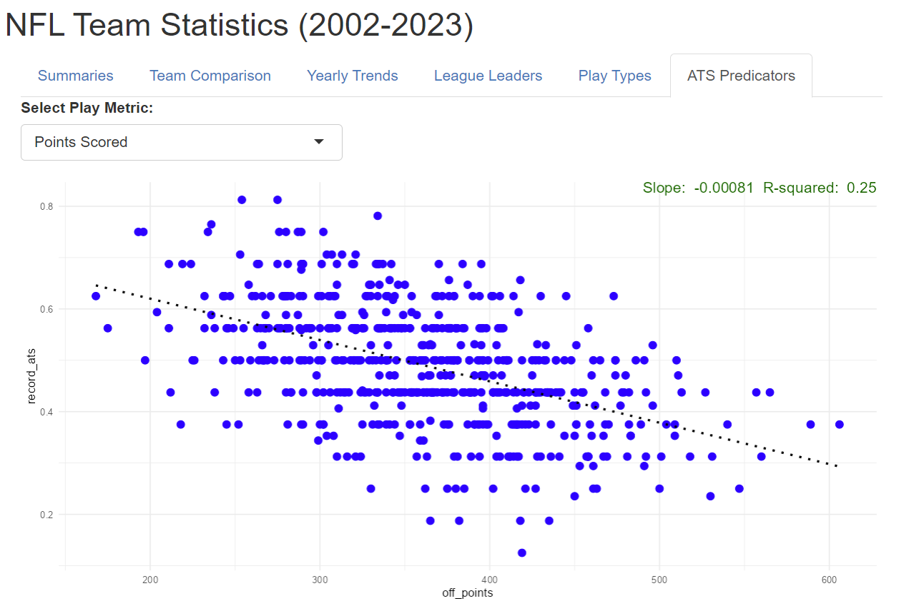

Slide 7
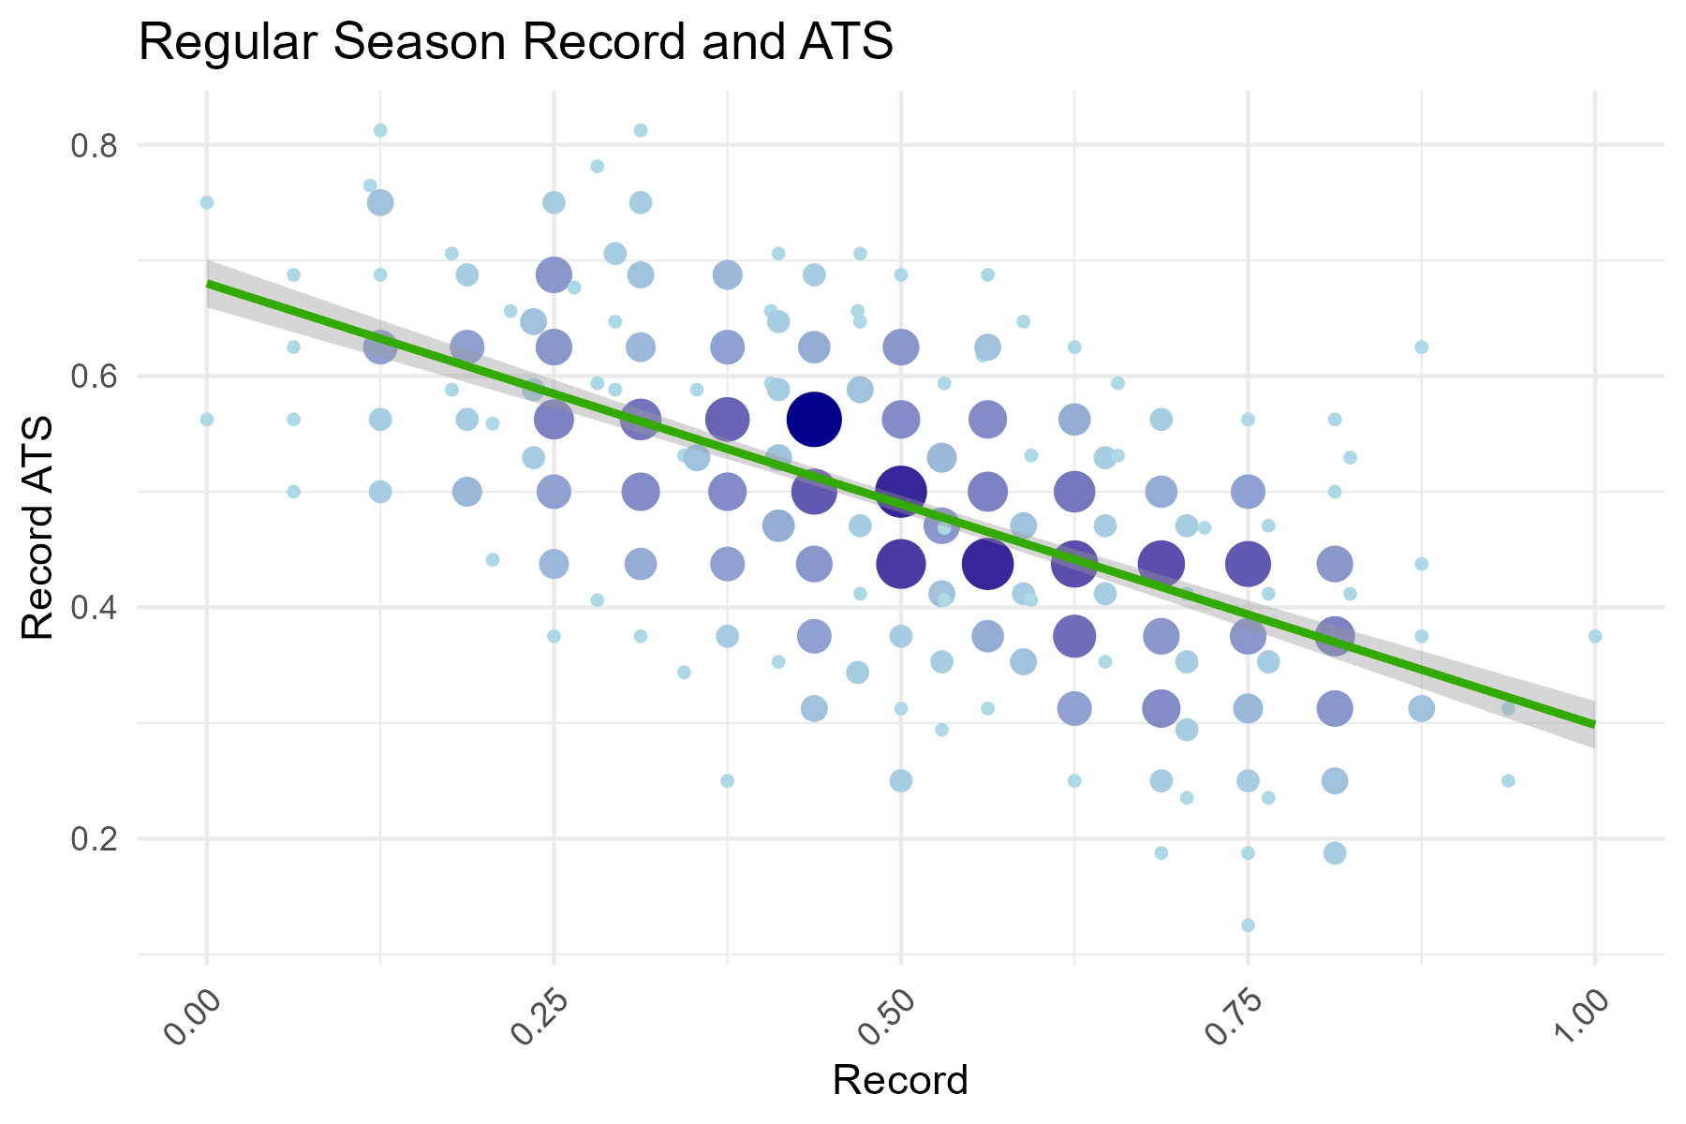

Slide 8
