Slide 1
Statistical Models for Automatic Speech Recognition
Lukáš Burget

Slide 2
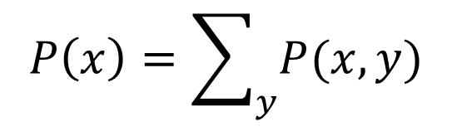

Basic rules of probability theory
Sum rule:
Product rule:
Bayes rule:
$$P\left(x\right)=\sum_{y}{P(x,y)}$$
$$P\left(x,y\right)=P\left(x|y\right)P\left(\text{y}\right)=P\left(y|x\right)P(x)$$
$$P\left(x|y\right)=\frac{P\left(y|x\right)P\left(x\right)}{P(y)}$$

Slide 3
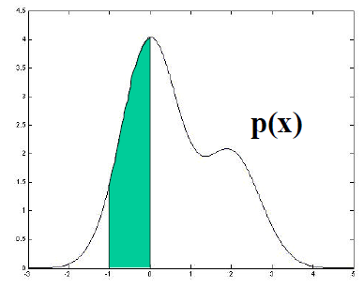

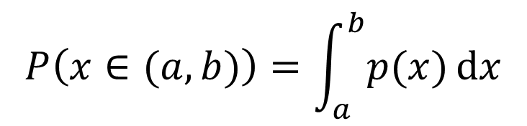
Continuous random variables
P(x) –probability
p(x) –probability density function
Sum rule:
$$P\left(x∈(a,b)\right)=\int_{a}^{b}{p(x)}dx$$
p(x)
→ x
$$p\left(x\right)=\int{p(x,y)}dy$$

Slide 4
Speech recognition problem
Feature extraction: preprocessing speech signal to satisfy needs of the following recognition process (dimensionality reduction, preserving only the “important” information, decorrelation).
Popular features are MFCC: modification based on psycho-acoustic findings applied to short-time spectra.
For convenience, we will use one-dimensional features in most of our examples (e.g. short time energy).

Slide 5
Classifying speech frame
unvoiced
voiced
→ p(x)
→ x

Slide 6


Classifying speech frame
unvoiced
voiced
→ p(x)
→ x
Mathematically, we ask the following question:
But the value we read from probability distribution is p(x|class).
According to Bayes Rule, the above can be revritten as:

Slide 7

Multi-class classification
The class being correct with the highest probability is given by:
silence
unvoiced
voiced
→ p(x)
→ x
But we do not know the true distribution, …

Slide 8
Estimation of parameters
… we only see some training examples.
silence
unvoiced
voiced
→ p(x)
→ x

Slide 9
Estimation of parameters
… we only see some training examples.
Let’s decide for some parametric model (e.g. Gaussian distribution) and estimate its parameters from the data.
Here, we are using the frequentist approach: Estimate and rely on distributions, which tells us how frequently we have seen similar feature x for individual classes.
silence
unvoiced
voiced
→ p(x)
→ x

Slide 10
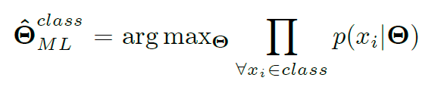
Maximum Likelihood Estimation
In the next part, we will use ML estimation of model parameters:
This allow as to individually estimate parameters, Θ, of each class given the data for that class. Therefore, for the convenience, we can omit the class identities in the following equations.
The models we are going to examine are:
Single Gaussian
Gaussian Mixture Model (GMM)
Hidden Markov Model
We want to solve three fundamental problems:
Evaluation of the model (computing likelihood of features given the model)
Training the model (finding ML estimates of parameters)
Finding most likely values of hidden parameters

Slide 11
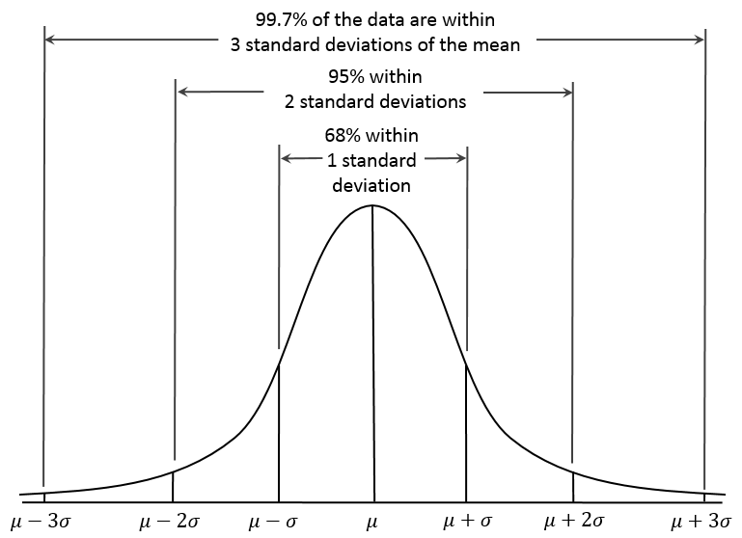
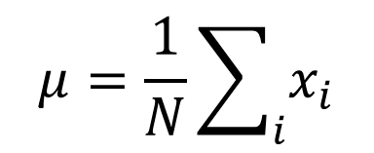
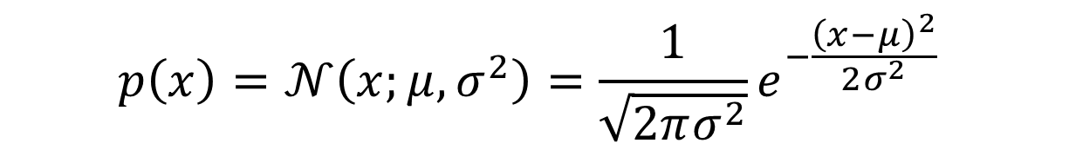
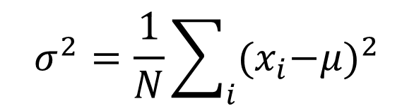
Gaussian distribution (univariate)
$$p\left(x\right)=𝒩\left(x;μ,σ^{2}\right)=\frac{1}{\sqrt{2πσ^{2}}}e^{−\frac{{\left(x−μ\right)}^{2}}{2σ^{2}}}$$
ML estimates of parameters
$$μ=\frac{1}{N}\sum_{i}{x_{i}}$$
$$σ^{2}=\frac{1}{N}\sum_{i}{{{(x}_{i}−μ)}^{2}}$$

Slide 12
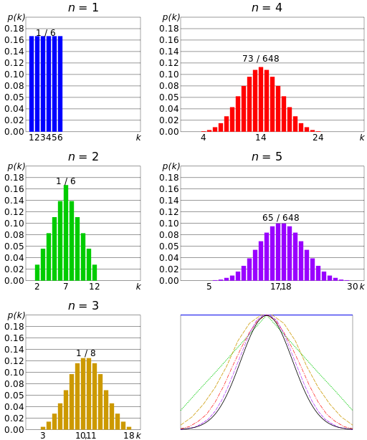
Why Gaussian distribution?
Naturally occurring
Central limit theorem: Summing values of many independently generated random variables gives Gaussian distributed observations
Examples:
Summing outcome of N dices
Galton’s board https://www.youtube.com/watch?v=03tx4v0i7MA

Slide 13
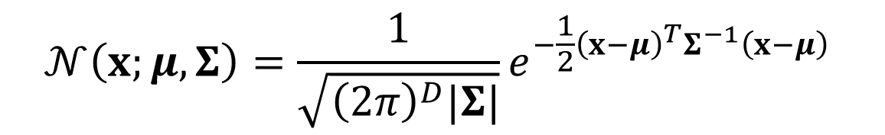

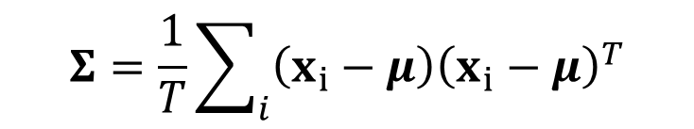
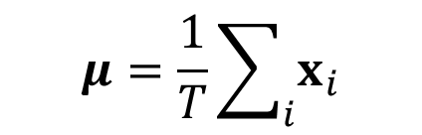
Gaussian distribution (multivariate)
$$p\left(x_{1}, …,x_{D}\right)=$$
$$𝒩\left(x;μ,Σ\right)=\frac{1}{\sqrt{{\left(2π\right)}^{D}|Σ|}}e^{−\frac{1}{2}{\left(x−μ\right)}^{T}Σ^{−1}\left(x−μ\right)}$$
ML odhad of parametrů:
$$μ=\frac{1}{T}\sum_{i}{x_{i}}$$
$$Σ=\frac{1}{T}\sum_{i}{{\left(x_{i}−μ\right)\left(x_{i}−μ\right)}^{T}}$$

Slide 14

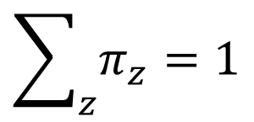

Gaussian Mixture Model (GMM)
$$p\left(x|Θ\right)=\sum_{c}{𝒩\left(x;μ_{z},Σ_{z}\right)π_{z}}$$
where
$$Θ=\{π_{z},μ_{z},Σ_{z}\}$$
$$\sum_{z}{π_{z}}=1$$
We can see the sum above just as a function defining the shape of the probability density function
or …

Slide 15
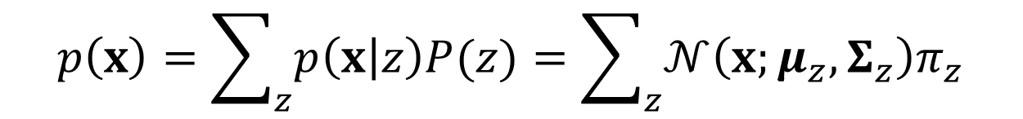
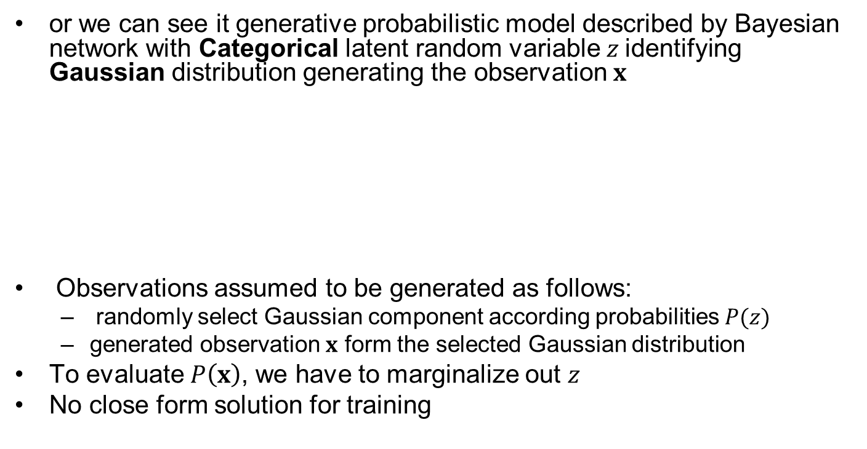


Gaussian Mixture Model
$$p\left(x\right)=\sum_{z}{p\left(x | z\right)P(z)}=\sum_{z}{𝒩\left(x;μ_{z},Σ_{z}\right)π_{z}}$$
or we can see it generative probabilistic model described by Bayesian network with Categorical latent random variable $z$identifying Gaussian distribution generating the observation $x$
Observations assumed to be generated as follows:
randomly select Gaussian component according probabilities $P(z)$
generated observation $x$ form the selected Gaussian distribution
To evaluate $P\left(x\right)$, we have to marginalize out $z$
No close form solution for training
$$z$$
$$p\left(x,z\right)=p\left(x | z\right)P(z)$$
x

Slide 16
Training GMM –Viterbi training
Intuitive and Approximate iterative algorithm for training GMM parameters.
Using current model parameters, let Gaussians to classify data as the Gaussians were different classes (Even though the both data and all components corresponds to one class modeled by the GMM)
Re-estimate parameters of Gaussian using the data associated with to them in the previous step.
Repeat the previous two steps until the algorithm converge.

Slide 17
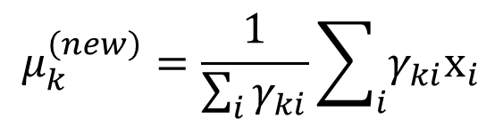
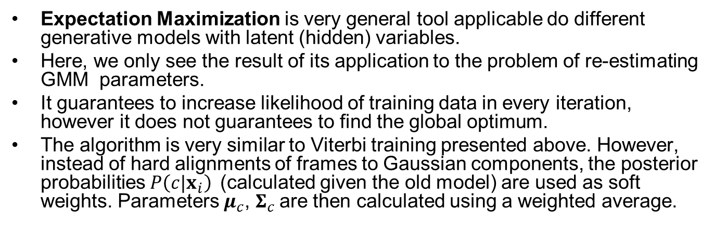
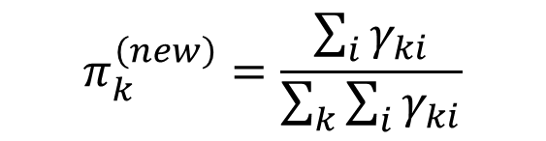
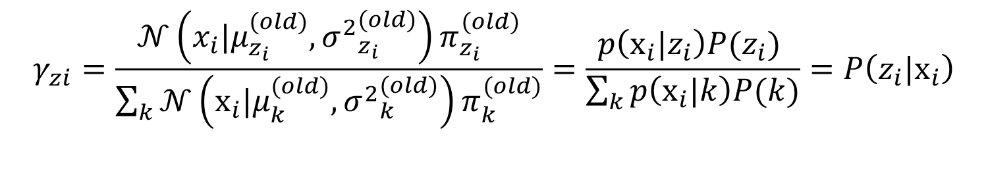
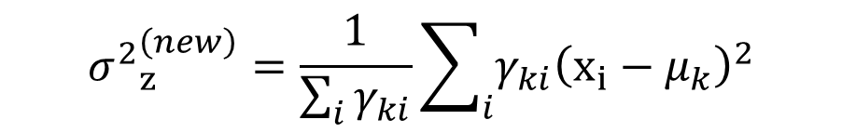
Training GMM – EM algorithm
Expectation Maximization is very general tool applicable do different generative models with latent (hidden) variables.
Here, we only see the result of its application to the problem of re-estimating GMM parameters.
It guarantees to increase likelihood of training data in every iteration, however it does not guarantees to find the global optimum.
The algorithm is very similar to Viterbi training presented above. However, instead of hard alignments of frames to Gaussian components, the posterior probabilities $P\left(c|x_{i}\right)$(calculated given the old model) are used as soft weights. Parameters $μ_{c}^{}$, $Σ_{c}^{}$are then calculated using a weighted average.
$$γ_{zi}=\frac{𝒩\left(x_{i}|μ_{z_{i}}^{(old)},{σ^{2}}_{z_{i}}^{(old)}\right)π_{z_{i}}^{(old)}}{\sum_{k}{𝒩\left(x_{i}|μ_{k}^{(old)},{σ^{2}}_{k}^{(old)}\right)π_{k}^{(old)}}}=\frac{p\left(x_{i}|z_{i}\right)P(z_{i}) }{\sum_{k}{p\left(x_{i}|k\right)P(k)}}=P\left(z_{i}|x_{i}\right)$$
$$μ_{k}^{\left(new\right)}=\frac{1}{\sum_{i}{γ_{ki}}}\sum_{i}{γ_{ki}x_{i}}$$
$$π_{k}^{\left(new\right)}=\frac{\sum_{i}{γ_{ki}}}{\sum_{k}{\sum_{i}{γ_{ki}}}}$$
$${σ^{2}}_{z}^{\left(new\right)}=\frac{1}{\sum_{i}{γ_{ki}}}\sum_{i}{γ_{ki}{\left(x_{i}−μ_{k}\right)}^{2}}$$

Slide 18
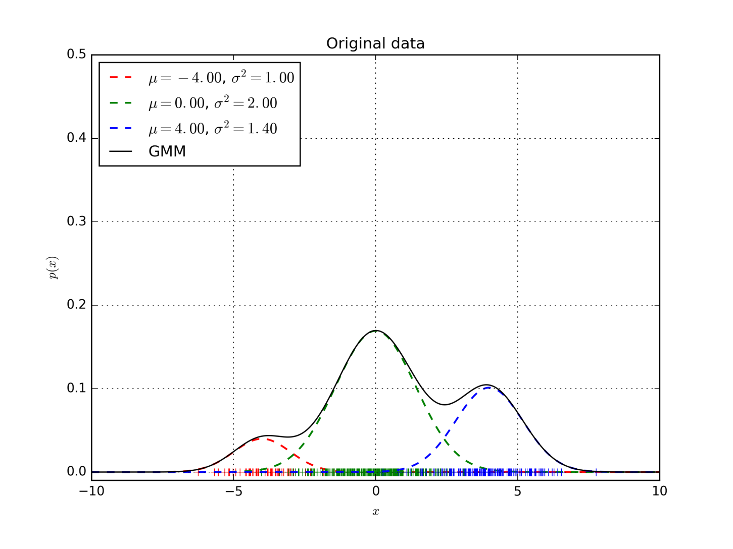
GMM to be learned

Slide 19
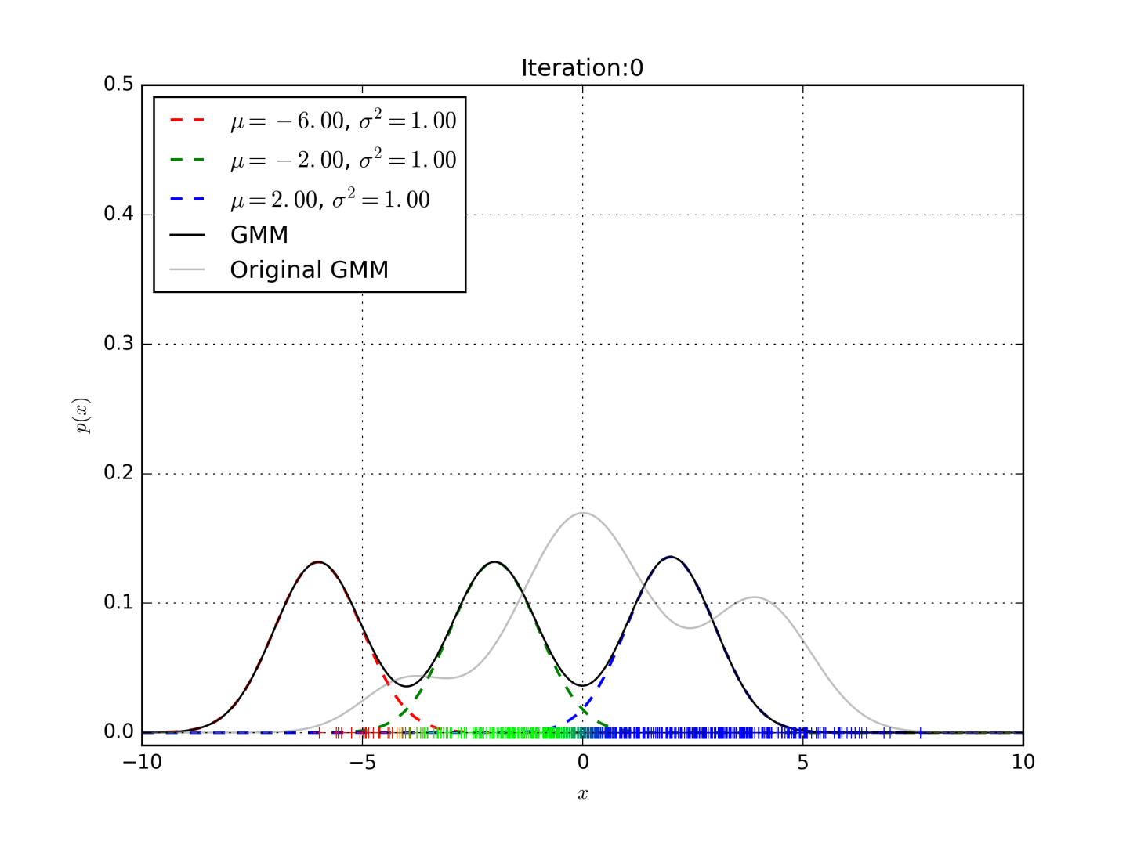
EM algorithm

Slide 20
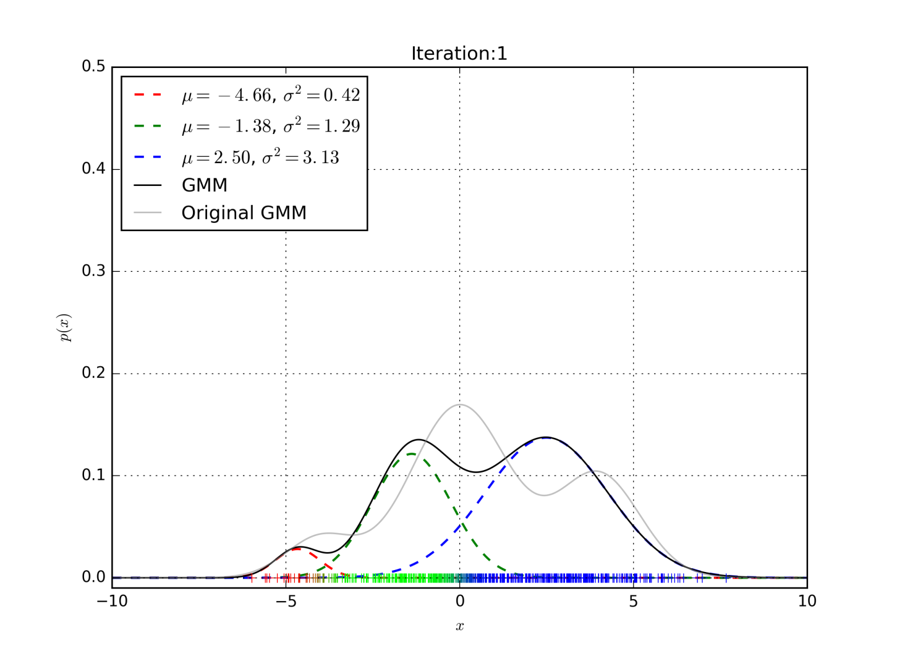
EM algorithm

Slide 21
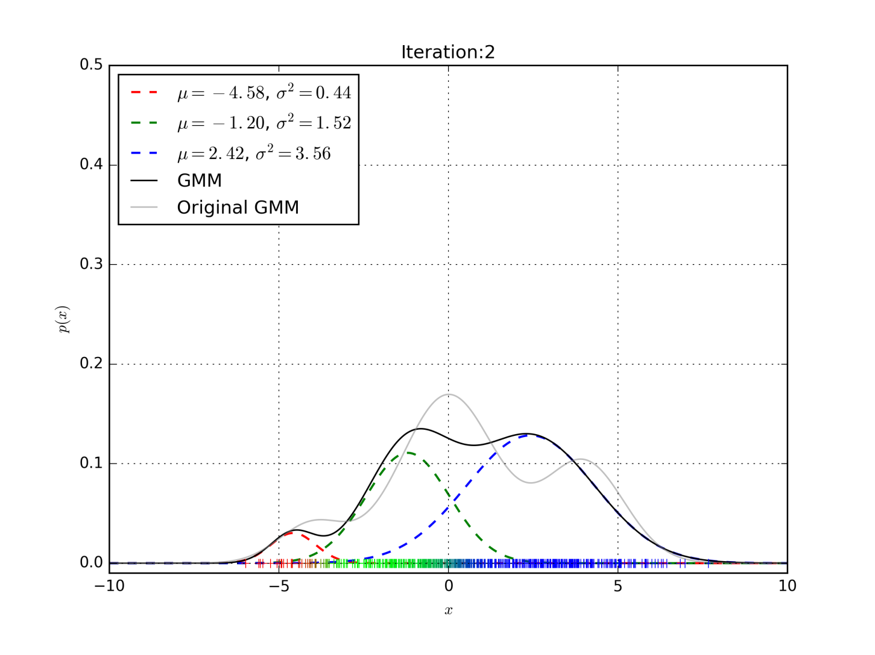
EM algorithm

Slide 22

EM algorithm

Slide 23

EM algorithm

Slide 24

EM algorithm

Slide 25

EM algorithm

Slide 26

EM algorithm

Slide 27
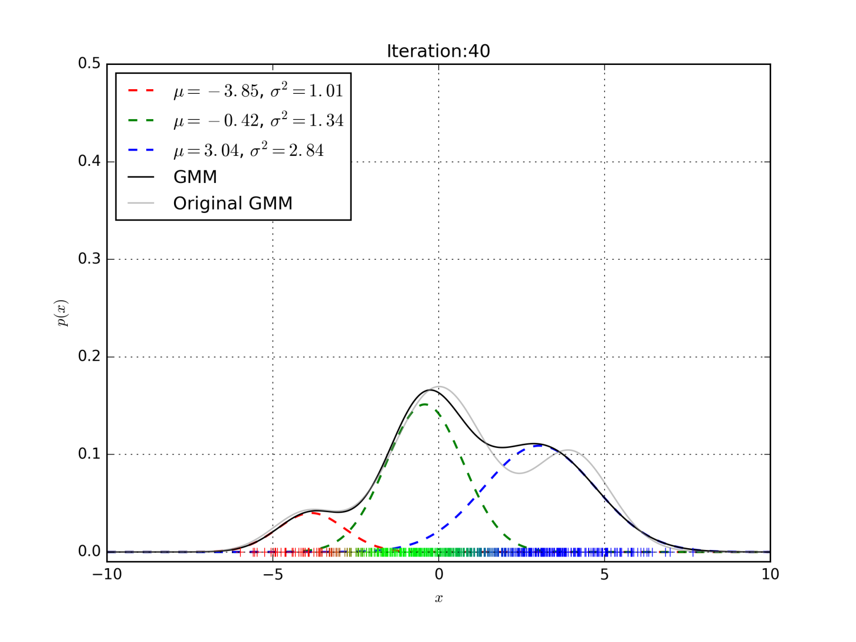
EM algorithm

Slide 28
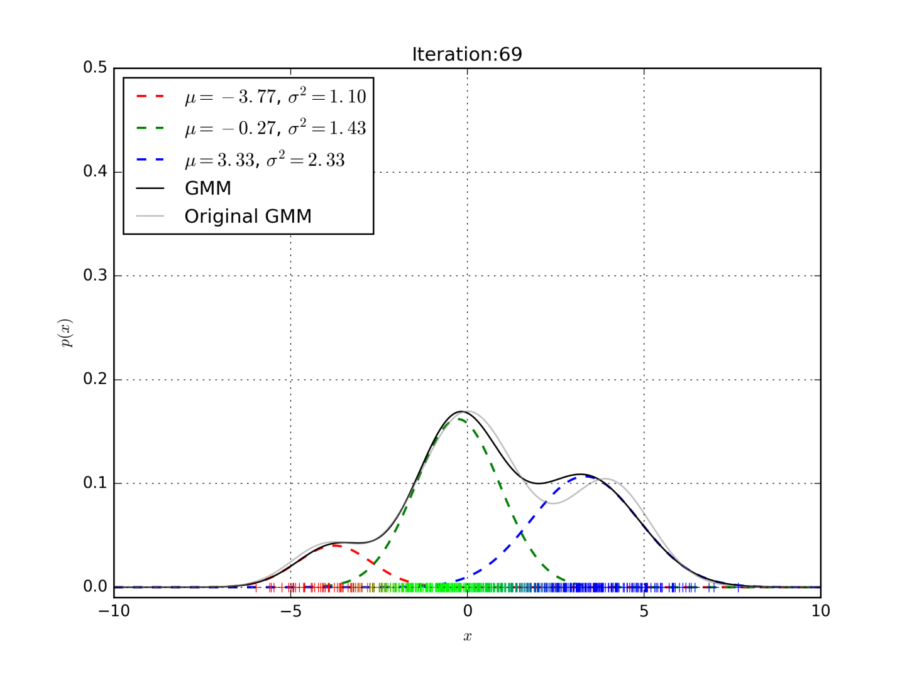
EM algorithm

Slide 29

Classifying stationary sequence
silence
unvoiced
voiced
Frame independency assumption

Slide 30
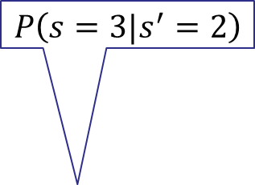

Modeling more general sequences: Hidden Markov Models
$$P\left(s=3|s^{′}=2\right)$$
a₁₁
a₂₂
a₃₃
a₀₁= 1
a₁₂
a₂₃
a_{3exit}
b₁(x)
b₂(x)
b₃(x)
$$p\left(x|s=3\right)$$
Generative model: For each frame, model moves from one state to another according to a transition probability a_{ij} and generates feature vector from probability distribution b_{j}(.) associated with the state that was entered.
To evaluate such model, we do not see which path through the states was taken.
Let’s start with evaluating HMM for a particular state sequence.

Slide 31
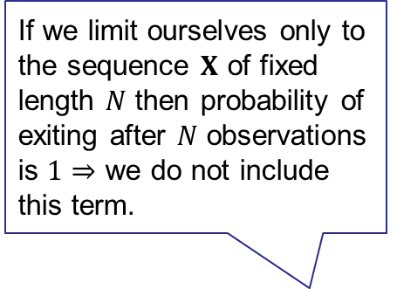
a₁₁
a₂₂
a₃₃
a₁₂
a₂₃
a_{3exit}
a₀₁= 1
b₁(x)
b₂(x)
b₃(x)
If we limit ourselves only to the sequence $X$ of fixed length $N$ then probability of exiting after $N$ observations is $1⇒$ we do not include this term.
a₃₃
a₂₃
a₃₃
a₂₃
b₃(x₄)
b₁(x₁)
b₃(x₄)
b₁(x₁)
a₁₂
a₀₁
b₁(x₂)
a₁₂
a_{3exit}
a₁₁
b₁(x₂)
b₃(x₅)
P(X,S) =
a₁₁
b₂(x₃)
b₃(x₅)
b₂(x₃)

Slide 32
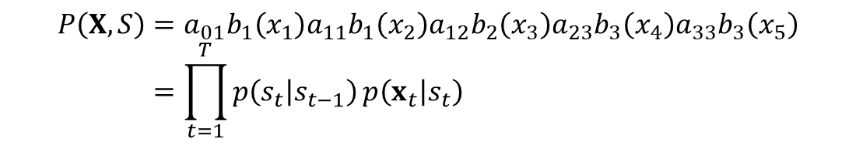
Evaluating HMM for a particular state sequence
$$P\left(X,S\right)=a_{01}b_{1}\left(x_{1}\right)a_{11}b_{1}\left(x_{2}\right)a_{12}b_{2}\left(x_{3}\right)a_{23}b_{3}\left(x_{4}\right)a_{33}b_{3}\left(x_{5}\right) \\ =\prod_{t=1}^{T}{p\left(s_{t} | s_{t−1}\right)}p\left(x_{t} | s_{t}\right)$$

Slide 33
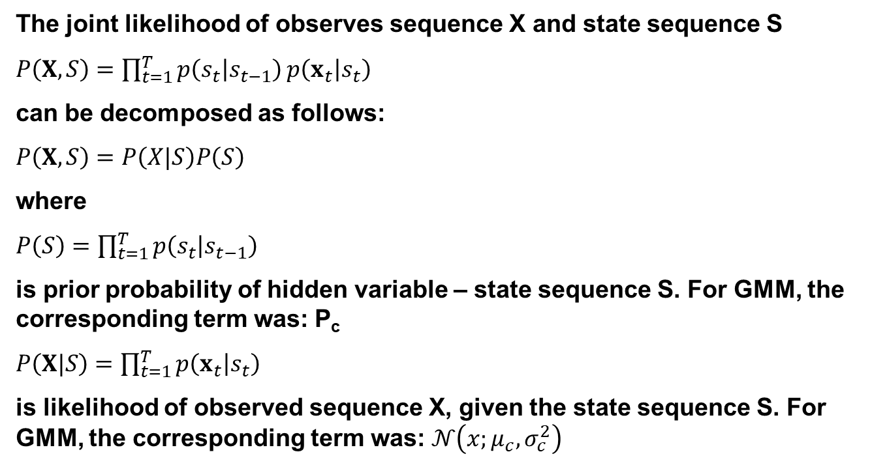
Evaluating HMM for a particular state sequence
The joint likelihood of observes sequence X and state sequence S
$P\left(X,S\right)=\prod_{t=1}^{T}{p\left(s_{t} | s_{t−1}\right)}p\left(x_{t} | s_{t}\right)$
can be decomposed as follows:
$P\left(X,S\right)=P\left(X|S\right)P\left(S\right)$
where
$P\left(S\right)=\prod_{t=1}^{T}{p\left(s_{t} | s_{t−1}\right)}$
is prior probability of hidden variable – state sequence S. For GMM, the corresponding term was: P_{c}
$P\left(X|S\right)=\prod_{t=1}^{T}{p\left(x_{t} | s_{t}\right)}$
is likelihood of observed sequence X, given the state sequence S. For GMM, the corresponding term was: $𝒩\left(x;μ_{c},σ_{c}^{2}\right)$

Slide 37
.

Slide 38
.

Slide 39
.

Slide 40
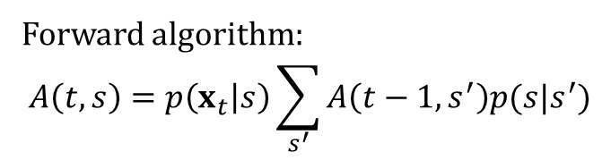
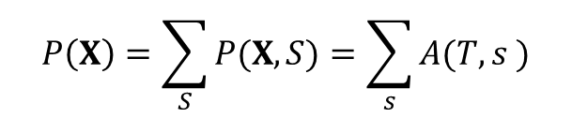
Evaluating HMM (for any state sequence)
Since we do not know the underlying state sequence, we must marginalize – compute and sum likelihoods over all the possible paths
$$P\left(X\right)=\sum_{S}{P(X,S)}=\sum_{s}{A(T,s )}$$
Forward algorithm:
$$A\left(t,s\right)=p\left(x_{t} | s\right)\sum_{s^{′}}{A\left(t−1,s^{′}\right)p(s|s^{′})}$$

Slide 46
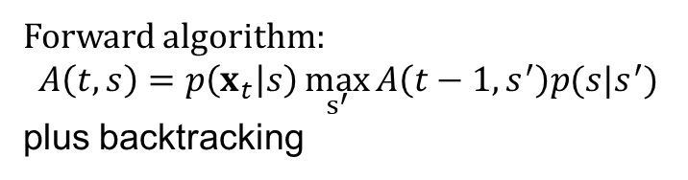

Finding the best (Viterbi) paths
$\hat{P}\left(X\right)=\underset{S}{arg max} P(X,S)$
Forward algorithm:
$$A\left(t,s\right)=p\left(x_{t} | s\right)\max_{s^{′}}{A\left(t−1,s^{′}\right)p(s|s^{′})}$$
plus backtracking

Slide 47
Training HMMs – Viterbi training
Similar to the approximate training we have already seen for GMMs
For each training utterance find Viterbi path through HMM, which associate feature frames with states.
Re-estimate state distribution using associated feature frames.
Repeat steps 1. and 2. until the algorithm converges.

Slide 48
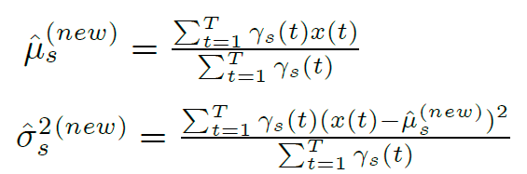


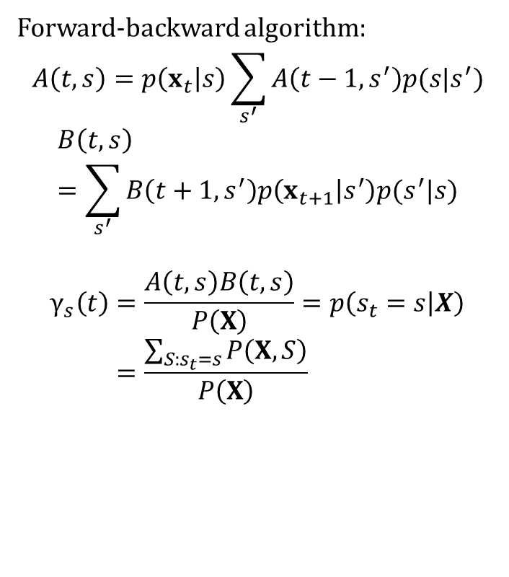
Training HMMs using EM
Forward-backward algorithm:
$$A\left(t,s\right)=p\left(x_{t} | s\right)\sum_{s^{′}}{A\left(t−1,s^{′}\right)p(s|s^{′})}$$
$$B\left(t,s\right)=\sum_{s^{′}}{B\left(t+1,s^{′}\right)p\left(x_{t+1} | s^{′}\right)p(s^{′}|s)}$$
$$γ_{s}\left(t\right)=\frac{A\left(t,s\right)B\left(t,s\right)}{P\left(X\right)}=p\left(s_{t}=s | X\right) \\ =\frac{\sum_{S:s_{t}=s}{P\left(X,S\right)}}{P\left(X\right)}$$
s
t

Slide 49
Isolated word recognition
YES
NO

Slide 50
Connected word recognition
YES
sil
sil
NO
See what words were traversed by the Viterbi path

Slide 51
Phoneme based models
y
eh
s
y
eh
s

Slide 52
Using Language model - unigram
P(one)
w
ah
n
one
sil
P(two)
t
uw
sil
two
P(three)
th
iy
three
r

Slide 53
Using Language model - bigram
one
P(W₂|W₁)
n
w
ah
sil
one
two
t
uw
sil
two
three
th
r
iy
three
sil

Slide 54
Other basic ASR topics not covered by this presentation
Context dependent models
Training phoneme based models
Feature extraction
Delta parameters
De-correlation of features
Full-covariance vs. diagonal cov. modeling
Adaptation to speaker or acoustic condition
Language Modeling
LM smoothing (back-off)
Discriminative training (MMI or MPE)
and so on

