Slide 1
HACKMANVR
Authors: Team TooEZ
So punny. Haha.

Slide 2
SETUP
Step 1
Get yourself a VR headset, a decent phone and a Bluetooth controller.
How do you make it work?
Step 2
Connect the controller to your phone.
Infographic Designed
Step 3
Launch the “HackManVR” app through the phone and put it in the headset.
Step 4
You are ready to go!

Slide 3



SETUP
How do you make it work?
Step 2
Step 1
Connect the controller to your phone.
Infographic Designed
Get yourself a VR headset, a decent phone and a Bluetooth controller.
Step 3
Launch the “HackManVR” app through the phone and put it in the headset.
Step 4
You are ready to go!

Slide 4



SETUP
How do you make it work?
Step 1
Get yourself a VR headset, a decent phone and a Bluetooth controller.
Step 3
Step 2
Launch the “HackManVR” app through the phone and put it in the headset.
Connect the controller to your phone.
Step 4
You are ready to go!

Slide 5
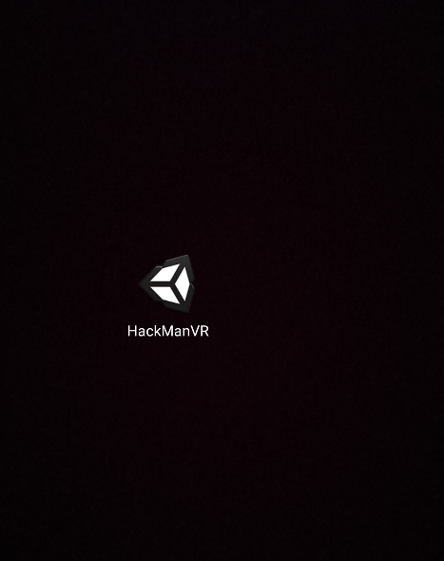

SETUP
How do you make it work?
Step 1
Get yourself a VR headset, a decent phone and a Bluetooth controller.
Step 2
Connect the controller to your phone.
Step 4
Step 3
You are ready to go!
Launch the “HackManVR” app through the phone and put the phone in the headset.

Slide 6


SETUP
How do you make it work?
Step 1
Get yourself a VR headset, a decent phone and a Bluetooth controller.
Step 2
Connect the controller to your phone.
Step 4
Step 3
You are ready to go!
Launch the “HackManVR” app through the phone and put the phone in the headset.

Slide 7

SETUP
How do you make it work?
Step 1
Get yourself a VR headset, a decent phone and a Bluetooth controller.
Step 2
Connect the controller to your phone.
Step 4
Step 3
You are ready to go!
Launch the “HackManVR” app through the phone and put the phone in the headset.

Slide 8

SETUP
How do you make it work?
Step 1
Infographic Designed
Get yourself a VR headset, a decent phone and a Bluetooth controller.
Easy to change colors, photos and Text.
Step 2
Connect the controller to your phone.
Step 3
Launch the “HackManVR” app through the phone and put it in the headset.
Step 4
You are ready to go!

Slide 9
WANNA GIVE IT A SHOT?
Got the stuff? Scan the QR code below:

Slide 10
LIVE DEMO
Now you actually get to see it! ♪~ ᕕ(ᐛ)ᕗ

Slide 11
THAT’S IT, FOLKS!
Wait, you made it this far..? I’m… impressed. 👏

