Slide 1
Distribution Ray Tracing
Depth of field, motion blur, soft shadows and glossy reflections
Simon Flannery

Slide 2
Depth of Field
Motivation:
  To focus attention.
  Exists in all still and motion picture photography.
Implementation:
  Extend the perspective camera with notions of lens size and distance to focus plane where objects are in perfect focus.
  For each pixel, sample many rays originating at random points within the “lens”, but all going through the same point on the focus plane.
  The amount of “depth of field” was controlled by the size of the “lens”.
    With large lens size, objects get blurrier more quickly.

Slide 3
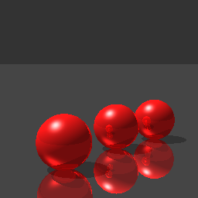
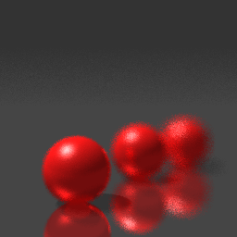

Depth of Field Results
Perfect Focus
16 samples / pixel
64 samples / pixel

Slide 4

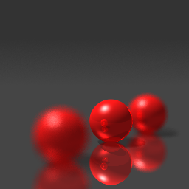

Depth of Field Results
Near Focus
Center Focus
Far Focus
All 128 samples / pixel

Slide 5
Motion Blur
Motivation:
  In still photography motion blur expresses dynamic motion.
Implementation:
  Extend an object with notions of velocity and time.
  Requires displacing the position of an object over non-zero time.
  For each pixel, sample many rays.

Slide 6
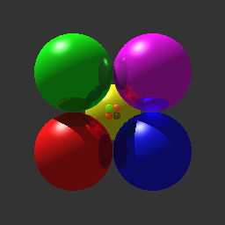
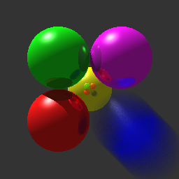
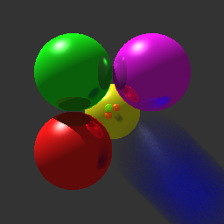
Motion Blur Results
Zero Velocity
Velocity = 0.5 units
Velocity = 1.0 units
All 128 samples / pixel

Slide 7

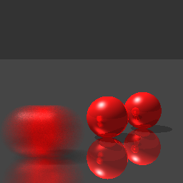
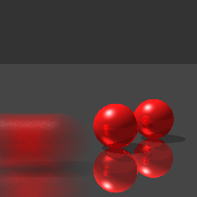
Motion Blur Results
Zero Velocity
Velocity = 0.5 units
Velocity = 1.0 units
All 128 samples / pixel

Slide 8
Soft Shadows
Motivation:
  Real life shadows are “soft”, not hard.
  Real shadows should have an umbra and penumbra’s.
Implementation:
  Represent light source as area rather than point.
  For each pixel, sample many rays aimed at different points on the light area.
  Points near the border of the shadow region will be partially lit.

Slide 9
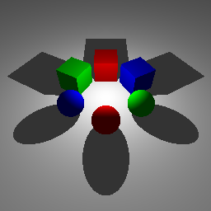
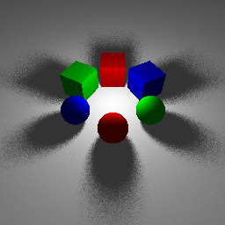

Soft Shadow Results
Hard Shadows
16 samples / pixel
64 samples / pixel

Slide 10
Glossy Reflections
Motivation:
  Small surface imperfections give a diffuse or glossing reflection.
  To model materials that are somewhere between ideal mirrors and diffuse.
Implementation:
  For each reflective hit point, sample many rays by Perturbing ideal reflection ray over a perpendicular square.
  Size of the square determines amount of blurriness.

Slide 11
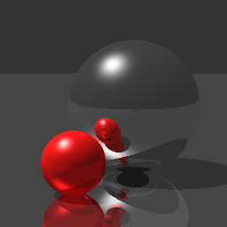
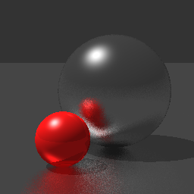

Glossy Reflection Results
Perfect Reflections
16 samples / pixel
64 samples / pixel

Slide 12
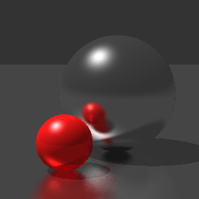

Glossy Reflection Results
Perfect Reflections
Blurriness = 0.25
Blurriness = 0.50
All 128 samples / pixel

Slide 13
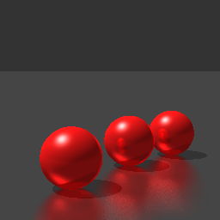
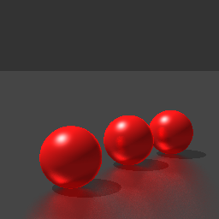
Glossy Reflection Results
Perfect Reflections
Blurriness = 0.25
Blurriness = 0.50
All 128 samples / pixel

Slide 14
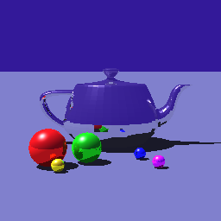
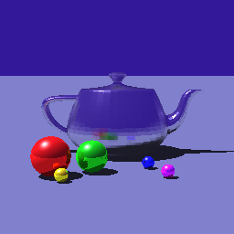
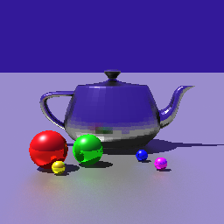
Glossy Reflection Results
Perfect Reflections
Glossy Teapot
Glossy Teapot and Floor
All 128 samples / pixel

