Slide 1






Vacation with the Adieu Token
Project Team: Sabahat Khan, Quinn Luong, Allen Z., and Daryl Redmond

Slide 2

Adieu Token – smart contract and token that allows for direct interaction between property owner and short-term renter
Blockchain
Ethereum Token
Decentralized
Trustless

Slide 3
Blockchain – the entire interaction takes place on the blockchain
Blockchain
Ethereum Token
Decentralized
Trustless

Slide 4
POPULAR PASTIMES

Slide 5
GETTING TO GREAT
Step 1
Get the Gear
Step 2
Get Started
Step 3
Practice a Lot

Slide 6
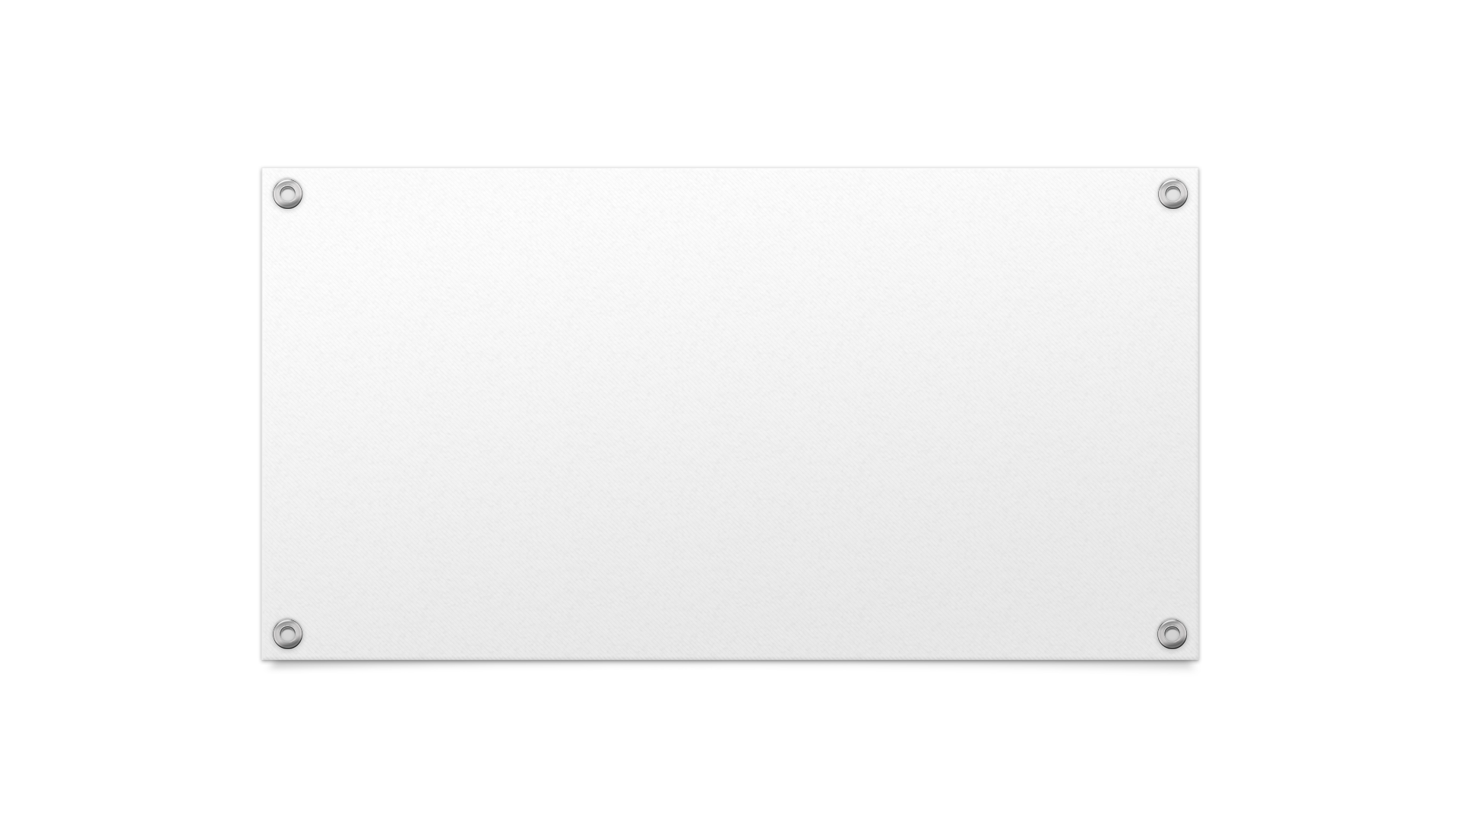

CONTACT US
someone@example.com

