Slide 1
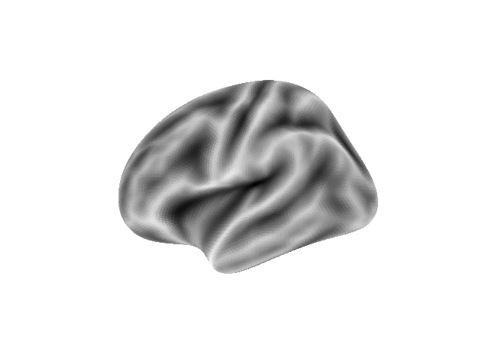
(A) Common Model of Cognition
(A) Common Model of Cognition
A
Action
Working Memory
WM
Procedural Memory
PM
LTM
P
Perception
Long-Term Memory
(B) Hub-and-Spoke
Architectures
(B) Hierarchical
Architectures
(C) Hub-and-Spoke
Architectures
A
A
A
WM
WM
WM
PM
PM
PM
P
P
LTM
P
LTM
LTM
Hub and Spoke, PFC
Hierarchical, Open
Hub and Spoke, PFC
A
A
A
WM
WM
WM
PM
PM
PM
P
P
LM
P
LTM
LTM
Hub and Spoke, BG
Hierarchical,Closed
Hub and Spoke, BG

Slide 2
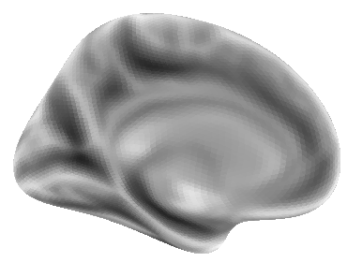
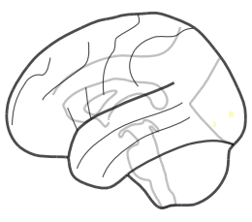
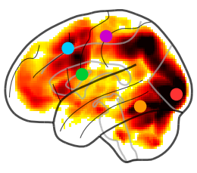
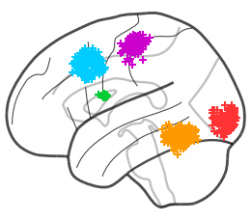
(A)
Long-Term
Memory
(B)
Motor
Parietal
Dorsal
PFC
Sensory
Auditory
Basal Ganglia
Procedural
Memory
Working
Memory
Visual
Temporal
Perception
Action
Left Lateral
Left Medial
(C)
Functional Anatomy Level
Group Level, By Task
Individual Level, By Task

Slide 3
Control Condition
(Easy)
Critical
Condition
(Hard)
Control Condition
(Easy)
Critical
Condition
(Hard)
Canonical
GLM matrix
DCM-Specific
GLM matrix
(A)
(B)
(C)
Control Condition
(Easy)
Critical
Condition
(Hard)
Baseline
Condition
(All Trials)
Critical
Condition
(Hard)
A
WM
PM
LTM
P
Canonical GLM
Design matrix
DCM-Specific
Design matrix
Critical
Condition
(Hard)
Baseline
Condition
(All Trials)

