Slide 1
Wine Classification using Unsupervised ML
A comparison of unsupervised machine learning versus supervised learning algorithms

Slide 2
The data
https://www.kaggle.com/datasets/maitree/wine-quality-selection
Red wine and white wine data
11 numerical features + numerical label
1599 red wine samples in total
Features scaled differently. Citric Acid scaled 0-1 but Total Sulphor Dioxide scaled from 6 to 289

Slide 3
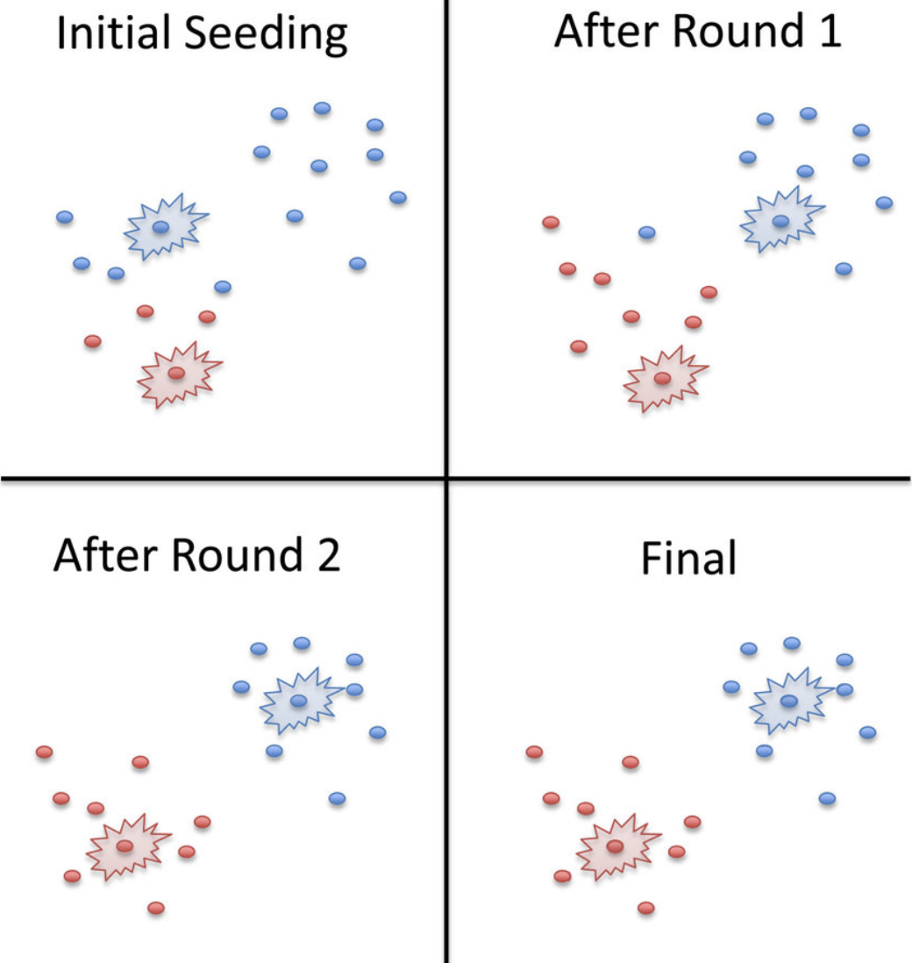
Mainly focusing on K-Means Clustering
Why choose K-Means clustering?
Simple algorithm
Easily explainable
Robust
Fast
Easy to implement (Scikit-learn)
K-Means clustering was compared against:
Static benchmarks
Hierarchical clustering
Supervised learning (Artificial neural networks)
Image source: https://devopedia.org/k-means-clustering

Slide 4
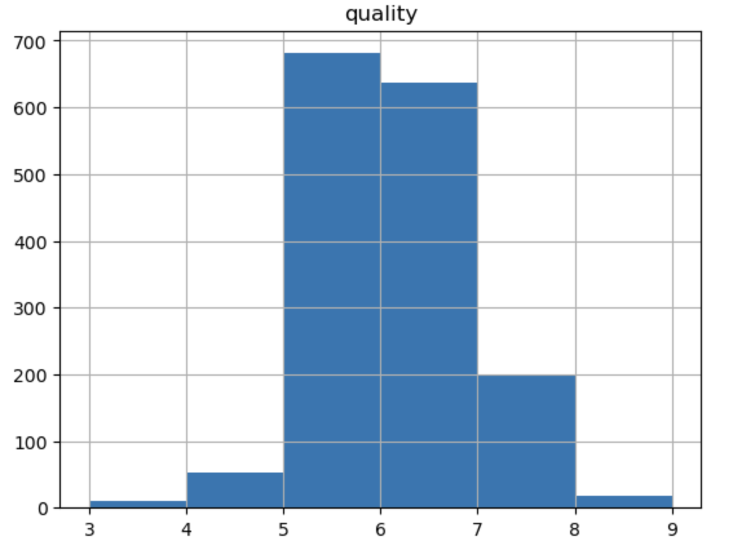
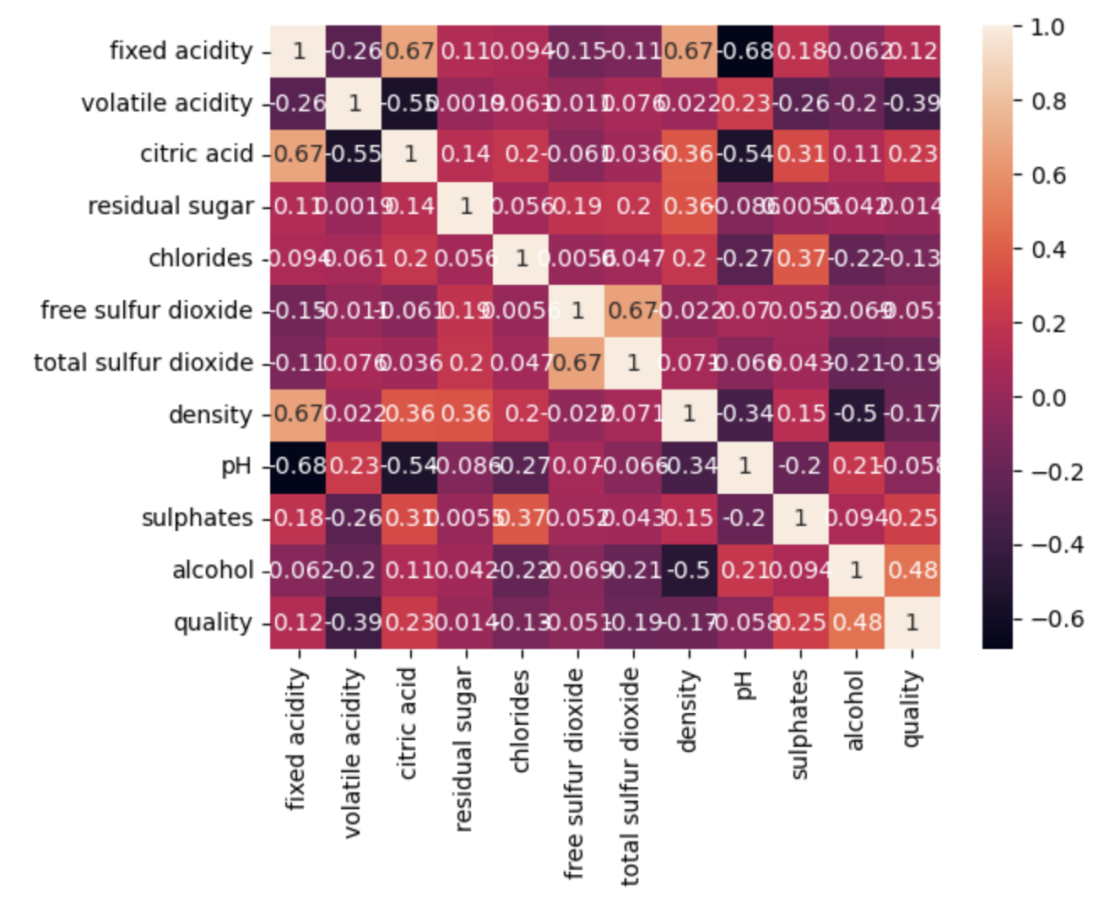
Data challenges

Slide 5
Metrics
Data was split 90/10 between training and test set.
Results compared using Macro F1 score and Mean Squared Error.

Slide 6
Feature engineering and data wrangling
Selection of most promising features
Dimensionality reduction through Pricipal Component Analysis
Min-Max scaling of features
Class concatination

Slide 7
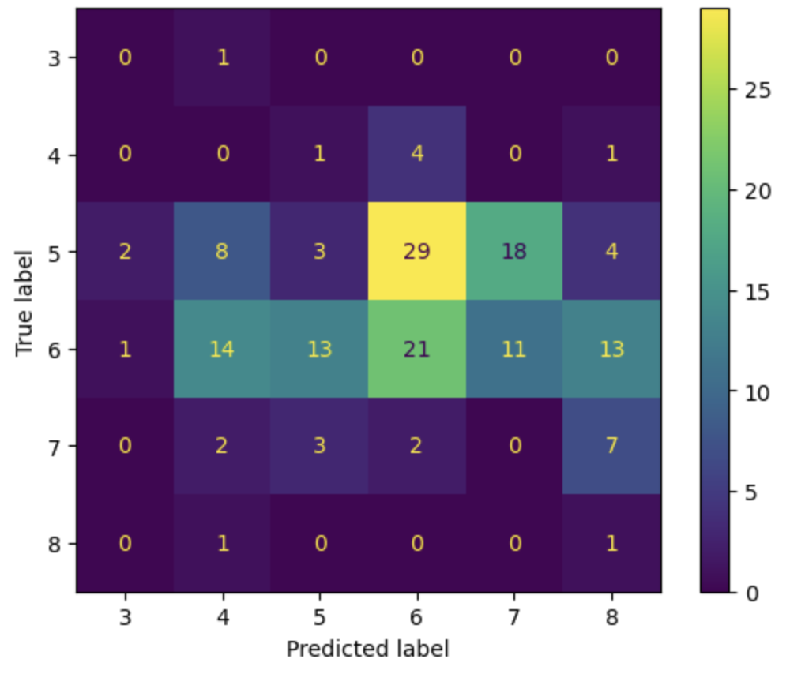
Initial results
Only 3 samples in test data from the two smallest classes
K-Means unable to differentiate between classes when used traditionally
Using a high number of clusters worked better

Slide 8
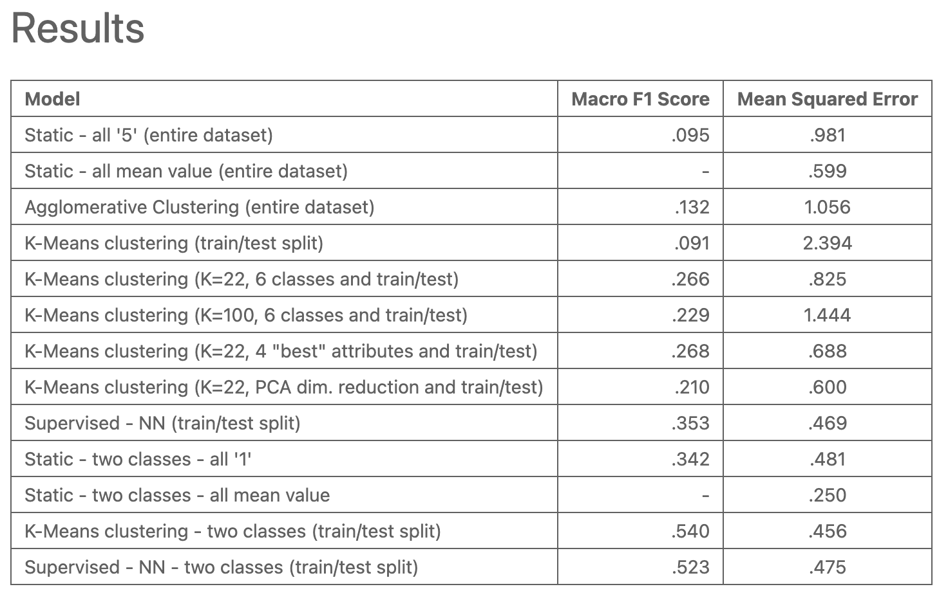

This Photo by Unknown Author is licensed under CC BY-NC

Slide 9
In the end..

