Slide 1

ZCAS UNIVERSITY · MSC DATA SCIENCE · GROUP 11
Detecting Financial Market Regimes
with Hidden Markov Models
A Gaussian HMM decodes Bull, Bear, and Sideways (Transition) regimes from five years of
daily S&P 500 returns and rolling volatility.
Group Members
Mardochee Tshiangala (202504163)
Yande K. Musonda (202502878)

Slide 2
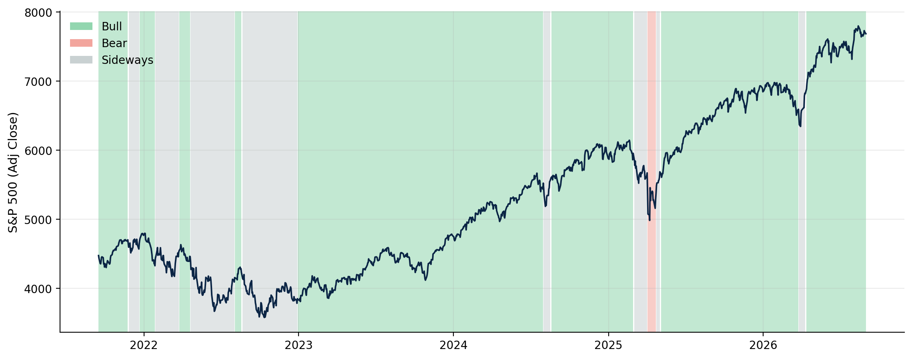

RESEARCH QUESTION
Can a small number of hidden states explain five years of S&P 500 behaviour?
PREVIEW OF THE DECODED OUTPUT
Model the S&P 500 as switches between a small number of unobserved market regimes
Three regimes recovered without any manual labels — details in the Results section.
Feed the model only two observable signals per day: the log return and a 10-day rolling volatility
Learn regimes and how long they persist directly from data — no manual bull/bear labelling
2

Slide 3
METHOD
Why a Hidden Markov Model?
HIDDEN STATE LAYER
Regimes persist. An HMM's transition matrix models that explicitly — today's regime depends on yesterday's, unlike k-means or GMM clustering on individual days.
Bear
Sideways
(Transition State)
Bull
Viterbi decodes the single most likely PATH through time, not just an independent label per day.
Observed each day:
log return & rolling volatility
Each regime gets its own 2-D Gaussian over (return, volatility); the calm state supplies the peak and the volatile state the tails.
3

Slide 4



PHASE 1 · DATA MANAGEMENT
From Raw Prices to a Model-Ready Matrix
Download
Validate & clean
Log returns
Rolling volatility
Observation matrix
^GSPC via yfinance,
cached with metadata
1,254 in, 1,254, 0 defects found
ln(Pₜ / Pₜ₋₁)
10-day standard
deviation of returns
(return, volatility)
per trading day
1,254
1,244
5 yrs
2
raw trading days
rows after feature warm-up
Sep 2021 → Sep 2026
features: return + volatility
4

Slide 5
PHASE 1 · A DECISION WORTH DEFENDING
We never fill in non-trading days
Weekends and holidays are not missing observations — the market is simply closed. Treating them as data would quietly distort the two signals the whole model depends on.
✕ Forward-fill weekends
✓ Drop non-trading days
Invents artificial “flat” return days that never happened
Silently deflates rolling volatility — the model reads the market as calmer than it was
Manufactures fake autocorrelation between adjacent “days”
Every log return in the dataset reflects a real trading session
Rolling volatility is computed only over genuine market activity
The regime the HMM learns is a statement about real trading, not calendar artefacts
5

Slide 6
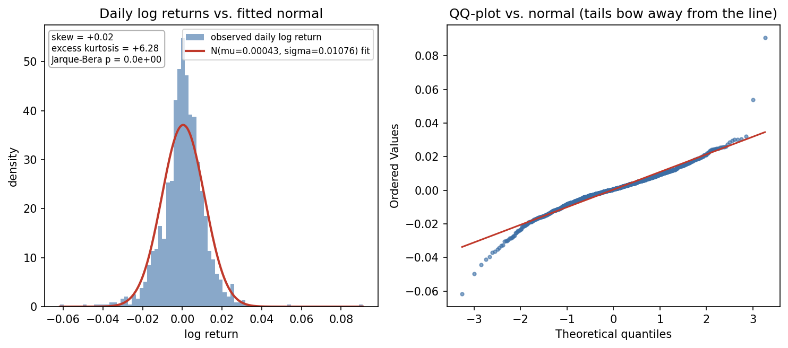
PHASE 2
Daily returns have fat tails, not a bell curve
+6.28
excess kurtosis (0 = normal)
p ≈ 0
Jarque-Bera test rejects normality
+0.02
skewness — close to symmetric
A single Gaussian cannot reproduce these tails. This is the direct motivation for a MIXTURE of regime-conditional Gaussians — the HMM's states — instead of one distribution for all five years.
6

Slide 7
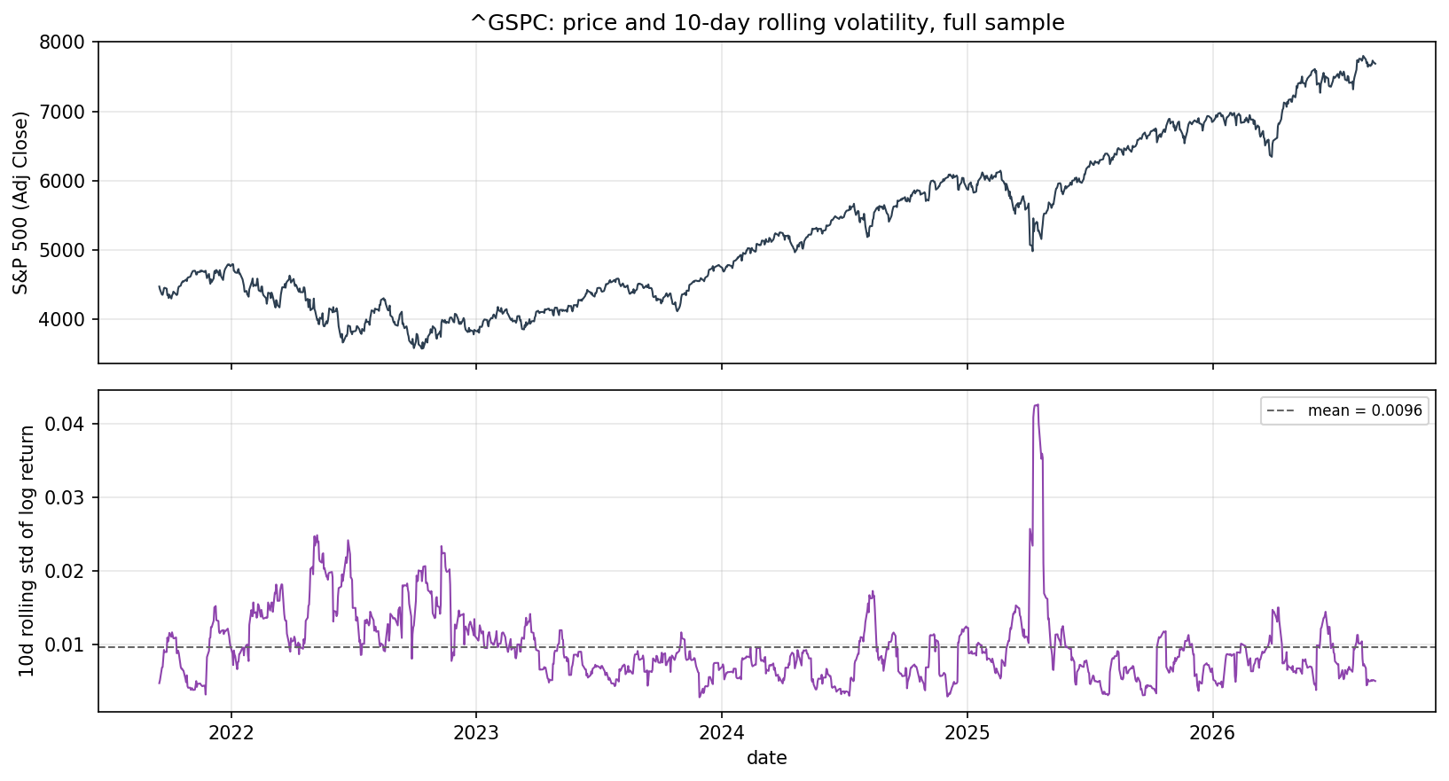
PHASE 2
Volatility clusters in time — it isn't noise
+0.96
lag-1 autocorrelation of volatility
15×
max / min volatility ratio
Calm and turbulent stretches persist for weeks, not single days. That persistence is what a clustering method would miss. This is what the HMM's transition matrix is built to exploit.
7

Slide 8
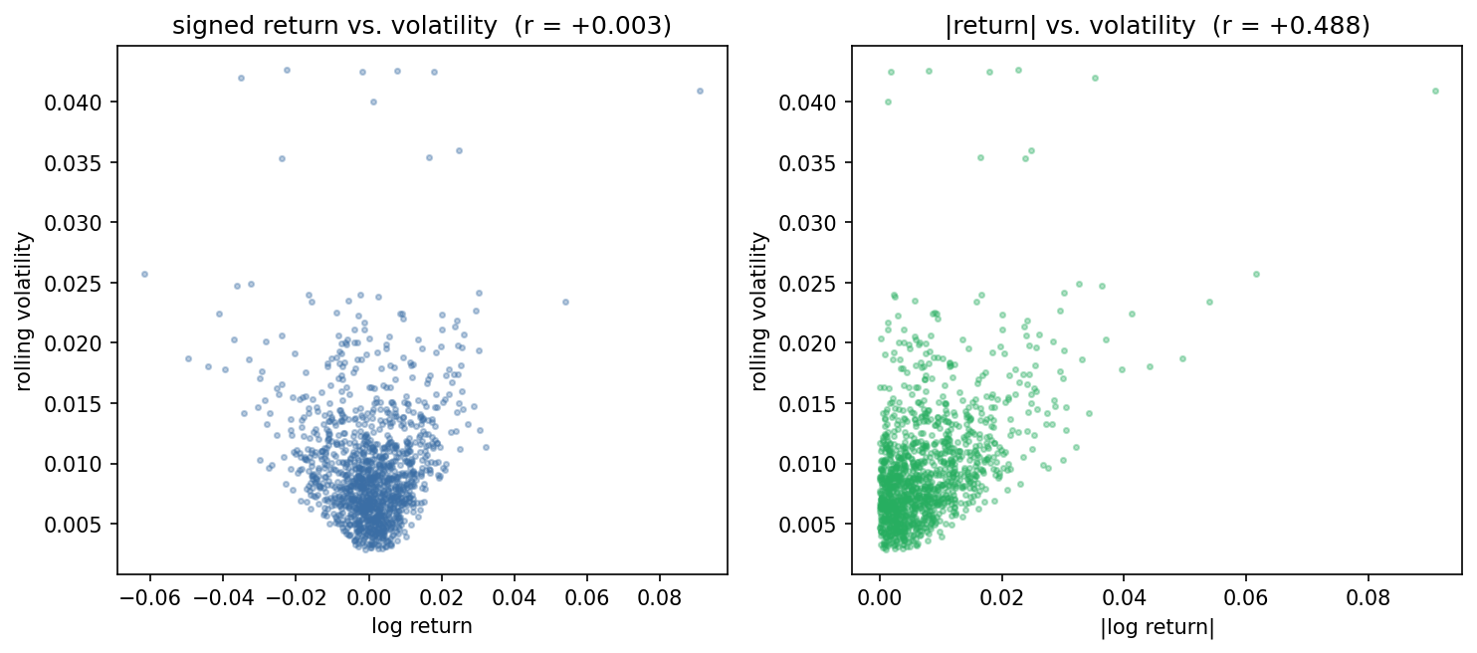
PHASE 2
Return and volatility carry different information
+0.003
corr(signed return, volatility) — sign cancels
+0.488
corr(|return|, volatility) — magnitude link
−0.161
corr(return, volatility +10d) — leverage effect
Volatility measures size, not direction.
Up days and down days both raise it, so the sign cancels. Return and volatility each tell us something the other can't.
8

Slide 9

PHASE 3
Fitting the Gaussian HMM
ALGORITHM
Baum-Welch (EM) for fitting, Viterbi for decoding
STATES
n_components = 3 (Bear / Sideways / Bull)
from src.model import fit_best_model
model = GaussianHMM(
n_components=3,
covariance_type="full",
n_iter=1000, tol=1e-4,
random_state=seed,
).fit(train_matrix)
COVARIANCE
covariance_type = “full” — each regime gets its own return–volatility covariance
RANDOM RESTARTS
20 restarts from different seeds; keep the highest training log-likelihood
WHY RESTART?
EM only guarantees a LOCAL optimum — a single fit can land on a non-opitimum solution
Trained on the TRAIN split only — the test period never touches the parameters.
10

Slide 10
PHASE 3 · EVALUATION
Chronological split, not random
A random split would let the model “see the future” during training. Instead, the first ~4 years train the model; the last ~1 year evaluates it on genuinely unseen time.
TRAIN — 993 days · Sep 2021 – Aug 2025
TEST — 250 days
HELD-OUT CHECK — AVERAGE LOG-LIKELIHOOD PER OBSERVATION
+7.51
+7.81
−0.30
train (log-lik / obs)
test (log-lik / obs)
gap (train − test)
The gap is negative — the model fits the unseen test year at least as well as training data. No sign of overfitting to the training window's specific regimes.
11

Slide 11
PHASE 3
Three regimes, decoded across five years
Bull
Sideways
Bear
Mean daily return
+0.068%
Mean daily return
−0.026%
Mean daily return
−0.342%
Mean volatility
0.76%
Mean volatility
1.53%
Mean volatility
3.50%
Expected duration
≈101 days
Expected duration
≈33 days
Expected duration
≈13 days
Share of sample
76.8%
Share of sample
22.0%
Share of sample
1.1%
12

Slide 12

PHASE 4 · INTERACTIVE DASHBOARD
Exploring regimes in Streamlit
MOCKUP — LAYOUT PREVIEW
streamlit run app.py
Loads the saved model
Current regime
As of
Streak (days)
Regimes
Bull
2026-08-31
—
3
Interactive Plotly chart, regime-shaded background
Sidebar date-range filter + train/test split toggle
Live regime statistics table (return, volatility, duration)
Sidebar (not shown): date-range picker, train/test toggle, regime legend, raw-data table.
13

Slide 13


CRITICAL REVIEW
Limitations & future work
Limitations
Future work
Gaussian emissions can't capture skew within a regime
State count fixed at 3, not selected via a BIC/AIC search over k
Labels are sorted post-hoc by mean return — still worth a manual sanity check each run
Five years contains very few true bear markets: Bear is only ≈1% of decoded days, a heavily imbalanced class
Compare 3 vs. 4+ states, or a Student-t emission HMM for heavier tails
Validate the decoded regimes against evidence the model never saw: VIX levels, peak-to-trough drawdown depth, and published bear-market dates
Backtest a simple regime-conditioned trading rule as an economic sanity check
14

Slide 14
CONCLUSION
Three learned regimes recover recognizable
S&P 500 history — with no manual labelling.
76.8%
22.0%
1.1%
16
Bull
Sideways
Bear
regime switches, 5 yrs
Gaussian HMM · hmmlearn · Baum-Welch + Viterbi · chronological evaluation · Streamlit dashboard
Thank you — questions?
Yande · Mardochee · Group 11

Slide 15
Demos

