Slide 1

ZCAS UNIVERSITY · MSC DATA SCIENCE · GROUP 11
Detecting Financial Market Regimes
with Hidden Markov Models
A Gaussian HMM decodes Bull, Bear, and Sideways regimes from five years of
daily S&P 500 (^GSPC) returns and rolling volatility.
Yande · Mardochee

Slide 2
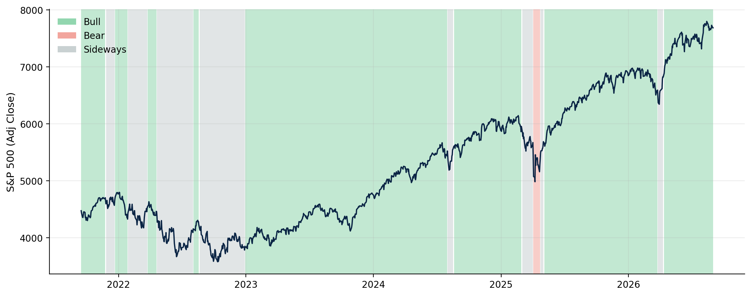

RESEARCH QUESTION
Can a small number of hidden states explain five years
of S&P 500 behaviour?
PREVIEW OF THE DECODED OUTPUT
Model the S&P 500 as switches between a small number of unobserved market regimes
Three regimes recovered without any manual labels — details in the Results section.
Feed the model only two observable signals per day: the log return and a 10-day rolling volatility
Learn regimes and how long they persist directly from data — no manual bull/bear labelling
2

Slide 3
METHOD
Why a Hidden Markov Model?
HIDDEN STATE LAYER
↺
↺
↺
Regimes persist. A HMM's transition matrix models that explicitly — today's regime depends on yesterday's, unlike k-means or GMM clustering on individual days.
Bear
Sideways
Bull
Viterbi decodes the single most likely PATH through time, not just an independent label per day.
Observed each day:
log return & rolling volatility
Each regime is its own 2-D Gaussian over (return, volatility) — the mixture that Task 2.4 already showed fits the data far better than one pooled Gaussian.
3

Slide 4



PHASE 1 · DATA MANAGEMENT
From raw prices to a model-ready matrix
Download
Validate & clean
Log returns
Rolling volatility
Observation matrix
^GSPC via yfinance,
cached with metadata
drop weekends,
no forward-filling
ln(Pₜ / Pₜ₋₁)
10-day standard
deviation of returns
(return, volatility)
per trading day
1,254
1,245
5 yrs
2
raw trading days
rows after feature warm-up
Sep 2021 → Sep 2026
features: return + volatility
4

Slide 5
PHASE 1 · A DECISION WORTH DEFENDING
We never fill in non-trading days
Weekends and holidays are not missing observations — the market is simply closed. Treating them as data would quietly distort the two signals the whole model depends on.
✕ Forward-fill weekends
✓ Drop non-trading days
Invents artificial “flat” return days that never happened
Silently deflates rolling volatility — the model reads the market as calmer than it was
Manufactures fake autocorrelation between adjacent “days”
Every log return in the dataset reflects a real trading session
Rolling volatility is computed only over genuine market activity
The regime the HMM learns is a statement about real trading, not calendar artefacts
5

Slide 6
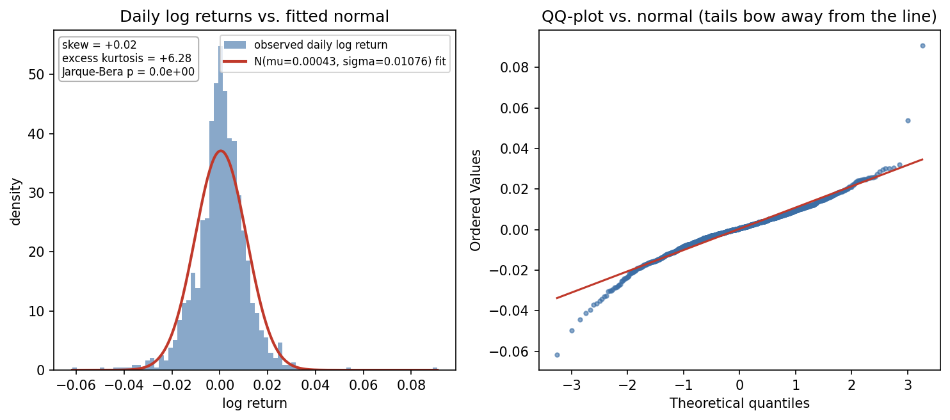
PHASE 2 · TASK 2.1
Daily returns have fat tails, not a bell curve
+6.28
excess kurtosis (0 = normal)
p ≈ 0
Jarque-Bera test rejects normality
+0.02
skewness — close to symmetric
A single Gaussian cannot reproduce these tails. This is the direct motivation for a MIXTURE of regime-conditional Gaussians — the HMM's states — instead of one distribution for all five years.
6

Slide 7
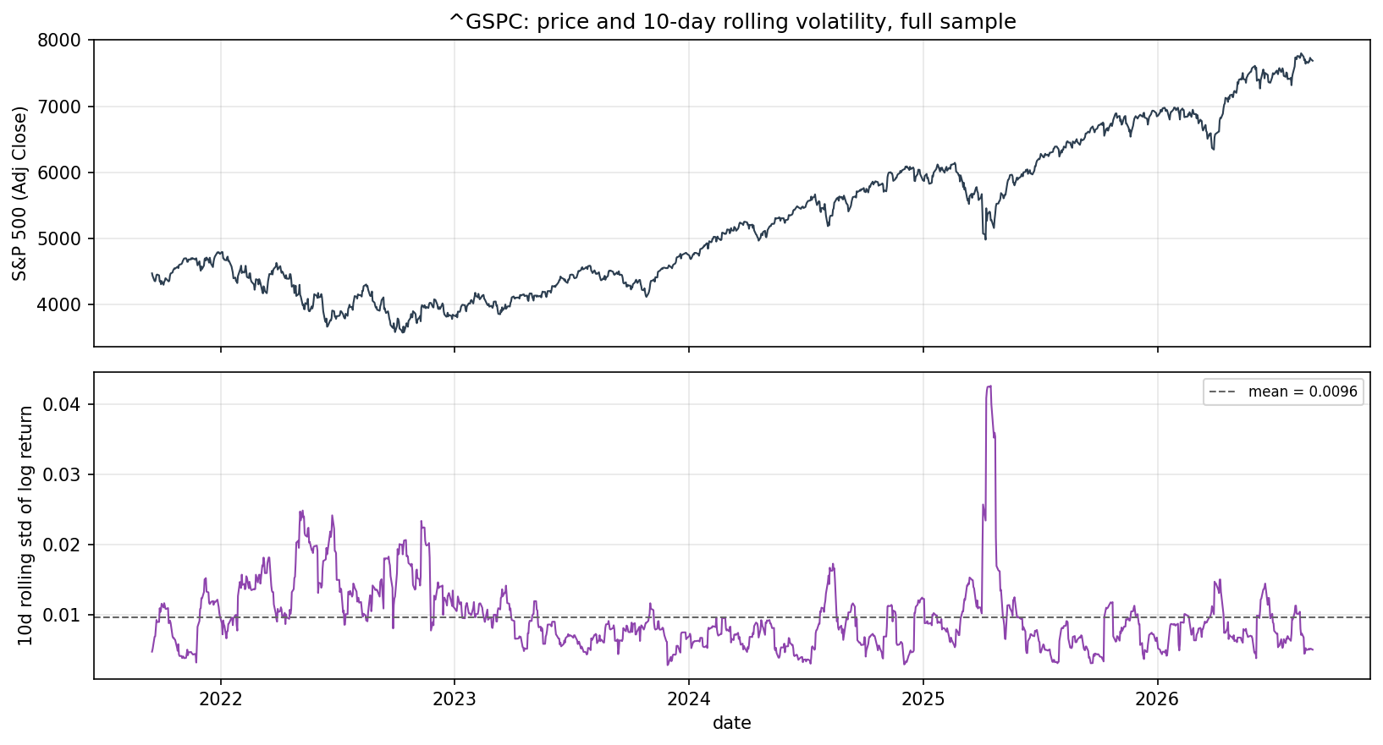
PHASE 2 · TASK 2.2
Volatility clusters in time — it isn't noise
+0.96
lag-1 autocorrelation of volatility
15×
max / min volatility ratio
Calm and turbulent stretches persist for weeks, not single days. That persistence is exactly what a memory-less clustering method would miss — and exactly what the HMM's transition matrix is built to exploit.
7

Slide 8
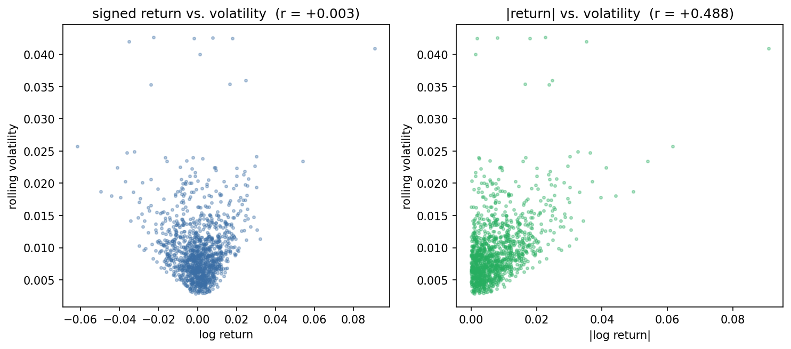
PHASE 2 · TASK 2.3
Return and volatility carry different information
+0.003
corr(signed return, volatility) — sign cancels
+0.488
corr(|return|, volatility) — magnitude link
−0.161
corr(return, volatility +10d) — leverage effect
Near-zero signed correlation but a clear unsigned one: the two features are complementary, not redundant. This justifies feeding the HMM the PAIR (return, volatility), not either alone.
8

Slide 9
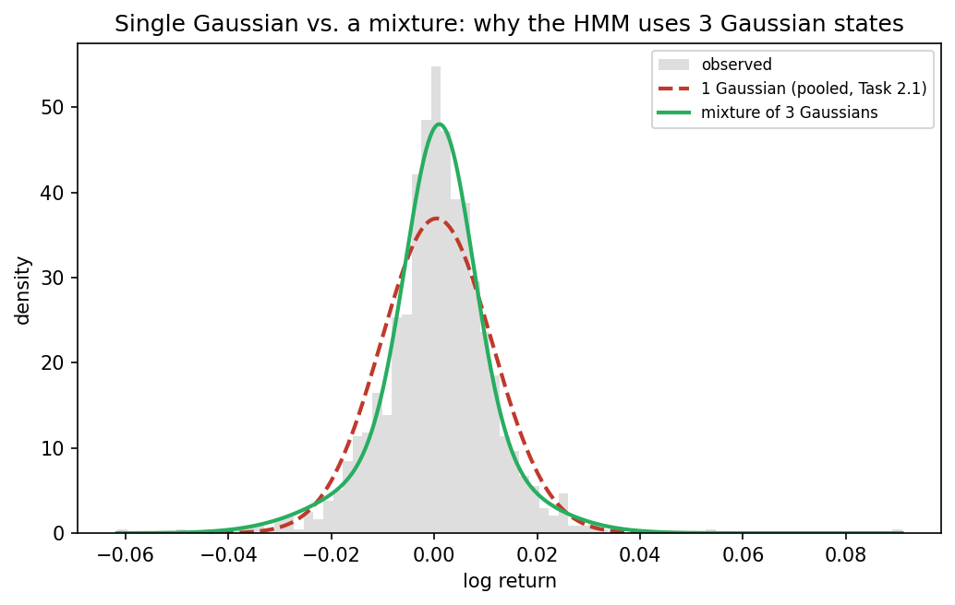
PHASE 2 · TASK 2.4
Why Gaussian, per state
↓ BIC
3-component mixture beats 1 component
DECISION
GaussianHMM(n_components=3, covariance_type=“full”).
A single Gaussian was already rejected (2.1). A mixture of 3 fits the pooled shape far better and each component maps onto an interpretable regime.
9

Slide 10

PHASE 3 · TASK 3.2
Fitting the Gaussian HMM
ALGORITHM
Baum-Welch (EM) for fitting, Viterbi for decoding
STATES
n_components = 3 (Bear / Sideways / Bull)
from src.model import fit_best_model
model = GaussianHMM(
n_components=3,
covariance_type="full",
n_iter=1000, tol=1e-4,
random_state=seed,
).fit(train_matrix)
COVARIANCE
covariance_type = “full” — each regime gets its own return–volatility covariance
RANDOM RESTARTS
20 restarts from different seeds; keep the highest training log-likelihood
WHY RESTART?
EM only guarantees a LOCAL optimum — a single fit can land on a mediocre solution
Trained on the TRAIN split only — the test period never touches the parameters.
10

Slide 11
PHASE 3 · TASKS 3.1 & EVALUATION
Chronological split, not random
A random split would let the model “see the future” during training. Instead the first ~4 years train the model; the last ~1 year evaluates it on genuinely unseen time.
TRAIN — 993 days · Sep 2021 – Aug 2025
TEST — 250 days
HELD-OUT CHECK — AVERAGE LOG-LIKELIHOOD PER OBSERVATION
+7.51
+7.81
−0.30
train (log-lik / obs)
test (log-lik / obs)
gap (train − test)
The gap is negative — the model fits the unseen test year at least as well as training data. No sign of overfitting to the training window's specific regimes.
11

Slide 12
PHASE 3 · TASKS 3.3 & 3.5
Three regimes, decoded across five years
Bull
Sideways
Bear
Mean daily return
+0.068%
Mean daily return
−0.026%
Mean daily return
−0.342%
Mean volatility
0.76%
Mean volatility
1.53%
Mean volatility
3.50%
Expected duration
≈101 days
Expected duration
≈33 days
Expected duration
≈13 days
Share of sample
76.8%
Share of sample
22.0%
Share of sample
1.1%
12

Slide 13

PHASE 4 · INTERACTIVE DASHBOARD
Exploring regimes in Streamlit
MOCKUP — LAYOUT PREVIEW
streamlit run app.py
Loads the saved model — never re-fits on page load
Current regime
As of
Streak (days)
Regimes
Bull
2026-08-31
—
3
Interactive Plotly chart, regime-shaded background
Sidebar date-range filter + train/test split toggle
Live regime statistics table (return, volatility, duration)
Sidebar (not shown): date-range picker, train/test toggle, regime legend, raw-data table.
13

Slide 14


CRITICAL REVIEW
Limitations & future work
Limitations
Future work
Gaussian emissions can't capture skew within a regime
State count fixed at 3, not selected via a BIC/AIC search over k
Labels are sorted post-hoc by mean return — still worth a manual sanity check each run
Five years contains very few true bear markets: Bear is only ≈1% of decoded days, a heavily imbalanced class
Compare 3 vs. 4+ states, or a Student-t emission HMM for heavier tails
Add macro features (VIX, yield-curve spread) to the observation vector
Walk-forward re-fitting instead of one static train/test split
Backtest a simple regime-conditioned trading rule as an economic sanity check
14

Slide 15
CONCLUSION
Three learned regimes recover recognizable
S&P 500 history — with no manual labelling.
76.8%
22.0%
1.1%
16
Bull
Sideways
Bear
regime switches, 5 yrs
Gaussian HMM · hmmlearn · Baum-Welch + Viterbi · chronological evaluation · Streamlit dashboard
Thank you — questions?
Yande · Mardochee · ZCAS University, Group 11

