Slide 1
An Analysis of Three- and Four-Dimensional Lorenz Systems
By joe swartz

Slide 2
Overview
Review
What is Chaos?
Who is Edward Lorenz?
Analysis of the Lorenz System
The Four-Dimensional System
Hyperchaos
Lyapunov exponents
The Modified System
Equilibrium Solutions
Local Stability
Hyperchaotic Behavior
Adaptive Controller
Goals for the future
Questions

Slide 3
Review: Chaos
The idea of chaos originated when Jules Henri Poincaré participated in a contest for the king of Sweden—this contest contained a question that was a generalization of the famous three body problem
“…small differences in the initial conditions produce very great ones in the final phenomena” –Poincaré
Notes:
-The forefather of dynamical chaos was Jules Henri Poincaré, and the idea of chaos started when he entered a contest that was sponsored by the king of Sweden. One of the questions in this contest was a generalization of the famous three body problem and was to show that the solar system as modeled by Newton’s equations is dynamically stable. Poincaré could not get a complete solution because difficulty arose in showing that solutions in terms of invariants converged, but nonetheless his work was so impressive that he won the prize and Weierstrass said that the publication of his work would usher in a new era in the history of celestial mechanics.
-Poincaré described the concept of chaos as “…small differences in the initial conditions produce very great ones in the final phenomena”.
NEXT SLIDE

Slide 4
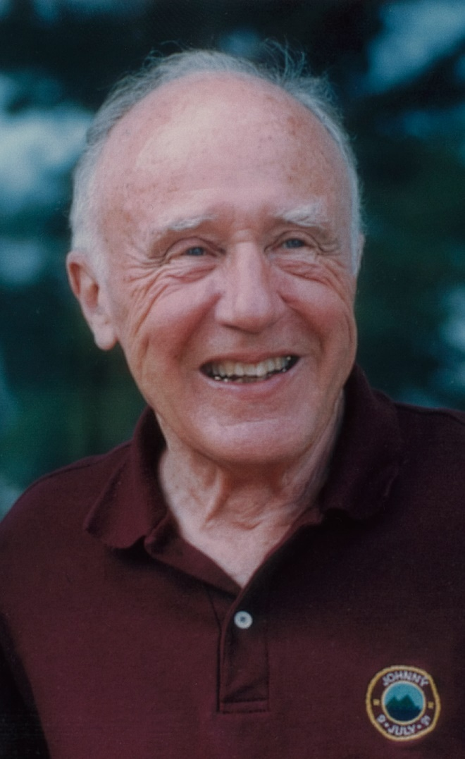
Review: Edward Lorenz
Lorenz graduated from Dartmouth College in 1938 with a bachelor’s in math and went to grad school at Harvard for his master’s
Served in the Army Air Corps as a weather forecaster
When computers came into existence, he sought to combine math and meteorology
https://anticargocultscience.wordpress.com/tag/edward-lorenz/
Notes:
-Edward Lorenz grew up fascinated with the weather and mathematics, and so upon graduating from Dartmouth College in 1938 he planned to go into the field of math. His plans were changed, however, when he got drafted into World War II where he was a weather forecaster in the Army Air Corps. At the conclusion of his service, Lorenz decided to pursue meteorology and published on many topics such as the general circulation of the atmosphere.
-When computers became a thing, Lorenz sought to combine math and meteorology.
NEXT SLIDE

Slide 5

Review: Analysis of the Lorenz System
Lorenz originally had 12 differential equations
Needed to simplify it further, decided to focus on rolling convection
This resulted in a new system of 3 equations
$\frac{dx}{dt}=σ\left(y−x\right)$
$\frac{dy}{dt}=ρx−y−xz$
$\frac{dz}{dt}=xy−βz$
Notes:
-He did this by creating a weather model that originally had 12 differential equations and ran continuous simulations on said equations. One day he wanted to look at a particular sequence a bit closer and so he stopped his model and restarted it using some of the previous output data as initial conditions in order to take a short cut. He went to get some coffee and returned to find that the system was drastically different than the one he first started with
-After that he decided to scale down and focus on rolling convection, and created what is now widely known as the Lorenz System, which you see here:
-This system created what is now commonly known as the Lorenz Attractor—known for its double spiral shape that resembles butterfly wings. This is actually a strange attractor, strange meaning it has a fractal structure
NEXT SLIDE

Slide 6

Definition: Attractor
Chaotic Attractor:
A closed set A is an attractor if it is the smallest set in which A never changes and there is an open set U containing A such that if an initial condition $P∈U$, then the distance from P to A tends to zero as $t→∞$
Notes:
A closed set A is an attractor if A is invariant, there exists an open set U containing A such that if a trajectory P is in U, then the distance from P to A tends to zero as t goes to infinity, and if A is the smallest such set.
NEXT SLIDE

Slide 7
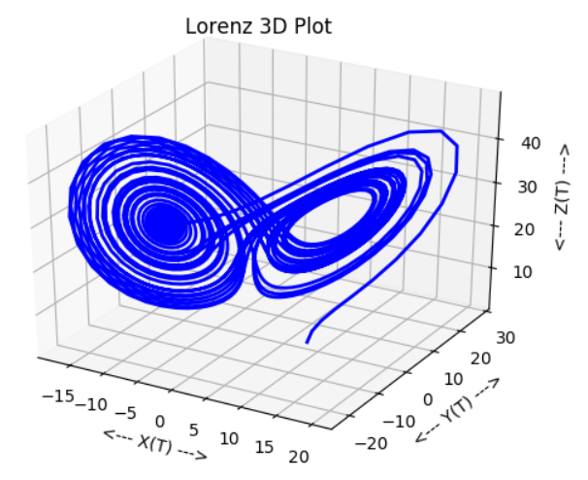

Review: Analysis of the Lorenz System cntd.
$\frac{dx}{dt}=σ\left(y−x\right)$
$\frac{dy}{dt}=ρx−y−xz$
$\frac{dz}{dt}=xy−βz$
x(t) = convective flow, y(t) = horizontal temperature distribution, and z(t) = vertical temperature distribution
$σ$ = ratio of fluid viscosity to thermal conductivity, $ρ$ = difference in temperature between the top and bottom of the system, and $β$ = ratio of width to height of the box that contains the system
Assumption that $σ,ρ,β$ are always positive
https://people.math.osu.edu/yang.2677/Files/Lorenz.html
Notes:
-X corresponds to convective flow, Y corresponds to horizontal temperature distribution, and Z corresponds to the vertical temperature distribution.
-Sigma is the ratio of fluid viscosity to thermal conductivity, Rho is the difference in temperature between the top and bottom of the system, and Beta is the ratio of width to height of the box that contains the system. It is assumed that sigma, rho, and beta are always positive.
NEXT SLIDE

Slide 8

Review: Analysis of the Lorenz System cntd.
For stability at the origin we need $0<ρ<1$
Lyapunov Function to prove global stability
Three conditions must be met:
$L\left(t\right)>0, ∀t>0$
$L\left(t\right)=0, t=0$
$\dot{L}\left(t\right)≤0, ∀t$
$L(t)= \frac{1}{σ}x^{2}+y^{2}+z^{2}$
$\dot{L}(t)=−2\left[{\left(x−\frac{1}{2}\left(1+ρ\right)y\right)}^{2}+\left(1−{\left(\frac{1+ρ}{2}\right)}^{2}\right)y^{2}+βz^{2}\right]$
Notes:
-An important note about the Lorenz System is that even though it is chaotic, it has global stability about the origin. This can be shown using a Lyapunov function that satisfies the Lyapunov stability criterion which are…
NEXT SLIDE

Slide 9

The Four-Dimensional System: Hyperchaos
Found a four-dimensional Lorenz System developed and analyzed by Si Gang-Quan, Cao Hui, and Zhang Yan-Bin
$$\dot{x}=a\left(y−x\right) \\ \dot{y}=cx−xz−y+ew \\ \dot{z}=x^{4}+y^{4}−bz \\ \dot{w}=−dy$$
Exhibits hyperchaos
Hyperchaos differs between chaos by increasing the number of positive Lyapunov Exponents
Notes:
-Time for the new and juicy stuff.
-To continue research on chaos theory, I stumbled upon a paper by the following authors in which they developed a four dimensional Lorenz System in order to study hyperchaos.
-Surely you’re wondering “what’s the difference between hyperchaos and normal chaos?” Well, “normal” chaos occurs only when a system has one positive Lyapunov exponent. When a dynamical system goes on to have 2 or more positive Lyapunov exponents, it then becomes possible to have hyperchaotic behavior. But there are other conditions that need met in order to have hyperchaos…
NEXT SLIDE

Slide 10
The Four-Dimensional System: Hyperchaos cntd.
Necessary conditions for hyperchaos:
The system should have a dissipative structure
The smallest dimension of the system should be at least four
The number of terms giving rise to instability should be more than one
Notes:
-These other conditions are as such: (read from slide)
-Dissipative structure basically means that the system has points that wander around and never return to a previous state
-The terms giving rise to instability are called Lyapunov exponents
NEXT SLIDE

Slide 11

The Four-Dimensional System: Lyapunov Exponents
Lyapunov exponents characterize the rate of separation of infinitesimally close trajectories
$λ_{max}=\lim_{t→∞}{\lim_{{δZ}_{0}→0}{\frac{1}{t}ln\frac{\left|δZ(t)\right|}{\left|{δZ}_{0}\right|}}}$
The limit ${δZ}_{0}→0$ ensures the validity of the linear approximation at any time
Notes:
-Lyapunov exponents are quantities that characterize the rate of separation of infinitesimally close trajectories
-CONSULT NOTES FOR THE DEFINITION
-The definition basically means that if you keep the trajectories close to each other for all time and they asymptotically stay together, then it the maximum Lyapunov exponent must be that lambda value because it determined the end behavior
-Other than MLEs, there is the idea of the Lyapunov spectrum which uses localized Jacobian matrices to give information on the fractal dimension of an attractor.
NEXT SLIDE

Slide 12

The Modified System: Equilibrium Solutions
The modified system I analyzed is:
$$\dot{x}=σ\left(y−x\right) \\ \dot{y}=ρx−xz−y+ew \\ \dot{z}=x^{2}+y^{2}−βz \\ \dot{w}=−dy$$
The only equilibrium solution is the origin, $(0,0,0,0)$
Notes:
-To modify the system I used to learn about hyperchaos, I changed the exponents around and found that even powers such as 2 and 6 had the same behavior as the 4th degree one, but odd powered equations made the system do some really whacky stuff and so I couldn’t draw any conclusions.
-Anyways I decided to stick with the power of 2. Solving the system you get that the only equilibrium solution is at the origin
NEXT SLIDE

Slide 13

The Modified System: Local Stability
Use the Jacobian to obtain the characteristic equation:
$$(λ+β)(λ^{3}+\left(σ+1\right)λ^{2}+\left(de−ρσ+σ\right)λ+deσ=0$$
Use the Routh-Hurwitz conditions for stability and obtain the conditions:
$σ,β,de>0$
$ρ<1+\frac{de}{σ^{2}+σ}$
Notes:
It is hard to talk about global stability with four dimensions, and so local stability is often what is analyzed. To do this we take the Jacobian of our system and find the characteristic equation. What’s neat is at the end you can factor out the (Lambda + Beta) term and so as long as we keep that positive, we can use the Routh-Hurtwitz stability criterion for a polynomial of degree 3, which is less confusing that the criterion for degree 4.
After satisfying the criterion, we get these necessary conditions for local stability about the origin:
NEXT SLIDE

Slide 14
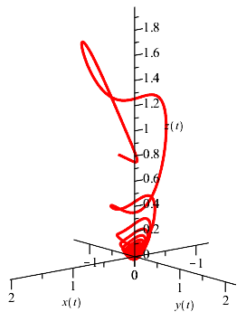
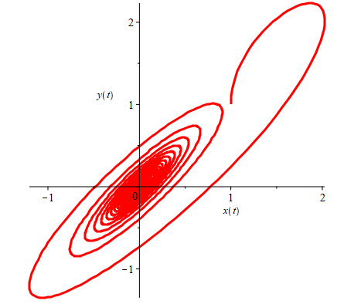
The Modified System: Local Stability cntd.
Notes:
-The result is as you see here. On the left is a space curve in the X-Y-Z coordinate system showing that solution curves tend toward the origin.
-On the right is a phase portrait in the X-Y plane showing a 2D perspective (phase portrait shows characteristics of ODEs by plotting solution curves in a vector field
NEXT SLIDE

Slide 15
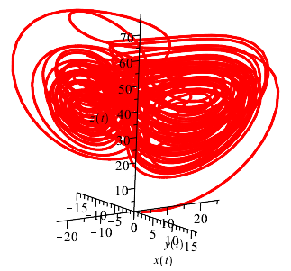
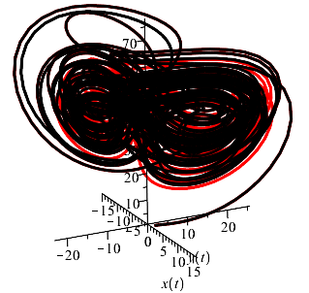
The Modified System: Hyperchaotic Behavior
Notes:
-Stability is boring though, so let’s look at what hyperchaotic behavior looks like. Not so nice is it?
-It looks all jumbly because we now have 2 positive Lyapunov exponents and so trajectories have a lot more speed and direction change.
-On the left, I plotted 2 trajectories, one with the initial condition of (1,1,1,1) and the other with the initial condition varying only by adding 1x10^-10 to each initial condition. After only 50 units the trajectories begin separating as you can see here.
NEXT SLIDE

Slide 16

The Modified System: Adaptive Controller
Adaptive controllers became popular when aircraft began needing better automatic control
Use real-time input to adjust control parameters
System controller:
$u\left(t\right)=\left[\begin{matrix}u_{1} \\ u_{2} \\ u_{3} \\ u_{4}\end{matrix}\right]$
Adaptive parameters:
$k=\left[\begin{matrix}k_{1} \\ k_{2} \\ k_{3} \\ k_{4}\end{matrix}\right]$
Notes:
-Another really cool concept is the idea of an adaptive controller for dynamical systems. The paper I studied implemented one for their system and so I thought why not do the same?
-Adaptive controllers became popular when aircraft gained the need for better automatic control. These are better than the conventional controllers because the adaptive controllers use realtime input to adjust control parameters, thus keeping good control of the system over time.
-Explain the controller and parameters.
NEXT SLIDE

Slide 17

The Modified System: Adaptive Controller cntd.
Updated system:
$$\dot{x}=σ\left(y−x\right)+u_{1} \\ \dot{y}=ρx−xz−y+ew+u_{2} \\ \dot{z}=x^{2}+y^{2}−βz+u_{3} \\ \dot{w}=−dy+u_{4}$$
With adaptive parameters defined as:
$$u_{1}=k_{1}x \\ u_{2}=xz+k_{2}y \\ u_{3}=−(x^{2}+y^{2})+k_{3}z \\ u_{4}=k_{4}w$$
Using $α>0$ as a constant that controls speed of convergence, adaptive laws are defined as:
$${\dot{k}}_{1}=−αx^{2} \\ {\dot{k}}_{2}=−αy^{2} \\ {\dot{k}}_{3}=−αz^{2} \\ {\dot{k}}_{4}=−αw^{2}$$
Notes:
-So to add the controller we simply slap it on the end of the system. Then we need to define adaptive parameters, which if chosen nicely will result in the cancellation of a lot of messy terms, and they are:
-The adaptive parameters then need adaptive laws which are basically your real-time input. These are defined using a positive constant alpha that allows for control of the speed of convergence of the system.
-Next stop would naturally be to graph the system and see if the controller works, but I could not figure out how to graph it due to part of the system using output from the other parts, and so I just did a stability analysis. The idea of a controller is to “control” the system, and so it should be globally stable about the origin.
NEXT SLIDE

Slide 18

The Modified System: Adaptive Controller cntd.
Three conditions must be met for Lyapunov stability:
$L\left(t\right)>0, ∀t>0$
$L\left(t\right)=0, t=0$
$\dot{L}\left(t\right)≤0, ∀t$
Notes:
-Quick reminder on what the Lyapunov stability criterion are:
NEXT SLIDE

Slide 19

The Modified System: Adaptive Controller cntd.
Use Lyapunov function to prove global stability about origin, thus showing the controller works
Let $L\left(t\right)=\frac{1}{2}\left(x^{2}+y^{2}+z^{2}+w^{2}\right)+$ $\frac{1}{2α}\left[{(k_{1}−σ+λ)}^{2}+{(k_{2}−1+λ)}^{2}+{(k_{3}−β+λ)}^{2}+{(k_{4}+λ)}^{2}\right]$
Here $λ>0$ is a constant
$\dot{L}\left(t\right)=x\dot{x}+y\dot{y}+z\dot{z}+w\dot{w}+\frac{1}{α}\left[\left(k_{1}−σ+λ\right){\dot{k}}_{1}+\left(k_{2}−1+λ\right){\dot{k}}_{2}+ \left(k_{3}−β+λ\right){\dot{k}}_{3}+(k_{4}+λ){\dot{k}}_{4}\right]$
Notes:
-Coming up with Lyapunov functions that work is a really hard guessing game, and so since my system is similar to the paper’s that I studied, I modified theirs to work for mine. This results in a Lyapunov function of:
-Here we are using Lambda as a positive constant
-Next step is to take the derivative like normal, and then ensues a messy and tedious job of substituting in our system and the adaptive controller’s parameters and laws.
NEXT SLIDE

Slide 20

The Modified System: Adaptive Controller cntd.
$\dot{L}\left(t\right)=−\left[λx^{2}+\left(σ+ρ\right)xy+λy^{2}+\left(d−e\right)yw+λz^{2}+λw^{2}\right]$
$=−\left[\begin{matrix}x & y & z & w\end{matrix}\right]∙\left[\begin{matrix}λ & −\left(σ+ρ\right) & 0 & 0 \\ 0 & λ & 0 & \left(d−e\right) \\ 0 & 0 & λ & 0 \\ 0 & 0 & 0 & λ\end{matrix}\right]∙\left[\begin{matrix}x \\ y \\ z \\ w\end{matrix}\right]$
Let $A=\left[\begin{matrix}x \\ y \\ z \\ w\end{matrix}\right]$ and $B=\left[\begin{matrix}λ & −\left(σ+ρ\right) & 0 & 0 \\ 0 & λ & 0 & \left(d−e\right) \\ 0 & 0 & λ & 0 \\ 0 & 0 & 0 & λ\end{matrix}\right]$
Notes:
-In the end we get some nice cancellation and the result is the top equation. If you think of factoring out terms in terms of matrix multiplication, we can rewrite this function in terms of matrices.
NEXT SLIDE

Slide 21

The Modified System: Adaptive Controller cntd.
Then $\dot{L}\left(t\right)=−A^{T}∙B∙A$. Thus B is a positive definite matrix, and therefore $\dot{L}(t)≤0$
We now meet all conditions of Lyapunov stability, so the system with the adaptive controller has global stability about the origin
Notes:
-Then we can rewrite the function in terms of the matrices as such. Finding the eigenvalues of B shows that B is a positive definite matrix, and thus we get that the derivative is less than or equal to zero for all t.
-Since a Lyapunov function was found for the adaptive controlled system that satisfies the necessary conditions for stability, it can be said that the controlled system has global stability about the origin and so the controller is conjectured to work as intended.
NEXT SLIDE

Slide 22
Goals for the Future
Develop a software package/application for a means to calculate Lyapunov exponents for any system
Notes:
-I unexpectedly here at the end became intrigued by Lyapunov exponents, and it blew my mind that you cannot readily find software to calculate them. So if I continue this project in the future, I intend to develop a software package and/or application to include with it so that people can find the Lyapunov exponents of their system and further be able to prove things about them.
NEXT SLIDE

Slide 23
Questions?

