Slide 1
Calculus assistant: applied nlp
By Joe swartz

Slide 2
Overview
Background
  Machine translation
  Evolution through the years
NLP Applications
  Speech recognition
  Analyzing grammar
My Application
  Live Demo
  How it works
  Difficulties
Future Development
  Mobile application

Slide 3
Background: machine translation
Machine Translation: going, by algorithm, from source text to useful target text without recourse to human translation or editing
First patent was in 1933 from Peter Troyanskii
Used in the Cold War to translate Russian to English
Notes:
-One of the first patents for machine translation came about in 1933 from a man named Peter Troyanskii and was for a machine used for selection and printing of words when translating from one language to another. This got ditched by the USSR and the idea of machine translation didn’t really make a comeback until the 1950s
-IBM’s 701 computer translated 60 Russian sentences into English for the first time in history. With the Cold War right around the corner, a surge in machine translation research occurred.
NEXT SLIDE

Slide 4
Background: evolution through the years
Linguistic research during the 1950s and the next decade or so focused on syntax
Those opposed to syntax opted for focusing on semantics
Semantic categories:
  Agent, Object, Action, Location
Semantic case frame
  Collections of facts that specify characteristic features, attributes, and functions of a denotatum, and its characteristic interactions with the things necessarily or typically associated with it
  Ex) Joe took the pizza from the box
Notes:
-Linguistic research in the 1950s and next decade or so was focused on syntax. This was due to syntactic parsing being necessary and the vast majority of researchers believed that syntax parsing was the way to go since it could allow the use of ambiguous words so that output could be correctly determined via the context of the target text.
Those who thought that semantics were more important, adopted semantically-driven processing, or semantic parsing—the process of mapping a natural-language sentence into a formal representation of its meaning; this made use of semantic categories and semantic case frames.
There are four semantic categories, and they are:
-Agent: words that refer to animate beings
-Object: inanimate objects
-Action: action words or verbs
-Location: notion of place; where an object is or moves to, or where an action takes place
Semantic case frames are collections of facts that specify “characteristic features, attributes, and functions of a denotatum (actually existing object), and its characteristic interactions with the things necessarily or typically associated with it”—in short, case frames allow one to determine meaning by examining words that generally surround a trigger word.
EXAMPLE
NEXT SLIDE

Slide 5
Background: evolution through the years cntd.
In 1966 the Automatic Language Processing Advisory Committee deemed that the progress of NLP had slowed down too much
  Cut funding and almost brought research to halt
To get away from machine translation, researchers switched focus to artificial intelligence
Notes:
-Research was almost brought to a halt when, in 1966, the Automatic Language Processing Advisory Committee deemed that the progress of NLP had slowed down enough to no longer be worth the funding.
-However, some researchers continued their work and switched their focus to artificial intelligence. This changed the perspective to world knowledge and NLP’s role in the construction and manipulation of meaning representations.
NEXT SLIDE

Slide 6
Background: evolution through the years cntd.
As computers got more powerful, work with A.I. became more feasible as did work with semantics and computational linguistics
  Lexicalist approach to grammar
NLP experienced massive growth with the advent of the World Wide Web in the early 1990s
Resulted in statistical language processing
  Probabilistic parsing
  Hidden Markov Models
Notes:
-As computers got more and more powerful, A.I. became more feasible to work with as did work on semantics and computational linguistics. An aspect of the work on semantics is the Lexicalist approach to grammar.
-Lexicalists study lexical chunks, which are pairs or groups of words commonly found together. These are useful because they tend to follow grammar rules.
-The surge of computer power paired with the advent of the World Wide Web in the early 1990s sparked immense progress within NLP because the sudden flood of information prompted the need to be able to analyze the data and at the same time provided a plethora of data for research. A result of this was statistical language processing.
-Probabilistic parsing is defining a probability distribution using weighted parsing which is attaching a weight to a parse and subparse. Higher weights correlate to a greater confidence of a given parse being correct.
-A Hidden Markov Model is a statistical Markov model in which the system being modeled is assumed to be a Markov process with unobserved or hidden states. The state changes within the model are invisible but the output isn’t, and so since the output is dependent on the states, weights are assigned to outputs.
NEXT SLIDE

Slide 7
Background: achievements
1957: Noam Chomsky published “Syntactic Structures” and created Phrase-Structure grammar
1958: John McCarthy released LISP (Locator/Identifier Separation Protocol)
1961: BASEBALL question answering system could take punch card input and answer questions about baseball games
1964: ELIZA, one of the first chatbots ever created, successfully impersonated a psychiatrist
1970: SHRDLU could take input like “put the blue cube on top of the red cube” and performed the action in the real world
1982: Jabberwacky, a chatbot designed to humorously mimic human speech
2011: IBM’s Watson won a game of Jeopardy against some of the best players of all time
Notes:
NEXT SLIDE

Slide 8
NLP APPLICATIONS: SPEECH RECOGNITION
Current speech recognition programs fall into two categories: small-vocabulary/many-users and large-vocabulary/limited-users
Small-vocabulary/many-user systems are ideal for automated phone answering and similar applications
Large-vocabulary/limited-user systems are ideal for business environments where the system is tailored to a small number of users
Notes:
-Current speech recognition programs fall into two categories: small-vocabulary/many-users and large-vocabulary/limited-users. Small-vocabulary/many-user systems are ideal for automated phone answering where users need to be able to speak with varying accent and speech patterns. Due to the nature of needing to work with a wide variety of inputs, the usage is limited to predetermined commands and inputs and thus not many use cases.
-Large-vocabulary/limited-user systems are ideal for business environments where the system learns from and is tailored to the use of a small number of users. These systems are able to support massive vocabularies but adding untrained users results in a loss of accuracy.
NEXT SLIDE

Slide 9
NLP APPLICATIONS: SPEECH RECOGNITION cntd.
How does it work?
  Microphone captures sound
  Analog-to-digital converter converts the sound to digital data
  Data is cleaned and then divided into chunks that are considered phenomes
  Hidden Markov Model (HMM) maps vectors to phenomes
    These vectors are comprised of cepstral coefficients
  The HMM then statistically determines what was said
Notes:
-When one speaks, vibrations are sent through the air. Speech recognition software utilizes a microphone to capture the sound and then an analog-to-digital converter to convert it into digital data. The ADC samples (or digitalizes) sound by taking precise measurements of the soundwave at frequent intervals, filters out unwanted noise, and then normalizes the sound so that it is easier analyzed.
-After the sound is collected and cleaned up, the signal is divided into chunks roughly 10-20 milliseconds in length. These chunks are then matched against known phenomes of the language in use—a phenome being the smallest unit of language. From here the two dominant means of choosing the most likely said speech are Hidden markov models and neural networks, but the HMMs are the most common.
-The application of an HMM involves mapping vectors to phenomes; these vectors are comprised of real numbers known as cepstral coefficients. These are found by taking the inverse Fourier transform of the logarithm of the power spectrum of the respective phenome. The dimension of these vectors is generally kept small (about 10) but accurate systems can use dimensions of 32 or more. The HMM then uses these vectors to statistically determine what was said.
NEXT SLIDE

Slide 10
NLP APPLICATIONS: analyzing grammar
Part of speech (POS) tagging is a necessary step in being able to determine the grammatical structure of a sentence
After POS tags are assigned, they get organized into chunks—textual units of adjacent POS tags
To achieve correct chunk structure, the sentence needs parsed
Notes:
-Part of speech tagging is a necessary step in being able to determine the grammatical structure of a sentence. POS tags are parts of speech including but not limited to: verbs, adverbs, nouns, pronouns, prepositions, and adjectives.
-These are then organized into chunks or textual units of adjacent POS tags. To achieve the correct chunk structure, the sentence first needs parsed.
NEXT SLIDE

Slide 11
NLP APPLICATIONS: analyzing grammar cntd.
Two methods of parsing: Top-down and Bottom-up. Bottom-up is the most popular
Take a sentence, combine the words into chunks, keep combining chunks until a sentence structure is obtained
Notes:
-There are two methods by which one can parse sentences and they are Top-down and Bottom-up parsing.
-The more used method is Bottom-up parsing, and this is the process in which a parser takes an input sentence, combines the words into chunks, and then combines the chunks until a sentence structure is obtained.
NEXT SLIDE

Slide 12
NLP APPLICATIONS: analyzing grammar cntd.
Chunk Types | Description | Example
NC | Noun Chunk | a young boy, the girls
VC | Verb Chunk | is playing, goes, went
AC | Adjective Chunk | more beautiful, younger, old
RC | Adverb Chunk | usually, quickly
PTC | Particle Chunk | up, down
PPC | Prepositional Chunk | at, on, in, under
COC | Conjunction Chunk | and, or, but
QC | Question Chunk | Where, Who, When
INFC | Infinitive Chunk | to
TC | Time Chunk | tomorrow, yesterday
Notes:
-This here is a table of common chunk types… explain
PROVIDE EXAMPLE FROM NOTES
Then SWITCH OVER TO LIVE DEMO OF SYSTEM
“Now on to my application. To start things off I will do a live demo…”
NEXT SLIDE

Slide 13
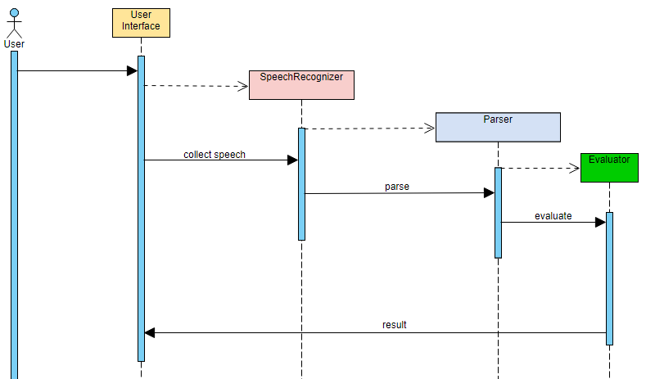
My application: how it works
Notes:
-Explain then move on to the next slide

Slide 14
My application: difficulties
Development Environment
Named-Entity Recognition
Parsing
Evaluator
Notes:
-Time to vent.
-When finished with the evaluator bloopers, go to next slide.

Slide 15
Future development
Research a different evaluator
Complete the generalization of parser to support up to multivariable calculus expressions
Research how to deploy for conversion to mobile app

Slide 16
Questions?

