Slide 1
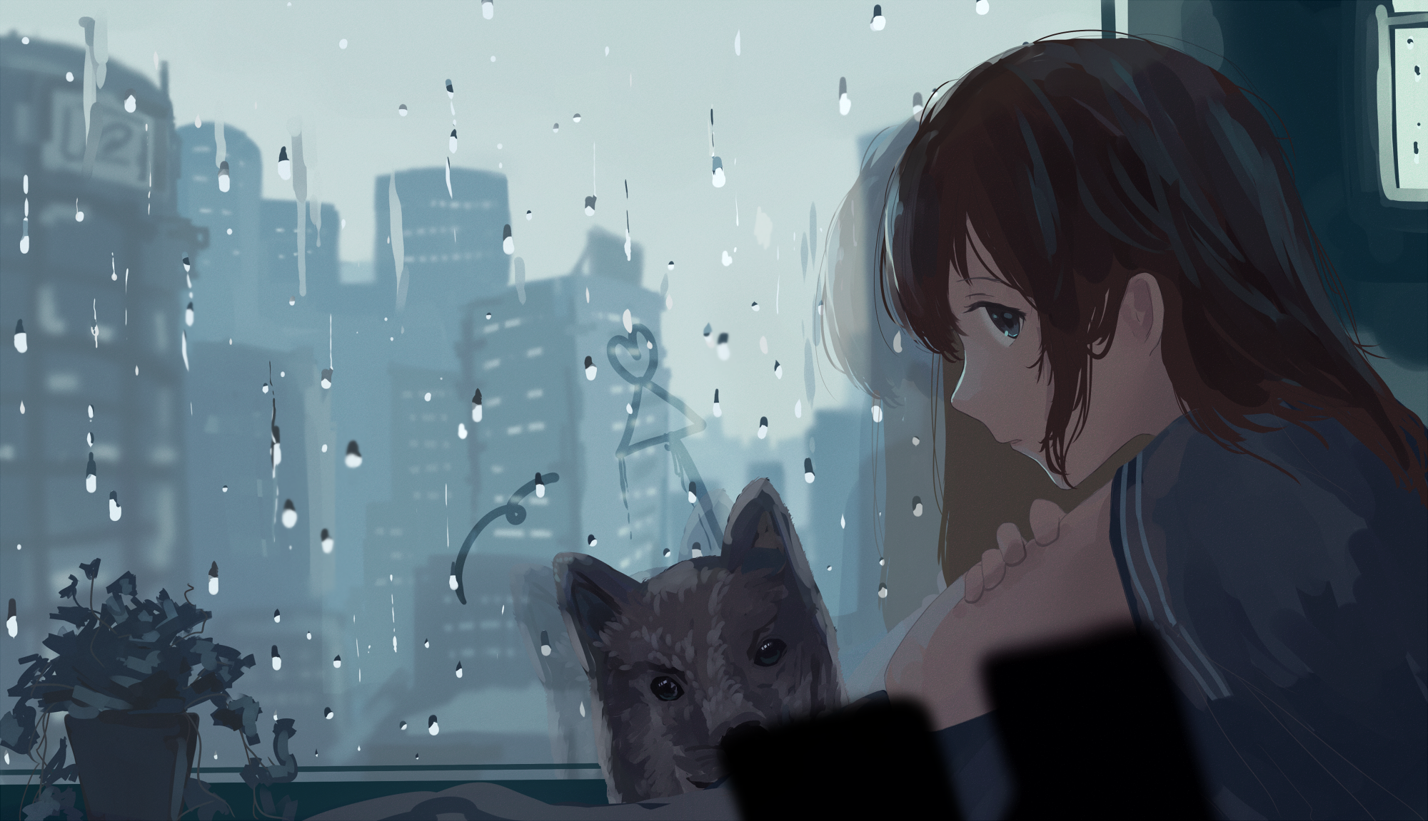
Anime™
Presented by Bajcsi Elias-Robert

Slide 2
What is Anime?

Slide 3
Importance of Anime

Slide 4
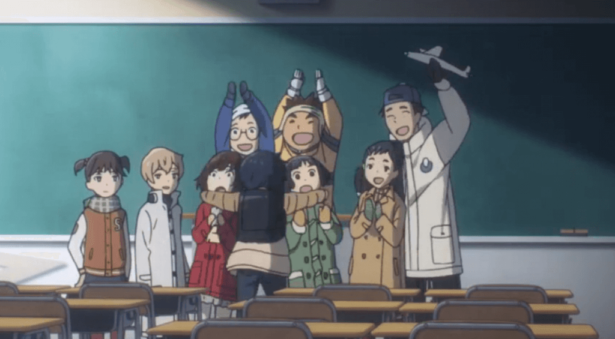
Importance of Anime:
Entertainment and Psychological Health

Slide 5
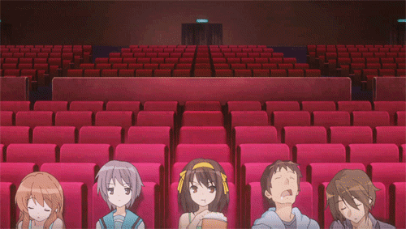
Importance of Anime:
The Movie Industry

Slide 6
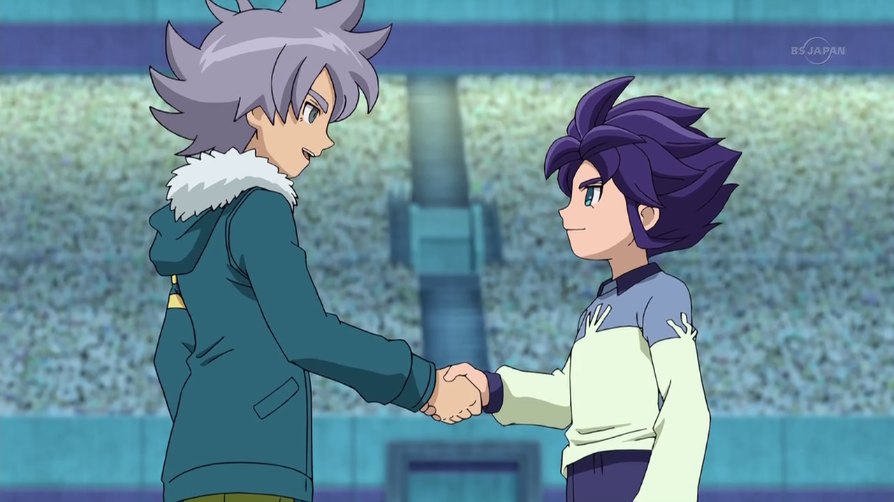

Importance of Anime:
Peace and Economy

Slide 7
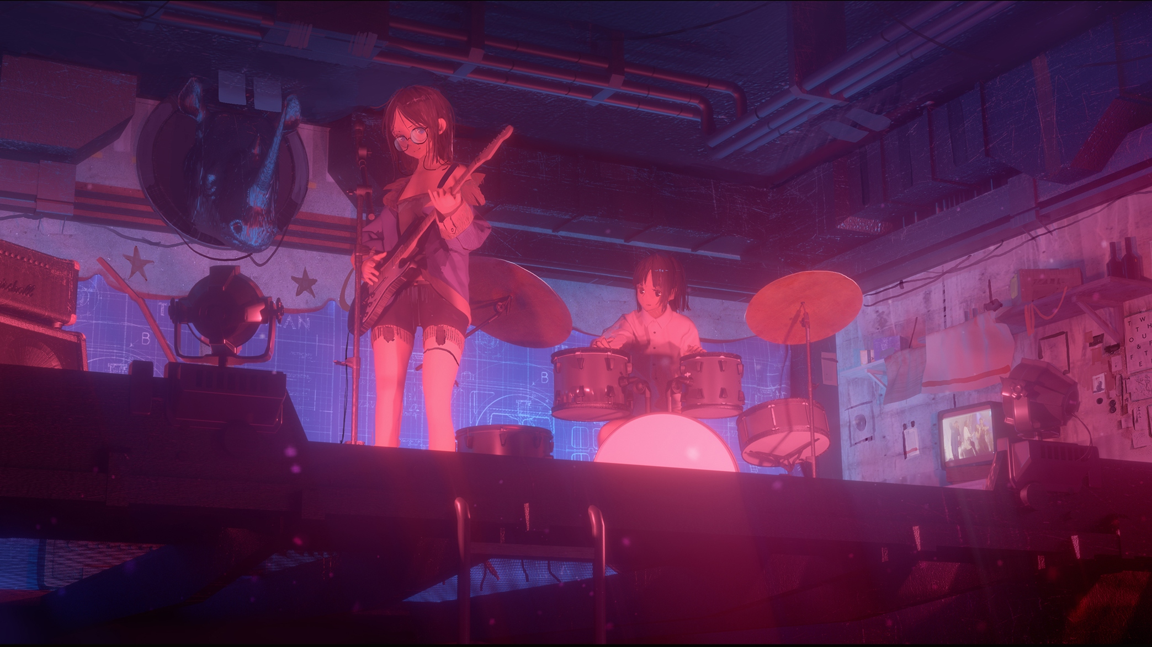
Importance of Anime:
Music Industry

Slide 8
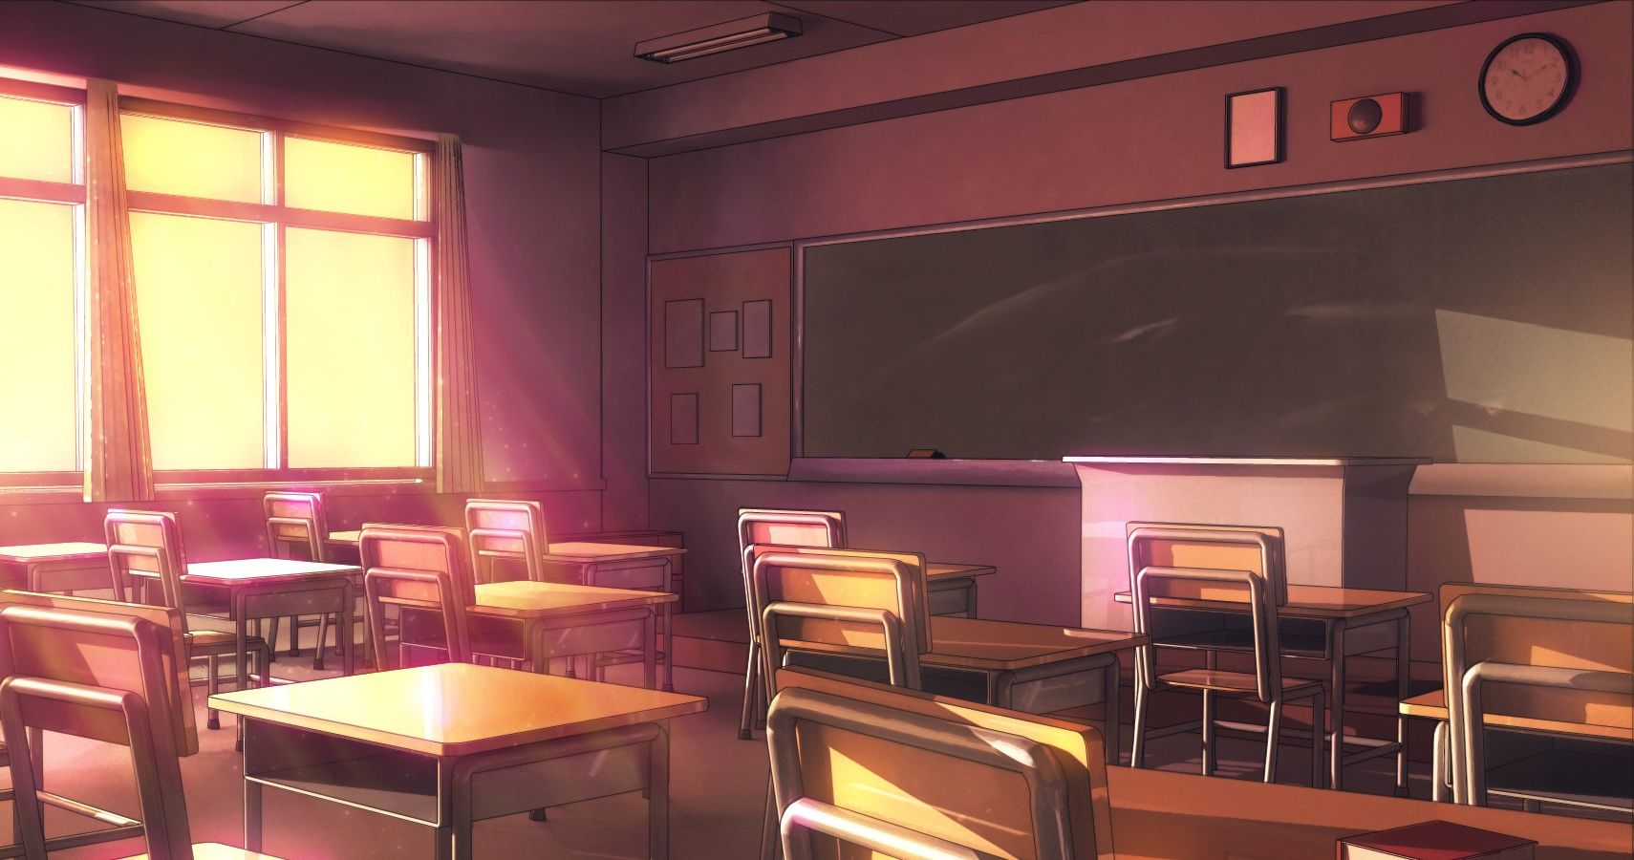
Importance of Anime:
Education

Slide 9


Thank you for your time!
お時間をいただきありがとうございます!
O jikan o itadaki arigatōgozaimasu!
The entire project presentation and resources are available as an archived git repository available on github:
https://github.com/TheRealOne78/anime_school_presentation 
Epic anime worth mentioning:
Suzumiya Haruhi no Yûutsu - The Melancholy of Haruhi Suzumiya
Darin in za Furankisu - DARLING in the FRANXX
Sakura-sou no Pet na Kanojo - The Pet Girl of Sakurasou
Toradora!
Hitsugi no Chaika - Chaika -The Coffin Princess-
HELLO WORLD

