Slide 1
Worksheet for Kids
Architecture and development journey
Worksheet for kids project team
React • Spring Boot • PostgreSQL
Notes:
Source: Repository title and my-react/public/img/BearImg.webp
Presenter note: Introduce the project and explain that the presentation follows how a small game became a complete learning platform.

Slide 2
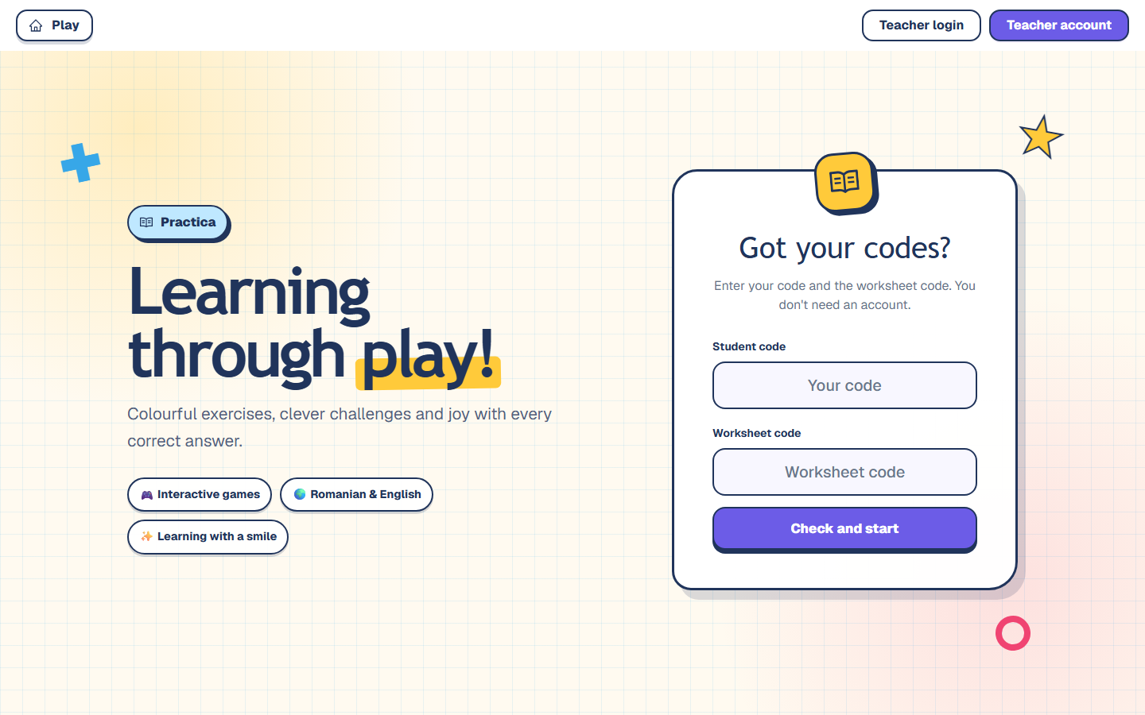
02
The current product
A shared workflow for teachers and children
Teachers compose activities and share a worksheet code.
Children enter two short codes, play the assigned activities, and return results to the class view.
One application connects authoring, play, and progress.
Worksheet for Kids
2
Notes:
Source: Current React application captured from / with mocked session API
Presenter note: Ground the technical story in the product users see today.

Slide 3
03
Development timeline
The architecture grew in response to product needs
07 Sep
14–18 Sep
28 Sep
06 Oct
Initial repository
Backend, auth, Flyway
Frozen revisions
Docker and CI
10 Sep
23–24 Sep
29 Sep
React mini-game
Worksheets and classes
Dynamic assets
Worksheet for Kids
3
Notes:
Source: git log from 2026-09-07 through 2026-10-06
Presenter note: Use the timeline to show that architecture changes followed concrete features rather than appearing all at once.

Slide 4
04
The first prototype
A focused React mini-game proved the interaction model
The starting point
A child-facing activity with colorful feedback, simple controls, and reusable visual assets.
The prototype established the experience. Persistence, ownership, and multi-user workflows came next.
Worksheet for Kids
4
Notes:
Source: Git commit 'Replace project with React minigame' on 2026-09-10 and my-react/public/img/FoxImg.webp
Presenter note: Explain that the project began with interaction design before adding platform infrastructure.

Slide 5
05
From game to platform
Each requirement introduced a durable architectural responsibility
Accounts
Identity and sessions
The codebase stopped being one game and became a learning platform.
Worksheet authoring
Editable drafts and validation
Classes
Membership and teacher ownership
Assignments
Per-user access and revocation
Results
Attempts and historical integrity
Worksheet for Kids
5
Notes:
Source: Repository feature history and current domain packages
Presenter note: Connect product growth to the new backend and database responsibilities.

Slide 6
06
Architecture decision
A modular monolith keeps one deployment while separating domain responsibilities
Spring Boot application
One API
One database
Identity
Classroom
Worksheet
Assignment
Attempt
Catalog
Worksheet for Kids
6
Notes:
Source: backend/src/main/java/com/worksheet package structure
Presenter note: The modules communicate in-process but keep controller, service, repository, and entity boundaries.

Slide 7
07
System topology
The browser reaches one API and one durable data store
PostgreSQL
Flyway schema
Browser
React + Vite
port 5173
Spring Boot API
port 8080
session cookie + CSRF
Asset storage
backend/data
Worksheet for Kids
7
Notes:
Source: docker-compose.yml, vite.config.js, application.properties
Presenter note: In development Vite proxies API requests. A production build can be served by Spring Boot.

Slide 8
08
Roles and authorization
The session identifies the user; services enforce ownership
USER
TEACHER
ADMIN
Join classes
Play assignments
View own attempts
Create worksheets
Manage classes
Review assigned results
Manage account roles
Version the catalog
Activate definitions
401 missing session • 403 wrong role • 404 inaccessible resource
Worksheet for Kids
8
Notes:
Source: SecurityConfig.java and backend authorization matrix
Presenter note: Frontend guards guide navigation. Backend services remain the security boundary.

Slide 9
09
Frontend architecture
Routes and feature components share one session-aware API boundary
React Router
Platform context
Feature pages
API modules
Shared client
App.jsx
PlatformProvider
platform + WorkSheet
api/*.js
credentials + CSRF
Worksheet for Kids
9
Notes:
Source: my-react/src/App.jsx, platform/PlatformContext.jsx, api/client.js
Presenter note: A single client handles credentials, CSRF, structured errors, and expired sessions.

Slide 10
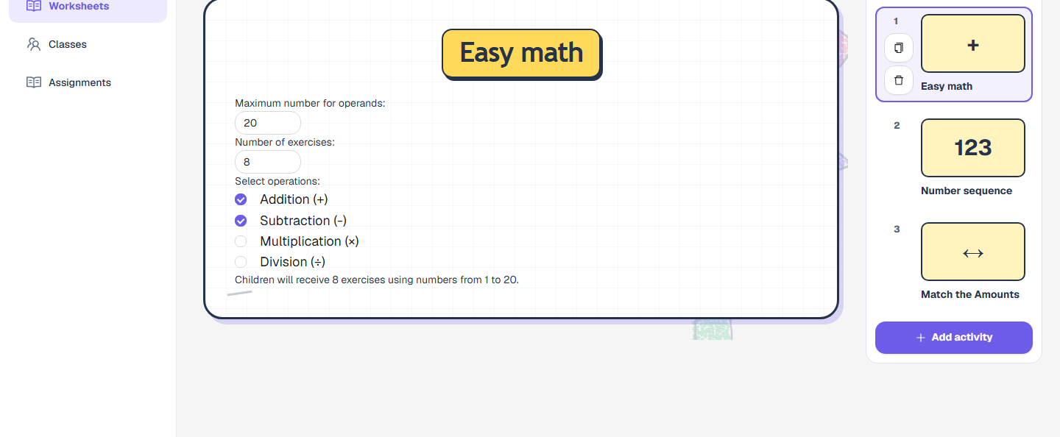
10
Teacher experience
One editor coordinates worksheet metadata, activities, preview, sharing, and saving
Worksheet for Kids
10
Notes:
Source: Current React application captured from /teacher/20 with fabricated API data
Presenter note: Point out the ordered activity rail, editable settings, child preview, and explicit save/share actions.

Slide 11
11
Backend architecture
Each request crosses explicit security, HTTP, domain, and persistence boundaries
Spring Security
session • CORS • CSRF
Controllers
HTTP and DTO mapping
Services
authorization • validation • transactions
Repositories
ownership-scoped persistence queries
PostgreSQL
constraints • indexes • history
Worksheet for Kids
11
Notes:
Source: backend/src/main/java/com/worksheet
Presenter note: Controllers stay thin. Services own the rules. Repositories only query persistence.

Slide 12
12
Dynamic mini-game pipeline
Versioned contracts connect backend validation to frontend behavior
Definition
type + version
Worksheet item
validated config
Frontend
editor + player
Attempt result
validated outcome
Protected image and audio assets
Worksheet for Kids
12
Notes:
Source: MiniGameDefinition, JsonSchemaValidationService, game-model.js, MiniGameAssetService
Presenter note: New game data is dynamic, but each behavior still needs a registered frontend renderer.

Slide 13
13
Worksheet draft and revision
Publishing freezes the content that assignments and attempts use
Editable worksheet draft
Immutable worksheet revision
content hash
name
ordered items
latest configuration
name snapshot
versioned definitions
frozen configuration
Unchanged content reuses the revision. New content creates the next revision.
Worksheet for Kids
13
Notes:
Source: WorksheetRevisionService and V15__create_immutable_worksheet_revisions.sql
Presenter note: This is the key historical integrity decision in the architecture.

Slide 14
14
Assignment lifecycle
A teacher assigns one frozen revision to each selected learner
Teacher
Classroom
Active member
Per-user assignment
Frozen revision
Removing membership records history, revokes active assignments, and preserves completed work.
Worksheet for Kids
14
Notes:
Source: WorksheetAssignmentService, ClassroomService, V10 and V11 migrations
Presenter note: Class assignment creates one assignment row per current member. Future members do not receive old assignments automatically.

Slide 15
15
Attempt lifecycle
The backend controls membership, state, completeness, and total aggregation
COMPLETED
all items complete or skipped
server sums totals
Start
IN_PROGRESS
Idempotent item result updates
ABANDONED
assignment revoked
unfinished work retained
Worksheet for Kids
15
Notes:
Source: WorksheetAttemptService and V16__create_worksheet_attempts.sql
Presenter note: Completed attempts are immutable. Client scores remain schema-validated and bounded before aggregation.

Slide 16
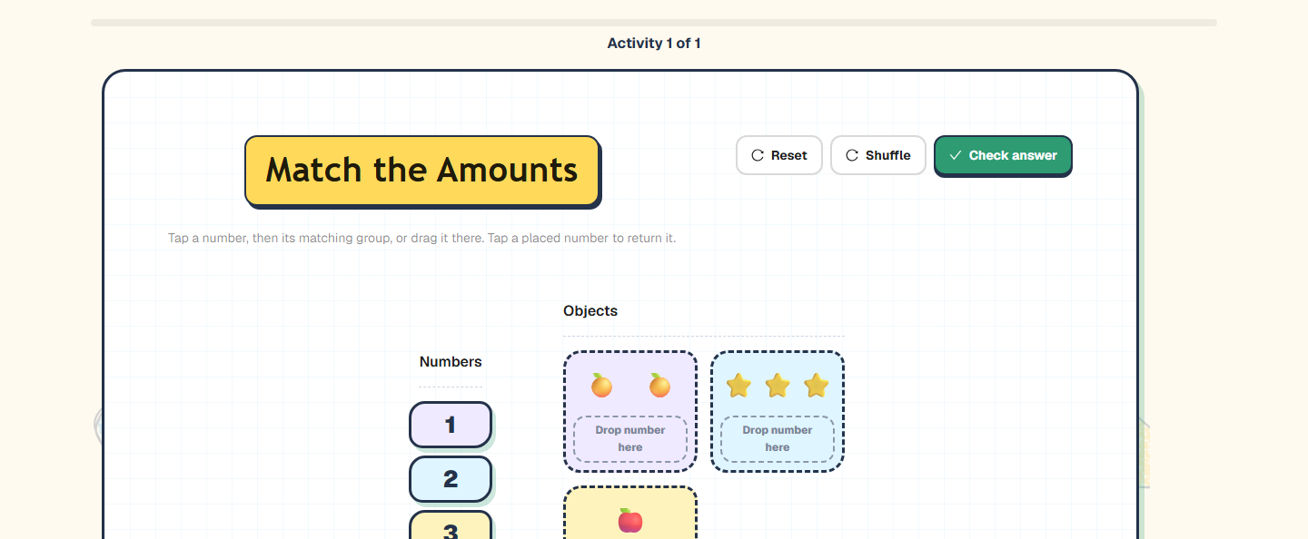
16
Child experience
The frozen revision becomes a focused, progress-aware play session
Worksheet for Kids
16
Notes:
Source: Current React application captured from /attempts/40 with fabricated API data
Presenter note: The player sees one activity at a time while the attempt records per-item outcomes.

Slide 17
17
Database architecture
Parent relationships carry ownership through drafts, revisions, assignments, and attempts
auth_users
worksheet
worksheet_revision
assignment
classroom
worksheet_item
revision_item
attempt
classroom_member
item_result
Worksheet for Kids
17
Notes:
Source: Flyway migrations V8–V21 and JPA entity relationships
Presenter note: Child tables derive access through their parent relationships instead of duplicating user IDs.

Slide 18
18
Docker architecture
Health checks establish the startup sequence for local development
postgres
PostgreSQL 18
backend
Temurin Java 25
frontend
Node 24 + Vite
pg_isready
GET /api/auth/csrf
persistent database
backend/data assets
live source + npm volume
Internal names: postgres:5432 • backend:8080 • frontend:5173
Worksheet for Kids
18
Notes:
Source: docker-compose.yml and service Dockerfiles on origin/main
Presenter note: Compose starts PostgreSQL, then the backend, then the frontend. Bind mounts keep local data and live frontend source.

Slide 19
19
Testing and continuous integration
Each layer checks a different failure mode before merge
Docker + Playwright
PostgreSQL integration
Healthy full stack
Unit tests
Browser workflows
Flyway upgrades
Hibernate schema validation
React model logic
Spring service behavior
Pull requests test the combined branch state, not isolated commits.
Worksheet for Kids
19
Notes:
Source: .github/workflows/ci.yml, backend Testcontainers tests, my-react Playwright tests
Presenter note: The CI pipeline runs frontend and backend checks in parallel before the full stack smoke job.

Slide 20
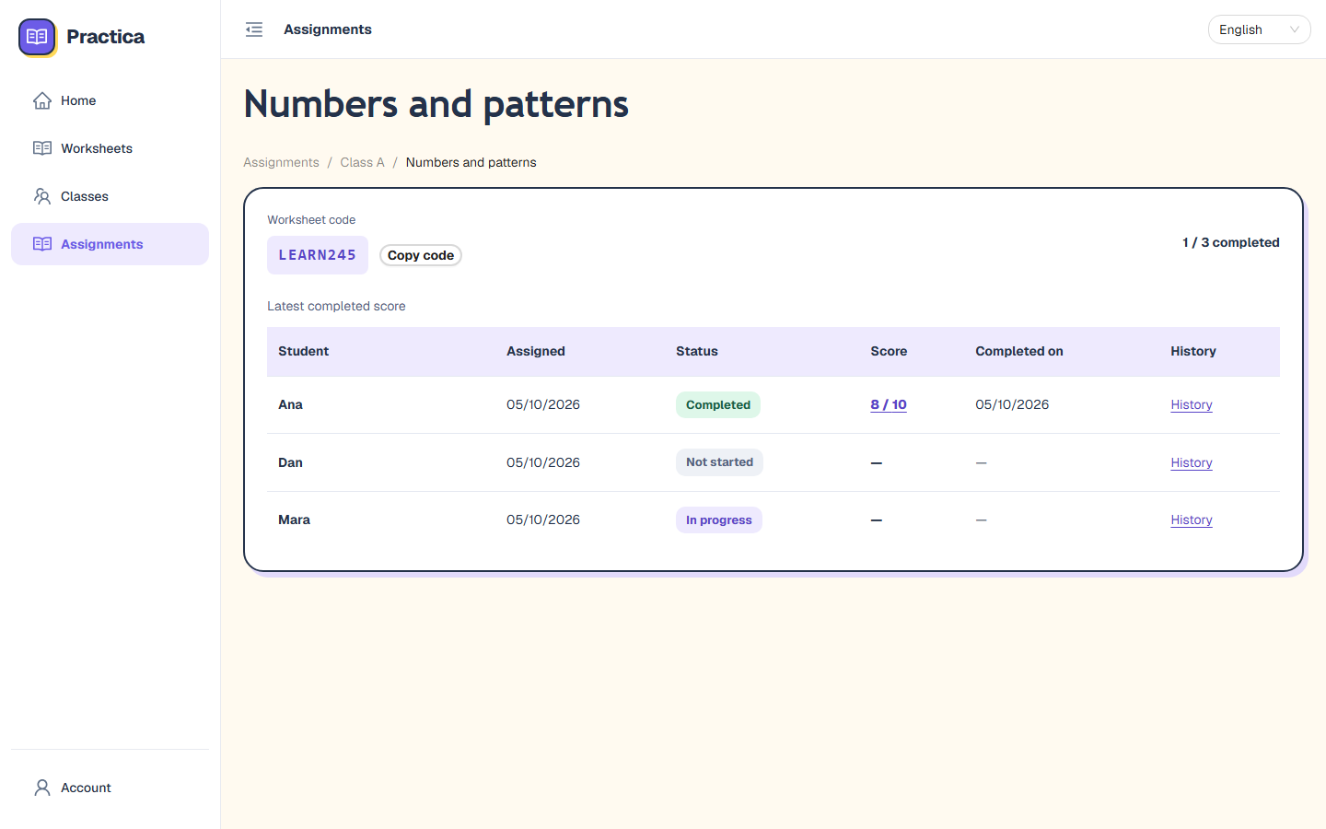
20
Current engineering foundation
The platform now preserves content history, access boundaries, and repeatable delivery
History stays stable
Frozen revisions keep old assignments meaningful.
Access follows ownership
Sessions and parent relationships scope every resource.
Changes remain verifiable
Flyway, Testcontainers, Docker, and CI check the system together.
A strong base for new activities and classroom workflows
Worksheet for Kids
20
Notes:
Source: Current assignment report UI and implemented architecture
Presenter note: Close by connecting the technical decisions to reliable teacher and learner workflows.

