Slide 1
RCC Tumor Modeling
Quantitative Lunch
20 AUG 2020

Slide 2
Acknowledgements
RCC-TGI-ML Team:
Jerry Li, Dana Nickens, Daniele Ouellet, Mohamed Shahin

Slide 3
Objectives
Background of RCC
Overview of studies
Background of tumor growth inhibition modeling
First-line RCC tumor growth inhibition model

Slide 4
Modeling Framework/Plan
Create a tumor growth inhibition (TGI) model for first line mRCC that characterizes monotherapy and combination immunotherapy treatments’ effects on tumor size
Assess TGI model tumor metrics, as well as other covariates, as predictors of clinical outcomes, including PFS/OS, using traditional time to event analyses or machine learning methodology
Focus of today’s presentation is on the first bullet of TGI modeling in first line mRCC.

Slide 5
Objectives
Develop a longitudinal model for the time course of tumor size in first line metastatic RCC patients, using a previously established model reported by Claret et al in second line RCC patients;
Evaluate treatment effect on the time course of tumor size with interferon-α, tyrosine kinase inhibitors (sunitinib, sorafenib, and axitinib), and combination therapy of an immunotherapy agent (avelumab) with axitinib;
Summarize tumor growth inhibition metrics that could be subsequently tested in future analyses to predict clinical outcomes.

Slide 6
Background of RCC
Renal cell cancer (RCC) is the most common kidney cancer and constitutes about 3% of all malignant tumors in adults.¹
RCC is often first detected at an advanced stage with about 25-30% of patients having metastatic disease at diagnosis. About 1/3 of patients with clear cell RCC present with Stage IV disease.²
In patients with advanced disease where complete resection is not possible, systemic therapy is often given.
Prior to the wide use of molecularly targeted agents, interferon-α was a commonly used systemic therapy. Studies of tyrosine kinase inhibitors (TKIs) have demonstrated effectiveness in this patient population and first-line systemic therapy usually uses one of the VEGF receptor TKIs (sunitinib, pazopanib, or sorafenib). Other first-line therapies include bevacizumab (monoclonal anti-VEGF antibody) in combination with interferon-α or temsirolimus (mTOR inhibitor).³⁻⁵
Recently, combination therapy of immunotherapy agent with VEGF inhibitors, including avelumab (anti-PD-L1) with axitinib (VEGF TKI), have shown prolonged survival in patients with first-line mRCC.
1 Gupta K., Cancer Treat Rev. 2008;34(3):193-205.
2 NCCN Clinical Practice Guidelines in Oncology: Kidney Cancer.
3 Gross-Goupil M., Curr Urol Rep. 2012; 13:16-23.
4 Mihaly Z., Curr Cancer Drug Targets. 2012; 12:857-872
5 Escudier B., Drugs. 2013;73(5):427-38.

Slide 7
Overview of Studies
A total of 4 studies Pfizer studies were included: A6181034, A4061051, B9991002, B9991003
In these studies, there were a total of 5 different treatments: interferon-α, sunitinib, axitinib, sorafenib, and avelumab+axitinib
 | A6181034 | A4061051 | B9991002 | B9991003
Study dates | 10 AUG 2004 - 19 SEP 2008 | 15 JUN 2010 - 27 JUL 2012 | 15 OCT 2015 – ongoing (03 APR 2018) | 23 MAR 2016 – ongoing (20 JUN 2018)
Phase/ Design | 3; 2-arm randomized | 3; 2-arm randomized | 1b; 1-arm open label | 3; 2-arm randomized
N | 750 | 288 | 55 | 886
Treatments | Sunitinib 50 mg sch 4/2 (n=375) v. INF-α 9MU TIW (n=375) | Axitinib 5 mg BID (n=192) v. sorafenib 400 mg BID (n=96) | Avelumab 10 mg/kg Q2W + axitinib 5 mg BID | Avelumab + axitinib (n=435) v. sunitinib 50 mg (n=438)

Slide 8
Overview of Studies (con’t)
 | A6181034 | A4061051 | B9991002 | B9991003
Tumor Assessments | Baseline Day 28 of cycles 1-4, and every 2 cycles thereafter | Baseline Weeks 6, 12, and every 8 weeks thereafter | Baseline Every 6 weeks up to 12 months, and every 12 weeks thereafter | Baseline Every 6 weeks up to 18 months, and every 12 weeks thereafter
Median PFS (months) | Sunitinib: 11 IFN-α: 5 | Axitinib: 10.1 Sorafenib: 6.5 | PFS: 8.3 [5.3, NE] At time of data cutoff, 56.4% had an event for PFS | A&A: 13.8 Sunitinib: 7.2

Slide 9
Avelumab (Bavencio®)
Fully human IgG1 anti-PD-L1 monoclonal antibody
Immuno-Oncology (IO) agent: inhibits PD-1/PD-L1 interactions for T-cell mediated antitumor immune response
Developed jointly by Pfizer Inc. and EMD Serono, subsidiary of Merck KGaA
US Indications:
treatment of patients ≥12 years with metastatic Merkel cell carcinoma (MCC) – March 2017
treatment of patients with locally advanced or metastatic urothelial carcinoma (UC) following platinum-containing chemotherapy (2L+) – May 2017
treatment of patients with advanced renal cell carcinoma (RCC) in combination with axitinib – May 14 2019
maintenance treatment of patients with locally advanced or metastatic UC that has not progressed with first-line platinum-containing chemotherapy – June 30, 2020

Slide 10
B9991003
Key Eligibility Criteria
Treatment-naive aRCC with a clear cell component
≥ 1 measurable lesion as defined by RECIST v1.1 by Investigator assessment
Tumor tissue available for PD-L1 staining
ECOG PS 0 or 1
Avelumab 10 mg/kg IV Q2W + Axitinib 5 mg PO BID (6-week cycle)
Stratification
ECOG PS (0 vs. 1)
Geographic region (USA vs. Canada/Western Europe vs. ROW)
N = 886
[560 PD-L1+*]
R 1:1
Sunitinib 50 mg PO QD (4 weeks on, 2 weeks off)
Primary Endpoints | PFS by BICR in the PD-L1+ Population OS in the PD-L1+ Population
Key Secondary Endpoints | PFS by BICR in the Overall Population OS in the Overall Population
Other Secondary | PFS by Investigator in the PD-L1+ and Overall Population OR by BICR and by Investigator in the PD-L1+ Population OR by BICR and by Investigator in the Overall Population Safety
* Definition- Patients whose tumor samples show PD-L1 staining on immune cells occupying ≥1% of the tumor area tumor area using the Ventana PD-L1 (SP263) assay.

Slide 11
B9991003 PFS by BICR
100
Median PFS (95% CI), months
Avelumab + Axitinib | 13.8 (11.1, NE)
Sunitinib | 7.2 (5.7, 9.7)
Stratified HR, 0.61 (95% CI: 0.475, 0.790) 1-sided p<0.0001
90
80
70
60
Progression-Free Survival, %
50
40
30
20
10
0
0
2
4
6
8
10
12
14
16
18
20
22
24
Months
Number at Risk
Ave + Axi | 270 | 227 | 205 | 154 | 120 | 76 | 53 | 32 | 23 | 13 | 3 | 1 | 0
Sunitinib | 290 | 210 | 174 | 119 | 85 | 49 | 35 | 16 | 13 | 5 | 0
Minimum follow-up, 6 months. Median follow-up, 9.9 months (avelumab + axitinib) and 8.4 months (sunitinib).
PFS crossed the prespecified efficacy boundary.
NE=not estimable

Slide 12
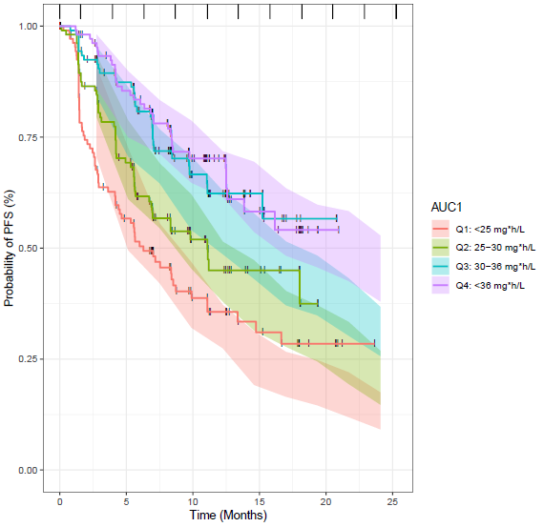
Exposure-Efficacy Response in IO Agents
Literature suggest exposure-efficacy response relationships for mAbs determined with data from just a single dose level may show an artefactual relationship.
Roy, Amit (Bristol-Myers Squibb). Modeling & Simulation Approaches to Support Development of Immuno-Oncology Drugs. ASCPT Preconference March 8, 2016, San Diego
Wang, Yaning (US FDA). Special Considerations for Modeling Exposure-Response for Biologics and ADCs-Regulatory Perspective. ASCPT Preconference March 8, 2016, San Diego
Risk factors for survival have been found to be associated with drug exposure (higher the risk, lower the exposure), leading to confounded steep exposure-response relationships”
Slide courtesy of Joanna Masters & Jennifer Hibma

Slide 13
Previous Publications in 2L RCC – Claret Models

Slide 14
Overview of TGI Modeling
Claret Model – Drug-disease modeling framework
Dose
Exposure
Tumor growth inhibition
OS or PFS
Drug specific
Disease specific
Using model based tumor growth inhibition metrics as biomarkers of drug effect to predict clinical outcome
Bruno et al. Clin Pharmacol Ther. 2013 Apr;93(4):303-5.
Claret et al. Cancer Chemother Pharmacol. 2015 Sep;76(3):567-73.
Claret et al. Cancer Chemother Pharmacol. 2016 Sep;78(3):605-10.

Slide 15
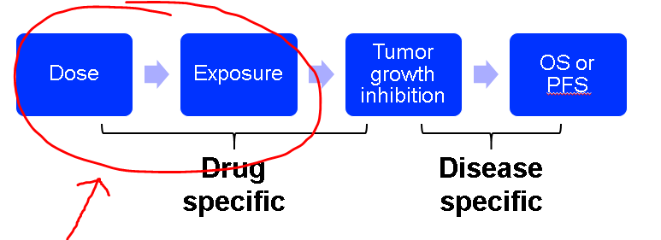
Overview of TGI Modeling
Claret Model – Drug-disease modeling framework
Treatment
Using model based tumor growth inhibition metrics as biomarkers of drug effect to predict clinical outcome
Bruno et al. Clin Pharmacol Ther. 2013 Apr;93(4):303-5.
Claret et al. Cancer Chemother Pharmacol. 2015 Sep;76(3):567-73.
Claret et al. Cancer Chemother Pharmacol. 2016 Sep;78(3):605-10.

Slide 16

Claret Model TGI Metrics
ETS_{i} = $\frac{Y_{week x,i}}{Y_{0,i}}$ TTG_{i} = $\frac{{log(KD}_{i}{\text{λ}}_{i}) −log({KL}_{i})}{{\text{λ}}_{i}}$
ETS = early tumor shrinkage, which is the ratio of tumor size at week x (where x = 6, 8, or some early time point) to baseline
Y = tumor size, Y₀ = baseline tumor size
TTG = time to tumor growth
KL = growth rate
KD = kill rate
λ = resistance appearance rate
where y is the tumor size; KL and KD are the tumor growth rate and tumor growth inhibition rate, respectively; λ is the rate constant that accounts for a decrease in tumor growth inhibition rate (KD) over time; y₀ is the tumor size at baseline; j is the observation of an individual i. Model parameters are estimated with a non-linear mixed method in NONMEM
Claret et al. Cancer Chemother Pharmacol. 2016 Sep;78(3):605-10

Slide 17
TGI Model NONMEM Dataset
C | PROT | ID | TRT | DAY | TAFD=TIME (weeks) | BSLD | SLD = DV (mm) | EVID
. | 1034 | 1 | 2 | -20 | 0 | 67 | 67 | 0
. | 1034 | 1 | 2 | 28 | 3.86 | 67 | 53 | 0
. | 1034 | 1 | 2 | 70 | 9.86 | 67 | 38 | 0
. | 1034 | 1 | 2 | 112 | 15.86 | 67 | 32 | 0
. | 1034 | 1 | 2 | 155 | 22 | 67 | 31 | 0
. | 1034 | 4 | 2 | -5 | 0 | 241 | 241 | 0
. | 1034 | 4 | 2 | 28 | 3.86 | 241 | 268 | 0
. | 1034 | 5 | 1 | -4 | 0 | 217 | 217 | 0
. | 1034 | 5 | 1 | 28 | 3.86 | 217 | 219 | 0
. | 1034 | 5 | 1 | 74 | 10.43 | 217 | 211 | 0
. | 1034 | 5 | 1 | 113 | 16 | 217 | 223 | 0
. | 1034 | 6 | 2 | -14 | 0 | 62 | 62 | 0
. | 1034 | 6 | 2 | 28 | 3.86 | 62 | 36 | 0
. | 1034 | 6 | 2 | 70 | 9.86 | 62 | 27 | 0
. | 1034 | 6 | 2 | 112 | 15.86 | 62 | 27 | 0
. | 1034 | 6 | 2 | 156 | 22.14 | 62 | 30 | 0

Slide 18
TGI Model NONMEM Code
$SUBROUTINE ADVAN 13 TOL=6
$MODEL COMP=TUMOR
$PK
TVKL=LOG(THETA(1)/52) ; change to rate/year from /weeks
MU_1=TVKL
KL = EXP(MU_1+ETA(1))
TVKD=LOG(THETA(2)/52)
MU_2=TVKD
KD = EXP(MU_2+ETA(2))
TVLAM=LOG(THETA(3)/52)
MU_3=TVLAM
LAM = EXP(MU_3+ETA(3))
A_0(1)=BSLD

Slide 19
TGI Model NONMEM Code (con’t)
$DES
;y(t) = y(0) exp[ kL t - (kD Treatment/lam)(1-exp(-lam t)) ].
;dy/dt = [kL t - kD/lam Treatment (exp(-lam t))] y(t).
DADT(1) = (KL - KD*EXP(-LAM*T))*A(1)
$ERROR
IPRED=A(1)
W = SQRT(THETA(4)**2*IPRED**2+THETA(5)**2)
Y=IPRED+W*ERR(1)
IWRES=(DV-IPRED)/W

Slide 20
NONMEM Code (Define TGI Metrics)
Still under $ERROR
TTG=(LOG(LAM*KD)-LOG(KL))/LAM
W6 = BSLD*EXP(KL*6-(KD/LAM)*(1-EXP(-LAM*6)))
W8 = BSLD*EXP(KL*8-(KD/LAM)*(1-EXP(-LAM*8)))
TR6= W6/BSLD
TR8= W8/BSLD

Slide 21
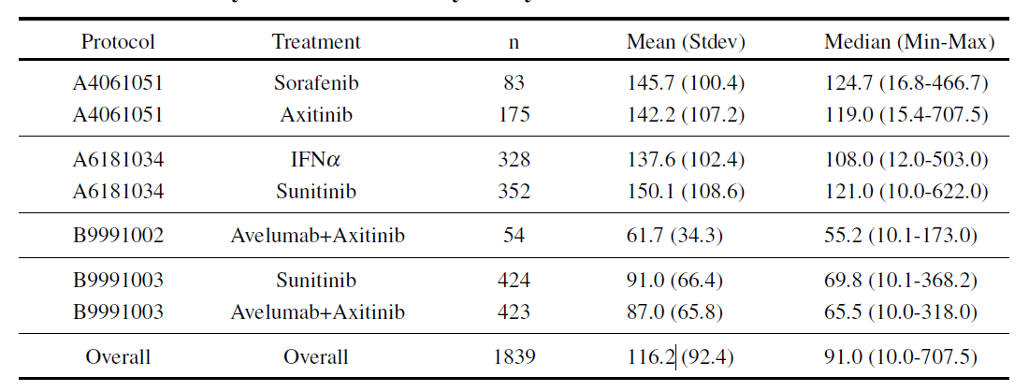
TGI Model: Results (observed data) Summary of Baseline SLD by Study and Treatment
Baseline SLD measurements are in mm.
Table abbreviations: SLD = sum of the longest tumor diameters, Stdev = standard deviation

Slide 22
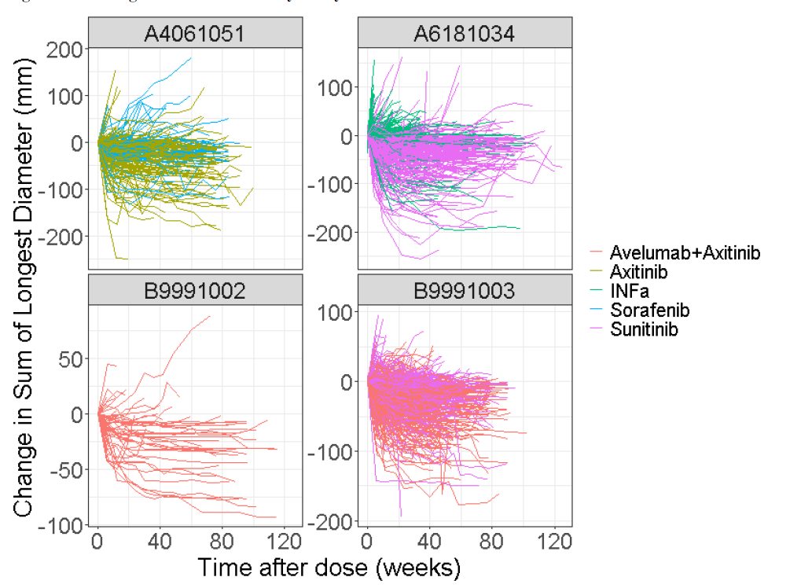
TGI Model: Results (observed data) Change in SLD (mm) over time by Study & Treatment

Slide 23
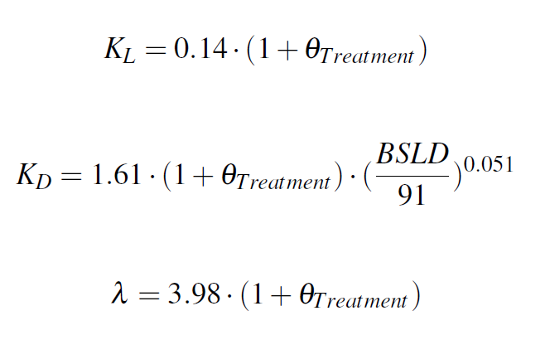
TGI Model: Final Model Results
Following SCM testing treatment (sunitinib as reference) and baseline SLD at forward inclusion at α=0.05 and backward elimination at α=0.001, the final model included the effect of treatment on all 3 parameters and baseline SLD (in the raw scale as a power function) on K_{D}

Slide 24
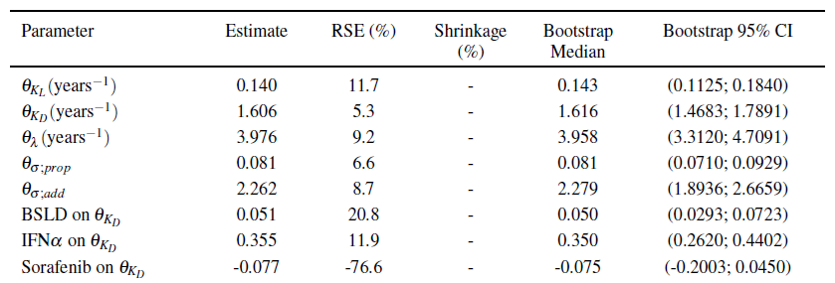
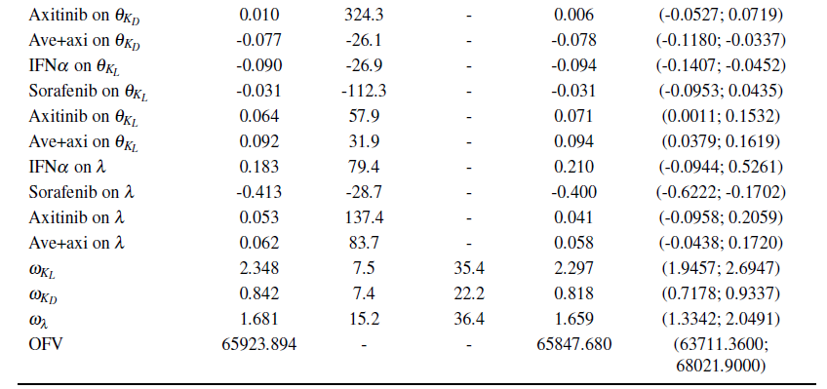
TGI Model: Final Model Estimates

Slide 25
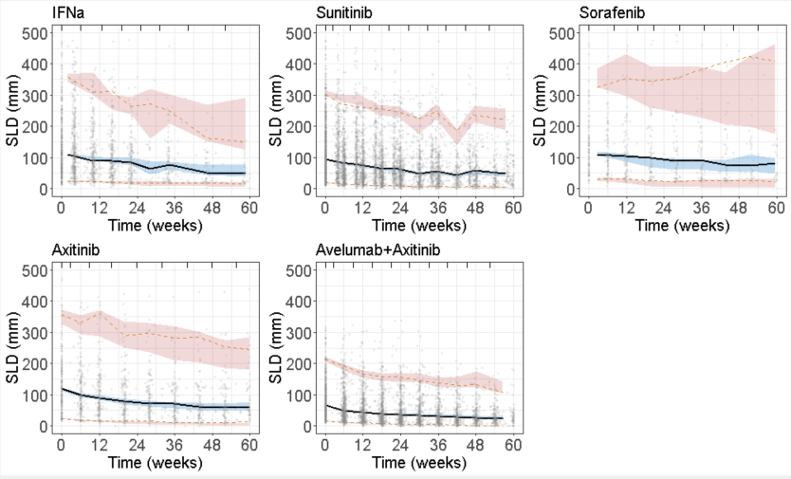
TGI Model: Final Model VPC
Those with PD per RECIST 1.1 criteria (20% increase in tumor size) were removed.

Slide 26
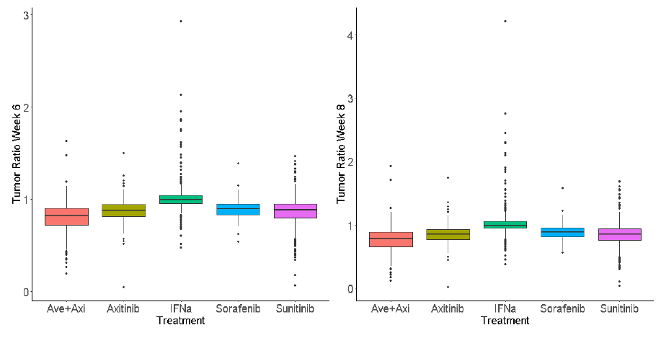
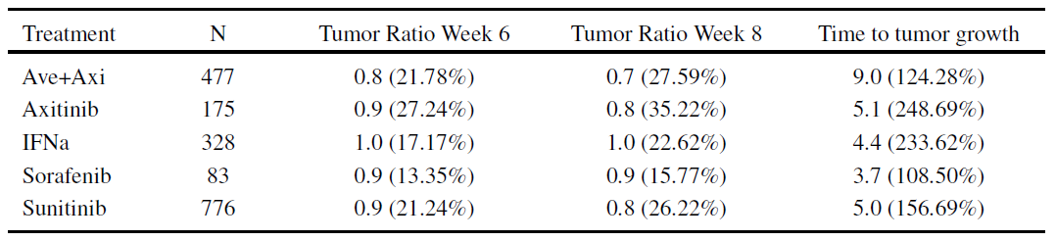
Summary of TGI Metrics
Data are geometric mean (geometric CV%). Time to tumor growth in weeks

Slide 27
Conclusions
The tumor kinetics from first line patients with RCC from 4 clinical studies and 5 treatments were well characterized by the Claret model;
Treatment was a significant covariate for all three parameters: KL, KD, and LAM;
Baseline SLD was a significant covariate on KD where smaller tumors at baseline trended with higher KD;
For the combination therapy avelumab+axitinib, TTG was the longest and tumor ratios at week 6 and week 8 were lowest, as compared to sunitinib.

