Slide 1
Tumor Growth Inhibition Modeling in First-line Advanced Renal Cell Carcinoma (RCC): an Analysis Across Multiple Types of Treatments
Note to authors: We have significantly revised the JAVELIN poster template to reduce text and highlight results. Guidelines for words/display elements are noted throughout. The overall look of the laid-out poster can be found on the last slide FYI.
Swan Lin, PharmD¹, Jerry Li, PharmD², Mohamed H. Shahin, Ph.D. ³, Dana Nickens, MS¹, Daniele Ouellet, PhD²
¹Pharmacometrics, Global Product Development, Pfizer Inc, San Diego, CA, USA;
²Pharmacometrics, Global Product Development, Pfizer Inc, Collegeville, PA, USA;
³Pfizer Global Research and Development, Groton, CT, USA
PIII-014. Presented at ASCPT 2021, Virtual, Monday, March 15th

Slide 2
Scope
Guideline: 1 bullet, 30-50 words max
Currently: x bullets, xx words
Not applicable

Slide 3
Conclusions
Guideline: 3-5 bullets, 100-150 words max
Currently: x bullets, xx words
Treatment was a significant covariate for all three model parameters: K_{L}, K_{D}, and λ
Baseline tumor size was a significant covariate on K_{D} where smaller tumors at baseline trended to have higher K_{D} compared to patients with larger tumors at baseline
The tumor kinetics from first-line patients with RCC were well characterized and reflected the different treatment modalities

Slide 4
Background
Guideline:
Standard: 3-6 bullets, 100-150 words max
Dense content: 6-10 bullets, 150-200 words max
Currently: x bullets, xx words
Early prediction of tumor response of patients could support drug development decisions in oncology.
Tumor growth inhibition (TGI) metrics estimated based on modeling of longitudinal tumor size data have been shown to be predictive of patients’ survival in a variety of tumor types.^{1,2,3}
TGI modeling across multiple treatments, including combination immunotherapy with a VEGF receptor inhibitor has not been studied.
A TGI model was developed to characterize the time course of tumor size in patients with advanced renal cell carcinoma (RCC) across 4 clinical studies and 5 different treatments.

Slide 5
Methods
Guideline: 3-5 bullets, 100-150 words max
Currently: x bullets, xx words
Four Phase 1b or 3 studies were included in the analysis with 5 treatments: interferon-α, sunitinib, sorafenib, axitinib, and avelumab + axitinib.
The primary tumor dynamic model took the general form previously described by Claret et al. and included cell kill rate constant (K_{D}), growth rate constant (K_{L}) and drug-resistance rate constant (λ) parameters.^{4,5}
Treatment and baseline tumor size were tested as covariates at α=0.05 for forward inclusion and α=0.001 for backward elimination following stepwise covariate model building procedure (SCM).
NONMEM version 7.4.3 was used for the nonlinear mixed effects modeling of the tumor size over time. PsN version 4.8.0 was used for the covariate analysis by SCM, and R version 3.5.1 was used for all data manipulation, graphics, and table creation.

Slide 6
Table 1. Summary of Baseline Tumor Size (mm) by Study and Treatment
Protocol | Treatment | n | Mean (Stdev) | Median (Min-Max)
Study 1 | Sorafenib | 83 | 145.7 (100.4) | 124.7 (16.8-466.7)
Study 1 | Axitinib | 175 | 142.2 (107.2) | 119 (15.4-707.5)
Study 2 | Interferon-α | 328 | 137.6 (102.4) | 108 (12.0-503.0)
Study 2 | Sunitinib | 352 | 150.1 (108.6) | 121 (10.0-622.0)
Study 3 | Avelumab+Axitinib | 54 | 61.7 (34.3) | 55.2 (10.1-173.0)
Study 4 | Sunitinib | 424 | 91 (66.4) | 69.8 (10.1-368.2)
Study 4 | Avelumab+Axitinib | 423 | 87 (65.8) | 65.5 (10.0-318.0)
Overall | Overall | 1839 | 116.2 (92.4) | 91 (10.0-707.5)

Slide 7
Figure 1. Change in Tumor Size Over Time by Study
Guideline for total display elements:
Standard: ≤6 figures/tables
Dense content: ≤9 figures/tables
Study 1
Study 2
Study 3
Study 4

Slide 8
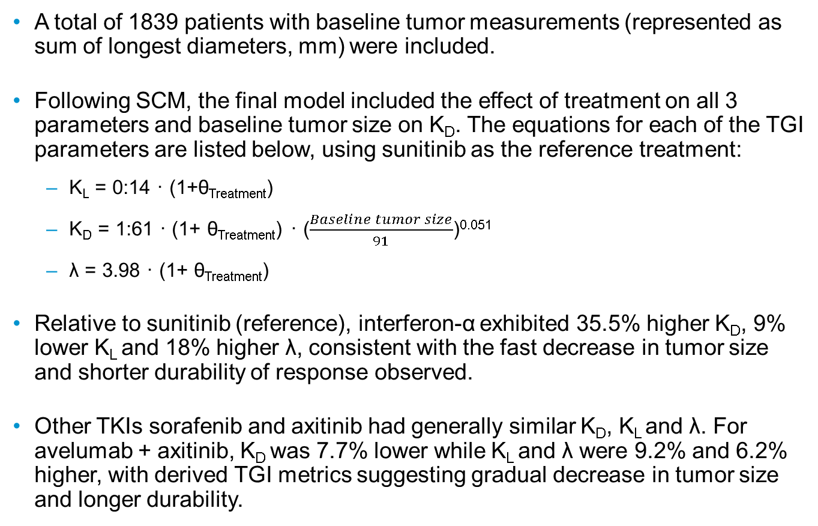
Results
Guideline for text:
Standard: 5-10 bullets, 120-250 words max
Dense content: 10-15 bullets, 250-350 words max
Currently: x bullets, xx words
A total of 1839 patients with baseline tumor measurements (represented as sum of longest diameters, mm) were included.
Following SCM, the final model included the effect of treatment on all 3 parameters and baseline tumor size on K_{D}. The equations for each of the TGI parameters are listed below, using sunitinib as the reference treatment:
K_{L} = 0:14 · (1+θ_{Treatment})
K_{D} = 1:61 · (1+ θ_{Treatment}) · ($\frac{Baseline tumor size}{91}$)^{0.051}
λ = 3.98 · (1+ θ_{Treatment})
Relative to sunitinib (reference), interferon-α exhibited 35.5% higher K_{D}, 9% lower K_{L} and 18% higher λ, consistent with the fast decrease in tumor size and shorter durability of response observed.
Other TKIs sorafenib and axitinib had generally similar K_{D}, K_{L} and λ. For avelumab + axitinib, K_{D} was 7.7% lower while K_{L} and λ were 9.2% and 6.2% higher, with derived TGI metrics suggesting gradual decrease in tumor size and longer durability.

Slide 9
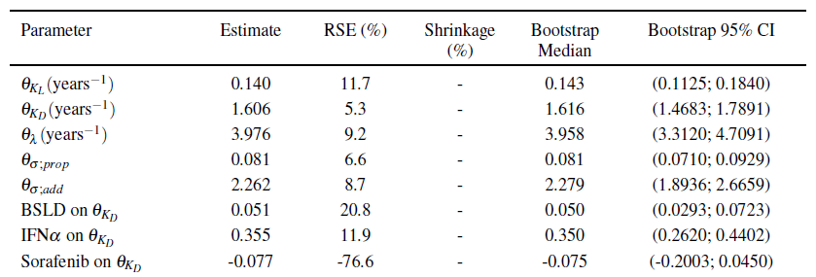
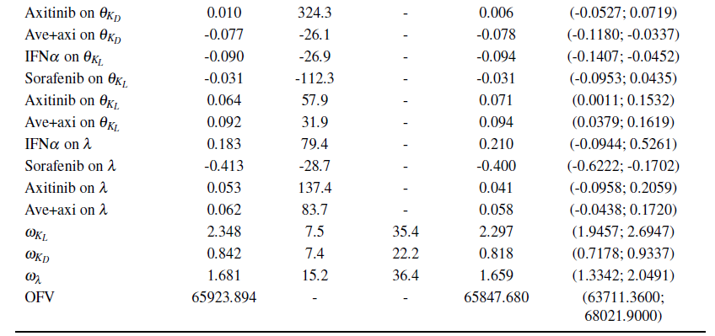
Table 2. Final TGI Model Parameter Estimates

Slide 10
Figure 2. Diagnostic Plots of Final TGI Model
a.
c.
b.
d.
Diagnostic plots of a. observed versus population predicted tumor size, b. observed versus individual predicted tumor size, c. CWRES versus population predicted tumor size, and d. IWRES versus population predicted tumor size.
Abbreviations: CWRES = conditional weighted residuals, IWRES = individual weighted residuals

Slide 11
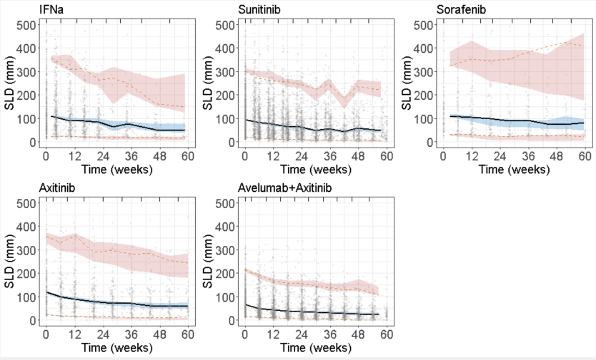
Figure 3. Final Model Visual Predictive Check

Slide 12
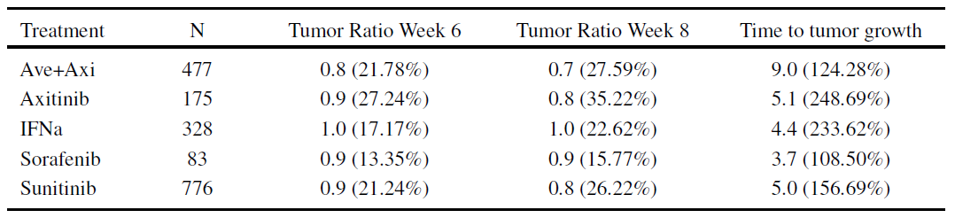
Table 3. Summary of TGI Metrics
Data are geometric mean (geometric CV%). Time to tumor growth are in weeks.

Slide 13
References
Guideline: ≤10 references
Currently: x references
Bruno R, Mercier F and Claret L, 2014, Evaluation of tumor size response metrics to predict survival in oncology clinical trials. Clinical Pharmacology & Therapeutics vol. 95: 386–393.
Claret L, Girard P, Hoff PM, Van Cutsem E, Zuideveld KP, Jorga K, Fagerberg J and Bruno R, 2009, Model-based prediction of phase iii overall survival in colorectal cancer on the basis of phase ii tumor dynamics. Journal of Clinical Oncology vol. 27: 4103–4108.
Simeoni M, Magni P, Cammia C, De Nicolao G, Croci V, Pesenti E, Germani M, Poggesi I and Rocchetti M, 2004, Predictive pharmacokinetic-pharmacodynamic modeling of tumor growth kinetics in xenograft models after administration of anticancer agents. Cancer research vol. 64: 1094–1101.
Claret L, Mercier F, Houk BE, Milligan PA and Bruno R, 2015, Modeling and simulations relating overall survival to tumor growth inhibition in renal cell carcinoma patients. Cancer chemotherapy and pharmacology vol. 76: 567–573.
Claret L, Zheng J, Mercier F, Chanu P, Chen Y, Rosbrook B, Yazdi P, Milligan PA and Bruno R, 2016, Model-based prediction of progression-free survival in patients with first-line renal cell carcinoma using week 8 tumor size change from baseline. Cancer chemotherapy and pharmacology vol. 78: 605–610.

Slide 14
Disclosures
All authors are current or former employees of Pfizer

Slide 15
Acknowledgments
Guideline: standard statement, <100 words
Currently: xx words
The authors would like to thank the patients and their families, investigators, co-investigators, and the study teams at each of the participating centers and at Merck KGaA, Darmstadt, Germany/Pfizer. This trial was sponsored by Merck KGaA/Pfizer and is part of an alliance between Merck KGaA and Pfizer. Medical writing support was provided by xxxx, and was funded by Merck KGaA and Pfizer.

Slide 16
QR code panel
Guideline: standard language
GET POSTER PDF
Copies of this poster obtained through Quick Response (QR) Code are for personal use only and may not be reproduced without permission from Congress name and the author of this poster
For questions, please contact permissions@XXXXXXX.org [or] Correspondence: a.b.name@institution.edu
GET PLAIN LANGUAGE SUMMARY
Please scan this quick response (QR) code with your smartphone app to view a plain language summary of the accepted scientific abstract
https://xxxx.xxxxxxx.com/xxxxxxxxxxxxx

Slide 17
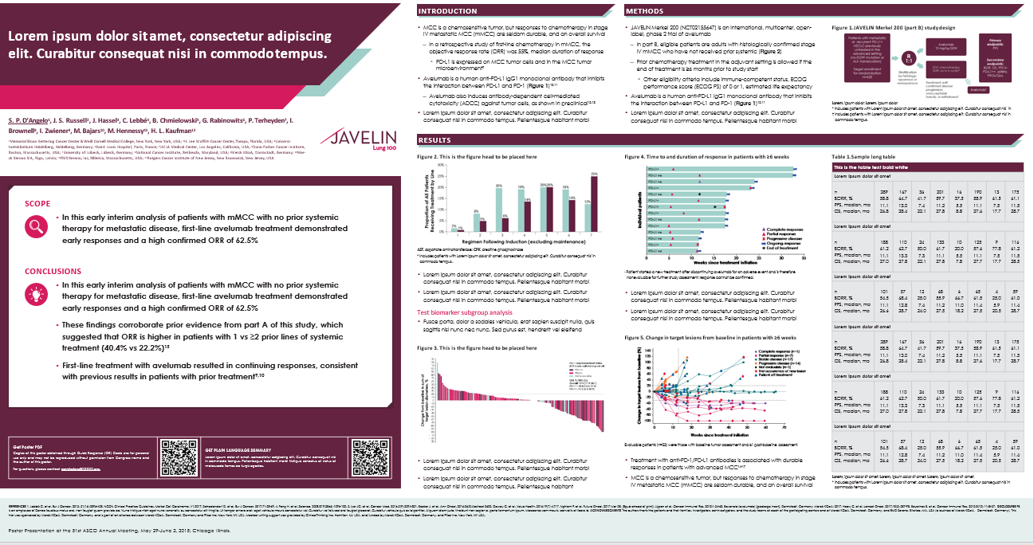
Example layout: landscape (standard)

Slide 18
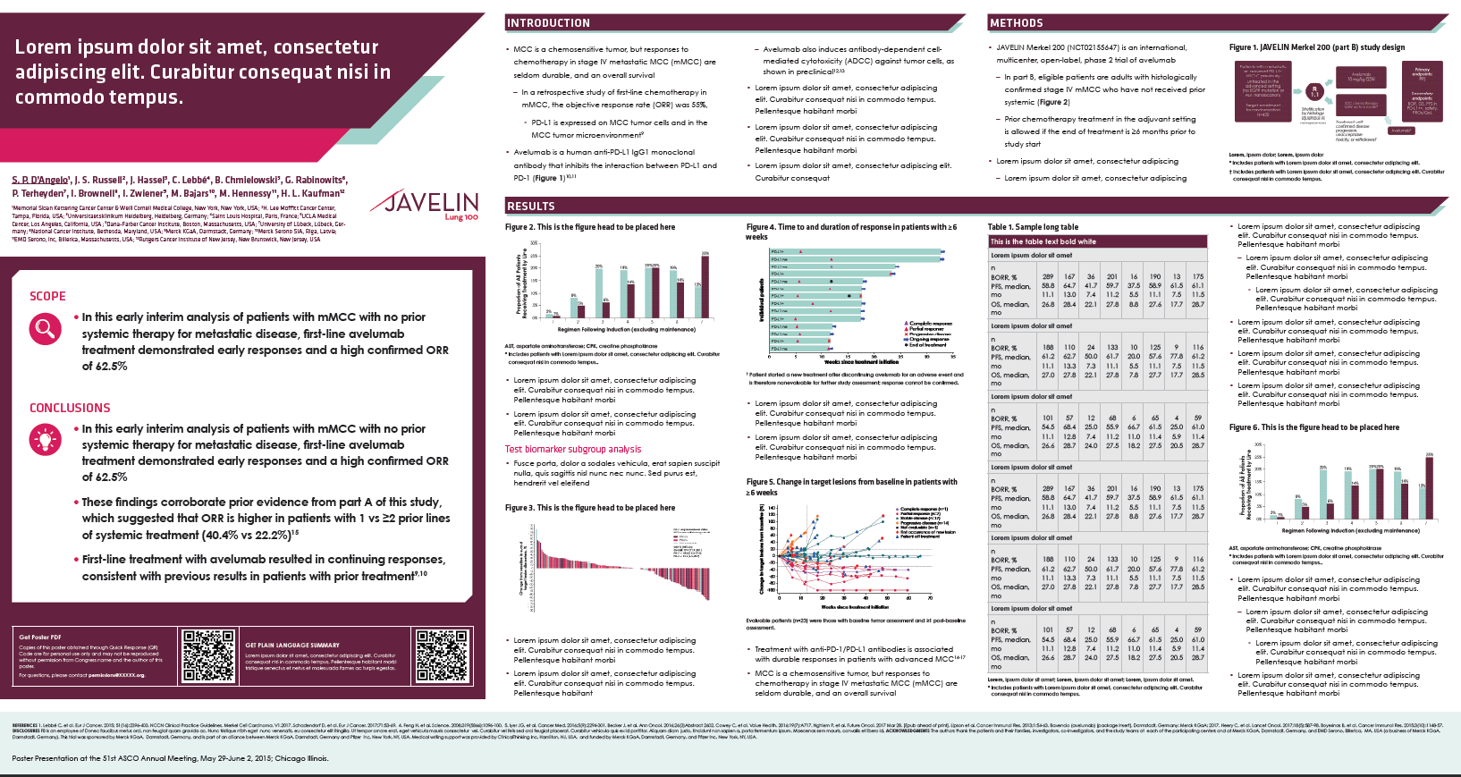
Example layout: landscape (dense)

Slide 19
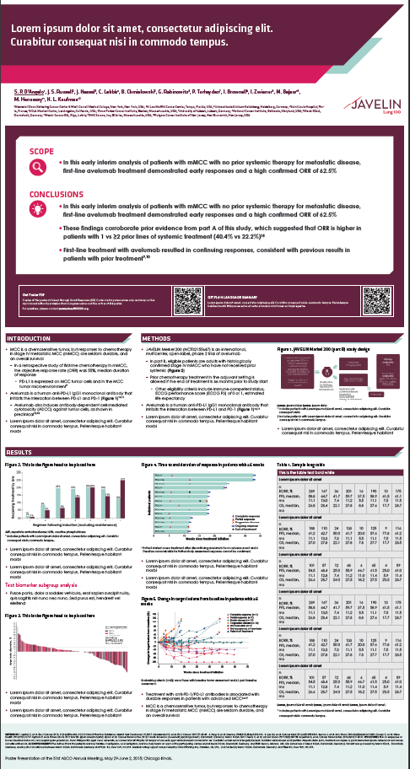
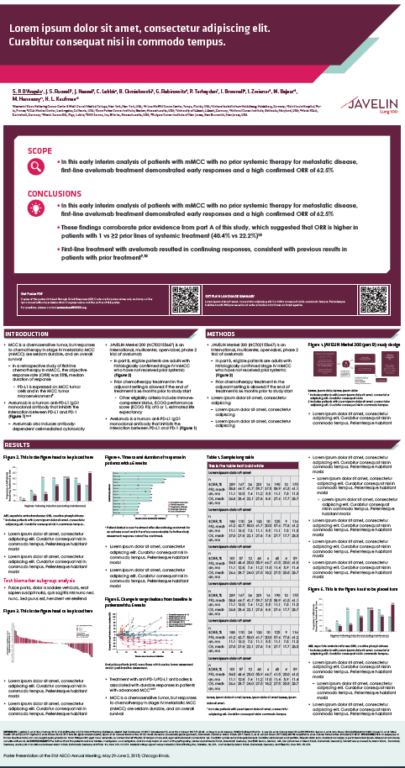
Example layout: portrait
Standard
Dense

