Slide 1
Design Pattern Barcamp Observer (Publish and subscribe)
Presented by
Christian Radke

Slide 2
Overview
Concept and idea
Typical use cases
Technical explanation
Example tasks
Quiz
Time: approx. 60 min

Slide 3

1. Concept and idea
Are you at home already?
No…
Mother
Child
Scenario: The Mother would like to know if her child got home safe after school…
Option 1: The Mother calls proactively (timing is unprecise -> multiple calls)

Slide 4
1. Concept and idea
Okay, thank you!
I am at home now!
Mother
Child
Scenario: The Mother would like to know if her child got home safe after school…
Option 2: The Mother informs her child about her interest.
Now the child is the one to proactively inform her. (Perfect timing -> One-time event)

Slide 5
1. Concept and idea
Okay, thank you!
I am at home now!
Object „Mother“ (Observer)
Object „Child“
(Subject)
Scenario: The Mother would like to know if her child got home safe after school…
Option 2: The Mother informs her child about her interest.
Now the child is the one to proactively inform her. (Perfect timing -> One-time event)

Slide 6
1. Concept and idea
Okay, thank you!
I am at home now!
Object „Mother“ (Observer)
Object „Child“
(Subject)
Publish information
Subscribe to information

Slide 7
1. Concept and idea
Creational Pattern
Structural Pattern
Behavorial Pattern

Slide 8
1. Concept and idea
Creational Pattern
Structural Pattern
Behavorial Pattern
Algorithm for interactions between objects

Slide 9








2. Use-Cases
Chat-Rooms:
Someone writes a message into a chat room (subject)
Chat rooms informs all users (observers) about this new message
Personalized Feeds:
Influencer (subject) posts something
That something is added to all of their followers (observers) feeds
FMBs in E-Mail clients:
FMB (Subject) receives new e-mails
Clients (observers) who are part of it can see them in their inbox

Slide 10
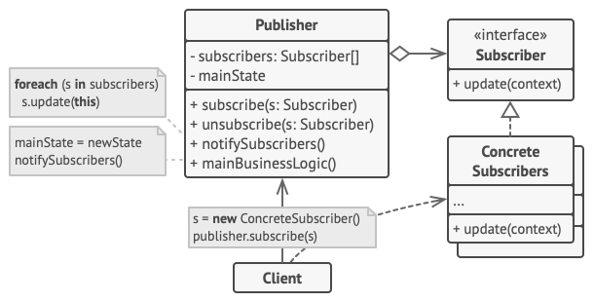
3. Technical explanation
→ Classes

Slide 11
3. Technical explanation
→ Classes → Subscribing

Slide 12
3. Technical explanation
→ Classes → Subscribing

Slide 13
3. Technical explanation
→ Classes → Subscribing → Interface

Slide 14
3. Technical explanation
→ Classes → Subscribing → Interface → Update logic

Slide 15
3. Technical explanation
→ Classes → Subscribing → Interface → Update logic

Slide 16
3. Technical explanation
→ Classes → Subscribing → Interface → Update logic

Slide 17

4. Example tasks

Slide 18
5. Quiz
Question 1:
What implementation does every subscriber need?
Answer:
An „update()“-method

Slide 19
5. Quiz
Question 2:
What methods are needed in the „Publisher“ class?
Answer:
addSubscriber, removeSubscriber & notifySubscriber

Slide 20
5. Quiz
Question 3:
What is still missing?
Answer:
The „list“ to save each subscriber

Slide 21
Thank you for your attention!
And don‘t forget to subscribe…

