Slide 1

A2Y
Easily visualizable data on the go.

Slide 2
Challenge
Surface-to-Air Quality:
Our challenge is to integrate NASA data, ground-based air quality data, and citizen science data to create an air quality surface that displays the most accurate data for a location and time. Create algorithms that select or weight the best data from several sources for a specific time and location, and display that information.

Slide 3
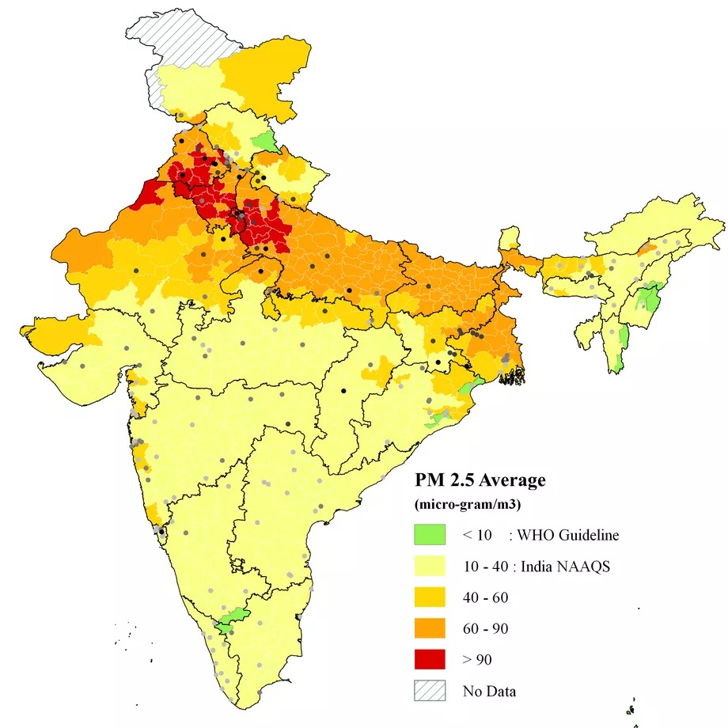
Ever wondered about the air that we breathe?
Here is how it looks(technically)

Slide 4
Why?
Spread the right information at the right time(Every hour counts)
No tool to easily visualize the data.
AQ forecast
Mask/no mask
Plan your daily route of healthy travel.
Can help government to take necessary and effective actions by giving adequate data about air content.

Slide 5
What?
An air quality visualization tool.
Easily accessible on a website.
Regular data
Personalized AI to predict and monitor your future visit

Slide 6

How?
Extrapolating the NASA data through Google maps
Website prototype.
Regularly updates the user about surrounding AQI

Slide 7

Future Plans
Better air quality prediction using surface data.
App coming soon.
Mass mailing in case of critical changes in air quality.

Slide 8
The Receptives
We are a group of undergraduates from UIET, Panjab University, Chandigarh.
Pratham Goyal
Tarun Jain
Deepak Singh
Pallav Bhalla

