Slide 1

Stochastic and parametric server optimization for a financial services company.
A small financial services company has grown tremendously in a few months. It only has one midrange server to process 50,000 trades per day and that server is experiencing major performance issues.
It is very important that most if not all trades be processed by 11am. If that window closes and there are unprocessed trade events, it leads to financial penalties as well as reputational damages.
The firm’s management has set the goal that 95% of all trades or trade events that occur between 7AM and 11 AM should be processed and settled.
Events Processed Between 7am and 11am (June 2021)
Date | Submitted | Processed | Pct Processed | Unprocessed Trades
June 7, 2021 | 19,988 | 15,132 | 76% | 4,856
June 8, 2021 | 21,194 | 14,085 | 66% | 7,109
June 9, 2021 | 23,722 | 17,847 | 75% | 5,875
June 10, 2021 | 23,618 | 15,878 | 67% | 7,740
June 11, 2021 | 22,884 | 14,311 | 63% | 8,573
This Photo by Unknown Author is licensed under CC BY

Slide 2
Simulation Model
While the company looks into investing in its architecture, the data science team is asked to work with the application and infrastructure teams to develop a simulation that could optimize the configurations within the existing architecture.
The simulation models the 7AM to 11AM EST “crunch” of activity. It will run 72000 Time Units, where each time unit is 200 milliseconds, thus it represents 4 hours of constant activity.
There are two ways to manage throughput of events.
One is by increasing or decreasing the number of transaction servers. Usually the more transaction server instances, the better. However, database contention occurs when multiple process try to update the same database. Moreover, the company only has one physical server, and so operating system memory usage can degrade performance more than the multiple servers can improve it.
The other is to adjust the packet processing. The packet processor attempts to perform things in bulk that the otherwise the transaction server would perform in iterations. The higher the packet size, the more effective this is. However, some types of events will peform worse with increased packet sizes.
The simulation program is not an exact replication of the algorithms of the system. The logic is approximated, and then it requires the insight by the system analysts to manage a set of distributions and factors that will translate into an accurate prediction of future results. The analysists then perform the validations during the development and testing phases to ultimately sign off on the results.

Slide 3
Traders
Brokers
Clients
Automations
The event hub polls in 200 millisecond intervals. If packet process is in effect, then it will let the packet processor perform some attributions.
The IT department may run any number of servers ( instances ) of a process. But too many and contention issues degrade performance.
Trades, Instructions, Valuations, Attributions
Event Hub
Process Packets ?
Yes
No
n Trade Processors
Packet Processor
1
2
3…
n

Slide 4
Two Input Parameters
Number of Servers. | Number of Packets.
N servers represents a n fold improvement. However the physical host can only support k servers. Plus database contention degrades performance. | A packet is a package of trades that the packet processor will analyze, and decide what kinds of operations can be done in bulk. If the trades are conducive, then the higher the packet size, the better.
Two Stochastic Distributions
Volume of Events | Baseline performance
Each event type has a manual distribution of expected volume across 720 time units. They will be randomly drawn with replacement. | Absolute values from a logistic distribution. So about 80% take between 1 and 5 milliseconds but at times the O/S has a problem and the baseline can degrade to 15-20 milliseconds.
Performance = Baseline * Server Factor * Packet Factor

Slide 5
Factors : Number of Servers
 | 1 | 2 | 3 | 4 | 5 | 6 | 7 | 8
Event 1 | 1.7 | 1.3 | 1.05 | 1.03 | 1.07 | 1.08 | 1.12 | 1.13
Event 2 | 3.4 | 2.6 | 1.9 | 1.4 | 1.2 | 1.1 | 1 | 1.1
Event 3 | 3.9 | 3.4 | 3.2 | 3.4 | 3.6 | 3.8 | 4 | 4.2
Event 4 | 3.2 | 3.05 | 3.2 | 3.4 | 3.9 | 4.6 | 5.4 | 5.6
Factors : Packet Processing
 | 1 | 10 | 20 | 30 | 40 | 50
Event 1 | 2 | 1.8 | 1.6 | 1.4 | 1.2 | 1.05
Event 2 | 1.7 | 1.2 | 1.05 | 1.2 | 1.7 | 5
Event 3 | 1.7 | 1.05 | 1.1 | 1.3 | 1.7 | 3
Event 4 | 1 | 3.5 | 4.45 | 6 | 7 | 9
Performance = Baseline * Server Factor * Packet Factor

Slide 6
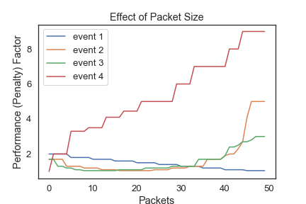
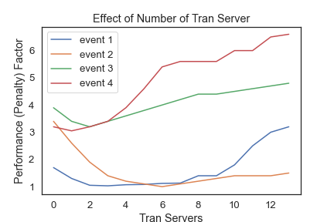
Event Types and Configurations
The model attributes a performance hit on each event type, according to the packet size and number of transaction servers that are running. As seen below, event 4 does very poorly with increased packet processing. Event 1 however does very well.
Event 2 performs very well with more transaction servers but notice they all start to perform worse after 6 servers.

Slide 7
Event Types
In order to make the model viable, we have defined four types of events to describe their expected processing performance in the packet and transaction servers.
The distinctions between each type has more to do with the expected database and network usage, as opposed to the business characteristics of the event.
Types | Description | Examples
Type 1 | High volume. Low footprint. Moderate improvement with increased packet sizes and transaction server instances. | Single attribution updates to existing trades. For example If 100 trades with customer X need to be flagged as “emerging market”, then the packet processor can do this easily with minimal work by the transaction server.
Type 2 | Also improves like type 1, but baseline footprint is higher, and the volume is about half. | Simple trades.
Type 3 | Requires web service calls. Low volume but subject to intermittent batch jobs. | Meta trades that require extra attributions and include extra database updates and web service calls.
Type 4 | Low volume but much database activity and web service calls. | Structured long term trades that usually contain 30 to 50 cash flows that require special processing. Regulatory requirements mandate a lot of extra database processing.

Slide 8
Event Type Volume : Distributions for 7AM-11AM EST
Events with Performance Type 1
Trade Packets | TU/Received | Total Trades
0 | 344 | 0
1 | 145 | 145
2 | 131 | 262
3 | 71 | 213
5 | 17 | 85
7 | 5 | 35
15 | 2 | 30
35 | 2 | 70
200 | 1 | 200
500 | 1 | 500
1000 | 1 | 1000
 | 720 | 2540
Events with Performance Type 2
Trade Packets | TU/Received | Total Trades
0 | 394 | 0
1 | 132 | 132
2 | 101 | 202
3 | 60 | 180
5 | 17 | 85
7 | 9 | 63
10 | 2 | 20
15 | 3 | 45
20 | 2 | 40
 | 720 | 767
The expected volumes for each event type are shown
on the left. Numbers are in thousands.
The model incorporates these distributions in randomly
submitting events to the event hub.
Events with Performance Type 3
Trade Packets | TU/Received | Total Trades
0 | 633 | 0
1 | 45 | 45
2 | 27 | 54
3 | 11 | 33
5 | 2 | 10
50 | 1 | 50
1000 | 1 | 1000
 | 720 | 1192
Events with Performance Type 4
Trade Packets | TU/Received | Total Trades
0 | 687 | 0
1 | 25 | 25
2 | 7 | 14
5 | 1 | 5
 | 720 | 44

Slide 9
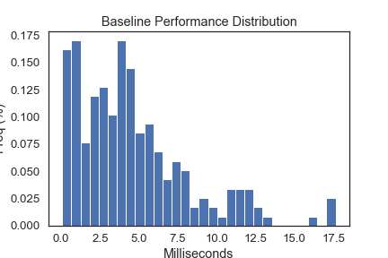
Baseline Performances
All event type metrics are based off baseline millisecond expectation for any event. A randomized draw from a logistic distribution, where negative values are converted to positive reveals a distribution that accurately reflects the random dispersion of performance in milliseconds.
All performance factors then are multiplied by the draw from this distribution to calculate the performance of a given event.

Slide 10
Results
Simulation was performed from 1 to 12 servers and from 1 to 50 packet sizes, with intervals of 2 and 10 respectively. Thus a single simulation compares 30 possible server/packet combinations.
With unseeded distributions of event volume and server performance ( random ) the results varied, sometimes 3 servers resulted in the best performance, sometimes 7 servers did. The many simulations clearly indicated that less than 3 servers was very poor, and above 7, performance
would be progressively worse.
The most common best performance was 3 servers and 40 packets.
The number of packets did not make much difference although 40 seemed to be optimal, and
40 packets is recommended. The analysists noted that the advantage of trying to group packets was only helpful when there are opportunities of eligible volumes.
3 servers and 40 packets is recommended.

