Slide 1

The Nuts and Bolts of Deep Learning
By: Ismail Elezi ismail.elezi@gmail.com
Felix makes a lot of questions. Be like Felix!

Slide 2
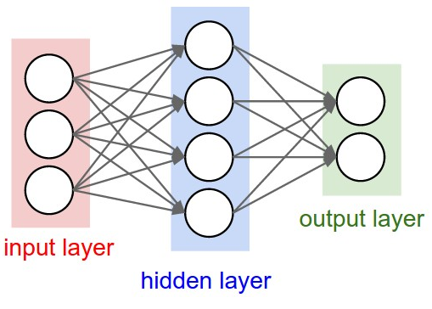
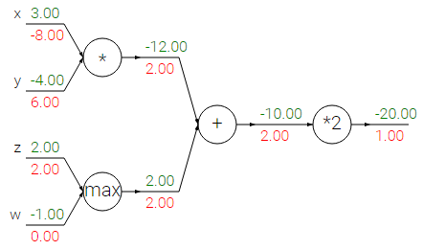
Backpropagation without formulas

Slide 3
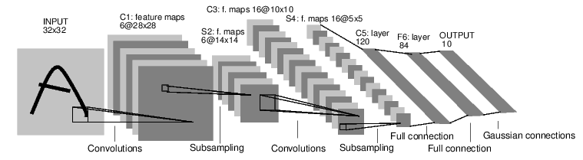
Convolutional Neural Networks (CNN)
Credit: Yann Lecun

Slide 4
Common CNN architectures
LeNet (1998): awful and ancient AlexNet (2012): bad and medieval VGG-X (2014): much better but not good enough Inception (2014-present): good but complicated ResNet (2015): good and default choice WideResNet (2017): better ResNet ResNeXt (2017): better ResNet DenseNet (2017): ResNet-like

Slide 5
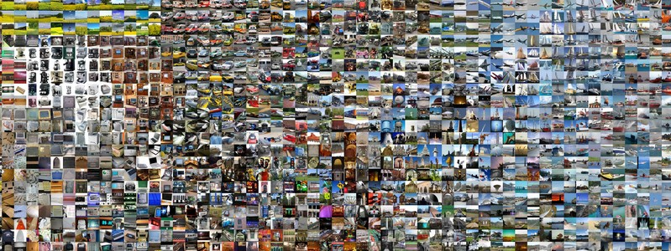
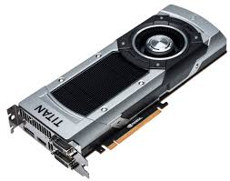

But we all know that (since the end of eighties)
We have more data - from Lena to ImageNet.
We have more computing power, GPUs are really good at this.
Last but not least, we have new ideas (and this is the focus of this lecture).

Slide 6
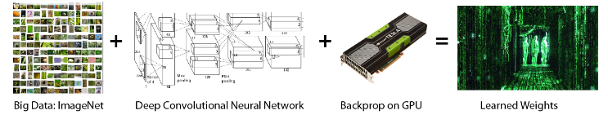
But we all know that (since the end of eighties)
We have more data - from Lena to ImageNet.
We have more computing power, GPUs are really good at this.
Last but not least, we have new ideas (and this is the focus of this lecture).

Slide 7
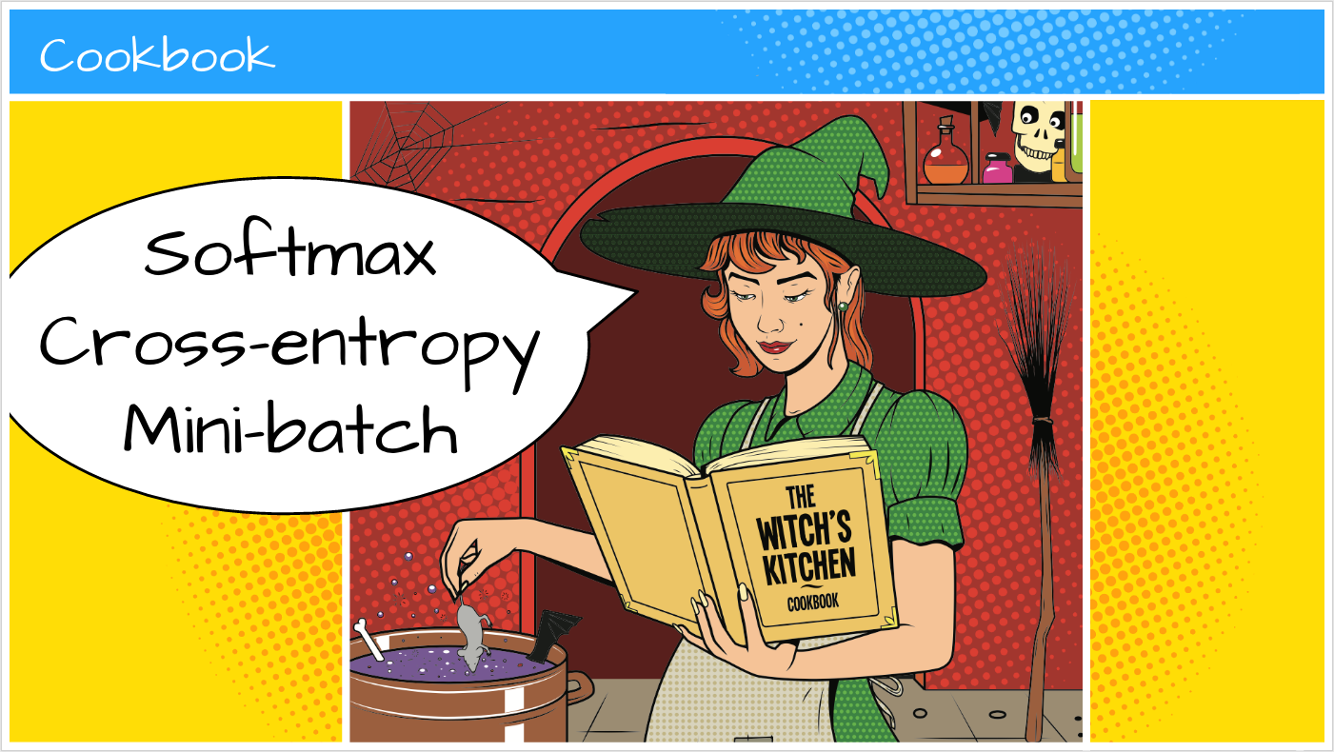
Use Mini-Batches

Slide 8
Use Mini-Batches
Question: Size of the minibatch???

Slide 9
Mini-Batches
Question: Size of the minibatch???
Answer: Powers of 2. Not too small because in this way you cannot exploit the vectorized code. Not too large (deep consequences) because they do not generalize well.
Recommendation: Make it as large as the memory allows, but not larger than 256.

Slide 10
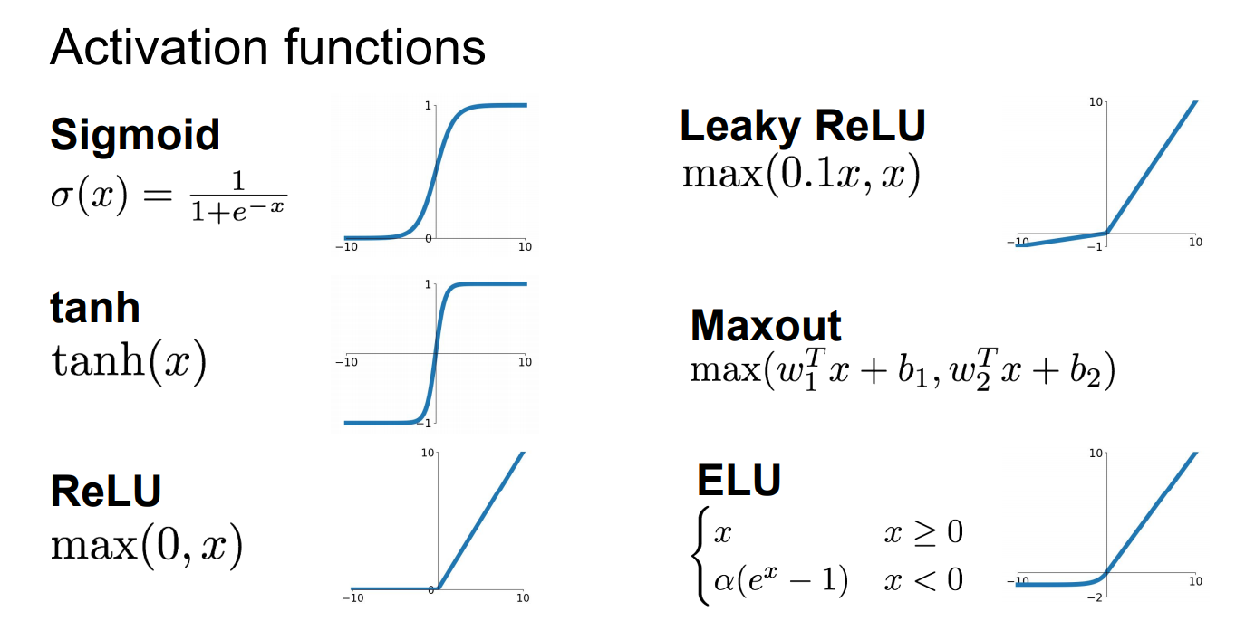

Slide 11
Activation functions
Recommendations:
Use ReLU in fully connected neural networks, convolutional neural networks, discriminator of GANs and variational autoencoders (???).
Use leaky ReLU in generator of GANs, bar the final layer.
Use tanh in the final layer of generator of GANs.
Use sigmoid and tanh in recurrent neural networks.
Use sigmoid in autoencoders (???).
Future:
Swish function could potentially replace ReLU.
It is almost impossible to optimize nets which use RBF.

Slide 12
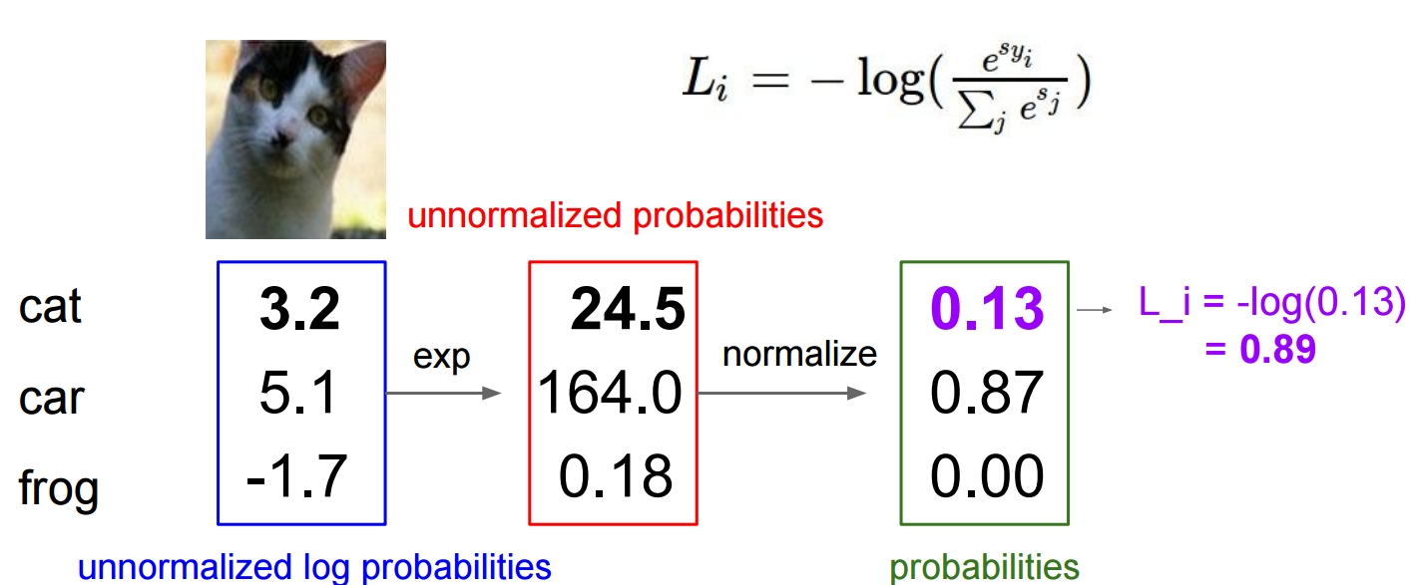
Softmax and Cross Entropy
Credit: Andrej Karpathy

Slide 13
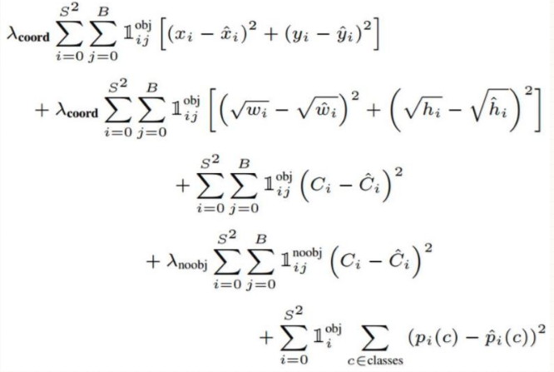
Loss functions
Softmax followed by cross-entropy for classification problems.
If number of classes is too large, use hierarchical softmax.
L2 norm squared for regression problems.
Complicated loss functions which involve many terms for many other problems.

Slide 14
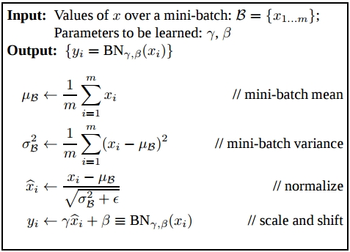
Batch-Normalization - use it
Do normalization using mean and standard deviation on each channel of the image.
Do scaling and shifting.
Find the parameters of scaling and shifting using backpropagation (this is really awesome, why other people didn’t think before about it?!).
Read the paper (Ioffe and Szegedy)
Follow up: Batch-renormalization

Slide 15
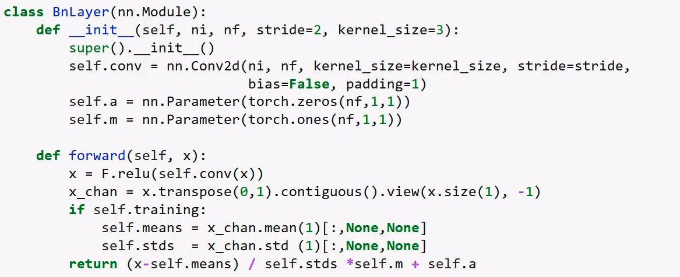
Batch-Normalization - PyTorch

Slide 16
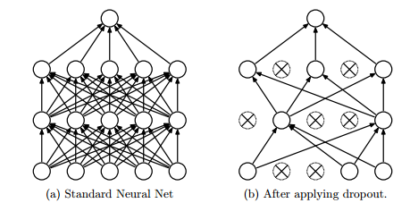
Consider using dropout (and L2 regularization)
Yet another regularizer (Srivastava et al., 2014).
Could be interpreted as an ensemble neural network.
That doesn’t mean that you shouldn’t also use L2 regularization.
Advanced: variational dropout. A series of papers from Yarin Gal.

Slide 17
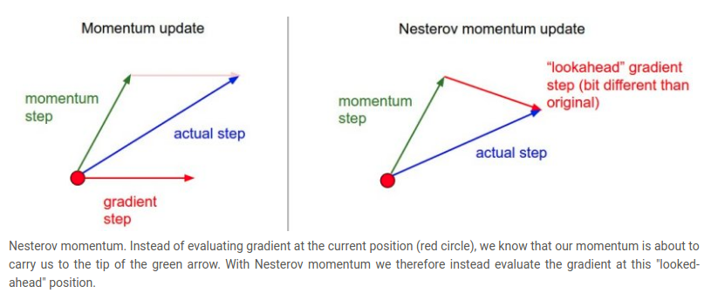
Different Optimizers - beyond SGD
Momentum and Nesterov’s Momentum
Credit: Andrej Karpathy

Slide 18
Adaptive optimizers
Adagrad, RMSProp, Adadelta, Adam are all popular choices.
Adam in particular is extremely famous (6k+ citations in 3 years).
Adaptive methods do not generalize as well as gradient descent. But it is easier to train a neural network with an adaptive optimizer.

Slide 19
Adaptive optimizers
Adagrad, RMSProp, Adadelta, Adam are all popular choices.
Adam in particular is extremely famous (5k+ citations in 3 years).
Adaptive methods do not generalize as well as gradient descent. But it is easier to train a neural network with an adaptive optimizer.
Recommendation: Use SGD with momentum if you want state-of-the-art results. Use Adam if you want to train e neural network fast. Use Adam when optimizing the generator in GANs.

Slide 20
Adaptive optimizers
Adagrad, RMSProp, Adadelta, Adam are all popular choices.
Adam in particular is extremely famous (5k+ citations in 3 years).
Adaptive methods do not generalize as well as gradient descent. But it is easier to train a neural network with an adaptive optimizer.
Recommendation: Use SGD with momentum if you want state-of-the-art results. Use Adam if you want to train a neural network fast. Use Adam when optimizing the generator in GANs.
Food for thought: Why not Newton’s method?

Slide 21
What about the learning rate of the optimizer?
Solution - Trial and error. Try different learning rates and choose the one which works best in the validation set.

Slide 22
What about the learning rate of the optimizer?
Solution - Trial and error. Try different learning rates and choose the one which works best in the validation set.
Solution++ - As a baseline, use what other people are using in a similar problem. If you use ResNet, start with the same learning rate Kaiming He used (0.1; divide by 10 when the error plateaus; momentum 0.9). If you use Adam as optimizer, Karpathy’s constant works well in practice.

Slide 23
What about the learning rate of the optimizer?
Solution - Trial and error. Try different learning rates and choose the one which works best in the validation set.
Solution++ - As a baseline, use what other people are using in a similar problem. If you use ResNet, start with the same learning rate Kaiming He used (0.1; divide by 10 when the error plateaus; momentum 0.9). If you use Adam as optimizer, Karpathy’s constant works well in practice.
Solution# - Combine the previous two solutions.

Slide 24
Initialization of weights
(Bad) Initialize weights with 0 and watch the neural network burn. :(
(Bad) Initialize weights to the same number and watch all the neurons do the same thing. :(

Slide 25
Initialization of weights
(Bad) Initialize weights with 0 and watch the neural network burn. :(
(Bad) Initialize weights to the same number and watch all the neurons do the same thing. :(
Initialize weights to small random numbers W = 0.01* np.random.randn(D,H) where randn samples from a zero mean, unit standard deviation gaussian.
Recommendation: Use Xavier initialization w = np.random.randn(n) / sqrt(n) or if you are using ReLU, use He initialization w = np.random.randn(n) * sqrt(2.0/n)

Slide 26
Initialization of weights
(Bad) Initialize weights with 0 and watch the neural network burn. :(
(Bad) Initialize weights to the same number and watch all the neurons do the same thing. :(
Initialize weights to small random numbers W = 0.01* np.random.randn(D,H) where randn samples from a zero mean, unit standard deviation gaussian.
Recommendation: Use Xavier initialization w = np.random.randn(n) / sqrt(n) or if you are using ReLU, use He initialization w = np.random.randn(n) * sqrt(2.0/n)
Biases usually are initialized to 0.

Slide 27
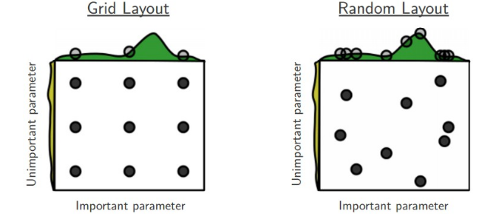
Hyperparameters search
The number of hyperparameters is very large on neural networks ( # hyperparameters >> 10).
There are a lot of rules of thumb for some of the hyperparameters, and intuition for many others.
Grid search is totally unfeasible, random search (Bergstra and Bengio, 2012) works much better.
Future: Bayesian hyper-optimization, gradient-based hyper-optimization.

Slide 28
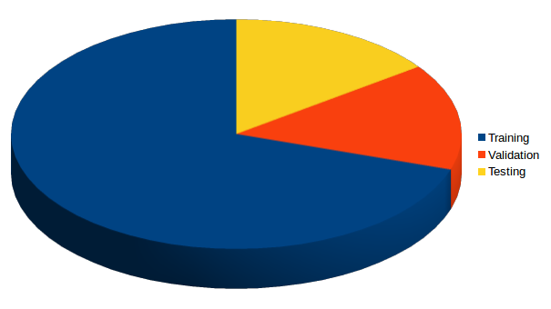
Testing set is not enough anymore (if it ever was)!
On traditional machine learning, there are some very bad people who split the data into just training and testing sets (crime against data).
That is wrong. It is double wrong to do so in deep neural nets. Overfitting is certain.
Use always a validation set.
Pedro Domingos’ paper is a must read on this (and many other useful things to know, extra points for being easy to read).
Use common sense for the split. While before the 50-25-25 and 60-20-20 splits were common, with the introduction of large datasets, you see extreme splits like 90-5-5 or even 98-1-1.

Slide 29
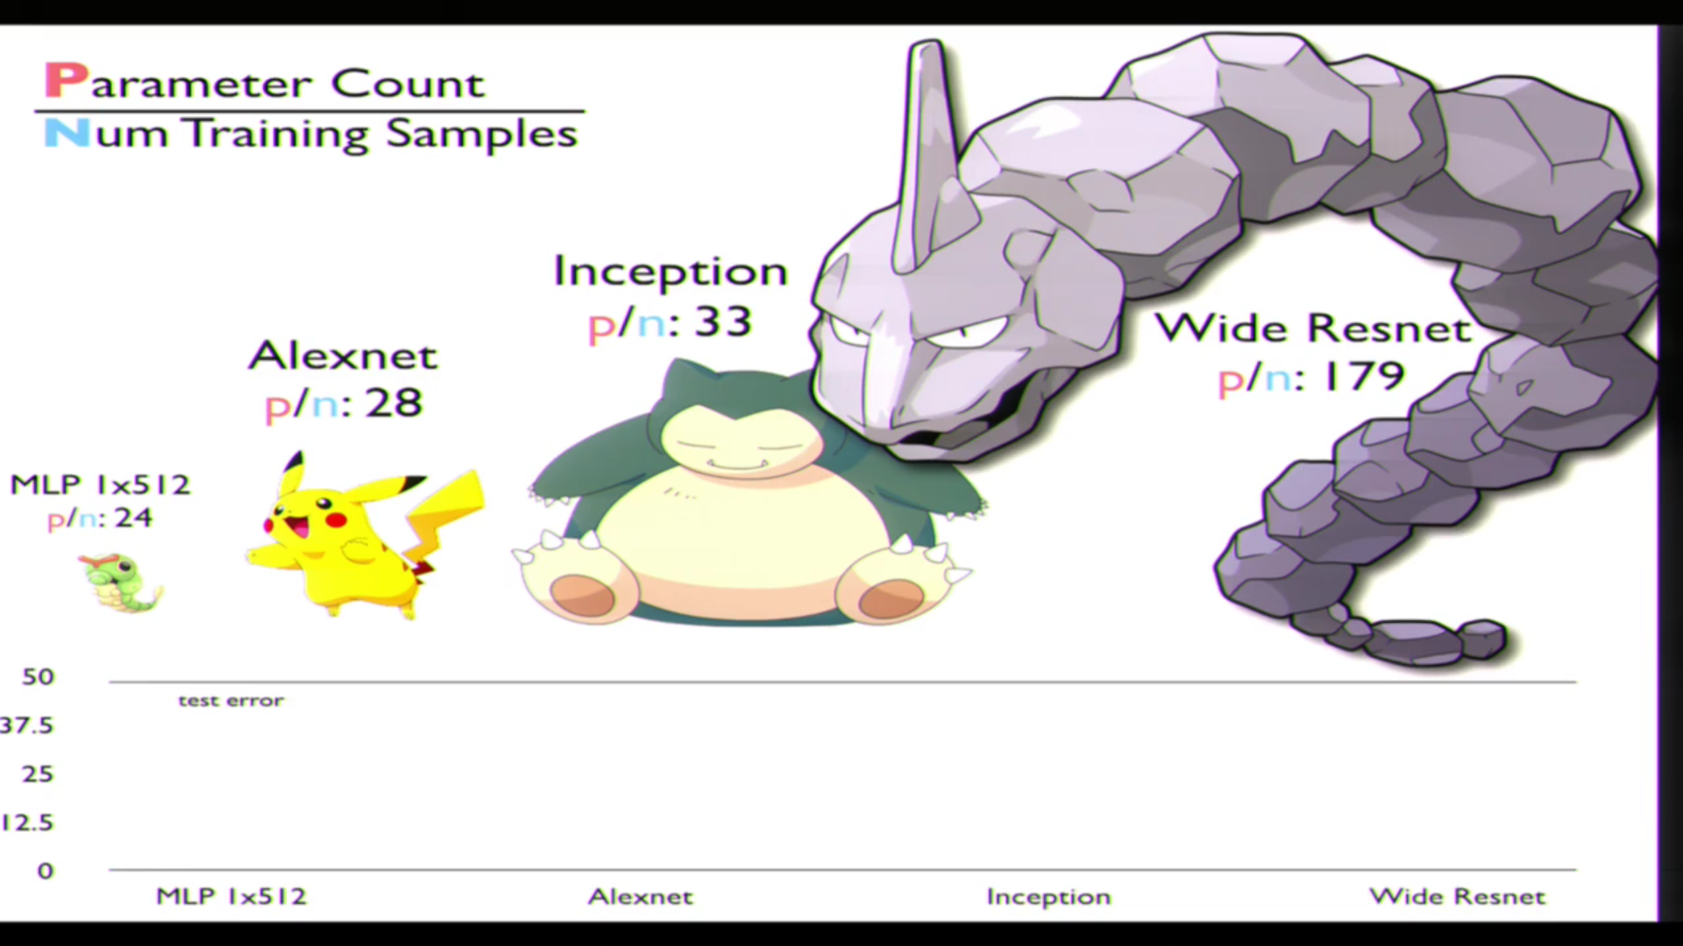
Large models are not evil
Credit: C. Zhang

Slide 30
Theory: Remember VC dimension, forget VC dimension!
Theory in deep learning is still lacking. While some researchers (Poggio, Bolcskei, Tishby etc) are doing fundamental theoretical research, deep learning is still not guided from theory.
Ironically, a lot of theoretical justifications, totally fail when it comes to deep learning, and are potentially harmful.
VC dimension is one of those. VC-dim = O(d * dim(w))
Understanding Deep Learning Requires Rethinking Generalization (ICLR 2017).
An interesting survey-like paper on generalization (NIPS 2017).
Naftali Tishby studies deep learning from information theoretical point of view. His lecture is impressive.

Slide 31
Use transfer learning - whenever is possible
Modern CNNs take potentially several weeks to be trained in a cluster of GPUs.
Instead of training a CNN from the scratch, download a pretrained one, remove the last layer, and finetune it.
This not only it saves a lot of precious time, but it can also give you better results.
Morale of the story: Use transfer learning in CNNs.
Joke of the day: No-one has ever trained a neural net from the scratch. Everyone just finetunes the first neural net.

Slide 32
How to do transfer learning?
If dataset is large:
Finetune the entire network.
Else:
If dataset is similar to the dataset the net is trained on:
Finetune only the last layer (linear classifier), freeze the other layers.
Else:
Train a linear classifier from previous layer codes.
NB: Typically, a smaller learning rate is used for finetuning. Interesting paper on transfer learning. Food for thought: What does large, smaller and similar means?

Slide 33
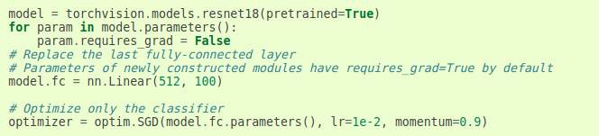
Finetuning - PyTorch

Slide 34
Finetuning - PyTorch
Notice, that we are freezing all layers bar the last one (fc)

Slide 35
Thank you!
Questions about deep learning, the universe and everything?

