Slide 1
The Robotics Club-SNIST
TEAM-12

Slide 2
SMART STREET LIGHTS

Slide 3
Problem Statement
Now a days generally during day time and when there is no vehicle movement at night time, the continues ON of street lights on the roads consumes a lot of energy. And the overspeeding of the vehicles during night time is the major concern on the highways. As there is a chance of leading to accidents.

Slide 4
Idea or Approach
The Smart Street light provides a solution for energy saving which is achieved by sensing an approaching vehicle using the IR sensors.
A block of street lights glow for a particular period of time when the IR sensors are detected .
The LDR sensors keeps the street light off in the day time even when vehicle is detected.
The speed of the vehicle can also be detected using IR sensors and the speed is displayed on the LCD.
When a vehicle is detected of overspeeding an alert is send to the nearest checkpost.

Slide 5
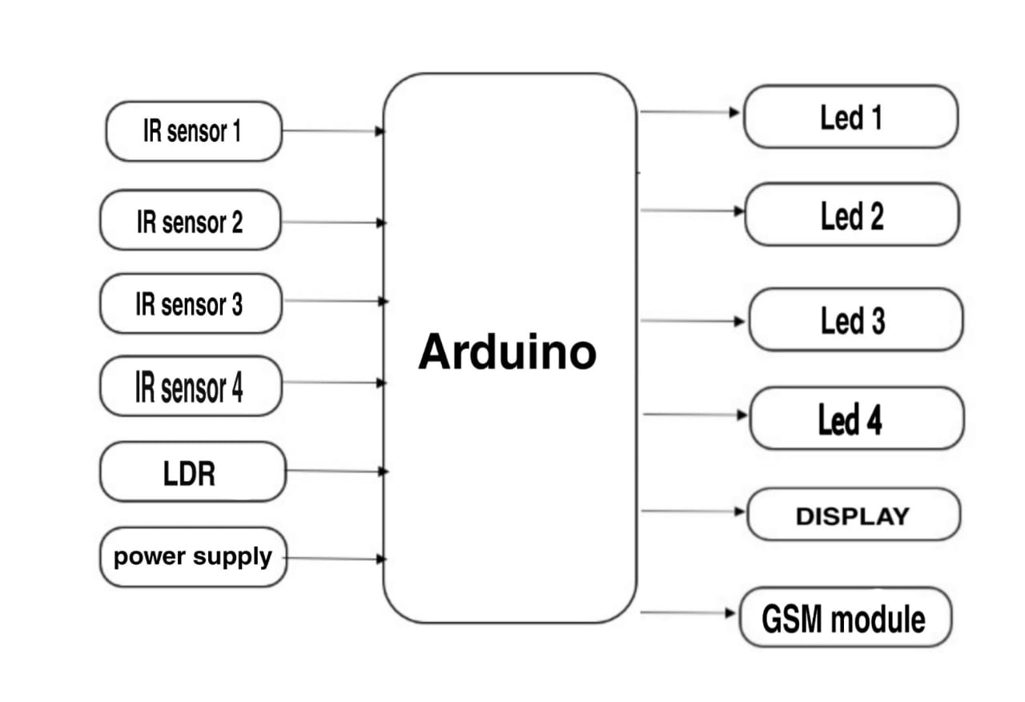
Block Diagram

Slide 6
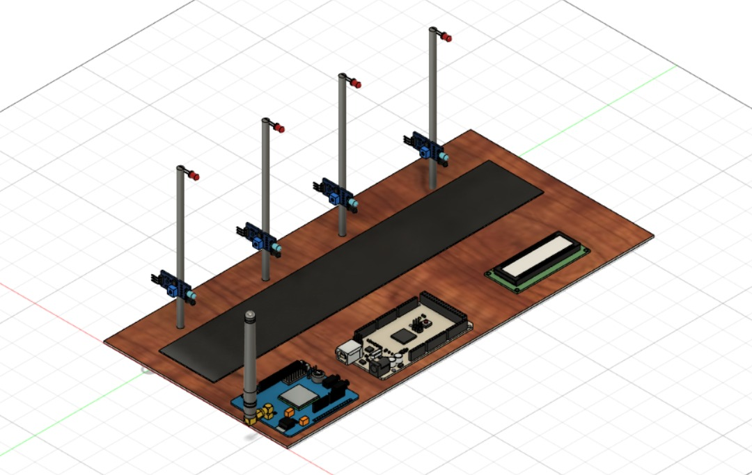
CAD DESIGN

Slide 7
Future Enhancement
In future we can modify in the way that when a vehicle is overspeeding we can capture the number plate of the vehicle and we can send fine to the particular mobile number.

Slide 8
Conclusion
We can save the energy by turning on the street lights only in the night time when vehicle is detected.
We can detect the speed and can send fines to the vehicles which are overspeeding with the help of live streaming

