Slide 1
PRASAAR Automated Foot Massager for Healthcare
THE ROBOTICS CLUB-SNIST INDUCTION‘22
Team 2

Slide 2
Problem Statement
Now-a-days we all observe that most people fall unconscious due to improper oxygen supply and also prone to death if immediate care is not provided. Poor circulation happens when something interferes with your complex, far-reaching circulatory system that delivers blood, oxygen and nutrients to your entire body. It is difficult to provide proper care to a person when the affected person is alone or asleep.

Slide 3
Approach
To automate the process of boosting circulation and reducing human effort, the team propounds an automatic foot massager using a combination of sensors, vibration motors and microcontrollers. A heart rate monitor will constantly read the patient’s pulse. When the pulse drops below a certain threshold, the foot massager will activate and stimulate the arteries and veins in the patient’s feet until the pulse rises to a safe level again. It activates when the oxygen level in blood drops below 80 percent and works until the normal oxygen percentage is restored.

Slide 4
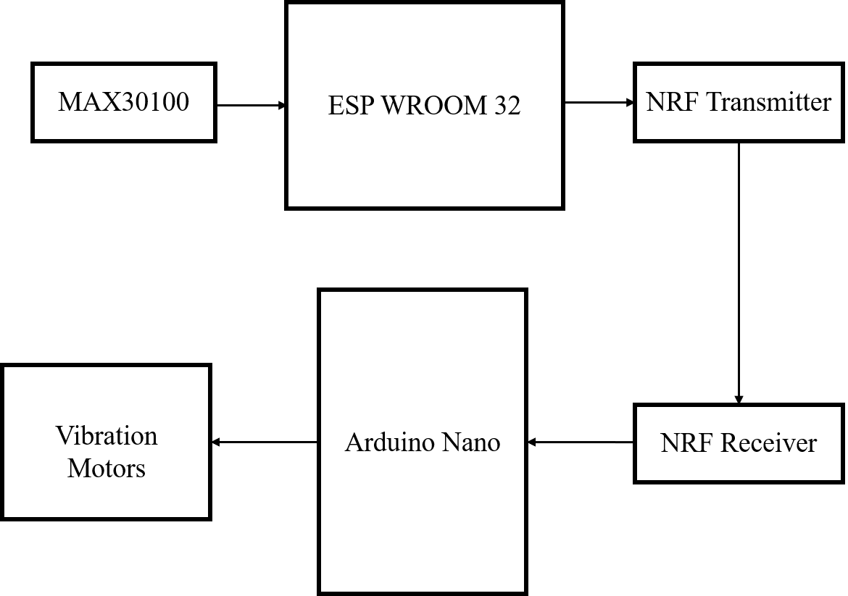
Block Diagram

Slide 5
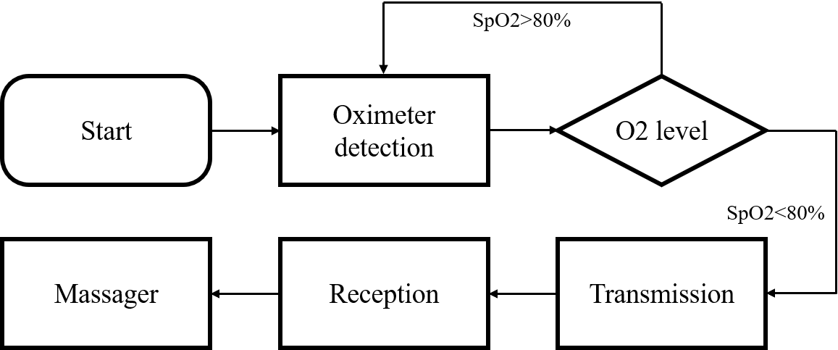
Working

Slide 6
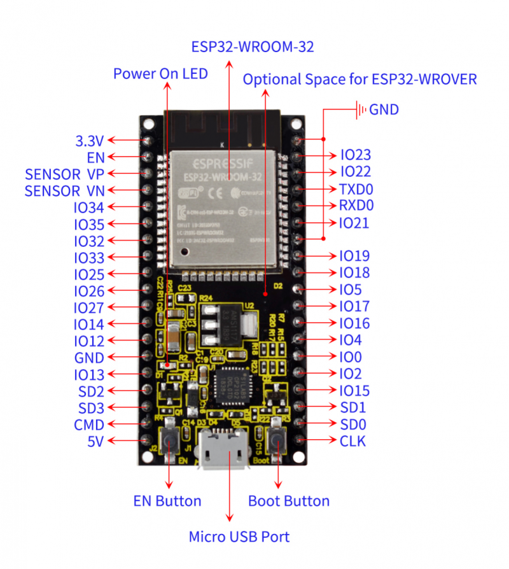
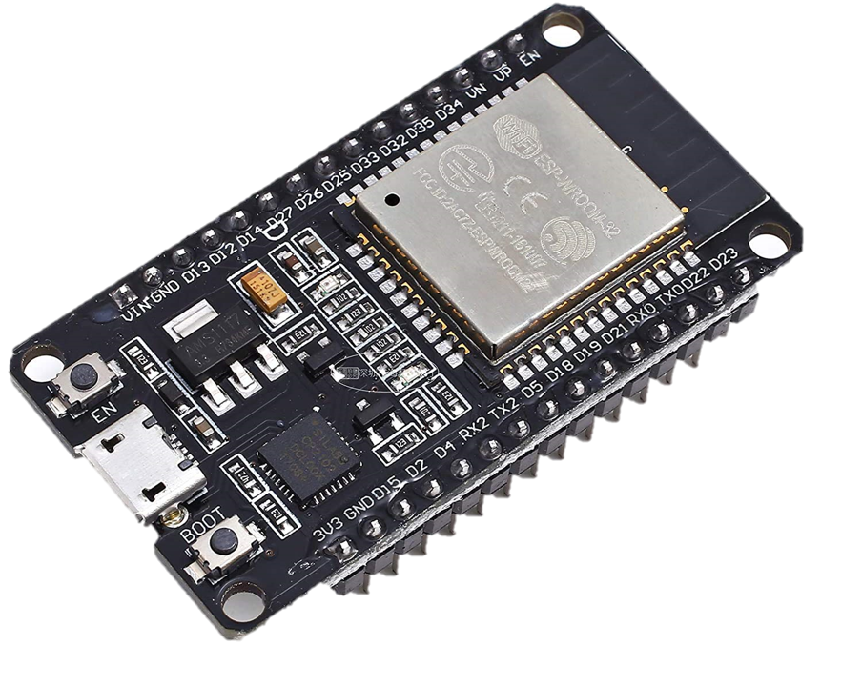
Components
ESP WROOM 32

Slide 7
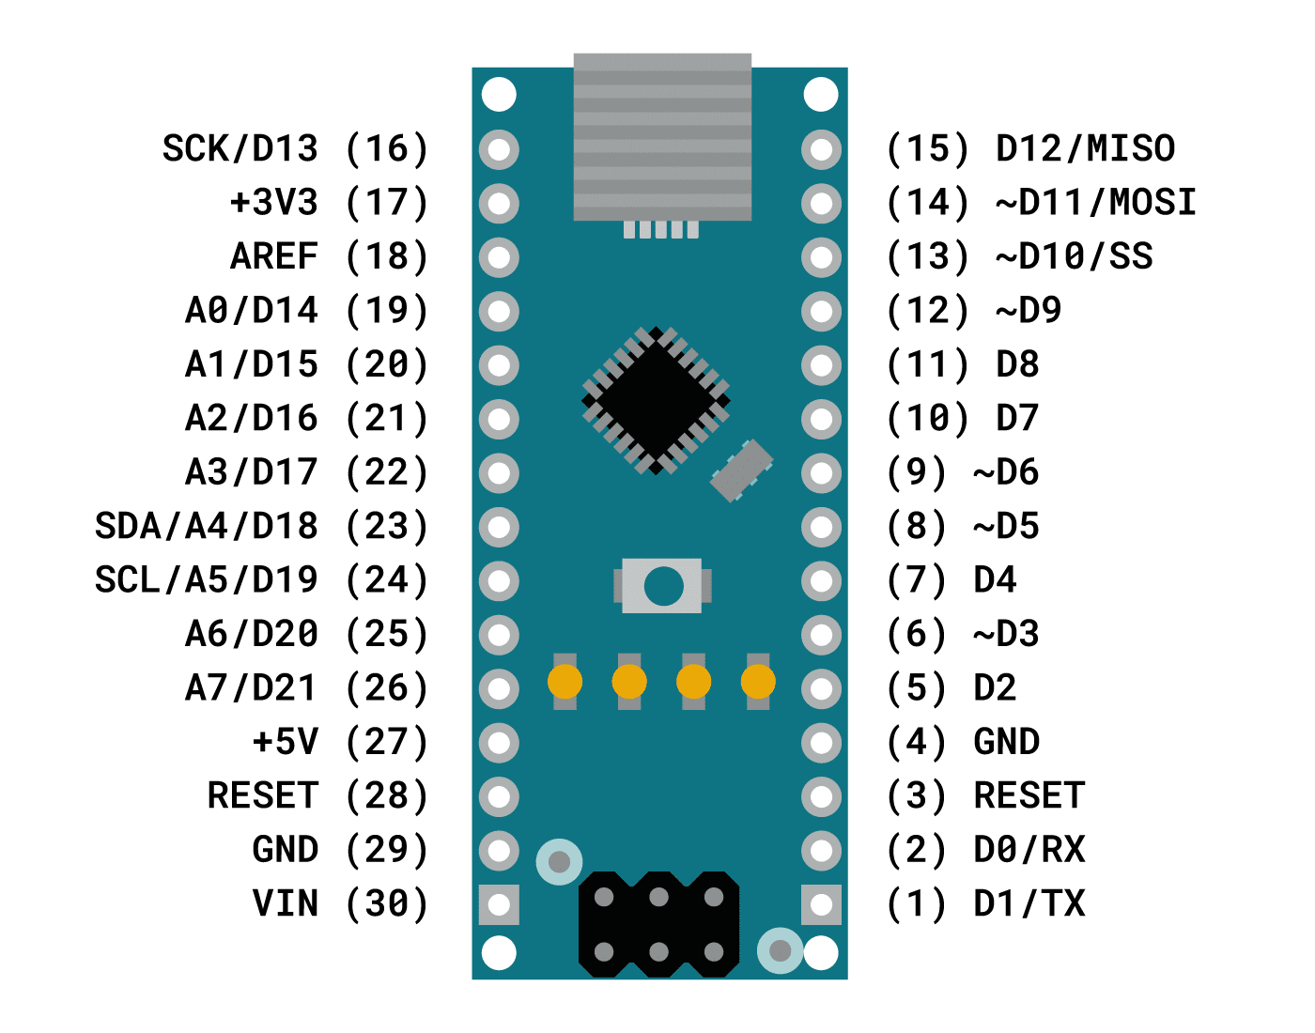
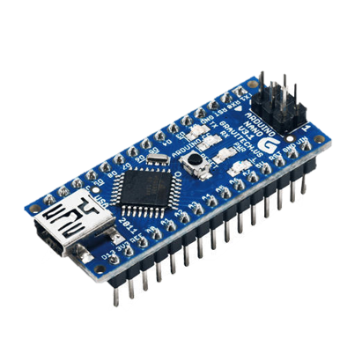
Components
Arduino Nano

Slide 8
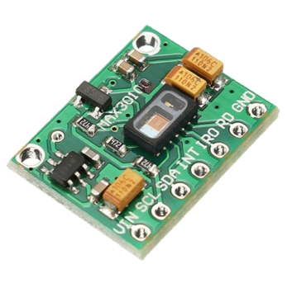
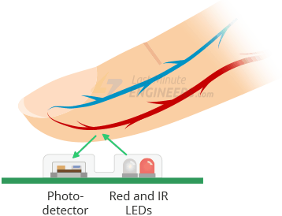
Components
MAX30100 Oximeter

Slide 9
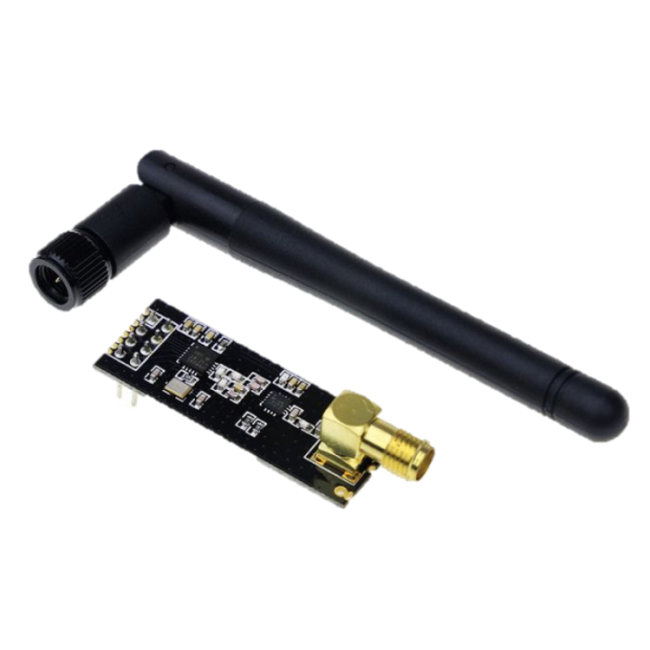
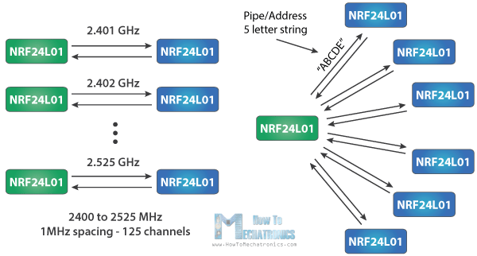
Components
NRF24L01

Slide 10
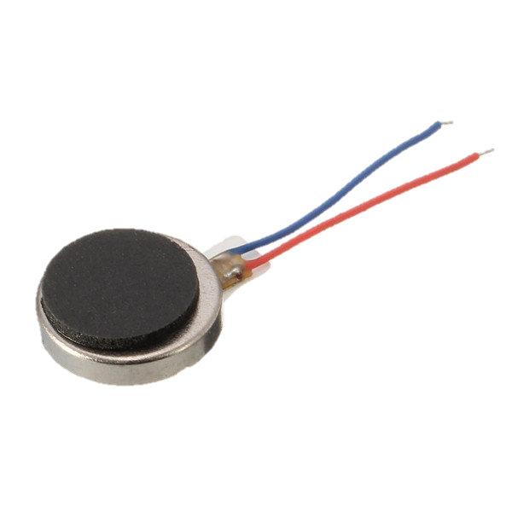
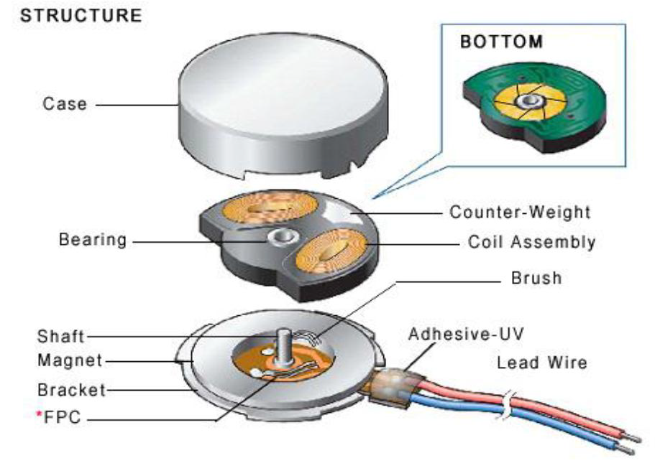
Components
Vibration Motors

