Slide 1
The Robotics Club-SNIST
INDUCTION 22

Slide 2
Team 06
KEETA
NASHAKA

Slide 3
PROBLEM STATEMENT
The spraying of pesticides plays a vital role in farming. But due to chemicals present in pesticides, there are many side effects to the farmers like skin diseases and other problems while spraying. To overcome this problem declaration, we require some robot which sprays the pesticides over the plants.
IDEA/APPROACH
The spraying of pesticides plays a vital role in farming. But due to chemicals present in pesticides, there are many side effects to the farmers like skin diseases and other problems while spraying. To overcome this assertion, we require a robot that sprays pesticides over the plants.

Slide 4
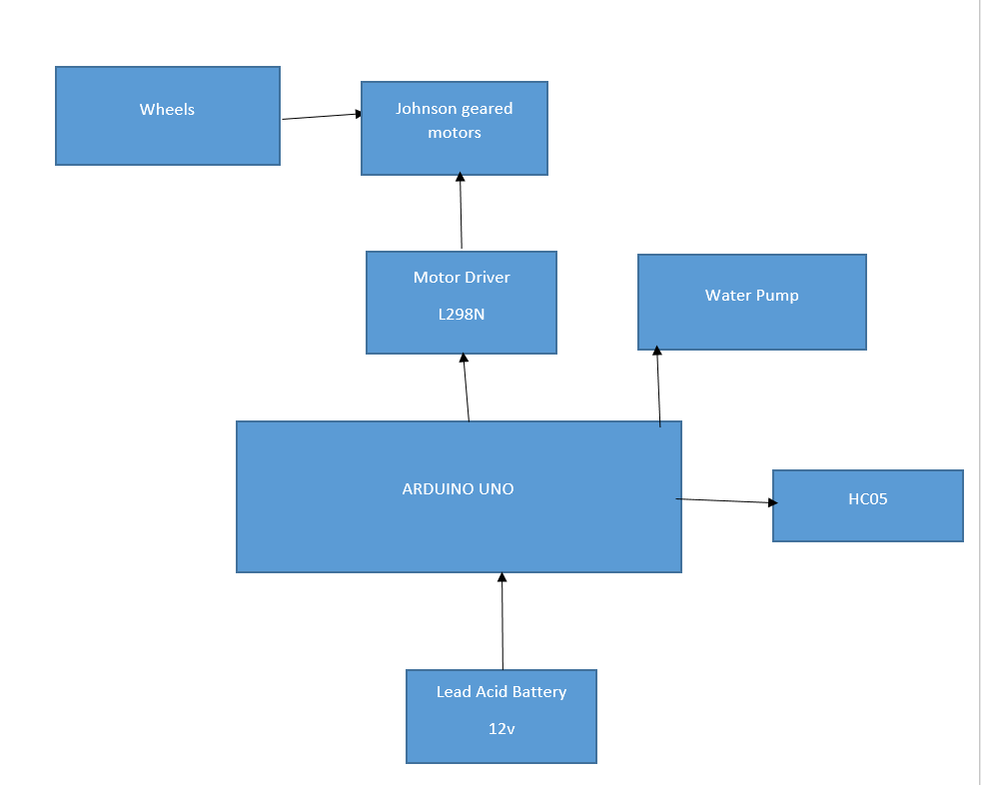
BLOCK DIAGRAM

Slide 5
Thank You

