Slide 1
Connecting Rooms
Presentation by:
Rochak Saini
Puneet Chawla
Ritik Agarwal
Suyash Agarwal
Saksham Gupta

Slide 2
Home automation for Hosteliers, Disabled at low cost.

Slide 3
Why less home automation in India
Considered complicated.
Easy solutions not available in India.
Considered costly.
Senior citizens not willing to try new technologies.

Slide 4
Why home automation
Sit back and relax.
Hands-free mode.
Device-select mode.
All controllable with one app.
Easy to use interface.

Slide 5
Circuit Diagram

Slide 6
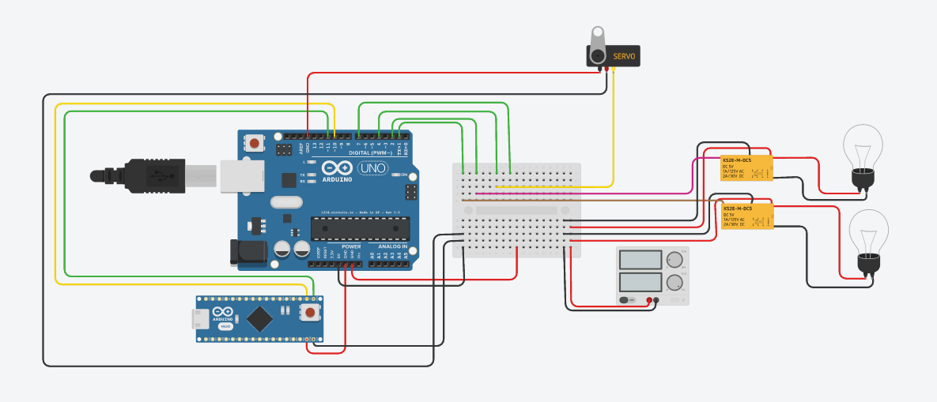


Slide 7
Implementation

Slide 8
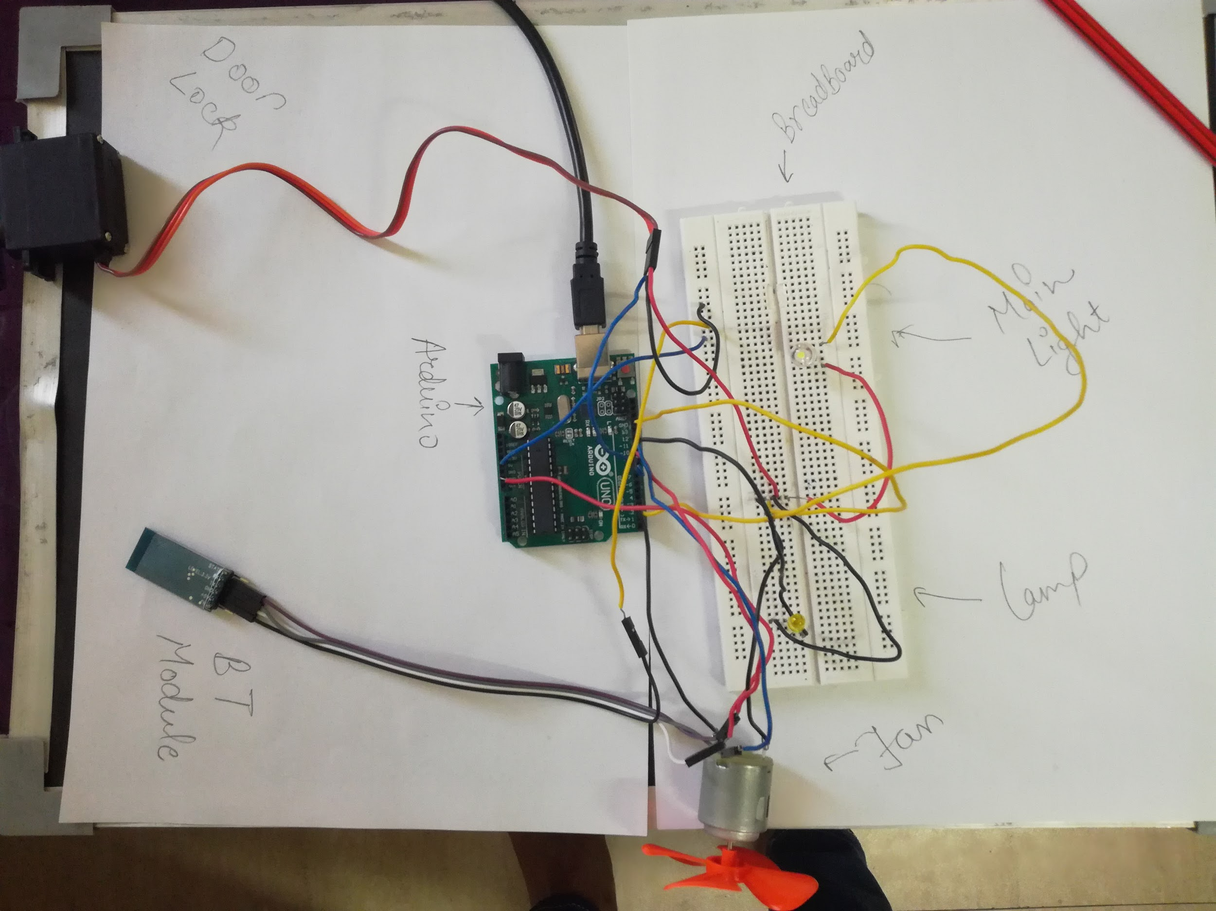

Slide 9
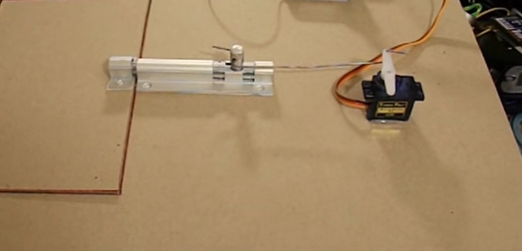

Slide 10
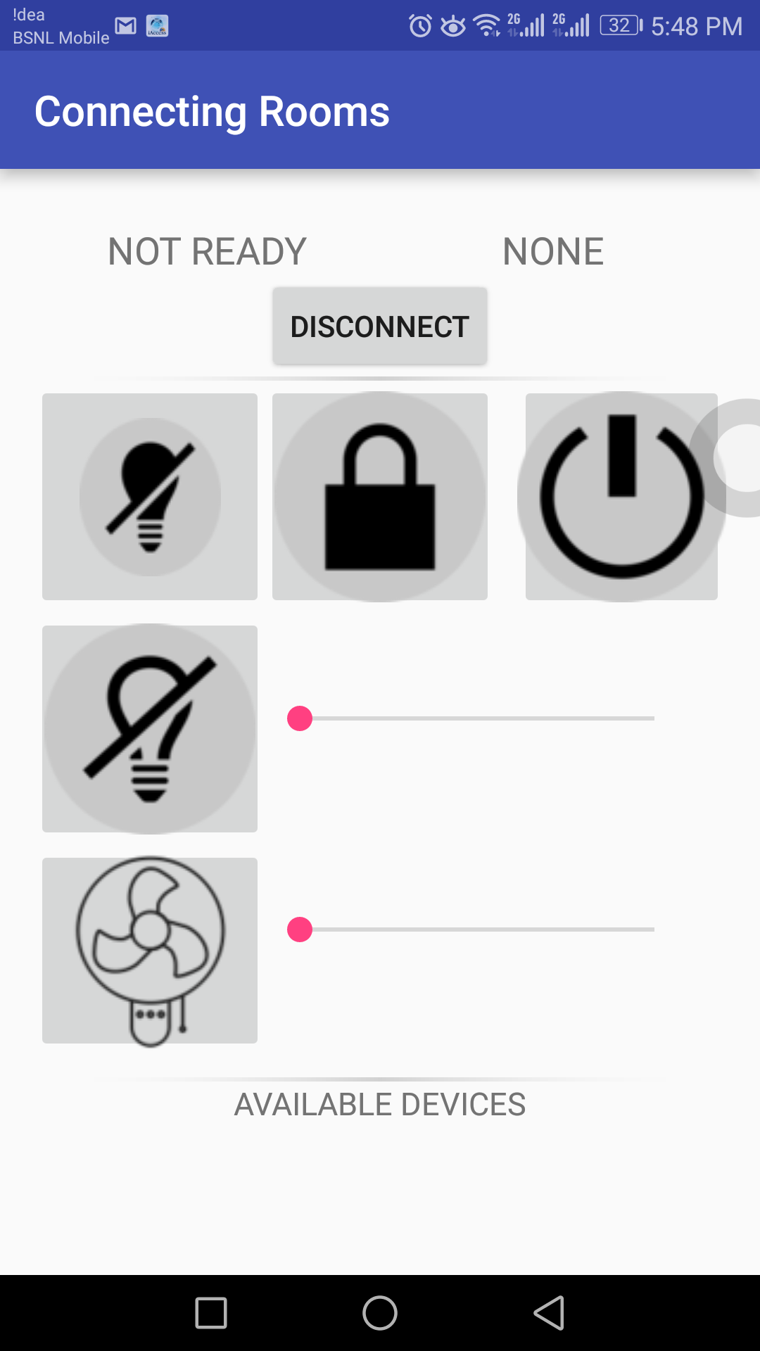
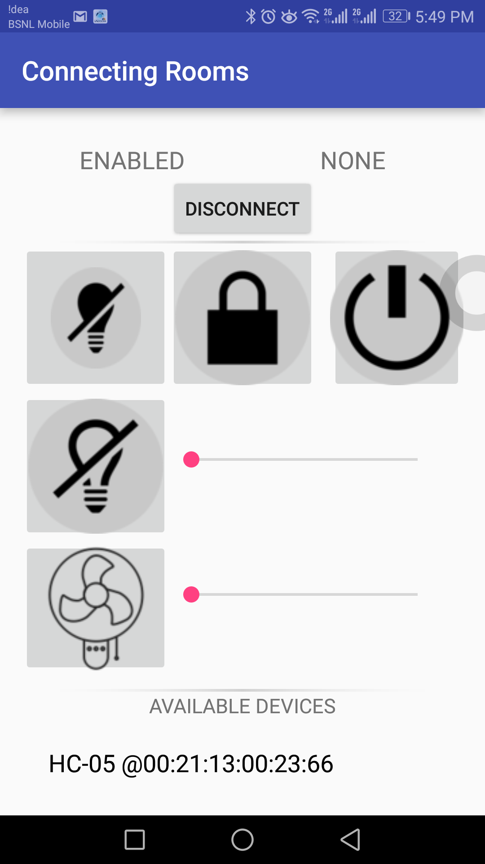
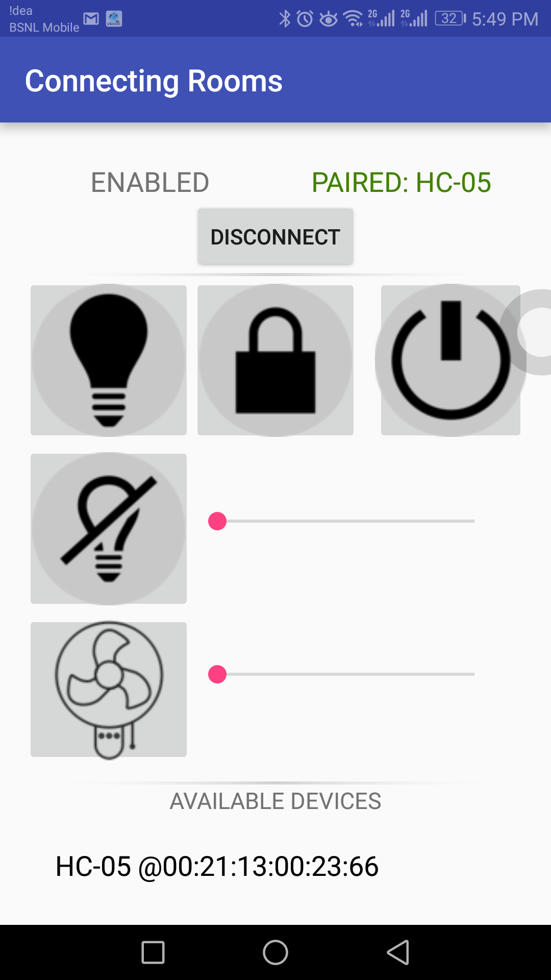
Screenshots of the Application

Slide 11
THANK YOU

