Slide 1
Paper review: Do Spatial Designs Outperform Classic Experimental Designs?
Javier Fernández González
18/10/2022

Slide 2
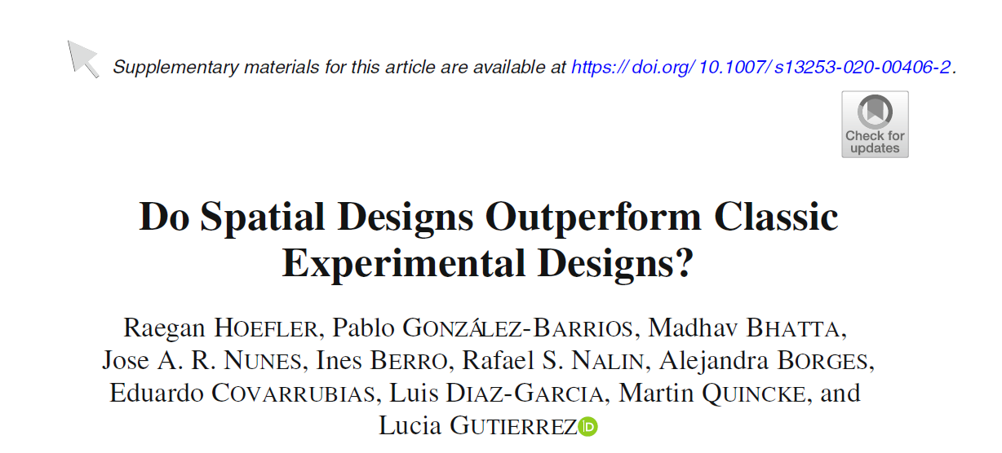
Notes:
Eg. treatment effect = genotypic effect.

Slide 3
Some basic concepts in experimental designs:
Treatment: anything that can affect the measured traits. In breeding we are usually interested in the effect of the genotype → treatment = genotype
The field is divided in plots. The plot is the basic experimental unit. For instance, if treatment = genotype, a single plot contains several plants with the same genotype. Having many plants in a plot allows to reduce the noise (you can estimate the average trait across all of them, which is more reliable the more plants you have). However, large plots require more space → more expensive and a larger field is usually more heterogenous (therefore, there will be more environmental variability within the field, which can be problematic).
Blocks: several plots can be grouped into blocks to try and control for the environmental variability within the field (as the field is divided into several smaller blocks, environment within a block is more homogeneous than within the larger entire field). The block is usually assumed to have a uniform environment, and generally the closer the reality gets to this assumption the better.
Replications: replicating a genotype in different positions within the field allows to better discriminate between actual genotypic effects and effects caused by the non-uniform environment within the field. The problem of replicating is that it increases the cost of the experiment for a given number of genotypes/it reduces the number of genotypes tested for a given field size.
Notes:
Hide this slide for a presentation. I included it here because it is useful for begginers

Slide 4
Introduction
Spatial heterogeneity in a field due to fertility, moisture, slope, shade, or management practices can bias the estimation of treatment effects (in this case, treatment = genotypic effects)
Deal with spatial heterogeinity:
Good experimental designs
Analysis after experiment: using a plot’s position to correct for spatial patterns through trend analysis (e.g autoregressive procceses)
Objectives:
Study effectiveness of spatial corrections in the analysis step with data obtained with classical experimental design
Analyze performance of experimental designs that take into account spatial corrections from the beginning
Notes:
Eg. treatment effect = genotypic effect.

Slide 5


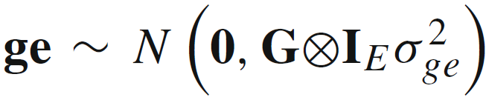
Spatial corrections: mixed model
Spatial corrections can be included in the modelling step.The model with spatial corrections used in this paper was the following:
trait
mean
Environmental effect (fixed)
Block effect
Residual error
i → genotype
j → environment
k → replicate
l → row
m → column
row effect (random)
Genotypic effect (random)
GxE
sdaasdf
G = genomic relationship matrix
column effect (random)
Notes:
Eg. treatment effect = genotypic effect.

Slide 6
Spatial corrections: autoregressive process
What is the variance-covariance structure of the row and column random effects?
We can model them using autoregression
We assume that closer plots in the row/column will have a higher correlation
Notes:
Eg. treatment effect = genotypic effect.

Slide 7
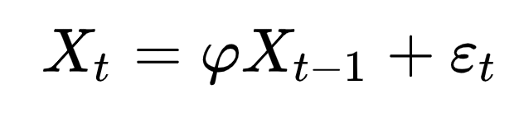
Spatial corrections: autoregressive process
Autoregressive process of order 1 (AR1): each element in a series depends on the previous one + an error.
The series can be a time series or it can be related to spatial position (e.g. first, second, etc. elements in a row or column).
Current element
Autoregressive parameter
Previous element
Previously known or estimated using REML or cross validation
Notes:
Eg. treatment effect = genotypic effect.

Slide 8
Spatial corrections: autoregressive process
Autoregressive process of order 1 (AR1): each element in a series depends on the previous one + an error.
The series can be a time series or it can be related to spatial position (e.g. first, second, etc. elements in a row or column).
Current element
Signal
Error
Notes:
Eg. treatment effect = genotypic effect.

Slide 9
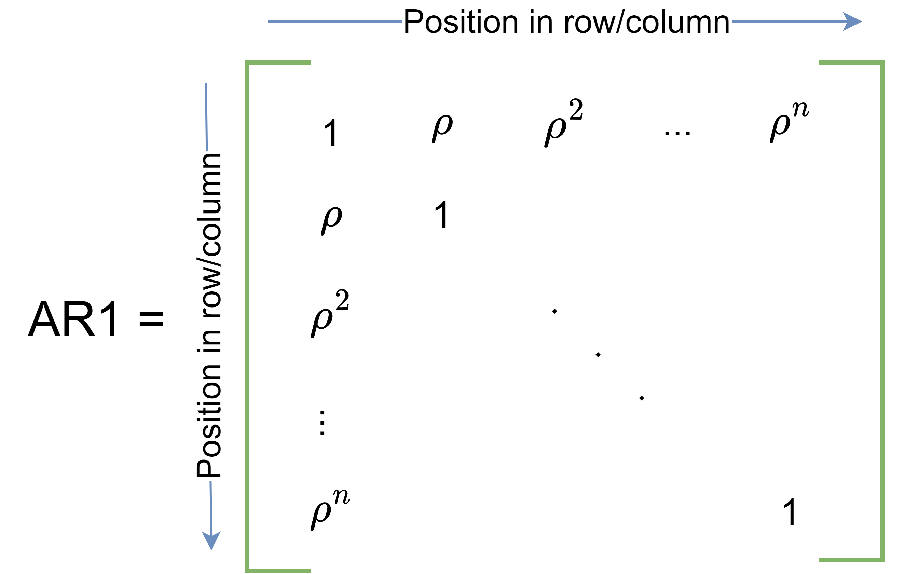
Spatial corrections: autoregressive process
Autoregression can be used to generate a relationship matrix (AR1)
Closer individuals will have a higher correlation (rho < 1)
Notes:
Eg. treatment effect = genotypic effect.

Slide 10
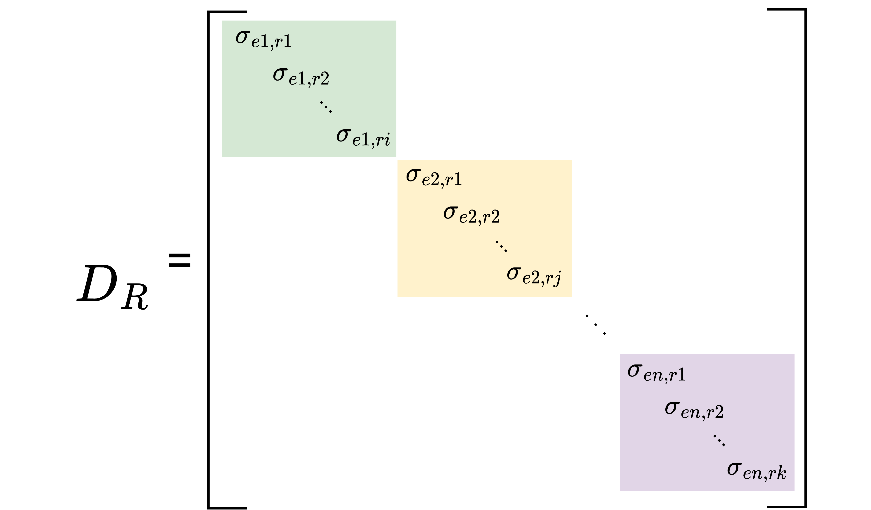
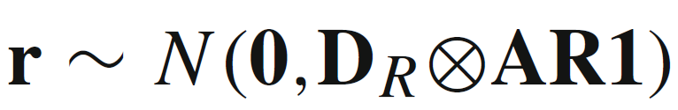
Spatial corrections: autoregressive process
How to use AR1 for a random effect?
Row random effect (r) includes AR1 in the variance-covariance structure:
DR = Diagonal block matrix for row variances within environments
Notes:
Eg. treatment effect = genotypic effect.

Slide 11
Spatial corrections: autoregressive process
Column effects can be modelled in the same way as row effects (row+column = 2D autoregression, AR1xAR1)
In this paper there were two independent effects for row and column effects due to software constraints (Convergence, time?)
It is possible (and probably better) to account for row and column effects with a single, combined random effect. I’m not sure how but it probably involves a Kronecker product of the row and column variance-covariance structures.
Notes:
Eg. treatment effect = genotypic effect.

Slide 12
Methodology recap
Let’s remember the objectives of the paper:
Study effectiveness of spatial corrections (autoregression) in the analysis step of data obtained with classical experimental design
Analyze performance of experimental designs that take into account spatial corrections (autoregression) from the beginning
Which designs were tested?
Testing a lot of designs in field trials is very expensive → some simulation was used to reduce costs.
Notes:
Eg. treatment effect = genotypic effect.

Slide 13
Experimental designs tested
Unreplicated (UNREP): all genotypes tested once in each environment
Complete randomized design (CRD): all genotypes tested twice in each environment, random disposition
Notes:
Eg. treatment effect = genotypic effect.

Slide 14
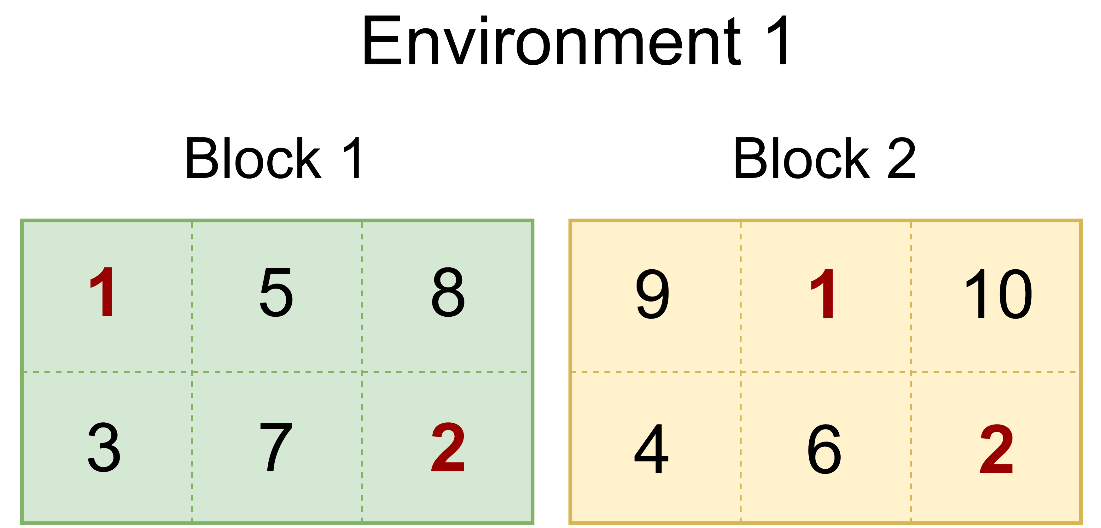
Experimental designs tested
Partially replicated designs (PREP):
80% of lines tested unreplicated (random position)
20% of lines (checks) in a randomized complete block design (2 reps → 2 blocks, each replicated genotype is exactly once in each block, random position)
Example:
Genotypes 1,2: replicated
Genotypes 3-10: unreplicated
2 blocks of 6 plots each
Notes:
Eg. treatment effect = genotypic effect.

Slide 15
Experimental designs tested
In PREP the replicated genotypes are the same ones across environments
PREP variations:
PREPg:
Same number of genotypes as in CRD
Less plots required than CRD
PREPn:
Same number of plots as in CRD
More genotypes tested than in CRD
Augmented PREP (A-PREP): same as regular PREP but replicated genotypes are different across environments
There are A-PREPg and A-PREPn
Notes:
Eg. treatment effect = genotypic effect.

Slide 16


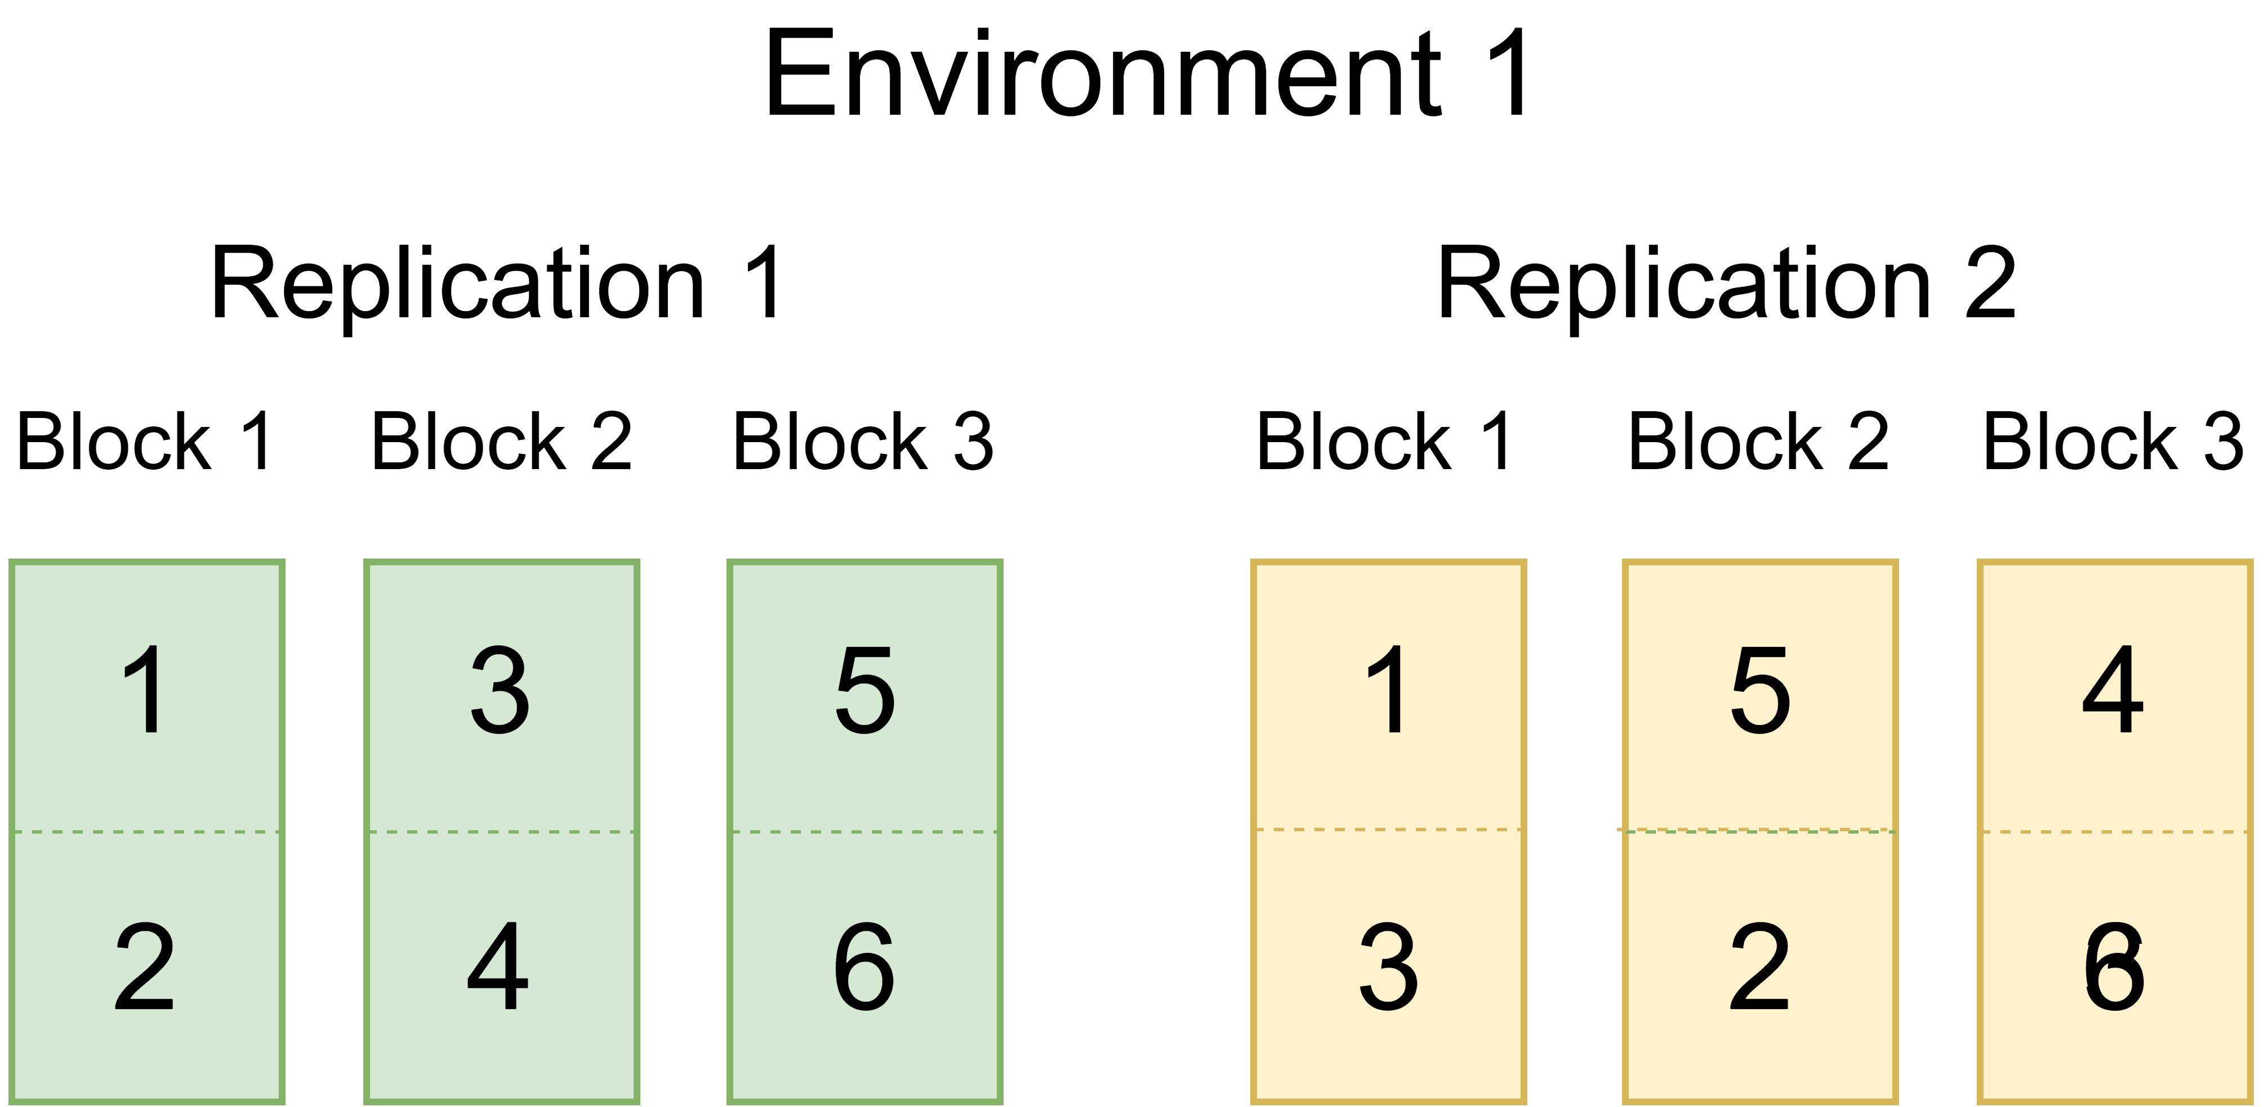
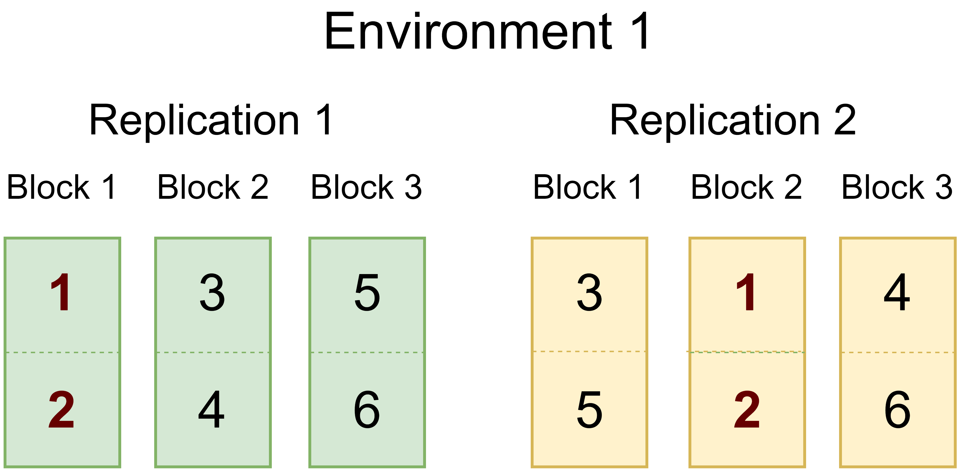
Experimental designs tested
Alpha lattice:
2 complete replications
Order (0,1) → each pair of genotypes appears 0 or 1 time across block
See example with 6 genotypes, 2 reps with 3 incomplete blocks of size 2 each (blocks are incomplete because to be complete they need to have all genotypes):
Repeated pairs

Slide 17
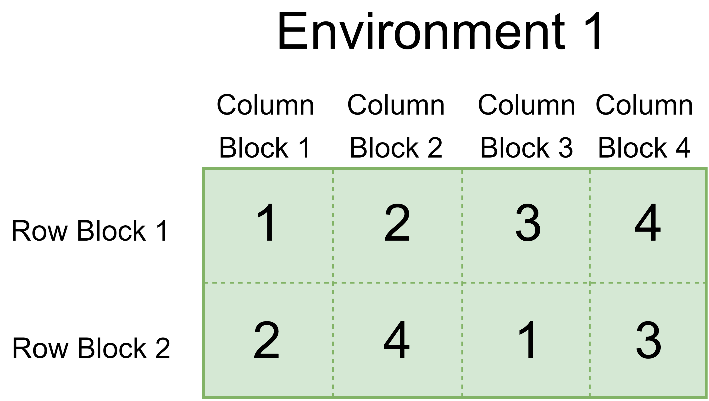
Experimental designs tested
Row-column alpha-lattice design (R-CD)
Same as before but now both rows and columns are incomplete blocks
Order (0,1) → no repeating pairs of genotypes in different rows/columns. I’m not sure if rows and columns are independent for this (ie. Can a pair that appears once in the rows also appear once in the columns?)
Example:
Genotypes 1-4, all replicated
No repeated pairs within rows/columns
Pair 1,2 appears both in a row and in a column. Is this allowed?

Slide 18
Experimental designs tested
Spatial experimental designs (SP)
It’s a R-CD design but instead of doing randomization within constraints it performs optimization
Optimization criterion: minimize A-optimality:
It includes row-column information through autoregression (AR1xAR1)
No genotypic information in the optimization criterion
Empirical knowledge about position effects (if available) can be included through the values of the autoregression parameters (rho). This was called SPsite
SP0.8 is a similar design but instead of using empirical data, rho was set to 0.8 for both rows and columns

Slide 19
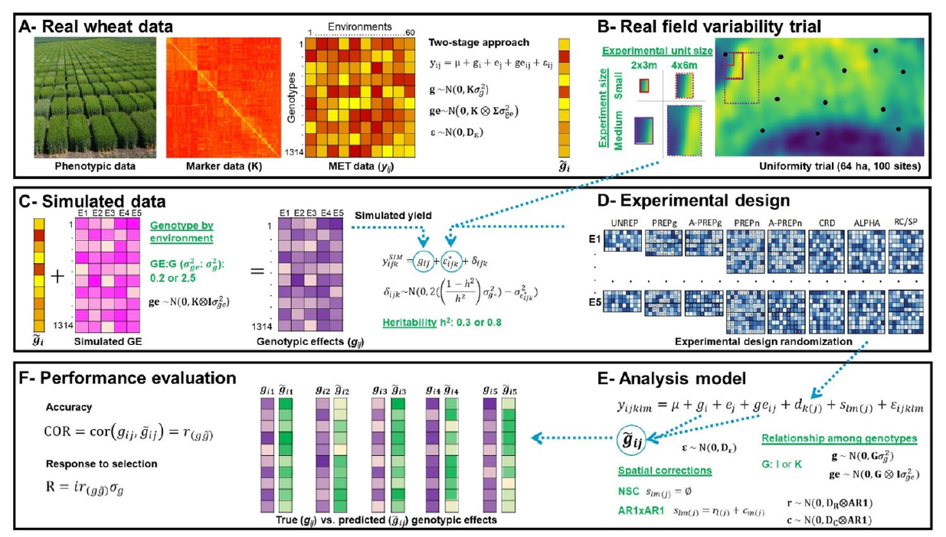
Simulation scheme
Field tests →
Simulate desired designs
→
Statistical analysis
→

Slide 20
Simulation scheme
1) multi-environment field experiments to calculate line GEBVs

Slide 21
Simulation scheme
2) Uniformity trials (estimate plot position effects in several fields) by planting same genotype in all plots

Slide 22
Simulation scheme
3) For each experimental design simulate phenotypes:
real GEBVs obtained in step 1 +
row/column effects obtained in step 2 +
GxE effects (2 different levels of GxE tested) +
noise (dependent on heritability, 2 values tested)

Slide 23
Simulation scheme
4) Modelling: test models with and without row/column effects and with and without genotypic information (genomic relationship matrix vs identity)

Slide 24
Simulation scheme
5) Performance evaluation.
Correlation TBV-GEBV
Response to selection (different intensities of selection tested)

Slide 25
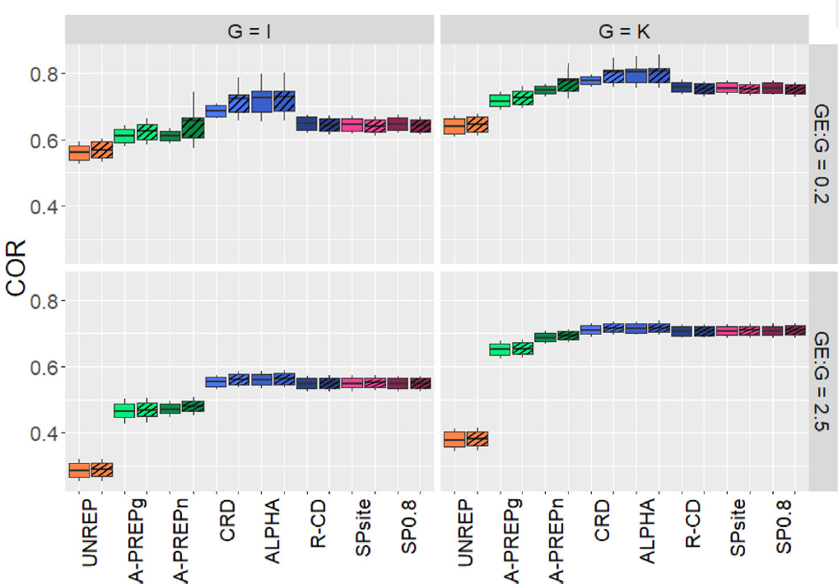
Results
Diagonal pattern: AR1xAR1 correction in model
No pattern: no spatial correction
SPsite and SP0.8 designs are optimized using AR1xAR1 spatial information

Slide 26
Results
AR1xAR1 correction in model barely had any influence in accuracy
ALPHA and R-CD were the best for accuracy, better than SPsite and SP0.8

Slide 27
Results
According to response to selection, PREP designs were the best. They compensate their lower accuracy with the higher number of tested genotypes (no complete replication needed).
More tested genotypes imply that a higher intensity of selection is possible. That’s the reason of the good response to selection with PREP designs

Slide 28
Discussion
In this paper, AR1xAR1 spatial correction had little influence, which contrasts with literature. Why?
The designs used here had small blocks. Therefore, there is low variation within blocks and the block effect in the model is enough to control for spatial variation. No row/column effect needed.
Here, independent random effects for row and column effects were used, while other studies take both of them into account together. This may reduce the performance of spatial corrections

