Slide 1
Predictive Maintenance: An End-to-End IoT System for Real-Time Anomaly Detection
Aditya Kumar Bharti-22CS30007
Nakul sharma-22CS30068

Slide 2
The Problem: The High Cost of Failure
Unexpected Downtime: When industrial machinery fails without warning, it halts production, leading to significant financial losses.
Inefficient Maintenance Schedules: Reactive Maintenance (Run-to-Fail): Fixing things only after they break is costly and disruptive.
Preventive Maintenance (Time-Based): Replacing parts on a fixed schedule can be wasteful, as parts are often replaced before they need to be.
The Goal: A smarter approach is needed—one that monitors machine health in real-time.

Slide 3
The Solution: A Smart Monitoring System
A complete system that automates the process of health monitoring.
LEARN: It first learns the unique, normal "vibration fingerprint" of a machine during a calibration phase.
MONITOR: It then continuously captures and analyzes high-frequency vibration and environmental data in real-time.
ALERT: If the data deviates from the learned baseline, it automatically triggers status changes and sends proactive alerts.
Key Technologies: ESP32, FastAPI (Python), InfluxDB, WebSockets, Chart.js, Telegram Bot API

Slide 4
System Architecture
Phase 1: Simulation
Validated the FFT and anomaly detection algorithms in Python using simulated "normal" and "faulty" vibration data before touching any hardware.
Phase 2: Core Hardware MVP
Built the essential hardware link using just the ESP32 and ADXL345 accelerometer to establish a stable, real-time WebSocket data stream.
Phase 3: Iterative Testing
Confirmed the data pipeline and server logic with real vibration data, ensuring a solid foundation before adding final features like sensors and LEDs.

Slide 5
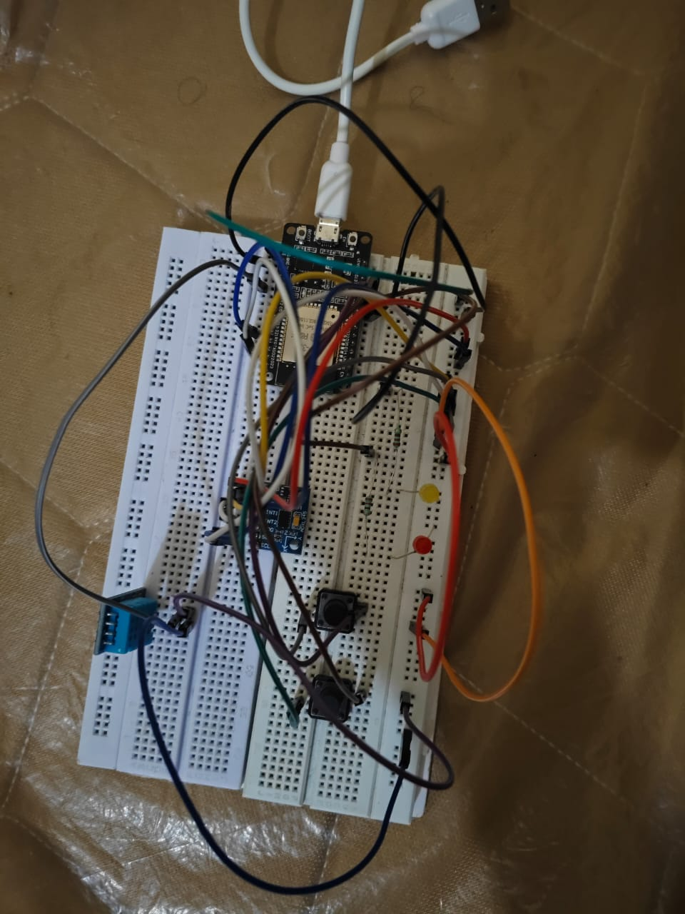
The IoT Device: Data from the Source
Microcontroller: An ESP32 is used for its powerful processor and built-in Wi-Fi capabilities.
Primary Sensor (Vibration): An ADXL345 accelerometer captures high-frequency vibration data (100 samples/second) across X, Y, and Z axes.
Secondary Sensor (Environment): A DHT11 sensor monitors ambient temperature and humidity.
Core Logic (sketch.ino):Establishes a persistent WebSocket connection to the server.
Collects 3,000 samples to create a robust operational baseline.
Streams live data in manageable chunks for real-time analysis.

Slide 6
The Backend Server
Core Framework: Built using FastAPI, a modern, high-performance Python web framework.
Real-time Analysis (main.py): Receives live vibration data via WebSockets.
Applies an Exponential Moving Average (EMA) to smooth the signal.
Performs a Fast Fourier Transform (FFT) to analyze the signal's frequency components.
Anomaly Detection: Compares the peak power (dB) of the live FFT against the learned baseline statistics (mean and standard deviation).
Triggers status changes (active, warning, critical) if thresholds are consistently breached.

Slide 7
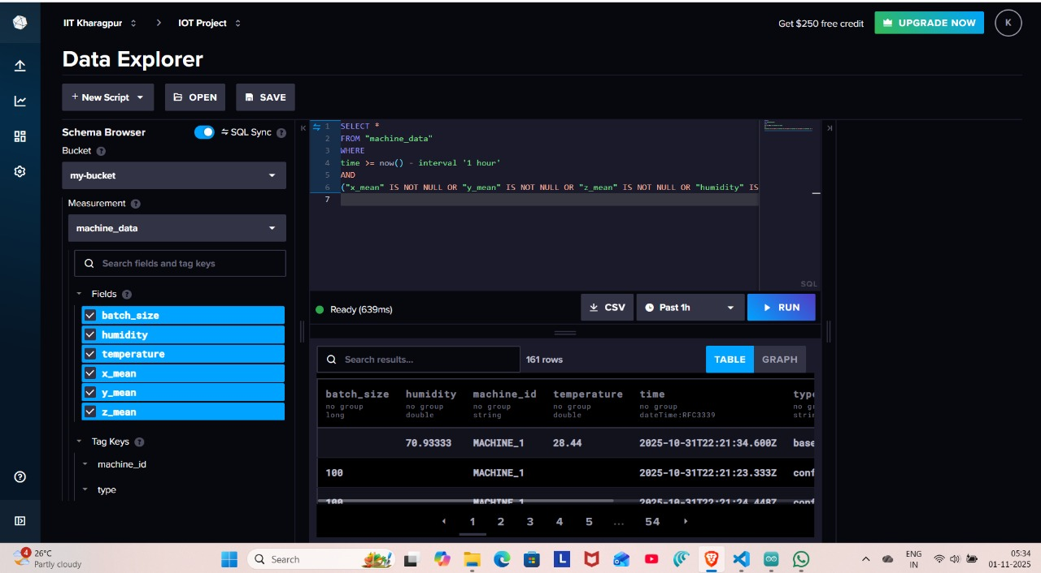
Data Persistence: Storing Data with InfluxDB
The Problem: Raw data disappears if the server restarts. Long-term trend analysis is impossible.
The Solution: All incoming data (vibration aggregates, temperature, humidity) is written to an InfluxDB database.
Why InfluxDB?
It's a Time-Series Database purpose-built for high-speed ingestion and querying of timestamped IoT data.
Provides the foundation for historical analysis and future machine learning model training.
Every data point is now a valuable, long-term asset.

Slide 8
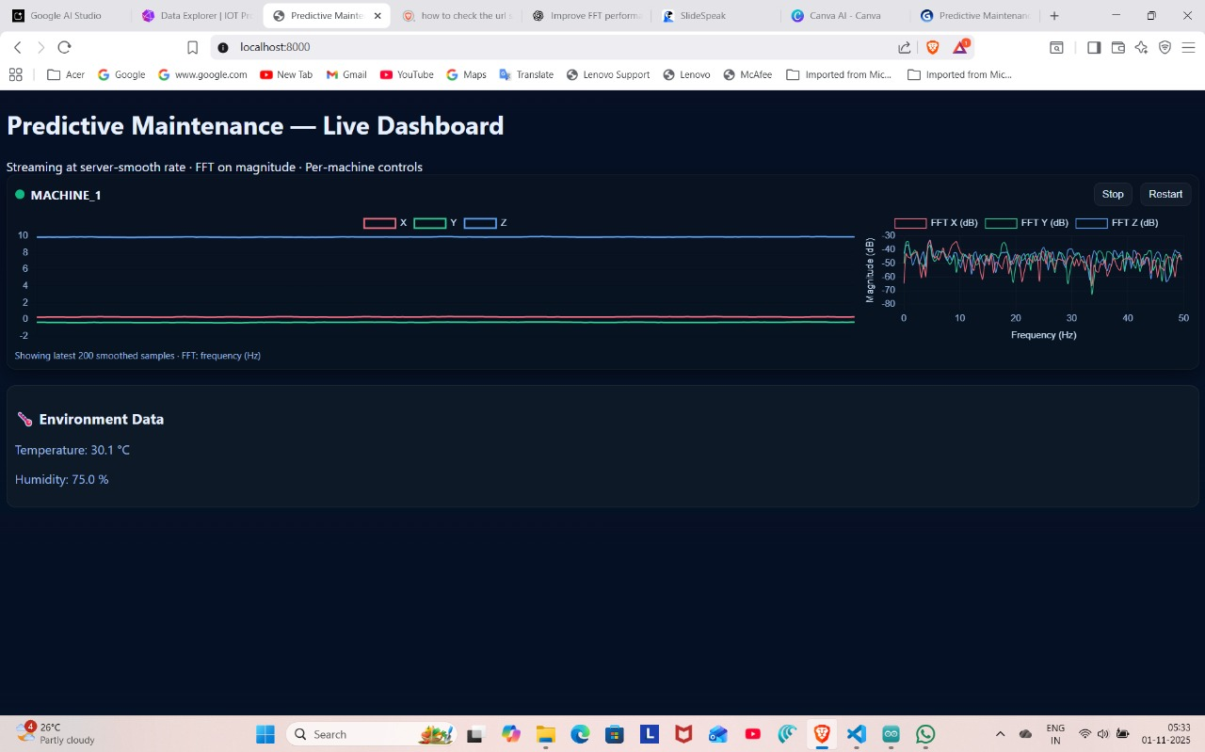
The Live Dashboard
Live Status Indicator: Green (Active), Amber (Warning), Red (Critical) gives an at-a-glance view of machine health.
Real-time Vibration Plot: Shows the smoothed time-series data for all three axes.
Real-time FFT Plot: Visualizes the frequency spectrum, which is key to diagnosing the type of vibration.
Interactive Controls: Allows a user to remotely stop or restart the monitoring process for any machine.

Slide 9
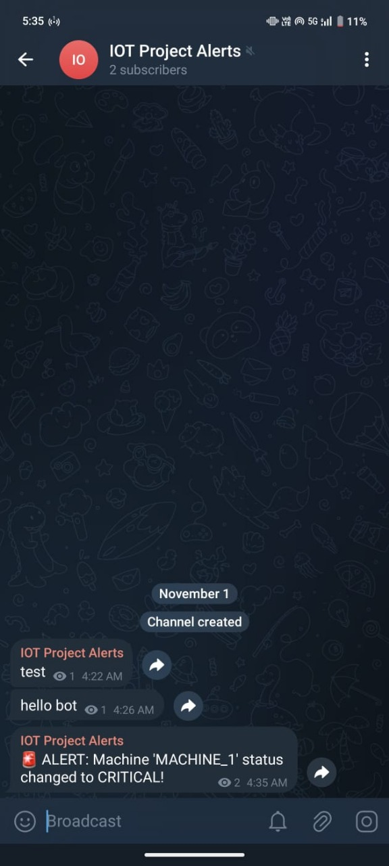
Proactive Alerting with Telegram
Automated Notifications: When the backend server detects a status change to "warning" or "critical," it triggers an immediate alert.
Telegram Bot Integration: A Python script connects to the Telegram Bot API to send a message to a dedicated private channel.
Benefit: Key personnel are notified instantly on their phones, no matter where they are, allowing for rapid response to potential failures.

Slide 10
The Future: Integrating Machine Learning
Current Limitation: The statistical model is effective but relies on fixed thresholds. It may not catch complex, multi-variate patterns.
Proposed ML Model: An unsupervised anomaly detection model, such as Isolation Forest or a One-Class SVM.
The Workflow: Collect Data: Use the data already being stored in InfluxDB to build a large dataset of "normal" operation.
Train Offline: Train the model to learn the complex boundaries of normal behavior.
Deploy for Inference: Load the trained model into the FastAPI server to predict in real-time if incoming data is an anomaly.

Slide 11
Challenges & Key Learnings
Data Handling: Managing high-frequency (100Hz) data required efficient chunking and a robust WebSocket connection to avoid overwhelming the server.
Baseline is Everything: The accuracy of the entire system depends entirely on collecting a clean, representative baseline. Any noise during calibration directly impacts performance.
End-to-End Complexity: Integrating five major components (Hardware -> Server -> Database -> Dashboard -> Alerts) required careful planning and debugging at each interface.

Slide 12
THANK YOU

