Slide 1
Predictive Maintenance: An End-to-End IoT System for Real-Time Anomaly Detection
Aditya Kumar Bharti - 22CS30007
Nakul sharma - 22CS30068

Slide 2
The Problem: The High Cost of Failure
Component failures : Failure of a component (Machines) in industries can cause disrupt in the entire production.
Cure : Generally , machine failed and then we fix. Here we will be trying to analyze the machine health and avoid and possible failures.

Slide 3
Solution : A smart Monitoring System
We are developing a system that can monitor the health of machine.
Baseline : Our Blackbox(Machine Maintainer) will first learn the ideal vibrations and temperatures of the machine.
Monitoring : After that our maintainer will keep tracking the conditions of machine and will sent it to the server for analysis.
Warning : if server finds any unusual behaviour pattern it will send signals to the maintainer which will be visual and can be taken action of.
Technolies and hardwares used: ESP32, FastAPI (Python), InfluxDB, WebSockets, Chart.js, Telegram Bot API

Slide 4
System Architecture
1. IoT Device (The Edge) | 2. Backend Server (The Brain) | 3. User Interfaces (The View)
Hardware / Components: ESP32 Microcontroller ADXL345 Accelerometer DHT11 Temp/Humidity Sensor | Core Stack: FastAPI & Uvicorn (Python) WebSocket Management Real-time Data Analysis (FFT) Data Persistence (InfluxDB) Alerting via Telegram API | Interface Features: Real-time Web Dashboard Live Vibration & FFT Charts Machine Status Indicators Manual Controls (Stop/Restart) Proactive Telegram Alerts Instant Notifications on Status Change
Responsibilities: Data collection Baseline Calibration Secure WebSocket Connection | Responsibilities: Anomaly Detection Logic Real-time Processing & Storage Telegram Alert Management | Responsibilities: Visualization of Metrics User Control Interface Display Alerts & Logs

Slide 5
Previous work
So far , we were up to our Simulation . We had modelled our Maintainer.
We had created the hardware circuits(excluding temperature sensors + Leds) and verified the flow of data from maintainer to the server.
We had performed a naïve FFT(with no fine tuning).So our system was not working so well.

Slide 6
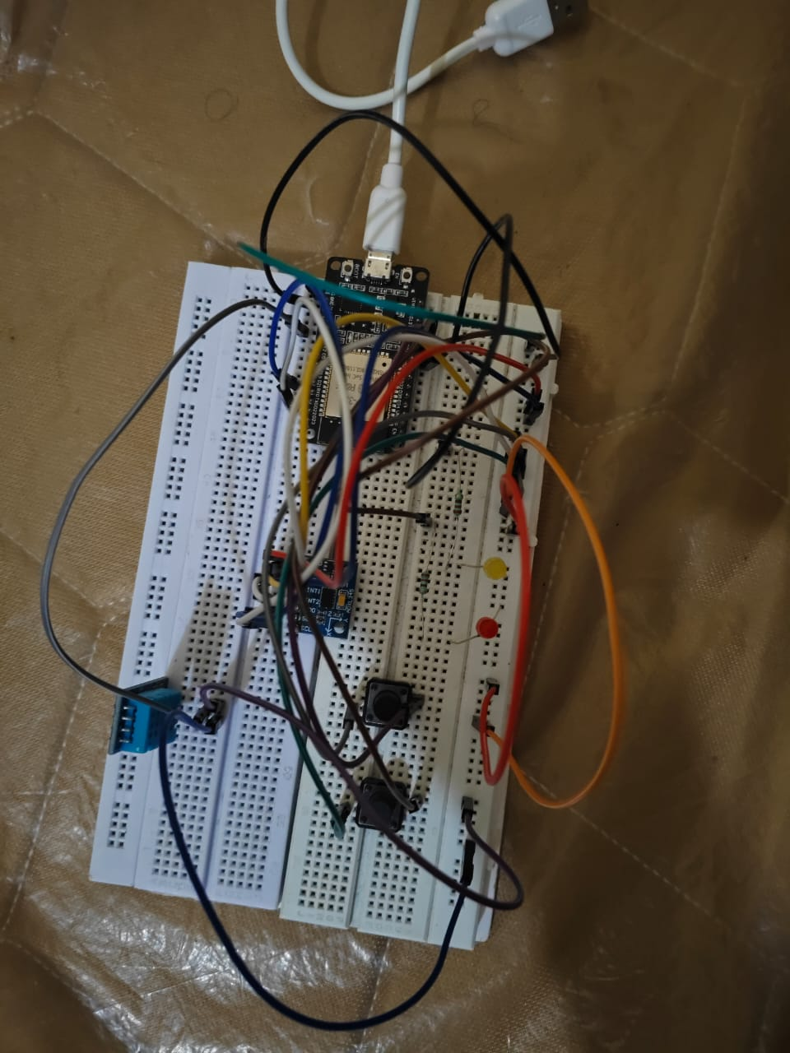
The IoT Device : Our maintainer
ESP32 : This is brain of our device. It helps sending the data collected by sensors and perform tasks like lighting the LEDs.
ADXL345 : This is accelerometer , it measures vibration across x,y and z-axes.
DHT11 : This sensed the temperature and humidity.
(sketch.ino): Establishes a persistent WebSocket connection to the server and drive the ESP32.
For baseline configuration , we are collecting 3000 samples.

Slide 7
The Backend Server
Framework: we built using FASTAPI python web framework.
Main.py : Our Server , it receives the data from the ESP32 and analyze it.
To average out the noise , in baseline configuration data , we have used the EMA(exponential moving average).
We have performed FFT fined tuned using Welch Algorithm to analyze the vibrations .
We are comparing the Baeline Configuration to data collected during monitoring phase.
Accordingly , we sent the signal to our Maintainer.

Slide 8
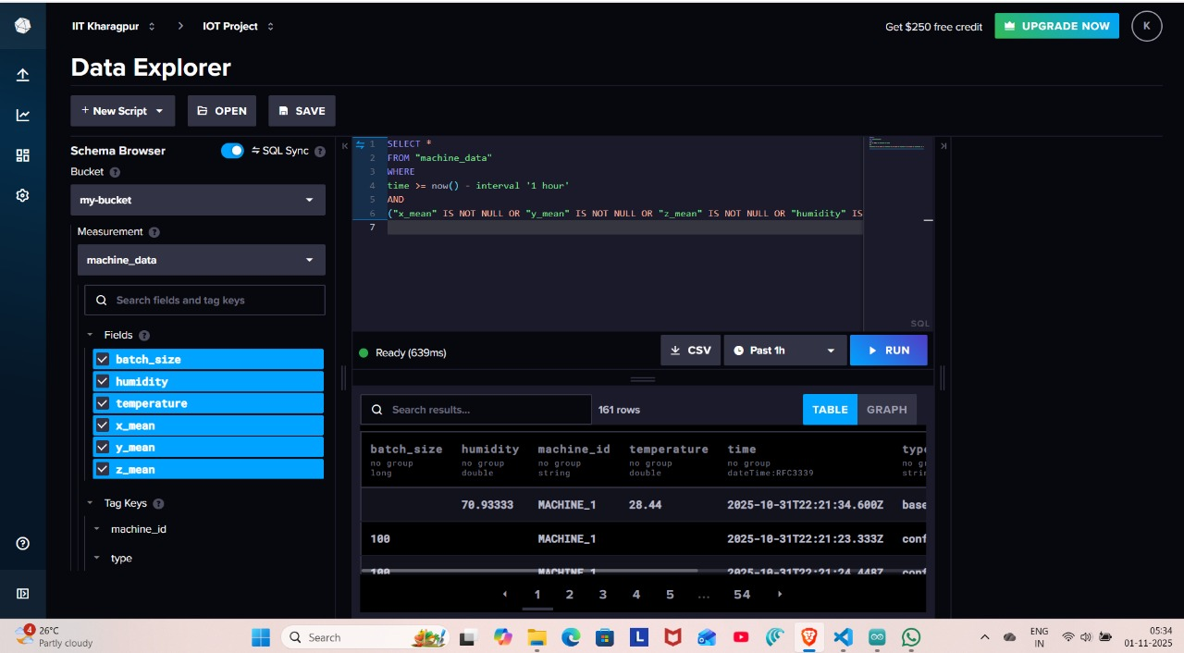
Data Storage: Storing Data with InfluxDB
The data we were monitoring is being stored on influxDB.
This will help in further analysis and tracking the history of Device.
We used influxDB – as it is a time series DB.

Slide 9
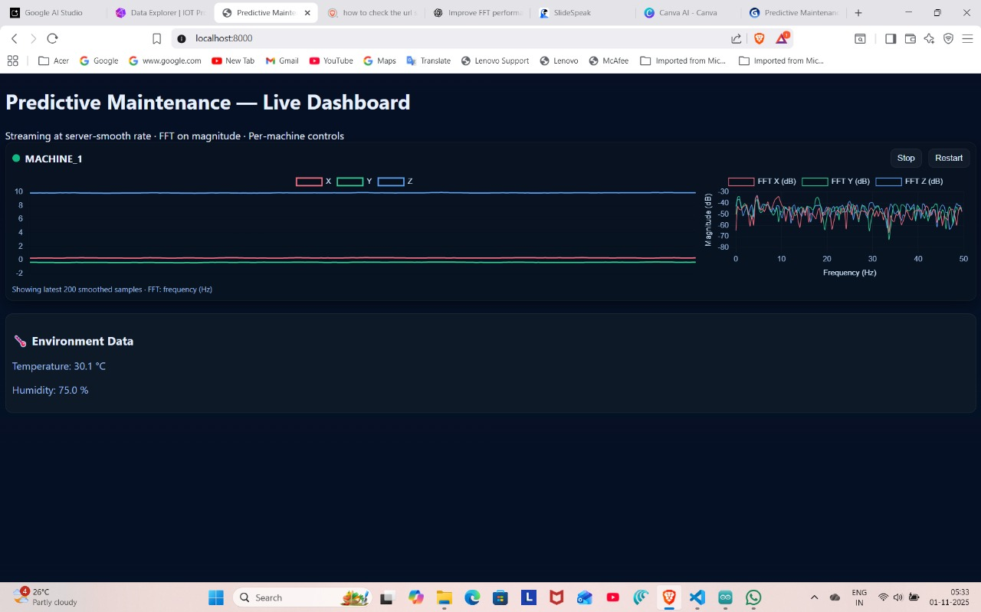
Dashboard
We have live status Indicator appering to the left of machine Id, green-functional , red - critical.
We have drawn the real-time plot of the vibrations and their FFT to the right of the Dashboard.
FFT plot helps us visualize the vibrations and anmoly in our mahcine.
We have added buttons like stop and restart for user to interact directly with ESP32 mode.

Slide 10
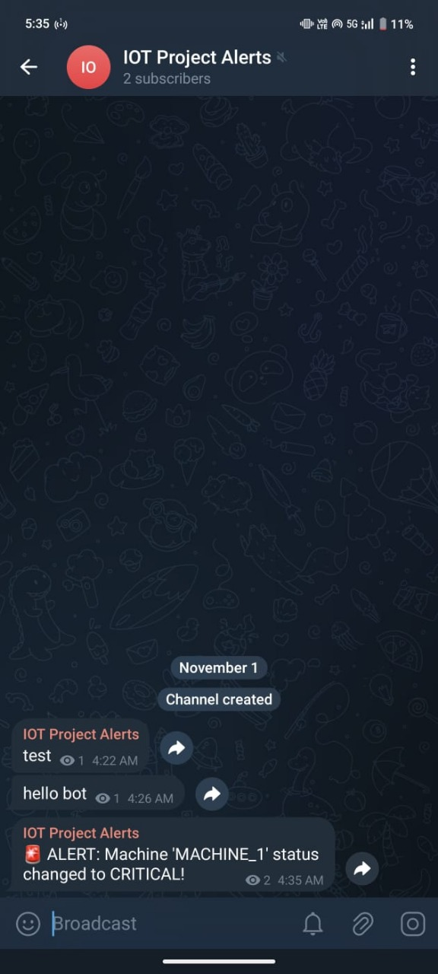
Alerts using Telegram
We have used the Telegram API of python, this helps us inform the Owner of machine in real time , if something crtical has happened to the mahcine.
We have a Python script that connects to the Telegram Bot API to send a message to a owner private channel.
This will help the Owner to act over some alarming situation.

Slide 11
The Future: Integrating Machine Learning
Our so far model is purely statistical , which makes it sensitive to noises and thus is sometime behaving in slghtly delayed fasion.
We are planning to build an ML model over the vibration and temperature readings.
This will make our system much more robust.

Slide 12
Challenges & Key Learnings
During data transfer between the ESP32 (powered by our laptop) and Server , our maintainer was getting disconnected due to the sudden low current supply.
What if Baseline is wrong , then our entire system will fail. We will be predicting all wrong.
We have also encountered the deadlock situation while implementing the stop button on dashboard . ESP32 toggles it’s state to off , so to make it on we re-press the stop button. But since receiving and sending of data in server was being handled by one thread , server before sending ESP32 , command to untoggled its state to monitoring , it was waiting for monitoring message. To avoid this we created a Connection – Manager , that decouples the sending and receiving of data by server.

Slide 13
THANK YOU

