Slide 1

Insertion Sort
for (i = 1; i < n; i++)
{/* insert a[i] into a[0:i-1] */
int t = a[i];
int j;
for (j = i - 1; j >= 0 && t < a[j]; j--)
a[j + 1] = a[j];
a[j + 1] = t;
}

Slide 2
Complexity
Space/Memory
Time
  Count a particular operation
  Count number of steps
  Asymptotic complexity
Notes:
Other types of complexity: programming complexity, debugging complexity, complexity of comprehension.

Slide 3
Comparison Count
for (i = 1; i < n; i++)
{/* insert a[i] into a[0:i-1] */
int t = a[i];
int j;
for (j = i - 1; j >= 0 && t < a[j]; j--)
a[j + 1] = a[j];
a[j + 1] = t;
}

Slide 4
Comparison Count
Pick an instance characteristic … n, n = a.length for insertion sort
Determine count as a function of this instance characteristic.

Slide 5
Comparison Count
for (j = i - 1; j >= 0 && t < a[j]; j--)
a[j + 1] = a[j];
How many comparisons are made?

Slide 6
Comparison Count
for (j = i - 1; j >= 0 && t < a[j]; j--)
a[j + 1] = a[j];
number of compares depends on
a[]s and t as well as on i

Slide 7
Comparison Count
Worst-case count = maximum count
Best-case count = minimum count
Average count

Slide 8
Worst-Case Comparison Count
for (j = i - 1; j >= 0 && t < a[j]; j--)
a[j + 1] = a[j];
a = [1, 2, 3, 4] and t = 0 => 4 compares
a = [1,2,3,…,i] and t = 0 => i compares

Slide 9
Worst-Case Comparison Count
for (i = 1; i < n; i++)
for (j = i - 1; j >= 0 && t < a[j]; j--)
a[j + 1] = a[j];
total compares = 1 + 2 + 3 + … + (n-1)
= (n-1)n/2 = ½(n²)-½(n)

Slide 10
Step Count
A step is an amount of computing that does not depend on the instance characteristic n
10 adds, 100 subtracts, 1000 multiplies
can all be counted as a single step
n adds cannot be counted as 1 step

Slide 11
Step Count
statements
for (i = 1; i < n; i++) 1
{/* insert a[i] into a[0:i-1] */ 0
int t = a[i]; 1
int j; 0
for (j = i - 1; j >= 0 && t < a[j]; j--) 1
a[j + 1] = a[j]; 1
a[j + 1] = t; 1
} 0
for (i = 1; i < n; i++)
{/* insert a[i] into a[0:i-1] */
int t = a[i];
int j;
for (j = i - 1; j >= 0 && t < a[j]; j--)
a[j + 1] = a[j];
a[j + 1] = t;
}

Slide 12
Step Count
“statement” isn’t always 0 or 1
x = sum(a, n);
where n is the instance characteristic and sum adds a[0:n-1] has a statement count of n

Slide 13
Step Count
statements
steps
for (i = 1; i < n; i++) 1
{/* insert a[i] into a[0:i-1] */ 0
int t = a[i]; 1
int j; 0
for (j = i - 1; j >= 0 && t < a[j]; j--) 1
a[j + 1] = a[j]; 1
a[j + 1] = t; 1
} 0
for (i = 1; i < n; i++)
{/* insert a[i] into a[0:i-1] */
int t = a[i];
int j;
for (j = i - 1; j >= 0 && t < a[j]; j--)
a[j + 1] = a[j];
a[j + 1] = t;
}
i+ 1
i

Slide 14
Step Count
for (i = 1; i < n; i++)
{ 2i + 4}
step count for body of for loop is
2(1+2+3+…+n-1) + 4(n-1)
= (n-1)n + 4(n-1)
= (n-1)(n+4)
= n²+3n-4

Slide 15
Asymptotic Complexity of Insertion Sort
O(n²)
What does this mean?

Slide 16
Complexity of Insertion Sort
Time or number of operations does not exceed cn² on any input of size n (n suitably large)
  Comparison count vs. Statement count
  ½(n²)-½(n) vs n²+3n-4
  Differ in c
  Both are O(n²)
Actually, the worst-case time is Θ(n²) and the best-case is Θ(n)
So, the worst-case time is expected to quadruple each time n is doubled

Slide 17
Complexity of Insertion Sort
Is O(n²) too much time?
Is the algorithm practical?

Slide 18
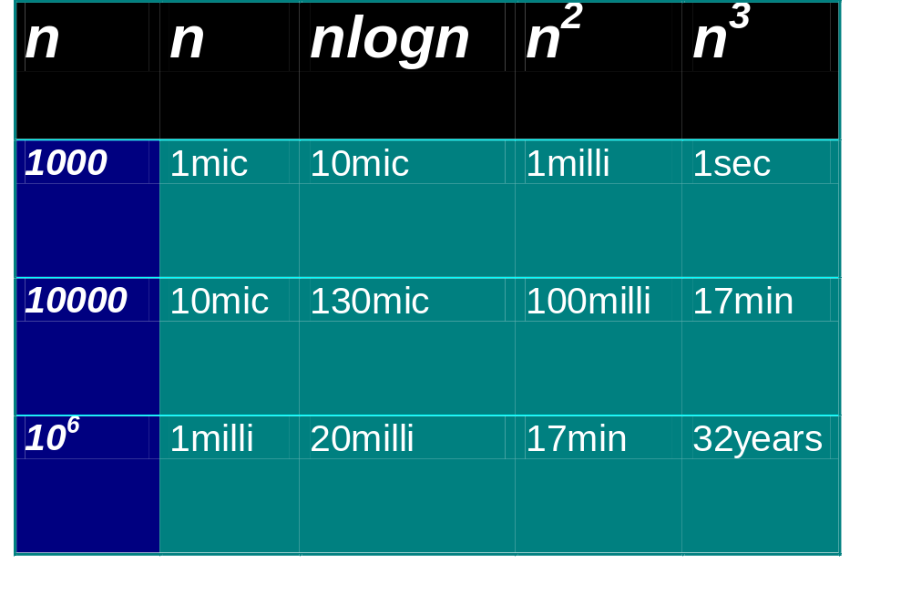
Practical Complexities
10⁹ instructions/second
Notes:
Teraflop computer the 32yr time becomes approx 10 days.

Slide 19
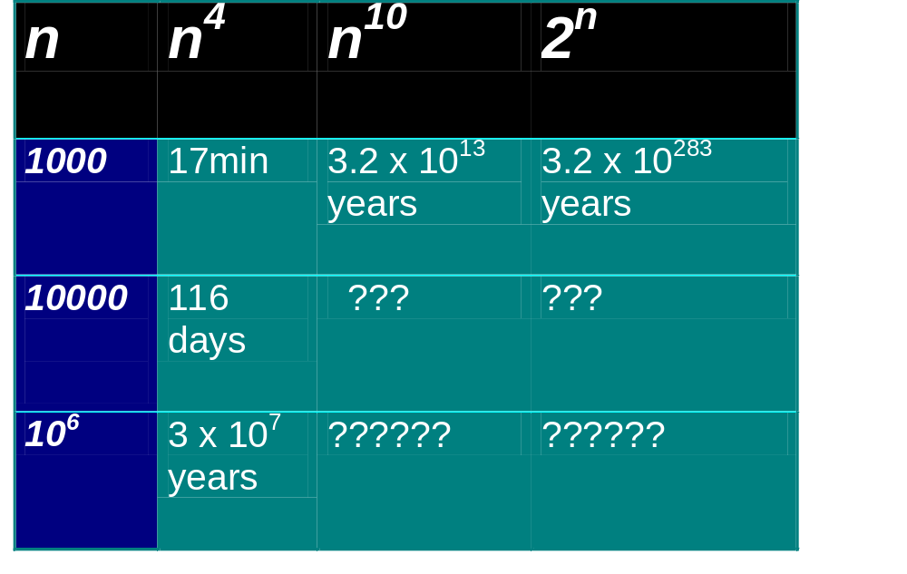
Impractical Complexities
10⁹ instructions/second

Slide 20
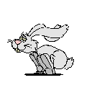

Faster Computer Vs Better Algorithm
Algorithmic improvement (software) more useful than hardware improvement
E.g. 2^{n} to n³

Slide 21
Complexity of Manipulating a Data Structure
Parts of a user’s program
Typical in polynomial time
  So that the performance of the user’s program shall NOT be outweighed by data structures he/she includes
A user’s program in general deals with NP problems
也就是，本課程所講述的資料結構其所伴隨的操作之計算複雜度是 “有效率的”

