Slide 1
Graph Search Methods
A vertex u is reachable from vertex v iff there is a path from v to u.
2
3
8
1
4
5
9
10
6
7
11

Slide 2
Graph Search Methods
A search method starts at a given vertex v and visits/labels/marks every vertex that is reachable from v.
2
3
8
1
4
5
9
10
6
7
11
Notes:
Visit, mark, and label used as synonyms.

Slide 3
Graph Search Methods
Many graph problems solved using a search method.
  Path from one vertex to another.
  Is the graph connected?
  Find a spanning tree.
  Etc.
Commonly used search methods:
  Depth-first search.
  Breadth-first search.

Slide 4
Depth-First Search
dfs(v)
{
Label vertex v as reached.
for (each unreached vertex u
adjacenct from v)
dfs(u);
}
Notes:
Note that vertices adjacent from v are examined one at a time. As soon as an unreached adjacent vertex u is found, a dfs(u) is done. Remaining vertices adjacent from v are examined after dfs(u) completes.

Slide 5
Depth-First Search Example
2
2
3
8
1
1
4
5
9
10
6
7
11
Start search at vertex 1.
Label vertex 1 and do a depth first search from either 2 or 4.
Suppose that vertex 2 is selected.

Slide 6
Depth-First Search Example
2
2
2
3
8
1
1
4
5
5
9
10
6
7
11
Label vertex 2 and do a depth first search from either 3, 5, or 6.
Suppose that vertex 5 is selected.

Slide 7
Depth-First Search Example
2
2
2
3
8
1
1
4
5
5
5
9
9
10
6
7
11
Label vertex 5 and do a depth first search from either 3, 7, or 9.
Suppose that vertex 9 is selected.

Slide 8
Depth-First Search Example
2
2
2
3
8
8
1
1
4
5
5
5
9
9
9
10
6
7
11
Label vertex 9 and do a depth first search from either 6 or 8.
Suppose that vertex 8 is selected.

Slide 9
Depth-First Search Example
2
2
2
3
8
8
8
1
1
4
5
5
5
9
9
9
10
6
6
7
11
Label vertex 8 and return to vertex 9.
From vertex 9 do a DFS(6).

Slide 10
Depth-First Search Example
2
2
2
3
8
8
8
1
1
4
4
5
5
5
9
9
9
10
6
6
6
7
11
Label vertex 6 and do a depth first search from either 4 or 7.
Suppose that vertex 4 is selected.

Slide 11
Depth-First Search Example
2
2
2
3
8
8
8
1
1
4
4
4
5
5
5
9
9
9
10
6
6
6
7
7
11
Label vertex 4 and return to 6.
From vertex 6 do a dfs(7).

Slide 12
Depth-First Search Example
2
2
2
3
8
8
8
1
1
4
4
4
5
5
5
9
9
9
10
6
6
6
7
7
7
11
Label vertex 7 and return to 6.
Return to 9.

Slide 13
Depth-First Search Example
2
2
2
3
8
8
8
1
1
4
4
4
5
5
5
9
9
9
10
6
6
6
7
7
7
11
Return to 5.

Slide 14
Depth-First Search Example
2
2
2
3
3
8
8
8
1
1
4
4
4
5
5
5
9
9
9
10
6
6
6
7
7
7
11
Do a dfs(3).

Slide 15
Depth-First Search Example
2
2
2
3
3
3
8
8
8
1
1
4
4
4
5
5
5
9
9
9
10
6
6
6
7
7
7
11
Label 3 and return to 5.
Return to 2.

Slide 16
Depth-First Search Example
2
2
2
3
3
3
8
8
8
1
1
4
4
4
5
5
5
9
9
9
10
6
6
6
7
7
7
11
Return to 1.

Slide 17
Depth-First Search Example
2
2
2
3
3
3
8
8
8
1
1
4
4
4
5
5
5
9
9
9
10
6
6
6
7
7
7
11
Return to invoking method.

Slide 18
Depth-First Search Property
All vertices reachable from the start vertex (including the start vertex) are visited.

Slide 19
Path from Vertex v to Vertex u
Start a depth-first search at vertex v.
Terminate when vertex u is visited or when dfs ends (whichever occurs first).
Time
  O(n²) when adjacency matrix used
  O(n+e) when adjacency lists used (e is number of edges)

Slide 20
Is the Graph Connected?
Start a depth-first search at any vertex of the graph.
Graph is connected iff all n vertices get visited.
Time
  O(n²) when adjacency matrix used
  O(n+e) when adjacency lists used (e is number of edges)

Slide 21
Connected Components
Start a depth-first search at any as yet unvisited vertex of the graph.
Newly visited vertices (plus edges between them) define a component.
Repeat until all vertices are visited.

Slide 22
Connected Components
2
3
8
1
4
5
9
10
6
7
11

Slide 23

Time Complexity
  O(n²) when adjacency matrix used
  O(n+e) when adjacency lists used (e is number of edges)

Slide 24

Spanning Tree
2
2
2
3
3
3
8
8
8
1
4
4
4
5
5
5
9
9
9
6
6
6
7
7
7
Depth-first search from vertex 1.
Depth-first spanning tree.
Notes:
Keep track of edges used to reach new vertices. These edges form a spanning tree if the graph is connected.

Slide 25
Spanning Tree
Start a depth-first search at any vertex of the graph.
If graph is connected, the n-1 edges used to get to unvisited vertices define a spanning tree (depth-first spanning tree).
Time
  O(n²) when adjacency matrix used
  O(n+e) when adjacency lists used (e is number of edges)

Slide 26
Breadth-First Search
Visit start vertex and put into a FIFO queue.
Repeatedly remove a vertex from the queue, visit its unvisited adjacent vertices, put newly visited vertices into the queue.

Slide 27
Breadth-First Search Example
2
3
8
1
4
5
9
10
6
7
11
Start search at vertex 1.

Slide 28
Breadth-First Search Example
2
FIFO Queue
1
3
8
1
1
4
5
9
10
6
7
11
Visit/mark/label start vertex and put in a FIFO queue.

Slide 29
Breadth-First Search Example
2
FIFO Queue
1
3
8
1
1
4
5
9
10
6
7
11
Remove 1 from Q; visit adjacent unvisited vertices;
put in Q.

Slide 30
Breadth-First Search Example
2
FIFO Queue
2
3
2
4
8
1
1
4
4
5
9
10
6
7
11
Remove 1 from Q; visit adjacent unvisited vertices;
put in Q.

Slide 31
Breadth-First Search Example
2
FIFO Queue
2
3
2
4
8
1
1
4
4
5
9
10
6
7
11
Remove 2 from Q; visit adjacent unvisited vertices;
put in Q.

Slide 32
Breadth-First Search Example
2
FIFO Queue
2
3
3
4
5
3
6
8
1
1
4
4
5
5
9
10
6
6
7
11
Remove 2 from Q; visit adjacent unvisited vertices;
put in Q.

Slide 33
Breadth-First Search Example
2
FIFO Queue
2
3
3
4
5
3
6
8
1
1
4
4
5
5
9
10
6
6
7
11
Remove 4 from Q; visit adjacent unvisited vertices;
put in Q.

Slide 34
Breadth-First Search Example
2
FIFO Queue
2
3
3
5
3
6
8
1
1
4
4
5
5
9
10
6
6
7
11
Remove 4 from Q; visit adjacent unvisited vertices;
  put in Q.

Slide 35
Breadth-First Search Example
2
FIFO Queue
2
3
3
5
3
6
8
1
1
4
4
5
5
9
10
6
6
7
11
Remove 5 from Q; visit adjacent unvisited vertices;
  put in Q.

Slide 36
Breadth-First Search Example
2
FIFO Queue
2
3
3
3
6
9
7
8
1
1
4
4
5
5
9
9
10
6
6
7
7
11
Remove 5 from Q; visit adjacent unvisited vertices;
  put in Q.

Slide 37
Breadth-First Search Example
2
FIFO Queue
2
3
3
3
6
9
7
8
1
1
4
4
5
5
9
9
10
6
6
7
7
11
Remove 3 from Q; visit adjacent unvisited vertices;
  put in Q.

Slide 38
Breadth-First Search Example
2
FIFO Queue
2
3
3
6
9
7
8
1
1
4
4
5
5
9
9
10
6
6
7
7
11
Remove 3 from Q; visit adjacent unvisited vertices;
  put in Q.

Slide 39
Breadth-First Search Example
2
FIFO Queue
2
3
3
6
9
7
8
1
1
4
4
5
5
9
9
10
6
6
7
7
11
Remove 6 from Q; visit adjacent unvisited vertices;
  put in Q.

Slide 40
Breadth-First Search Example
2
FIFO Queue
2
3
3
9
7
8
1
1
4
4
5
5
9
9
10
6
6
7
7
11
Remove 6 from Q; visit adjacent unvisited vertices;
  put in Q.

Slide 41
Breadth-First Search Example
2
FIFO Queue
2
3
3
9
7
8
1
1
4
4
5
5
9
9
10
6
6
7
7
11
Remove 9 from Q; visit adjacent unvisited vertices;
  put in Q.

Slide 42
Breadth-First Search Example
2
FIFO Queue
2
3
3
7
8
8
8
1
1
4
4
5
5
9
9
10
6
6
7
7
11
Remove 9 from Q; visit adjacent unvisited vertices;
  put in Q.

Slide 43
Breadth-First Search Example
2
FIFO Queue
2
3
3
7
8
8
8
1
1
4
4
5
5
9
9
10
6
6
7
7
11
Remove 7 from Q; visit adjacent unvisited vertices;
  put in Q.

Slide 44
Breadth-First Search Example
2
FIFO Queue
2
3
3
8
8
8
1
1
4
4
5
5
9
9
10
6
6
7
7
11
Remove 7 from Q; visit adjacent unvisited vertices;
  put in Q.

Slide 45
Breadth-First Search Example
2
FIFO Queue
2
3
3
8
8
8
1
1
4
4
5
5
9
9
10
6
6
7
7
11
Remove 8 from Q; visit adjacent unvisited vertices;
  put in Q.

Slide 46
Breadth-First Search Example
2
FIFO Queue
2
3
3
8
8
1
1
4
4
5
5
9
9
10
6
6
7
7
11
Queue is empty. Search terminates.

Slide 47
Time Complexity
Each visited vertex is put on (and so removed from) the queue exactly once.
When a vertex is removed from the queue, we examine its adjacent vertices.
  O(n) if adjacency matrix used
  O(vertex degree) if adjacency lists used
Total time
  O(mn), where m is number of vertices in the component that is searched (adjacency matrix)
  O(n + sum of component vertex degrees) (adj. lists) = O(n + number of edges in component)

Slide 48
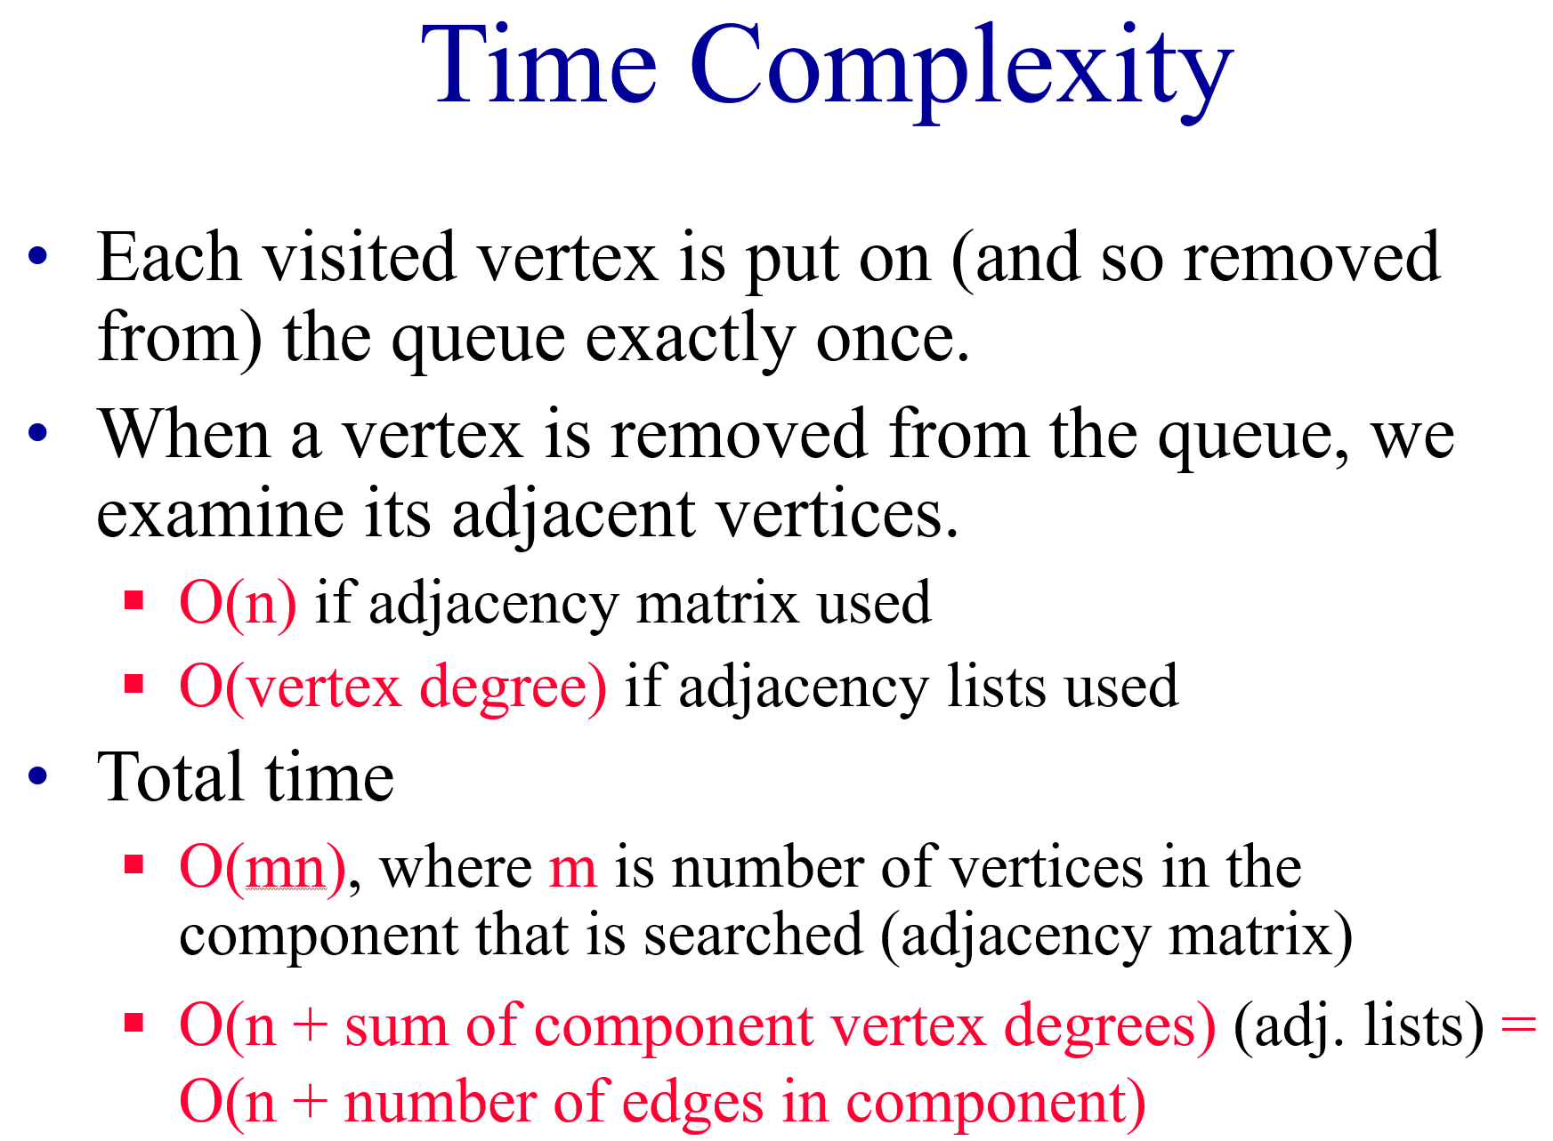
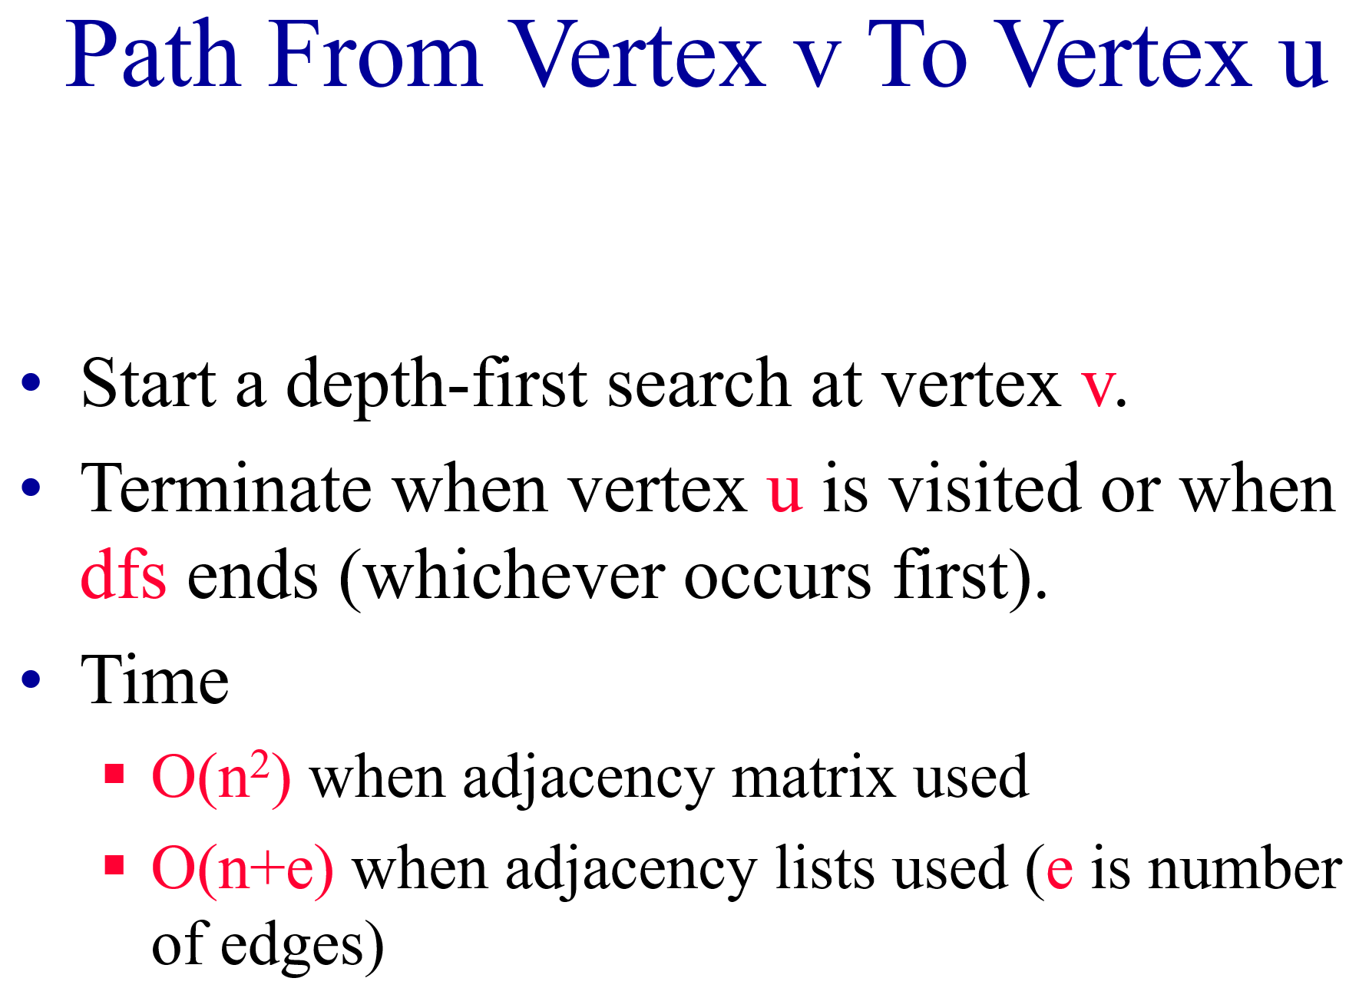
Breadth-First Search Properties
Same complexity as dfs.
Same properties with respect to path finding, connected components, and spanning trees.
Edges used to reach unlabeled vertices define a depth-first spanning tree when the graph is connected.
There are problems for which bfs is better than dfs and vice versa.

