Slide 1


Deleting nodes less then given value from Doubly Linked List .
COVER SLIDE
By Parth Bharvadiya

Slide 2
Prepared by – Parth Bharvadiya Roll no. – 177 Enrollment no. – 22002170210065 Branch – IT Batch – D6

Slide 3
Agenda.
AGENDA SLIDE
₀₁
₀₂
₀₃
What is a Linked List?
Doubly Linked List.!
Code Structure.
₀₄
₀₅
Delete Algorithm
Uses of Linked List.

Slide 4
What is a Linked List?
SECTION TITLE SLIDE
01.
A linked list is a linear data structure, in which the elements are not stored at contiguous memory locations. The elements in a linked list are linked using pointers

Slide 5
Doubly LinkedList.
SECTION TITLE SLIDE
02.
A doubly linked list (DLL) is a special type of linked list in which each node contains a pointer to the previous node as well as the next node of the linked list.

Slide 6
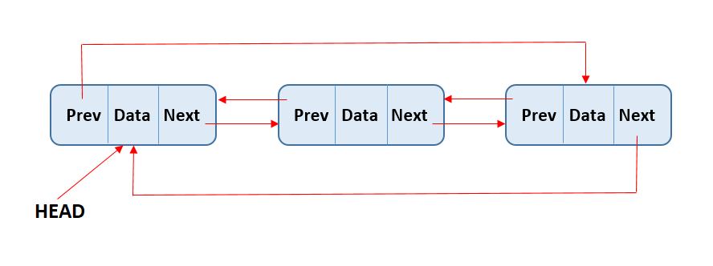
Structure of Doubly Linked List.
Get Started for Free
Get Started for Free

Slide 7
Delete Algorithm
TEXT HEAVY CONTENT SLIDE
Delete All the nodes less then the given value:
1. If 'first' node is null:
1.1. Print "List is Empty!"
2. Else:
2.1. Make a node 'tem' and set it to 'first'.
2.2. While 'tem' is not null then loop:
2.2.1. If 'tem.data' is less than 'data':
2.2.1.1. If 'tem' is equal to first node:
2.2.1.1.1. Call the deleteFirst() function to delete the first node.
2.2.1.2. Else if 'tem.next' is null:
2.2.1.2.1. Call the deleteLast() function to delete the last node.
2.2.1.3. Else:
2.2.1.3.1. Set 'tem.pre.next' to 'tem.next'.
2.2.1.3.2. Set 'tem.next.pre' to 'tem.pre'.
2.2.2. Set 'tem' to tem.next.
loop ends.

Slide 8
Uses of Linked List.
SAMPLE CONTENT SLIDE
Doubly linked lists are efficient for insertions and deletions
Doubly linked lists allow for easy traversal in both forward and backward directions.
Doubly linked lists can be used to implement both stacks and queues efficiently.
Doubly linked lists are often used to implement undo and redo functionality in applications like text editors.

Slide 9
Thank you.
END SLIDE

