Slide 1


CONSTRUCT A BINARY SEARCH TREE FROM PREORDER TRAVERSAL AND DISPLAY PREORDER AND INORDER

Slide 2
Prepared by:
Name:Patel Pratham
Rollno:154 Div.:D6
Er no.22002170210080
Name:Kansoda Ronil
Rollno:167 Div.:D6
Er no.22002170210038
Name:Thakkar Smit
Rollno:172 Div.:D6
Er no.22002170210120
Name:Bharvadiya Parth
Rollno:177 Div.:D6
Er no.22002170210065
Name:Marvania Brinda
Rollno:183 Div.:D6
Er no.22002170210070

Slide 3
INTRODUCTION
Binary Search Trees (BSTs) are fundamental data structures used in computer science and programming for efficient data storage and retrieval.
In this discussion, we will explore the process of constructing a Binary Search Tree from a pre-order traversal sequence and then demonstrate how to perform postorder and inorder traversals on resulting tree.

Slide 4
Applications of BST
BST’s are used for indexing in databases.
It is used to implement searching & sorting algorithms.
Used for data caching.
It is also used to implement dictionaries.
Used in priority queues.
Used in spell checkers.

Slide 5
Algorithm
1. If the 'preorder' is null or empty: -- Print "Write Something!!!" -- Exit the program. -- Return null.
2. Split the 'preorder' string into an array of strings 'nodes' using space as the delimiter.
3. Create an integer array 'index' with a single element initialized to 0.
4. Call the makeBST function with arguments 'nodes', 'index', 'Integer.MIN_VALUE', and 'Integer.MAX_VALUE' and return the result.
5.Algorithm makeBST(nodes: String[], index: int[], min: int, max: int) -> BST -- If 'index[0]' is greater than or equal to the length of 'nodes': -- Return null (no more nodes to process).
6.Create a BST if all conditions in step 5 gets satisfied.

Slide 6
7.Recursively call makeBST for the left subtree and right subtree then the tree will be constructed.
8.Main Function
--- Read a pre-order traversal string 'preorder' from the user. --- Close the scanner.
--- Call the ‘makeBST' function with 'preorder' as an argument and store the resulting BST in 'root'.

Slide 7
Advantages
BST is fast in inserstion and deletion when balanced
BST code is as simple as compared to other data structures.
BST can automatically sortt elements as they are inserted,so the elements are always stored in a sorted order.
Space Efficiency: Relatively memory-efficient compared to other structures.
Simplicity: Simple to implement and understand.

Slide 8
DISADVANTAGES
A BST can be imbalanced or degenerated which can increase the complexity.
Do not support some operations that are possible with ordered data structures.
Regular BSTs do not guarantee balanced structures, and maintaining balance manually can be complex and error-prone.
They are not well-suited for data structures that need to be accessed randomly

Slide 9
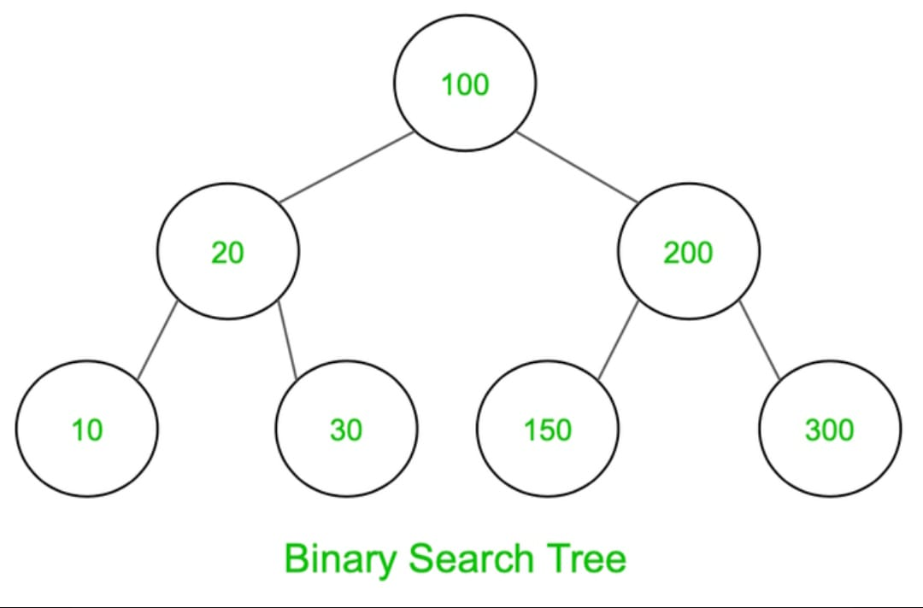
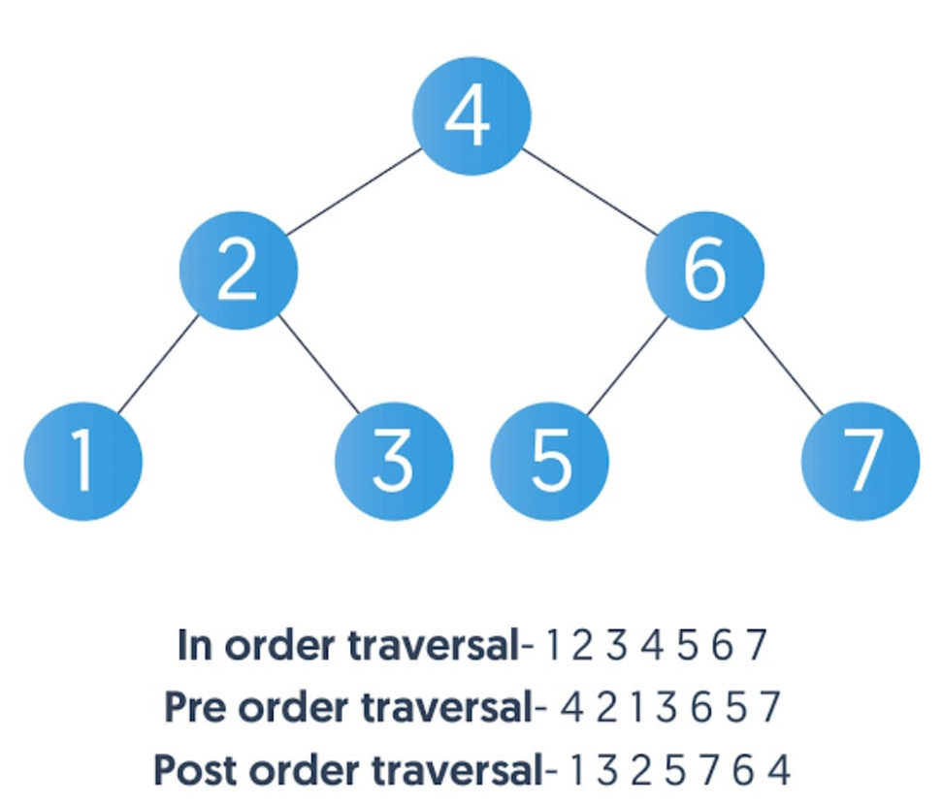
Examples

Slide 10
THANK YOU

