Slide 1


E-Commerce Management System

Slide 2
Prepared by
Name:Patel Pratham Name:Kansoda Ronil
Rollno:154 Div:D6 Roll no:167 Div:D6
Er no:22002170210080 Er no:22002170210038
Name:Thakkar Smit Name:Bharvadiya Parth
Rollno:172 Div:D6 Rollno:177 Div:D6
Er no:22002170210120 Er no:22002170210065
Name:Marvania Brinda
Rollno:183 Div:D6
Er no:22002170210070

Slide 3
Introduction
The E-commerce Management System will primarily provide a platform to purchase, sell, distribution of items, product or service through the internet and on some other network.
It will provide an option to a customer for the comparison of product with another seller, while a shop is available only at day time the e-commerce is available 24 hours of a day and seven days of the week.
This system will provide the detailed description of the products to users so that they can compare to the different product and will by the one which is more suitable to them.
.

Slide 4
Schema
orders(o_id ,cust_id ,o_date ,status ,p_id ,quantity ,total_price)
customer(cust_id ,cust_name ,cust_city,email ,ph_no ,gender)
category(cat_id ,cat_name )
product(p_id ,cat_id ,p_name,price ,size ,color,brand ,material,stock_quantity ,rating )

Slide 5
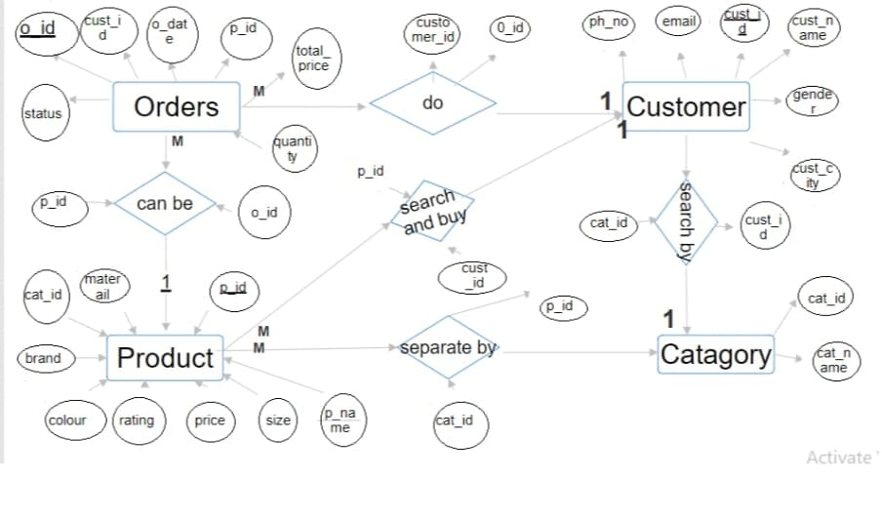
ER Diagram

Slide 6
Funtionality
Check quality
Buy
Search by type and range
Print bill
Change product Price
.

Slide 7
Merits
Data Integrity
Scalability
Security
Data Retrieval
Conurrent Access
Backup and Recovery
Data Consistency

Slide 8
Demerits
Complexity
Performance
Data Loss
Compatibility Issues
Maintenance Overhead
Vendor Lock-In
Cost

Slide 9
Thank you !!

