Slide 1
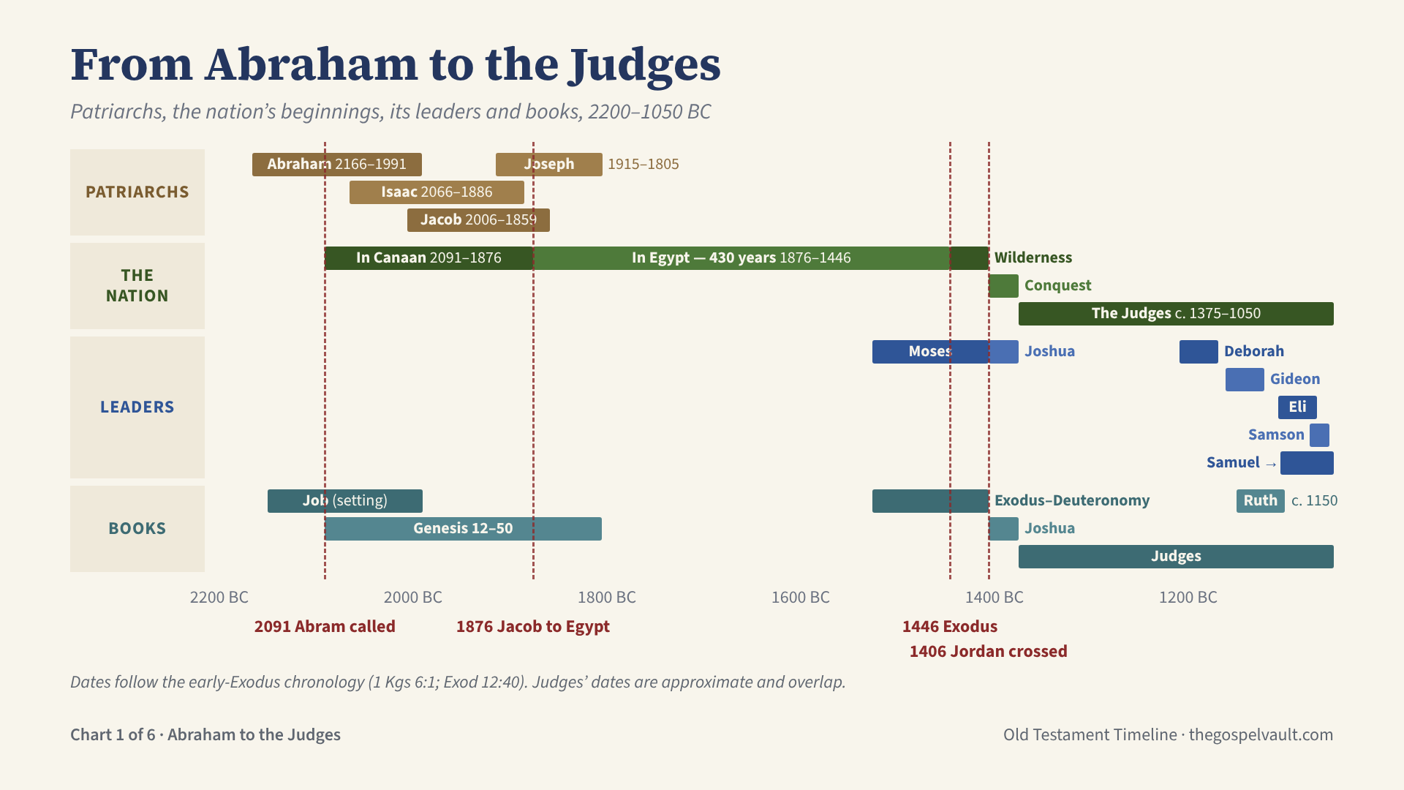
Notes:
Why start at Abraham (c. 2166 BC)? Genesis 1–11 cannot be dated with confidence. Abraham is where dated redemptive history and the covenant line to Messiah begin, and where Matthew’s genealogy begins (Matt 1:1–17). Chronology: 1 Kings 6:1 places the Exodus 480 years before Solomon’s fourth year (966 BC), which gives 1446 BC. Exodus 12:40 gives 430 years in Egypt, so Jacob entered Egypt in 1876 BC. The patriarchs’ dates come from the ages Genesis gives (Gen 12:4; 21:5; 25:26; 47:9). Leaders: Moses led Israel 1446–1406 (born c. 1526). Joshua led the conquest from 1406. The judges often ruled regionally and overlapped, so their dates are approximate. Samuel was born c. 1105 and anointed Saul c. 1051. Books: Job is set in the patriarchal era (when it was written is uncertain). Moses wrote Genesis–Deuteronomy c. 1446–1406. Ruth is set “in the days when the judges governed” (Ruth 1:1).

Slide 2
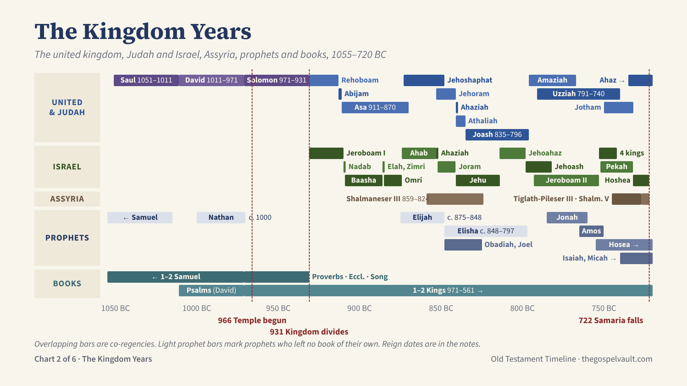
Notes:
Kings’ dates follow Thiele, as on the Isaiah chart. Overlapping bars are co-regencies, when a son reigned alongside his father (Jehoshaphat with Asa, Uzziah with Amaziah, Jotham with Uzziah).
Judah: Rehoboam 931–913, Abijam 913–911, Asa 911–870, Jehoshaphat 873–848, Jehoram 853–841, Ahaziah 841, Athaliah 841–835, Joash 835–796, Amaziah 796–767, Uzziah 791–740, Jotham 750–732, Ahaz 735–715.
Israel: Jeroboam I 931–910, Nadab 910–909, Baasha 909–886, Elah 886–885, Zimri 885 (seven days), Omri 885–874, Ahab 874–853, Ahaziah 853–852, Joram 852–841, Jehu 841–814, Jehoahaz 814–798, Jehoash 798–782, Jeroboam II 793–753, then the “4 kings” Zechariah, Shallum, Menahem and Pekahiah (753–740), Pekah 752–732, Hoshea 732–722.
Assyria: Shalmaneser III (859–824) fought Ahab’s coalition at Qarqar in 853, and his Black Obelisk shows Jehu bowing with tribute in 841. Tiglath-Pileser III (745–727), called Pul in 2 Kgs 15:19, took tribute from Menahem and deported much of Galilee (2 Kgs 15:29). Shalmaneser V (727–722) besieged Samaria, which fell in 722 and was deported to Assyria (2 Kgs 17:3–6).
Prophets: Samuel, Nathan, Elijah and Elisha left no book of their own. Obadiah and Joel are placed by the early dating; many date them later. Jonah ministered under Jeroboam II (2 Kgs 14:25) and preached to Nineveh, Assyria’s great city. Isaiah and Micah continue on the next chart.
Books: David wrote about half the Psalms; Solomon wrote most of Proverbs, Ecclesiastes and the Song of Songs. 1–2 Kings runs from Solomon to Jehoiachin’s release in 561 BC.

Slide 3
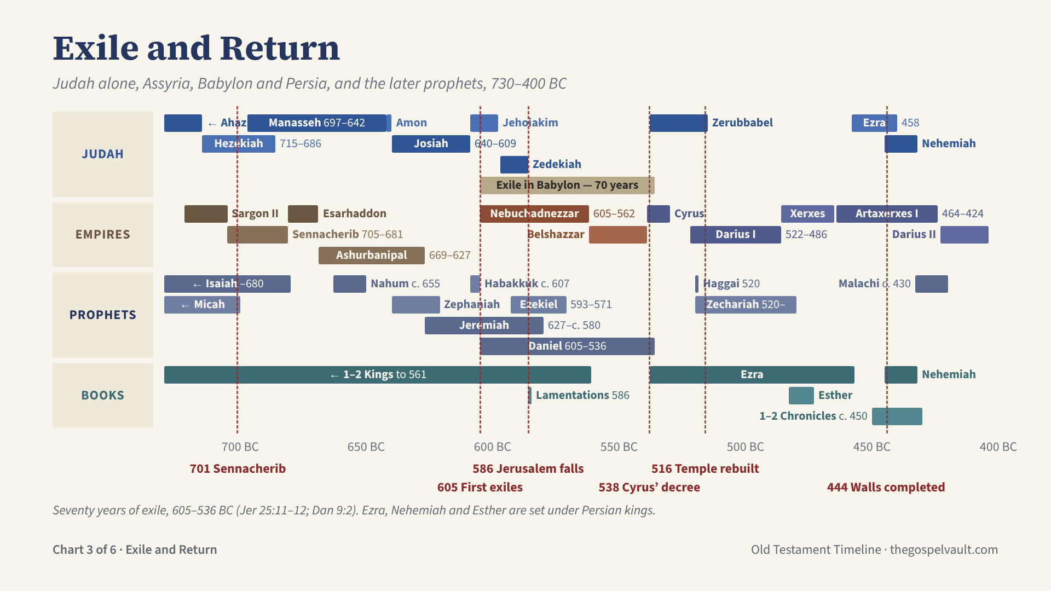
Notes:
Judah’s last kings: Hezekiah 715–686, Manasseh 697–642, Amon 642–640, Josiah 640–609, Jehoahaz (three months, 609), Jehoiakim 609–598, Jehoiachin (three months, 598–597), Zedekiah 597–586. Jehoahaz and Jehoiachin reigned too briefly to draw.
Three deportations: 605 (Daniel and his friends), 597 (Jehoiachin and Ezekiel), 586 (Jerusalem and the temple destroyed).
The seventy years: Jeremiah foretold them (Jer 25:11–12; 29:10) and Daniel read the prophecy (Dan 9:2). They are counted 605–536 for the exile, or 586–516 for the temple lying in ruins.
Return: Cyrus’ decree in 538 (Ezra 1:1–4) sent the first return under Zerubbabel. Haggai and Zechariah urged the rebuilding, and the temple was finished in 516 (Ezra 6:15). Ezra came in 458 (Ezra 7:8). Nehemiah came with Artaxerxes’ permission (Neh 2:1) and the walls were completed in fifty-two days, 444 BC (Neh 6:15).
Esther is set under Xerxes (Ahasuerus), about 483–473. Belshazzar ruled Babylon as co-regent with his father Nabonidus until its fall in 539 (Dan 5).
Malachi, about 430 BC, is the last Old Testament prophet.

Slide 4
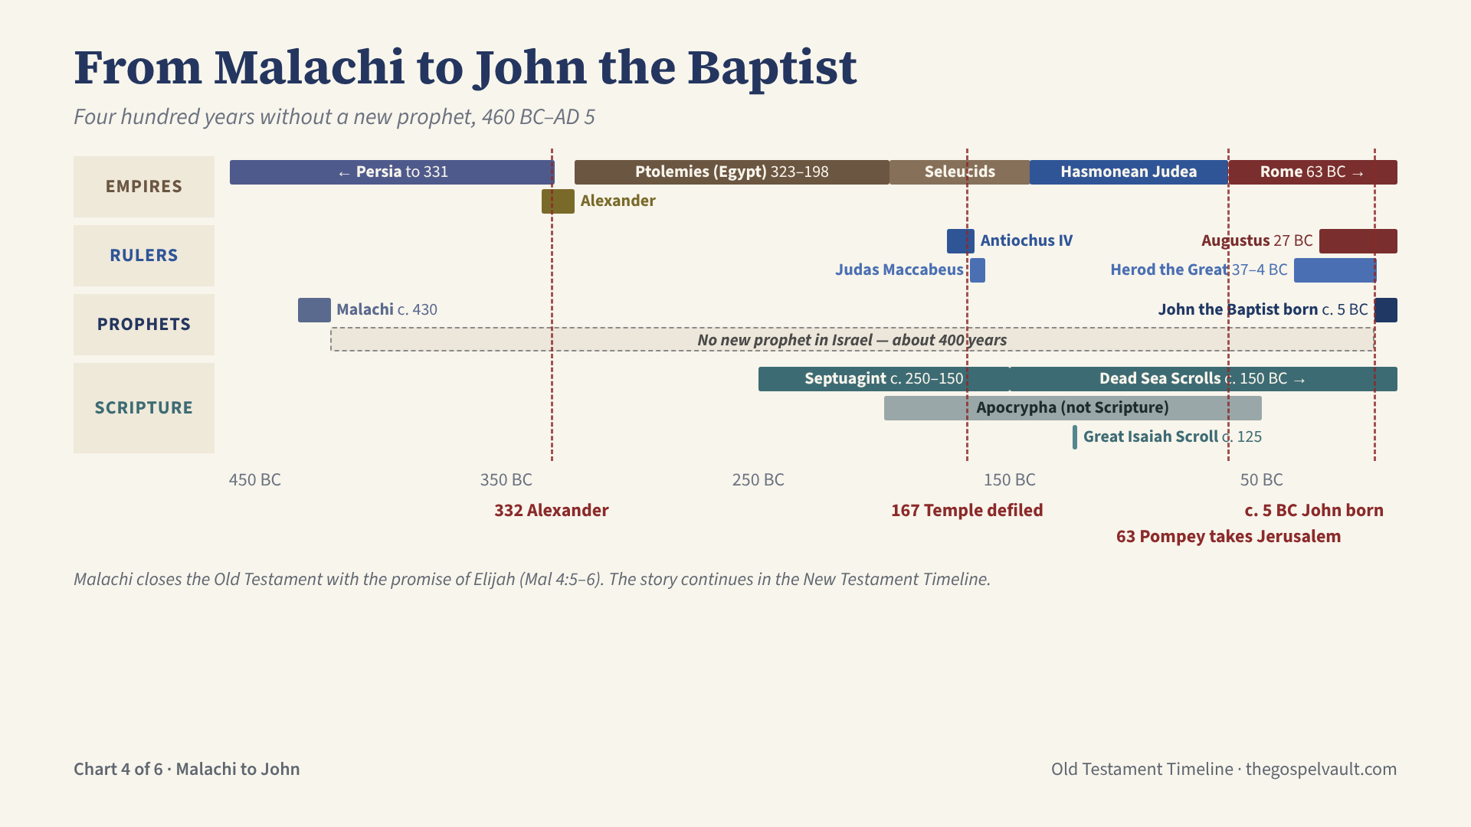
Notes:
After Malachi (about 430 BC) no new prophet spoke in Israel for about four hundred years. Even 1 Maccabees notes that no prophet had appeared (1 Macc 9:27). Malachi ends with the promise of Elijah before the day of the LORD (Mal 4:5–6).
Empires over Judea: Persia until 331; Alexander the Great, who took the region in 332; the Ptolemies of Egypt 323–198; the Seleucids of Syria from 198. Antiochus IV Epiphanes defiled the temple in 167 BC, which sparked the Maccabean revolt. The temple was rededicated in 164 (Hanukkah, the Feast of Dedication in John 10:22). The Hasmoneans ruled until Pompey took Jerusalem for Rome in 63 BC.
Herod the Great reigned 37–4 BC (Matt 2:1), under Augustus, emperor from 27 BC.
Scripture in the gap: the Septuagint (the Greek Old Testament) was translated about 250–150 BC. The Dead Sea Scrolls were copied about 150 BC–AD 68, including the Great Isaiah Scroll (about 125 BC). The Apocrypha was written in this period but is not part of the Hebrew canon.
John the Baptist was born about 5 BC, six months before Jesus (Luke 1:36). His ministry and the life of Christ continue in the New Testament Timeline.

Slide 5
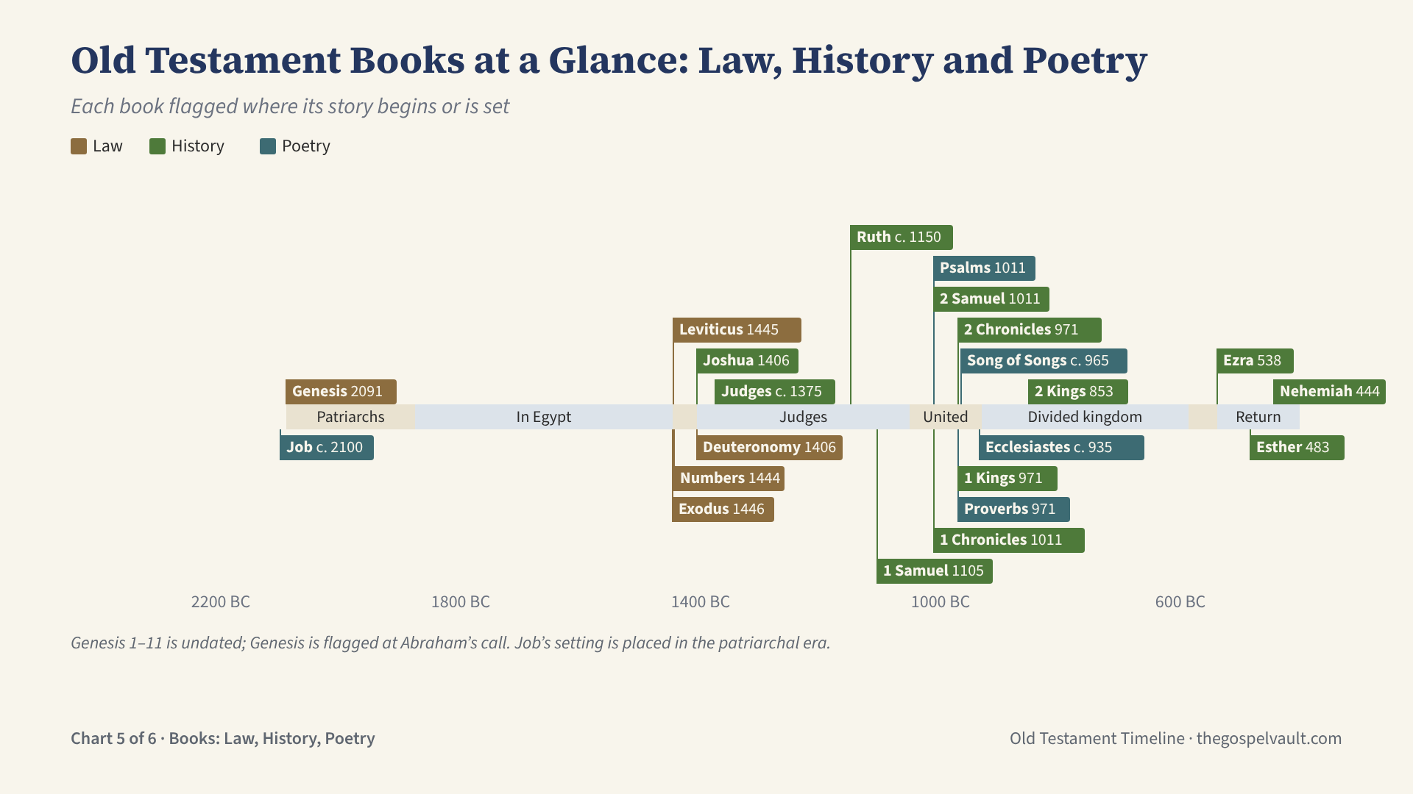
Notes:
Each of the 22 books of Law, History and Poetry is flagged where its story begins or is set, not when it was written.
Law: Genesis is flagged at Abraham’s call (2091 BC); chapters 1–11 come before any datable event. Exodus, Leviticus and Numbers begin at the Exodus and Sinai (1446–1444). Deuteronomy is Moses’ farewell on the plains of Moab (1406).
History: Joshua 1406; Judges c. 1375; Ruth c. 1150; 1 Samuel from Samuel’s birth c. 1105; 2 Samuel and 1 Chronicles from David’s reign (1011); 1 Kings and 2 Chronicles from Solomon (971); 2 Kings from Ahaziah of Israel (853); Ezra from Cyrus’ decree (538); Esther under Xerxes (483); Nehemiah 444.
Poetry: Job is set in the patriarchal era (date uncertain). Most Psalms come from David’s reign (1011–971). Proverbs, the Song of Songs and Ecclesiastes come from Solomon’s reign (971–931); Ecclesiastes is often placed late in his life.
The colored band shows the era: patriarchs, Egypt, wilderness, judges, the united and divided kingdoms, exile and return.

Slide 6
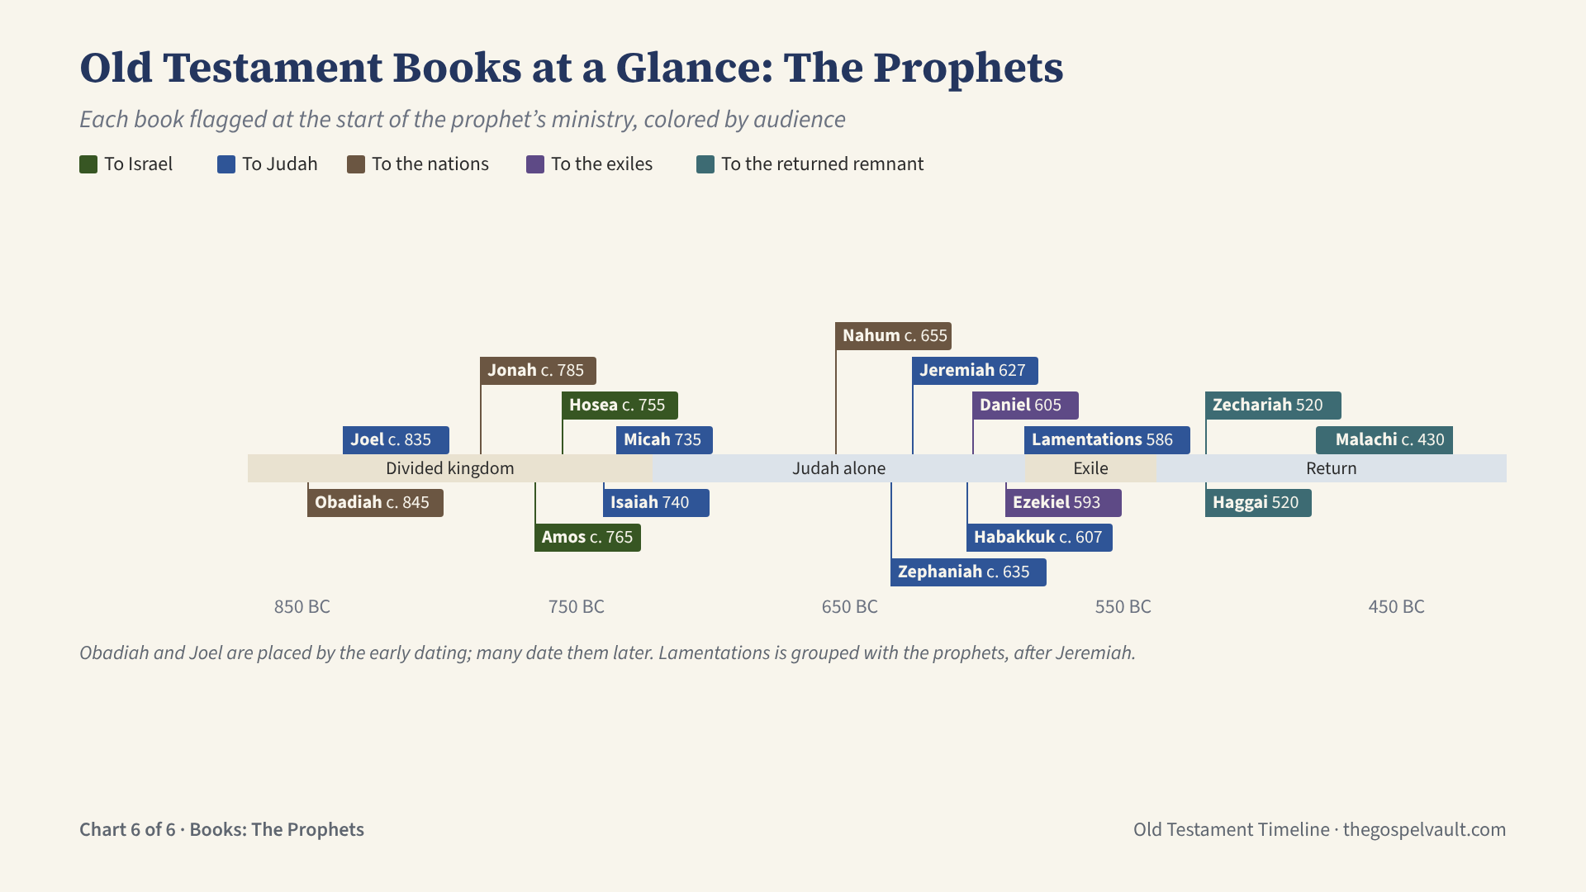
Notes:
The 17 prophetic books (Isaiah through Malachi, with Lamentations) are flagged at the start of each prophet’s ministry and colored by audience.
To Israel, the northern kingdom: Amos and Hosea, warning of the fall of Samaria in 722.
To Judah: Joel, Isaiah, Micah, Zephaniah, Jeremiah, Habakkuk and Lamentations.
To the nations: Obadiah (Edom), Jonah and Nahum (Nineveh).
To the exiles in Babylon: Daniel and Ezekiel.
To the remnant who returned: Haggai, Zechariah and Malachi.
Obadiah and Joel are placed by the early dating (in the 800s BC); many scholars date them later. Jonah ministered under Jeroboam II (2 Kgs 14:25). Habakkuk wrote just before Babylon’s first invasion in 605. Malachi, about 430 BC, is the last Old Testament prophet.

