Slide 1
Isaiah at a Glance
From Isaiah’s call to the new heavens and new earth · not to scale
Isaiah 1–39 · judgment
Isaiah 40–66 · comfort, written ahead to the exile and beyond
Isaiah’s Day
the Assyrian crisis
Exile & Return
Babylon → Persia
The Church Age
the hidden valley
Tribulation
Isa 24; 34
Millennial Kingdom
Isa 2; 11; 35; 60
Eternal State
Isa 65:17; 66:22
740 BC
Uzziah dies;
Isaiah called (6:1)
701 BC
Sennacherib turned
back (37:36–37)
539–538 BC
Babylon falls; Cyrus
frees the captives
(44:28; 45:1)
Second Coming
from Edom, Bozrah
Isa 63:1–6
722 BC
Samaria falls to
Assyria (7:8)
586 BC
Jerusalem falls
(foretold 39:6)
First Advent
Isa 7:14; 9:6
52:13–53:12
The prophet saw Messiah’s sufferings (ch. 53) and His glory (ch. 11) on one horizon; the Church Age between them was not yet revealed (see Prophecy Chart 10, the Two-Mountain View).
Chart 1 of 18 · Overview
Notes:
PLACEMENT: Isaiah notes, Introduction; book overview. SOURCES: Lyons, Isaiah 1–66 Outline and Notes (thegospelvault.com/bible-studies/isaiah/) — Introduction: ministry 740–680 BC from the year Uzziah died (6:1); 722 BC fall of Samaria (7:8; 8:4 notes; 2 Kings 17); 701 BC Sennacherib (36–37); Babylonian captivity total in 586 BC (39:6 notes); Babylon falls to the Medes 539 BC (13:17 notes); Cyrus (44:28–45:1). Bands follow the notes’ assignments: Tribulation (24, 34), Millennial Kingdom (2, 4, 11, 25, 35, 60), Second Coming from Bozrah (63:1–6). Era colors match God’s Prophetical Program Chart 1.

Slide 2
Kings and Prophets in Isaiah’s Day
Judah, Israel, Assyria and the eighth-century prophets, 800–670 BC
JUDAH
Uzziah 791–740
Ahaz 735–715
Manasseh 697–642 →
Jotham 750–732
Hezekiah 715–686
ISRAEL
Jeroboam II 793–753
4 kings
Pekah 752–732
Hoshea
ASSYRIA
Tiglath-Pileser III
745–727
Sh.
V
Sargon II
722–705
Sennacherib
705–681
PROPHETS
Amos
Hosea c. 755–715
Micah c. 735–700
ISAIAH 740–680
800 BC
780 BC
760 BC
740 BC
720 BC
700 BC
680 BC
732 Damascus falls
722 Samaria falls
701 Sennacherib
Isaiah to Judah; Micah to Judah; Amos and Hosea to the Northern Kingdom. Reigns overlap where a son ruled with his father.
Chart 2 of 18 · Introduction
Notes:
PLACEMENT: Isaiah notes, Introduction (§I.D–J) and Isaiah 7. SOURCES: Lyons, Isaiah 1–66 Outline and Notes (thegospelvault.com/bible-studies/isaiah/): Uzziah 791–740; Jeroboam II 793–753 (Isa 7 notes; Introduction gives 782–753 as his sole reign); Pekah 752–732; Rezin and Pekah die 732; Ahaz dies 715 (14:28); Hezekiah dies 686 (38 notes); Samaria falls 722; Sargon dies 705; Sennacherib 705–681 (37 notes give 681; Introduction 680); Isaiah 740–680; Micah to Judah, Amos and Hosea to Israel (Introduction §I.C). Other reign dates follow E. R. Thiele, The Mysterious Numbers of the Hebrew Kings, including co-regencies (Jotham, Manasseh). Prophets’ ranges approximate from Amos 1:1, Hos 1:1, Mic 1:1.

Slide 3
The Shape of the Book
Sixty-six chapters in two great movements: judgment, then comfort
Isaiah 1–39 · Judgment
Isaiah 40–66 · Comfort
1–12
Judah and Jerusalem; Immanuel
13–23
Burdens on the nations
24–27
In that day
28–35
Woes and the coming King
36–39
History
40–48
Deliverance from Babylon: Cyrus
49–57
The Suffering Servant
58–66
Restoration consummated
1
10
20
30
39
40
48
53
57
66
48:22 and 57:21
“There is no peace,” says the LORD, “for the wicked” — the refrain that closes 40–48 and 49–57
52:13–53:12
The Suffering Servant, at the center of chapters 40–66
61–63
The heart of 58–66: the coming of Messiah
36–39
History: the hinge between Assyria (36–37) and Babylon (39)
Book order is not always time order: the notes date Hezekiah’s illness and Babylon’s envoys (38–39) before Sennacherib’s siege (36–37), all in 701 BC.
Chart 3 of 18 · Overview
Notes:
PLACEMENT: Isaiah notes, Introduction and Isaiah 40. SOURCES: Lyons, Isaiah 1–66 Outline and Notes (thegospelvault.com/bible-studies/isaiah/), Isaiah 40: “While the first 39 chapters … are filled with messages of judgment, this section emphasizes restoration and deliverance”; 40–48 deliverance from captivity in Babylon, ending “there is no peace for the wicked” (48:22), Cyrus the chief deliverer; 49–57 the rejection and restoration of the suffering servant, ending 57:21, with 52:13–53:12; 58–66 the consummation of God’s restoration; the heart of the section is the coming of Messiah, ch. 61–63. Isaiah 13 notes: 13–23 judgment on the nations. Isaiah 38 notes: chapters 38–39 occurred before 36–37. Subdivisions of 1–39 are descriptive groupings of the chapters’ content.

Slide 4
Messiah in Isaiah: The First Advent
The sufferings: prophecies fulfilled when Christ came the first time
1
7:14 Born of a virgin: “Immanuel,” God with us
Matt 1:22–23
9
40:11 The Shepherd gathers the lambs
John 10:11
2
8:14; 28:16 The stone: stumbling stone and sure foundation
Rom 9:33; 1 Pet 2:6–8
10
42:1–4 The gentle, Spirit-anointed Servant
Matt 12:17–21
3
9:1–2 A great light dawns in Galilee
Matt 4:13–16
11
49:6 A light to the Gentiles
Luke 2:32; Acts 13:47
4
9:6 “A child is born, a Son is given”
Luke 2:11
12
50:6 His back to the smiters; His face to spitting
Matt 26:67; 27:30
5
11:1–2 Shoot from Jesse; the Spirit rests on Him
Acts 13:23; Matt 3:16
13
52:13–53:12 Wounded for our transgressions; bore the sin of many
Acts 8:32–35; 1 Pet 2:22–25
6
22:22 The key of the house of David
Rev 3:7
14
55:3 The sure mercies of David
Acts 13:34
7
35:5–6 The blind see, the deaf hear, the lame leap
Matt 11:4–5
15
61:1–2a Anointed to preach good news — He stopped mid-verse
Luke 4:16–21
8
40:3 A voice in the wilderness prepares His way
Matt 3:3; John 1:23
16
62:11 “Behold, your salvation comes”
Matt 21:5
In Nazareth Jesus read Isaiah 61:1–2a and stopped before “the day of vengeance” (61:2b), which waits for His return (see Prophecy Chart 11).
Chart 4 of 18 · Messiah in Isaiah
Notes:
PLACEMENT: Isaiah notes, book overview; linked from chapters 7, 9, 11, 35, 40, 42, 49, 50, 53, 55, 61, 62. SOURCES: passages and New Testament fulfillments are a synthesis, not taken from the notes alone; see Arnold G. Fruchtenbaum, Messianic Christology (Tustin, CA: Ariel Ministries, 2010) [FGR]. The notes themselves treat 7:14 (near and far fulfillment, Matt 1), 9:6–7, 11:1–5, 40:3–5 (John the Baptist), 42:1 (Matt 12), 49:1–6, 50:4–9, 52:13–53:12 (substitutionary death of Christ). Classification as First Advent follows the Two-Mountain View (Prophecy Chart 10).

Slide 5
Messiah in Isaiah: The Second Advent
The glories: prophecies that wait for Christ’s return and kingdom
1
2:2–4 Nations stream to the LORD’s house; swords into plowshares
Mic 4:1–3
8
32:1 A King will reign in righteousness
Jer 23:5–6
2
4:2 The Branch of the LORD, beautiful and glorious
Jer 23:5; Zech 6:12
9
33:17 Your eyes will see the King in His beauty
Rev 22:4
3
9:7 On David’s throne: no end to His government
Luke 1:32–33
10
49:7 Kings will see and arise; princes will bow
Phil 2:10–11
4
11:3–10 Judges in righteousness; the wolf with the lamb
Rev 19:11
11
59:20 The Redeemer will come to Zion
Rom 11:26
5
11:11–12 Regathers Israel a second time
Matt 24:31
12
60:1–3 The glory of the LORD rises on Zion; nations come to her light
Rev 21:23–24
6
16:5 A throne in the tent of David, established in mercy
Amos 9:11
13
61:2b–3 The day of vengeance of our God
2 Thess 1:7–8
7
25:8 Swallows up death forever; wipes away tears
1 Cor 15:54
14
63:1–6 Comes from Edom, His garments stained red
Rev 19:13–15
See Prophecy Chart 24 (from Bozrah to the Mount of Olives, Isaiah 63) and Chart 31 (Isaiah 2 and Micah 4).
Chart 5 of 18 · Messiah in Isaiah
Notes:
PLACEMENT: Isaiah notes, book overview; linked from chapters 2, 4, 9, 11, 16, 25, 32, 33, 49, 59, 60, 61, 63. SOURCES: synthesis; see Fruchtenbaum, Messianic Christology [FGR], and J. Dwight Pentecost, Things to Come [FGR]. The notes place 2:2–4 (“the last days – the time of the millennial kingdom”), 4:2–6, 11, 25, 32:1 (“has to be the age to come”), 35 and 60 in the millennial kingdom, and 63:1–6 at the Second Coming. New Testament references are cross-references (cf.), not all direct quotations.

Slide 6
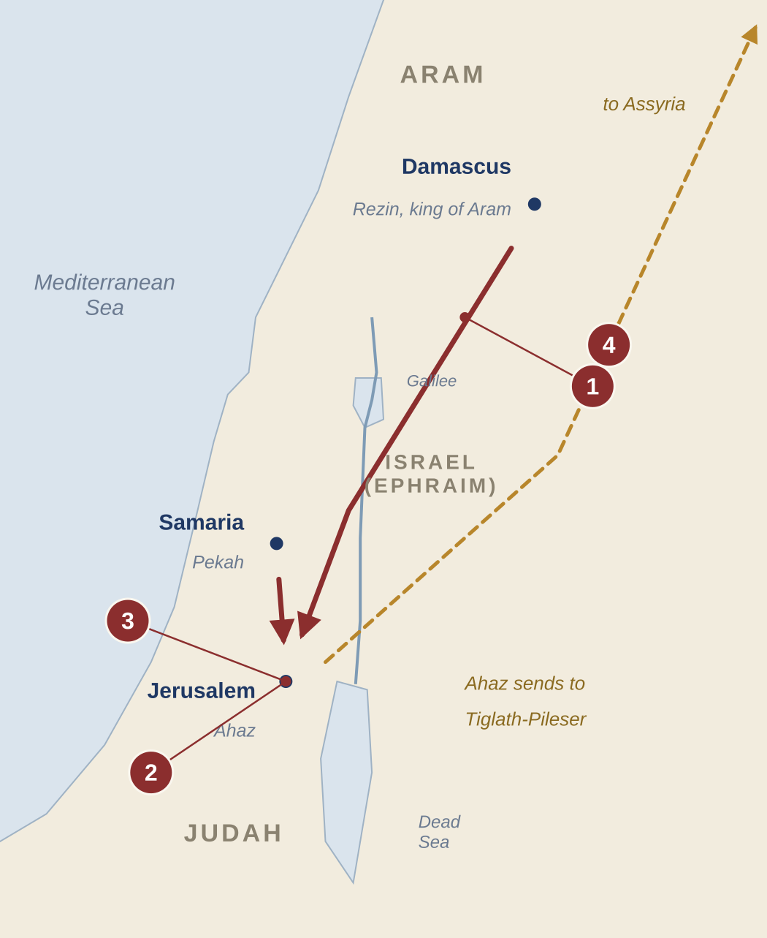
The Syro-Ephraimite Crisis
Isaiah 7–8 · Aram and Israel against Judah, about 735–732 BC · schematic map
1
The alliance
Rezin of Aram and Pekah of Israel march on Jerusalem to set up a puppet king (7:1–6)
2
At the upper pool
Isaiah and his son Shear-jashub meet Ahaz: “If you will not believe, you surely shall not last” (7:3–9)
3
The sign refused
Ahaz will not ask for a sign; God gives one anyway: Immanuel (7:10–16)
4
Ahaz turns to Assyria
Assyria takes Damascus in 732 BC; Samaria falls in 722 BC (8:4; 2 Kings 16:7–9; 17:6)
Thirty-three years later Hezekiah faces Assyria at the same upper pool (36:2) — and trusts the LORD.
Chart 6 of 18 · Isaiah 7–8
Notes:
PLACEMENT: Isaiah notes, Isaiah 7 (and 8). SOURCES: Lyons, Isaiah 1–66 Outline and Notes (thegospelvault.com/bible-studies/isaiah/), Isaiah 7: Rezin of Aram and Pekah of Israel (752–732) allied to replace Ahaz with a puppet king (7:6); Isaiah meets Ahaz at the upper pool with Shear-jashub (7:3); “If you will not believe, you surely shall not last” (7:9); Immanuel sign (7:14–16); both kings died in 732. Isaiah 8: Tiglath-Pileser III subdued Damascus and Samaria (732), Samaria fell 722. Ahaz’s appeal to Assyria: 2 Kings 16:7–9.

Slide 7
Isaiah’s Sign-Children
“I and the children whom the LORD has given me are for signs” (8:18)
Shear-jashub
“A remnant shall return”
Immanuel
“God with us”
Maher-shalal-hash-baz
“Quick pickings, easy prey”
Isaiah 7:3
Isaiah 7:14; 8:8, 10
Isaiah 8:1–4
Goes with Isaiah to meet Ahaz at the upper pool. His name is the message: Judah will not be destroyed; a remnant will return (cf. 10:20–22).
Near: before the child is grown, the alliance of Rezin and Pekah is broken.
Far: born of a virgin — Jesus Christ (Matt 1:22–23).
Before he can say “father” or “mother,” Assyria plunders Damascus and Samaria (732 BC). The longest personal name in the Bible.
Isaiah’s own name means “the LORD is salvation.” Father and sons together were a living sermon to Judah.
Chart 7 of 18 · Isaiah 7–8
Notes:
PLACEMENT: Isaiah notes, Isaiah 7 and 8. SOURCES: Lyons, Isaiah 1–66 Outline and Notes (thegospelvault.com/bible-studies/isaiah/): Shear-jashub “a remnant will return” (7:3); Immanuel “God with us,” born of a virgin, near fulfillment to Ahaz and far fulfillment in Christ quoted by Matthew (7:14 notes); Maher-shalal-hash-baz “quick pickings, easy prey,” the longest personal name in the Bible; a year after his birth Assyria plundered Damascus and Samaria (8:1–4 notes).

Slide 8
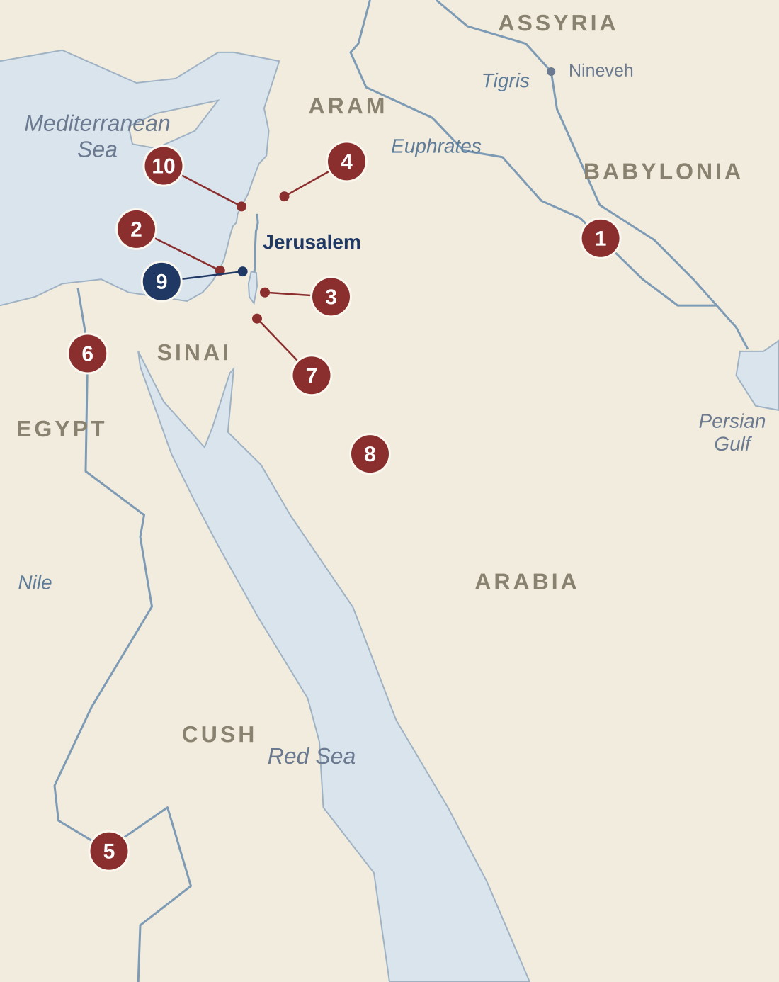
The Burdens on the Nations
Isaiah 13–23 · ten oracles, from Babylon to Tyre · schematic map
1
Babylon 13:1–14:27 (21:1–10)
6
Egypt 19:1–20:6
Overthrown by the Medes (13:17); the king of Babylon brought down
Isaiah walks stripped three years: Egypt cannot save Judah
2
Philistia 14:28–32
7
Edom (Dumah) 21:11–12
Given the year Ahaz died: do not rejoice that the rod is broken
“Watchman, what of the night?”
3
Moab 15:1–16:14
8
Arabia 21:13–17
Ar and Kir fall in a night; within three years Moab’s glory is degraded
Dedan, Tema and Kedar; Kedar’s splendor ends within a year
4
Damascus (Aram) 17:1–14
9
Jerusalem 22:1–25
Rezin’s capital, allied with Israel, ceases to be a city
The “valley of vision”: feasting while the city is threatened
5
Cush (Ethiopia) 18:1–7
10
Tyre 23:1–18
Envoys in papyrus vessels; a gift brought to Mount Zion
The great Phoenician seaport and its trade brought low
God rules the nations Judah feared or trusted. Locations approximate.
Chart 8 of 18 · Isaiah 13–23
Notes:
PLACEMENT: Isaiah notes, Isaiah 13 (introduction to chapters 13–23), linked from each of 13–23. SOURCES: oracle list exactly as Lyons, Isaiah 1–66 Outline and Notes (thegospelvault.com/bible-studies/isaiah/), Isaiah 13 §I.A–J. Medes 539 BC (13:17); Philistia oracle in the year Ahaz died, 715 BC (14:28); Moab within three years (16:13–14); Damascus capital of Rezin (17); papyrus envoys (18:2, 7); Isaiah’s three-year sign (20); Dedan, Tema, Kedar (21:13–17); valley of vision = Jerusalem (22:1). The notes read 21:1–10 as Merodach-baladan’s Babylon (c. 722–702 BC).

Slide 9
Near and Far in the Burdens
Some oracles were fulfilled in Isaiah’s near future; some also look to “that day”
ORACLE
NEAR · in Isaiah’s era
FAR · “in that day”
Babylon
Isaiah 13–14
Overthrown by the Medes, 539 BC (13:17–22)
The Day of the LORD, the Tribulation (13:6–13); Israel restored and singing over the fallen king (14:1–4)
Moab
Isaiah 15–16
Within three years Moab’s glory is degraded (16:14)
—
Damascus
Isaiah 17
Rezin’s alliance broken; Damascus plundered, 732 BC (17:1–3; 8:4)
—
Cush
Isaiah 18
Assyria cut down like pruned branches (18:5–6)
A gift brought to Mount Zion — possibly in the millennium (18:7)
Egypt
Isaiah 19–20
Isaiah’s three-year sign: Egypt led away by Assyria (20:3–4)
Egypt and Assyria worship with Israel “in that day” (19:18–25)
Tyre
Isaiah 23
Trade cut off for “seventy years,” about 700–630 BC (23:15–17)
—
A dash: the notes place that burden in Isaiah’s near history. Isaiah often joins a near judgment to a far one (compare Chart 1).
Chart 9 of 18 · Isaiah 13–23
Notes:
PLACEMENT: Isaiah notes, Isaiah 13–23. SOURCES: Lyons, Isaiah 1–66 Outline and Notes (thegospelvault.com/bible-studies/isaiah/): Babylon — Medes 539 BC (13:17), 13:6–13 “looks forward to the tribulation period,” Israel restored in “that day” (14:1–4); Moab — within three years (16:14); Damascus — Rezin and Pekah died 732, Damascus plundered (7:16; 8:4 notes); Cush — 18:7 offerings to Zion “at the time of the destruction of Assyria or possibly at the time of the millennium”; Egypt — 20:3–4 three-year sign; 19:16–25 “in that day Egypt will know the true God of Israel,” Assyria included; Tyre — trade cut off c. 700–630 BC, the seventy years (23:15–17). A dash means the notes keep that burden in near history.

Slide 10
“In That Day”: Isaiah 24–27
The earth judged, the dragon slain, and the kingdom opened
Tribulation
Second Coming
Millennial Kingdom
24:1–3 The earth laid waste and emptied
27:1 The LORD slays Leviathan, the twisting serpent, with His sword
25:6 A feast for all peoples on Mount Zion
24:19–20 A worldwide earthquake: the earth reels like a drunkard
25:8 Death swallowed up forever; tears wiped away
24:21–22 The LORD punishes the host on high and the kings of the earth
24:23 The LORD of hosts reigns on Mount Zion
25:9 “This is our God; we have waited for Him”
26:17–18 Israel in labor, like a woman giving birth
26:1–3 A strong city; perfect peace for the steadfast mind
26:19 Israel’s dead will live
26:20–21 “Hide yourself … until the indignation is past”
27:2–6 The vineyard kept and fruitful, filling the world
27:12–13 The great trumpet: Israel gathered from the Euphrates to Egypt
“First comes the tribulation, chapter 24. Then comes the millennial kingdom.” — the notes on 25:1
Chart 10 of 18 · Isaiah 24–27
Notes:
PLACEMENT: Isaiah notes, Isaiah 24–27. SOURCES: Lyons, Isaiah 1–66 Outline and Notes (thegospelvault.com/bible-studies/isaiah/): “God will ‘ruin’ the whole earth” (24 notes); worldwide earthquake (24:19–20); “In that day, the Lord will punish” (24:21); “First comes the tribulation chapter 24. Then comes the millennial kingdom” (25:1 notes); 25:6–8 from Mount Zion; 26:1 “In that Day – not today”; 26:17 the tribulation a time of “labor” for Israel; 26:19 Israel’s resurrection after the tribulation; 27:1 Leviathan slain at the end of the tribulation at Christ’s second advent (Rev 19:11–16); 27:2–6 the vineyard; 27:12–13 regathering from the Euphrates to Egypt.

Slide 11
Six Woes and the Coming King
Isaiah 28–33 · misplaced trust, and God’s answer
1
28:1 Woe: Ephraim’s drunkards
GOD’S ANSWER
The proud crown of Samaria, soon trampled
28:16 A tested cornerstone, a sure foundation in Zion
30:15 “In returning and rest you shall be saved”
30:18 The LORD waits to be gracious to you
32:1 A King will reign in righteousness
33:17 Your eyes will see the King in His beauty
33:22 The LORD is our Judge, Lawgiver and King
2
29:1 Woe: Ariel — Jerusalem
Worship by rote; hearts far from God (29:13)
3
29:15 Woe: Those who hide plans from the LORD
The clay questioning the potter (29:16)
4
30:1 Woe: Rebellious children
Off to Egypt without asking the LORD
5
31:1 Woe: Those who trust Egypt’s horses
Chariots instead of the Holy One of Israel
6
33:1 Woe: The destroyer — Assyria
The destroyer will itself be destroyed
“Woe” appears 22 times in Isaiah, more than in any other prophetic book.
Chart 11 of 18 · Isaiah 28–33
Notes:
PLACEMENT: Isaiah notes, Isaiah 28–33. SOURCES: Lyons, Isaiah 1–66 Outline and Notes (thegospelvault.com/bible-studies/isaiah/): 28:1 woe to the Northern Kingdom, Ephraim, Samaria — the drunkards; 29:1 Woe O Ariel – Jerusalem, 29:13 why it has gone this way; 29:15–16 woe to those who hide plans, potter and clay; 30:1 rebellious children who go to Egypt without consulting God; 31:1 woe to those who go down to Egypt for help; 33:1 woe to the destroyer – Assyrians; “woe” occurs 22 times in Isaiah, more than any other prophetic book (notes on 18:1). God’s answer: 28:16 a cornerstone in Zion; 30:15; 32:1 “has to be the age to come”; 33:17 Messiah the King seen.

Slide 12
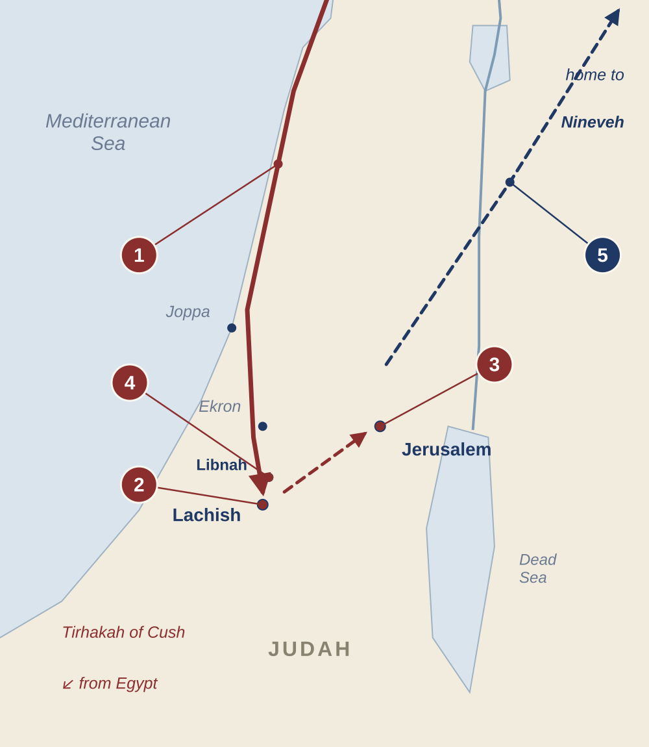
Sennacherib’s Campaign, 701 BC
Isaiah 36–37 · 2 Kings 18–19 · schematic map
1
Down the coast
“In the fourteenth year of King Hezekiah” Sennacherib takes the fortified cities of Judah (36:1)
2
From Lachish
The Rabshakeh is sent to Jerusalem with a great army (36:2)
3
At the upper pool
He mocks Hezekiah’s trust, where Isaiah once met Ahaz (36:2–20; 7:3)
4
At Libnah
Sennacherib hears that Tirhakah of Cush is coming (37:8–9); Hezekiah spreads the letter before the LORD (37:14–20)
5
Home to Nineveh
The angel of the LORD strikes 185,000; Sennacherib returns, later killed by his sons (37:36–38)
Chart 12 of 18 · Isaiah 36–37
Notes:
PLACEMENT: Isaiah notes, Isaiah 36 and 37. SOURCES: Lyons, Isaiah 1–66 Outline and Notes (thegospelvault.com/bible-studies/isaiah/): “In the fourteenth year of King Hezekiah” (36:1); 701 BC (Introduction §H); the Rabshakeh at the conduit of the upper pool (36:2) — the same place Isaiah met Ahaz 33 years earlier (7:3 notes); Sennacherib left Lachish for Libnah, five miles north; Tirhakah, king of Cush, came (37:8–9); 185,000 struck (37:36; Introduction); Sennacherib assassinated by two sons twenty years later (37 notes: 681 BC). Route along the coast is schematic.

Slide 13
Hezekiah’s Three Crises
In the order they happened · all in 701 BC, according to the notes
Book order: 36–37 → 38 → 39 Order of events: 38 → 39 → 36–37
Illness
›
Babylon’s envoys
›
Assyria’s siege
1
2
3
Isaiah 38 · 2 Kings 20:1–11
Isaiah 39 · 2 Kings 20:12–19
Isaiah 36–37 · 2 Kings 18:13–19:37
“Set your house in order.” Hezekiah prays and is given fifteen more years. The sign: the shadow goes back ten steps (38:8). His song of thanksgiving (38:9–20).
Merodach-baladan’s envoys arrive. Hezekiah shows them everything. Isaiah: all of it will be carried to Babylon (39:6).
The Rabshakeh mocks at the upper pool. Hezekiah spreads the letter before the LORD. The angel of the LORD strikes 185,000.
Placed last, chapter 39 turns the book from Assyria to Babylon — the setting of chapters 40–66.
Chart 13 of 18 · Isaiah 36–39
Notes:
PLACEMENT: Isaiah notes, Isaiah 36–39. SOURCES: Lyons, Isaiah 1–66 Outline and Notes (thegospelvault.com/bible-studies/isaiah/), Isaiah 38: “Chapters 38 & 39 occur chronologically before Chapters 36 & 37”; Hezekiah died 686, so his sickness was in 701; Isaiah 39: Merodach-baladan’s envoys came before Sennacherib’s attack, since the treasures had not yet been paid as tribute (2 Kings 18:13–16) — “Hezekiah’s illness, Merodach-baladan’s visit, and Sennacherib’s attack – all three occurred in 701 B.C.” Parallels: 2 Kings 18–20; 2 Chron 32.

Slide 14
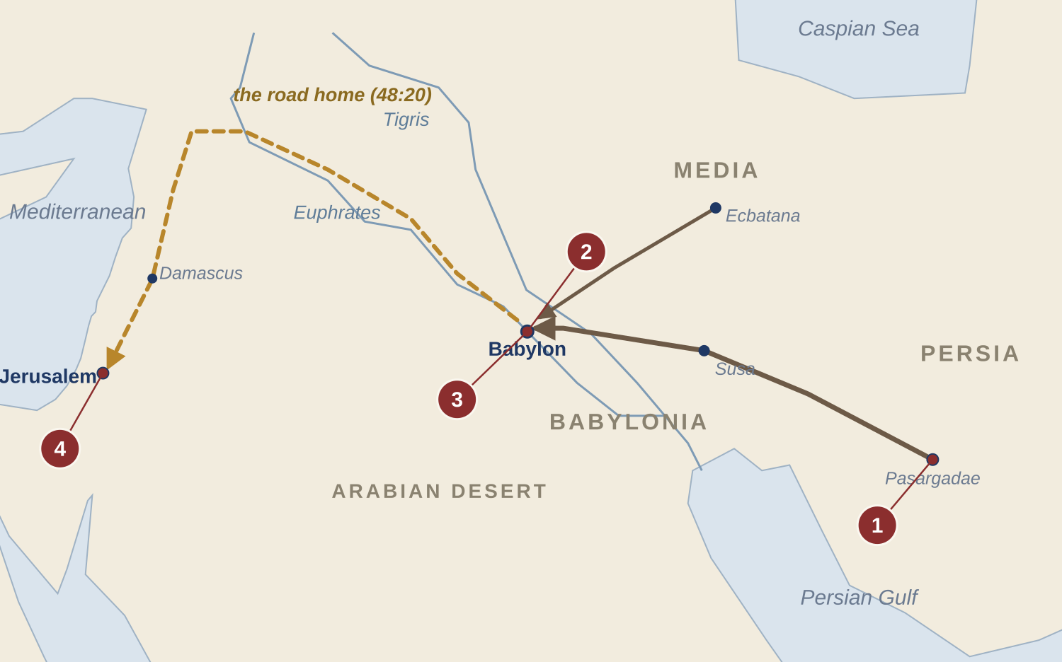
Cyrus and the Road Home
Isaiah 41–48 · the deliverer named in advance · schematic map
1
One from the east
God stirs up Cyrus of Persia: “My shepherd,” “His anointed” (41:2; 44:28; 45:1)
2
Babylon falls, 539 BC
The river dried up (44:27); Bel bows down, Nebo stoops (46:1)
3
The decree, 538 BC
“You shall be built” (44:28; 2 Chron 36:22–23; Ezra 1:1–4)
4
The road home
“Go forth from Babylon! Flee from the Chaldeans!” (48:20)
God named Cyrus and his work long before he was born — proof that the LORD alone declares the end from the beginning (46:10).
Chart 14 of 18 · Isaiah 40–48
Notes:
PLACEMENT: Isaiah notes, Isaiah 44–45 (and 40–48). SOURCES: Lyons, Isaiah 1–66 Outline and Notes (thegospelvault.com/bible-studies/isaiah/): “Cyrus is the chief deliverer! Isa. 44:28–45:1” (40 notes); one from the east, Cyrus of Persia, who subdues Babylon in 539 BC (41:2 notes); Cyrus diverted the waters of the Euphrates (44:27 notes); “My shepherd,” “His anointed” (44:28; 45:1); Bel and Nebo (46:1); “When Cyrus issues his decree – flee quickly” (48:20 notes; 2 Chron 36:22–23; Ezra 1:1–4). Routes schematic.

Slide 15
The Living God and the Idols
Isaiah 40–48 · “To whom will you liken Me?” (40:18, 25; 46:5)
THE IDOLS
THE LORD
Made by a craftsman from half a log; the other half cooks his dinner (44:9–17)
Made the heavens and stretched out the earth (40:12, 26; 44:24)
Must be carried on weary animals: Bel bows, Nebo stoops (46:1–2)
Carries His people from birth to old age (46:3–4)
Set in its place, it cannot move (46:7)
Sits above the circle of the earth (40:22)
Cannot tell what is past or what is coming (41:21–24)
Declares the end from the beginning; names Cyrus in advance (46:9–10; 44:28)
Cannot answer or save in trouble (45:20; 46:7)
“Besides Me there is no Savior” (43:11; 45:21–22)
Its makers will be put to shame (44:9–11; 45:16)
“I am the First and I am the Last” (44:6)
Chart 15 of 18 · Isaiah 40–48
Notes:
PLACEMENT: Isaiah notes, Isaiah 40, 41, 44 and 46. SOURCES: Lyons, Isaiah 1–66 Outline and Notes (thegospelvault.com/bible-studies/isaiah/): “The God of Israel is the only God and, therefore, idol worship makes no sense!” (44:6); “How an Idol Comes To Be” (44:9–17); Bel and Nebo carried on animals (46:1–2); God’s ability to predict the future “makes Him stand alone as the unique God” (46:10 notes; 44:28; 45:1).

Slide 16
The Four Servant Songs
The Servant who succeeds where the servant nation failed · Isaiah 42–53
SONG
THE SERVANT IN ISAIAH
FULFILLED IN CHRIST
Song 1
Isaiah 42:1–9
Chosen, upheld and Spirit-anointed; quiet and gentle, He brings justice to the nations
Matt 12:17–21; 3:16–17
Song 2
Isaiah 49:1–13
Called from the womb; restores Jacob and is a light to the Gentiles. Named “Israel” (49:3)
Luke 2:30–32; Acts 13:47
Song 3
Isaiah 50:4–11
The obedient disciple: His ear opened, His back given to the smiters, His face set like flint
Matt 26:67; 27:26; Luke 9:51
Song 4
Isaiah 52:13–53:12
Marred, despised, wounded for our transgressions, silent as a lamb, then highly exalted
Acts 8:32–35; 1 Pet 2:22–25
The servant nation blind and deaf to its calling (42:19) The Servant “I was not rebellious” (50:5): obedient to the Father’s will
Chart 16 of 18 · Isaiah 42–53
Notes:
PLACEMENT: Isaiah notes at Isaiah 42, 49, 50 and 52:13–53:12. SOURCES: Lyons, Isaiah 1–66 Outline and Notes (thegospelvault.com/bible-studies/isaiah/): 42:1 “My Servant (in contrast to the nation of Israel, vs. 19),” Matt 12:15–20; Spirit upon Him (Matt 3:16–17); justice to the nations at His second advent. 49 — the Servant speaks (vs. 1–5); “You are Israel” (49:3, Rom 9:6); light to the Gentiles (49:6). 50:4–9 — “The Servant is not like the nation … one of obedience.” 52:13–53:12 — the Suffering Servant. New Testament references added for the fulfillment column.

Slide 17
Isaiah 52:13–53:12: Who Is Speaking?
God speaks of “My Servant”; Israel confesses “we” and “our”
GOD SPEAKS
52:13–15
“My Servant” will prosper and be exalted; His appearance marred more than any man; He will sprinkle many nations, and kings will shut their mouths.
QUOTED IN THE NEW TESTAMENT
52:15 Rom 15:21
53:1 John 12:38; Rom 10:16
53:4 Matt 8:17
53:5–6 1 Pet 2:24–25
53:7–8 Acts 8:32–33
53:9 1 Pet 2:22
53:12 Luke 22:37
ISRAEL SPEAKS
53:1–9
“Who has believed our report?” Despised and rejected; He bore our griefs; wounded for our transgressions; all we like sheep have gone astray; silent as a lamb; His grave with the rich.
THE LORD’S PURPOSE
53:10–12
It pleased the LORD to bruise Him, an offering for sin; He will see His seed; “My righteous Servant shall justify many”; He bore the sin of many and intercedes.
One Servant, innocent, suffering in the place of others: “He was wounded for our transgressions” (53:5).
Chart 17 of 18 · Isaiah 52:13–53:12
Notes:
PLACEMENT: Isaiah notes, Isaiah 52:13–53:12. SOURCES: Lyons, Isaiah 1–66 Outline and Notes (thegospelvault.com/bible-studies/isaiah/): “God is doing the speaking” (52:13–15); “People of Israel do the speaking” (53:1ff.); the pronoun clues (“we, us, our” and “he, him, his”) and the Servant as a single, innocent sufferer, from Fruchtenbaum, The Suffering Messiah of Isaiah 53, as cited in the notes; substitutionary death of Christ. New Testament list from the notes (“Often quoted in the New Testament”) with one correction: John 12:38 and Rom 10:16 quote 53:1 (the notes list them under 52:15); 52:15 is quoted in Rom 15:21. 53:10–12 labeled by its content (“My righteous Servant,” 53:11).

Slide 18
Israel, the Wife of Jehovah
The marriage picture behind Isaiah 50, 54 and 62
The Marriage
›
The Great Adultery
›
Separation
›
The Divorce
›
The Punishment
›
The Remarriage
Ex 19:1–8; Ezek 16:8
Jer 3:1–5, 20; Ezek 16:15–34
Isa 50:1
Jer 3:6–10
Ezek 16:35–43; Hos 2:6–13
Jer 31:31–34; Isa 54:1–8; 62:4–5
WHAT ISAIAH ADDS
50:1 Sent away, not forsaken
54:5–8 “Your Maker is your husband”
62:4–5 New names
“Where is your mother’s certificate of divorce?” She was sent away for her own sins — for a time.
“For a mere moment I have forsaken you, but with great mercies I will gather you.”
“Forsaken” becomes Hephzibah, “My delight is in her”; “Desolate” becomes Beulah, “Married.”
Idolatry was Israel’s adultery; the remarriage rests on the New Covenant (Jer 31:31–34).
Chart 18 of 18 · Isaiah 50; 54; 62
Notes:
PLACEMENT: Isaiah notes, Isaiah 54 (and 50:1, 62:4–5). SOURCES: Lyons, Isaiah 1–66 Outline and Notes (thegospelvault.com/bible-studies/isaiah/), Isaiah 54 §I “Notes on the picture used in the scriptures of Israel as the wife of Jehovah”: the Marriage (Ex 19:1–8; Ezek 16:8), the Great Adultery (Jer 3:1–5, 20; Ezek 16:15–34; Hos 2:2–5), a Period of Separation (Isa 50:1), the Divorce (Jer 3:6–10), the Punishment (Ezek 16:35–43; Hos 2:6–13), the Remarriage (Jer 31:31–34; Ezek 16:60–63; Isa 54:1–8; 62:4–5; Hos 2:14–23). Isaiah 50 notes: the Lord “divorcing” Zion temporarily. Isaiah 62 notes: “Forsaken is now called ‘God’s delight.’”

