Slide 1
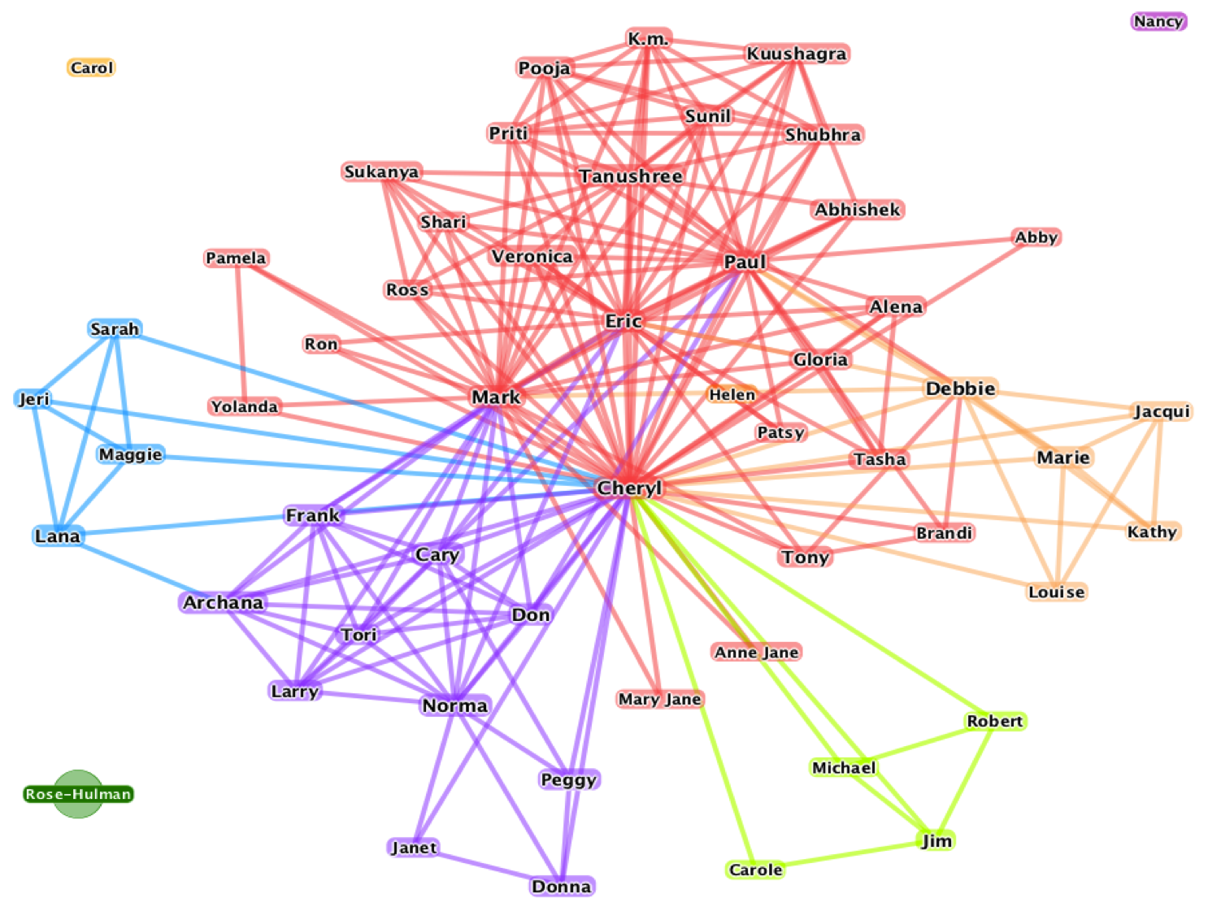
CS 581 Online Social Networks
Introduction

Slide 2
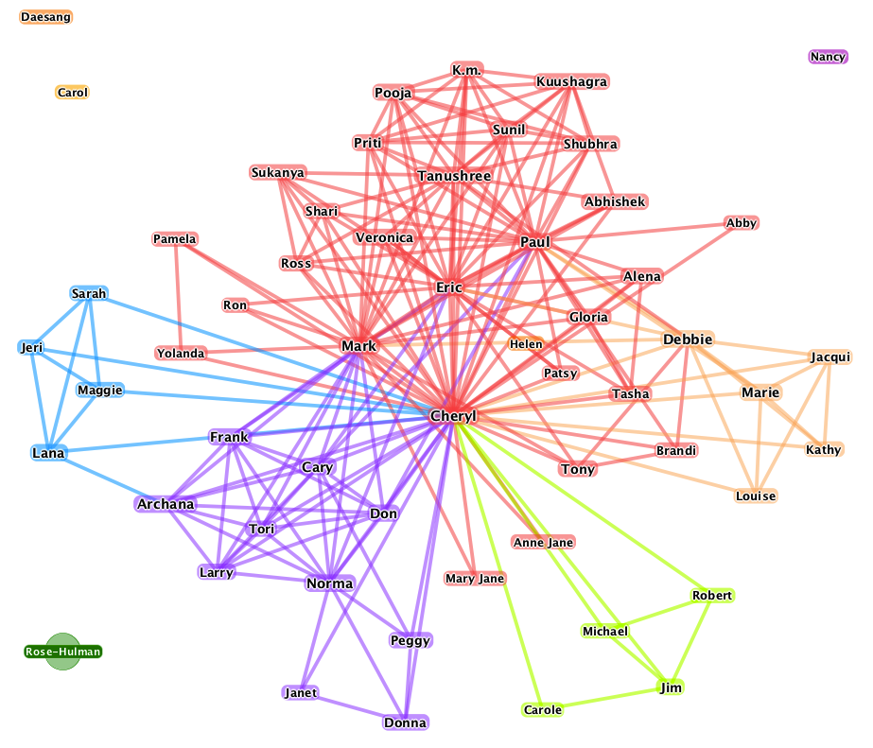
Networks are Everywhere
Communications Networks
Computer Networks
The Internet
Power Networks
Transportation Networks
Terrorism Networks
Social Networks (SN)
Online Social Networks (OSN)

Slide 3
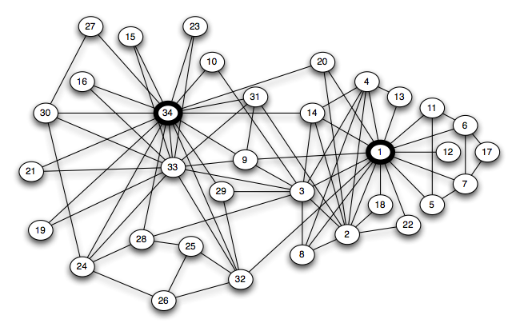
SN Example: Friendships in a Karate Club
Studied by Anthropologist Wayne Zachary in 1970s
Circles (Nodes) represent people
Lines (Edges) represent friendships
Links 1 and 34 are special (more about that later)

Slide 4
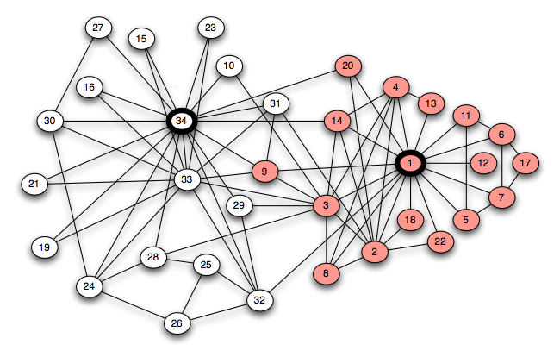
Network Characteristics
Structure
Graph Theory
Strong Ties, Weak Ties
Behavior
Game Theory
Network Dynamics
Structural Effects
Aggregate Behavior
The world will react to what you do: Cause/Effect relationships can be subtle
Highlighted Nodes give clue to schism that eventually split the club in two

Slide 7
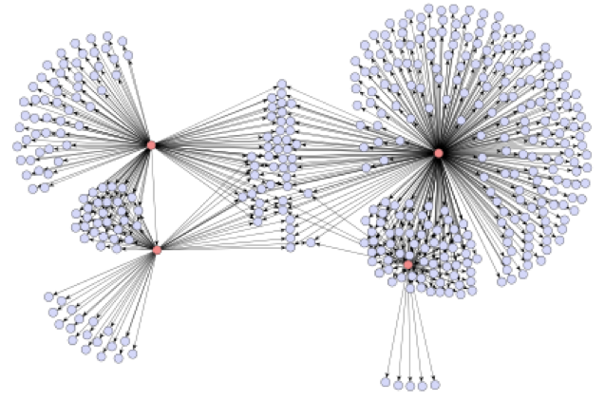
Some Terminology and Concepts
Connectivity in Structure
Who is connected to whom
Connectivity in Behavior
How does action of one node affect the behavior of a (directly or indirectly) connected node
Diffusion
Epidemics
Network Effects
Tipping Point or Going Viral
Email recommendations for a book: illustrates social contagion in network

Slide 8
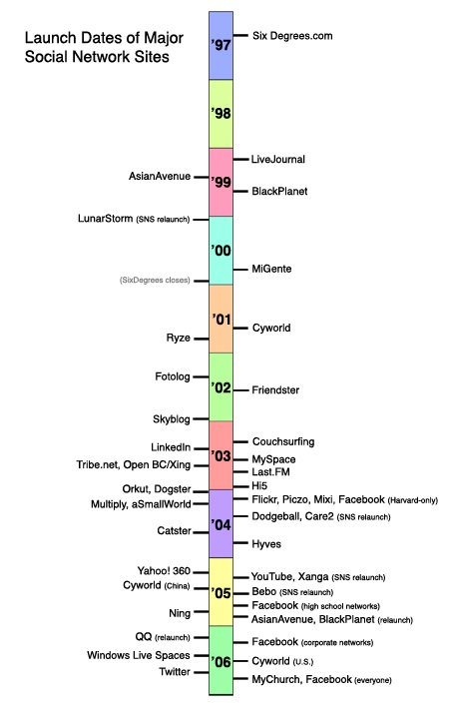
Online Social Networks: Timeline
Source: http://jcmc.indiana.edu/vol13/issue1/boyd.ellison.html
Facebook and Twitter were “latecomers”
Why did they flourish?

Slide 9
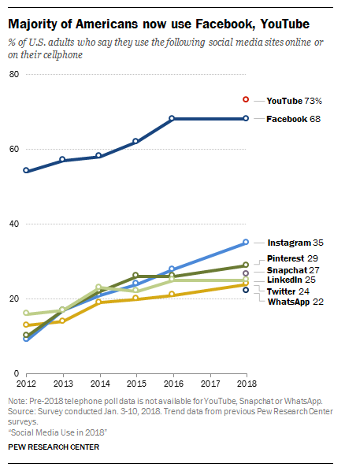
OSN Use in U.S. 2018

Slide 10
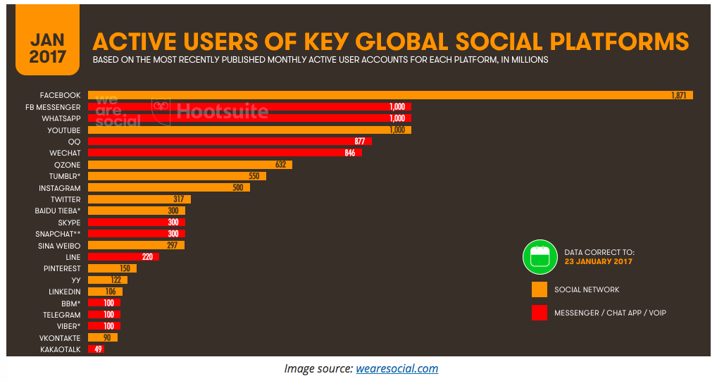
Global OSN Use

Slide 11
The End

