Slide 1

Introduction to Javascript
Presented By:
Jitesh Kumar Bhatia
GLA University, Mathura

Slide 2
Introduction
JavaScript is a front-end scripting language developed by Netscape for dynamic content.
Lightweight, but with limited capabilities.
Client-side technology
Embedded in your HTML page
Interpreted by the Web browser
Simple and flexible

Slide 3
Advantages of Javascript
JavaScript allows interactivity such as:
Implementing form validation
React to user actions
Changing an image on moving mouse over it
Sections of a page appearing and disappearing
Content loading and changing dynamically
Performing complex calculations
Many others….

Slide 4
Using Javascript code
The JavaScript code can be placed in:
<script> tag in the head
<script> tag in the body – not recommended
External files, linked via <script> tag the head
Files usually have .js extension
Highly recommended
The .js files get cached by the browser
Linking an external javascript file named “abc.js”
<script src=“abc.js” type="text/javscript"> </script>

Slide 5
When does Javascript code gets executed?
JavaScript code is executed during the page loading or when the browser fires an event
All statements are executed at page loading
Some statements just define functions that can be called later
Function calls can be attached as "event handlers" via tag attributes (onsubmit, onclick, onkeypress, etc.)
Executed when the event is fired by the browser

Slide 6
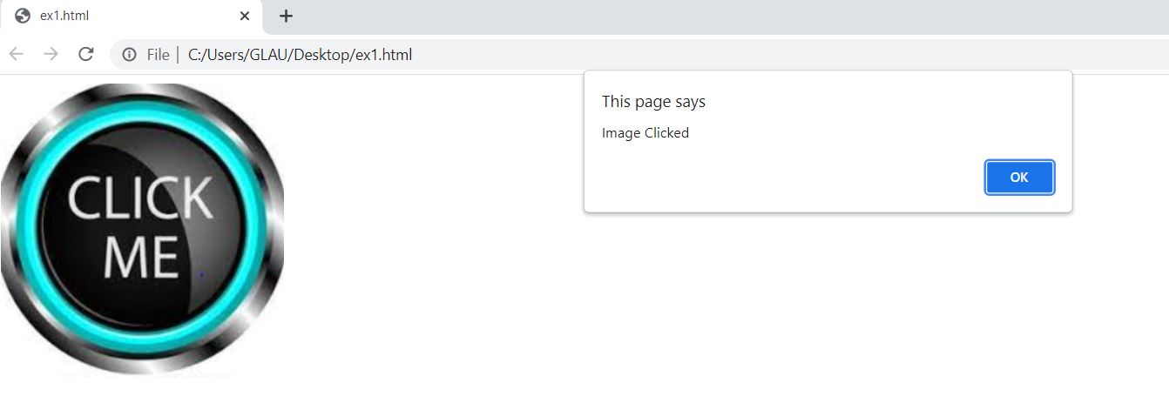
Example 1
<html>
<head>
<script type="text/javascript">
function test () {
alert(“Image Clicked”);
}
</script>
</head>
<body>
<img src=“logo.jpg” onclick="test()" />
</body>
</html>

Slide 7
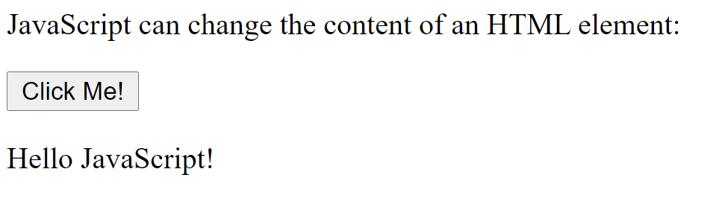
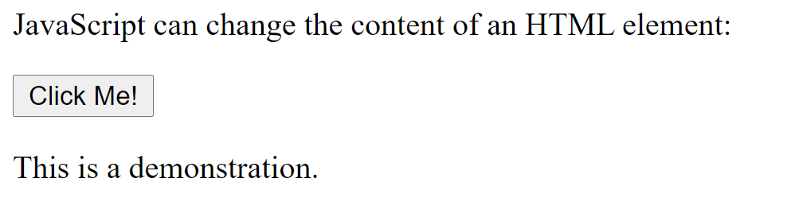
Example 2
<html>
<body>
<p>JavaScript can change the content of an HTML element:</p>
<button type="button" onclick="myFunction()">Click Me!</button>
<p id="demo">This is a demonstration.</p>
<script>
function myFunction() {
document.getElementById("demo").innerHTML = "Hello JavaScript!";
}
</script>
</body>
</html>

Slide 8
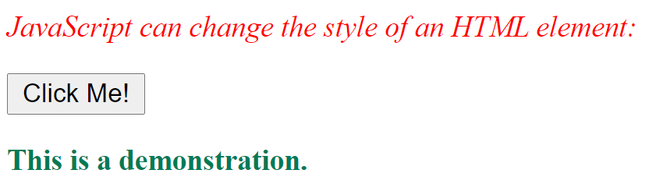
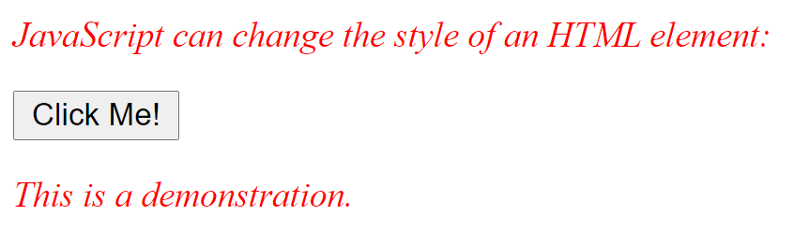
Example 3
<html>
<head>
<style>
p
{
color:red;
font-style: italic;
font-size: 15px;
}
</style>
</head>
<body>
<p>JavaScript can change the style of an HTML element:</p>
<button type="button" onclick="myFunction()">Click Me!</button>
<p id="demo">This is a demonstration.</p>
<script>
function myFunction() {
document.getElementById("demo").style.fontStyle="normal";
document.getElementById("demo").style.color="rgb(0,122,85)";
document.getElementById("demo").style.fontWeight="bold";
}
</script>
</body>
</html>

Slide 9
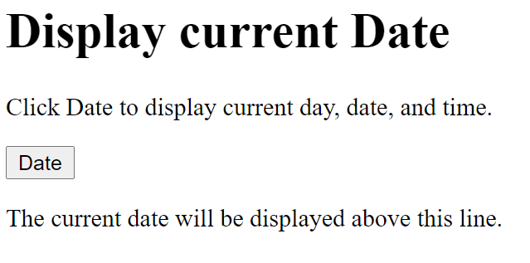
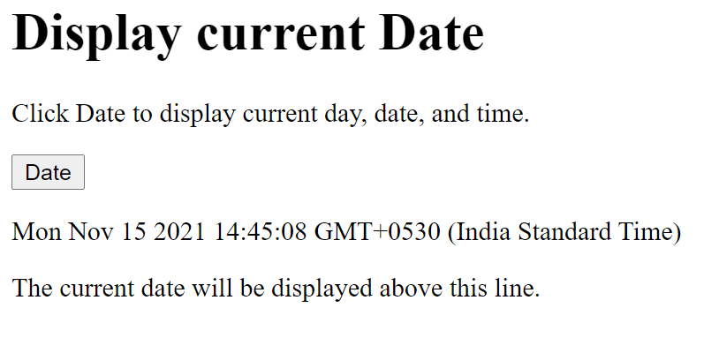
Example 4
<html>
<head>
<script>
function abc() {
document.getElementById("demo").innerHTML = Date();
}
</script>
</head>
<body>
<h1>Display current Date</h1>
<p>Click Date to display current day, date, and time.</p>
<button type="button" onclick=“abc()">Date</button>
<p id="demo"></p>
The current date will be displayed above this line.
</body>
</html>

Slide 10
Example 5
<html>
<head>
<script>
function myTimer() {
document.getElementById("demo").innerHTML = Date();
}
</script>
</head>
<body>
<button type="button" onclick="setInterval(function(){myTimer()}, 1000);">Start Clock</button>
<p id="demo"></p>
</body>
</html>

Slide 11
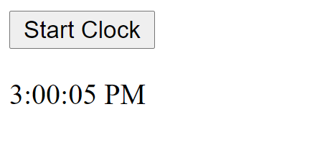
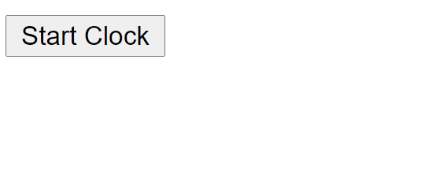
Example 6
<html>
<head>
<script>
function myTimer() {
var d = new Date();
document.getElementById("demo").innerHTML = d.toLocaleTimeString();
}
</script>
</head>
<body>
<button type="button" onclick="setInterval(function(){myTimer()}, 1000);">Start Clock</button>
<p id="demo"></p>
</body>
</html>

Slide 12
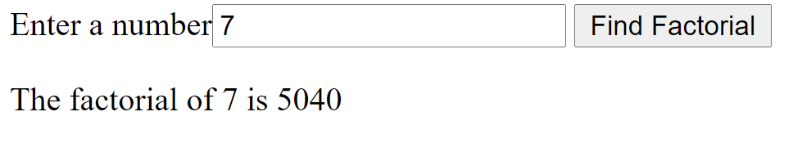
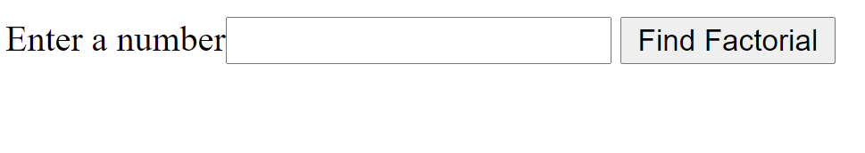
Example 7
<html>
<head>
<script type="text/javascript">
function facto(){
var str=document.getElementById("num").value;
var f=1;
var num=parseInt(str);
for(i=num;i>0;i--){
f=f*i;
}
document.getElementById("result").innerHTML="The factorial of "+num+" is "+f;
}
</script>
</head>
<body>
Enter a number<input type=text name=t1 id=num>
<input type=button value="Find Factorial" onclick=facto()>
<p id=result></p>
</body></html>

Slide 13
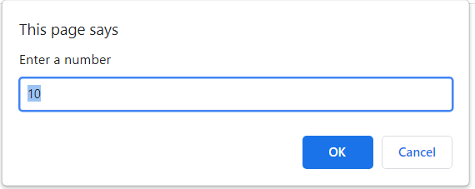
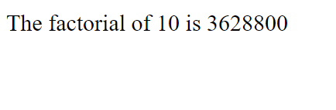
Example 8 (script without function)
<html>
<head></head>
<body>
<script type="text/javascript">
var str=prompt("Enter a number","10");
var f=1;
var num=parseInt(str);
for(i=num;i>0;i--)
{
f=f*i;
}
document.write("The factorial of "+num+" is "+f);
</script>
</body>
</html>

Slide 14
Example 9
<html><head>
<script type="text/javascript">
function xyz(){
var str=document.getElementById("num").value;
var num=parseInt(str);
document.getElementById("result").innerHTML="";
for(i=1;i<=10;i++){
document.getElementById("result").innerHTML+="<tr><td>" + num + "</td><td>*</td><td>" + i + "</td><td>=</td><td>" + num*i+ "</td></tr>";
}}
</script>
</head>
<body>
Enter a number<input type=text name=t1 id=num>
<input type=button value="Show Table" onclick=xyz()>
<table border=1 id=result>
</table>
</body></html>

Slide 15
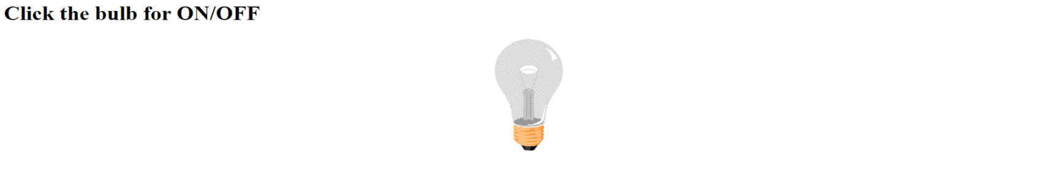
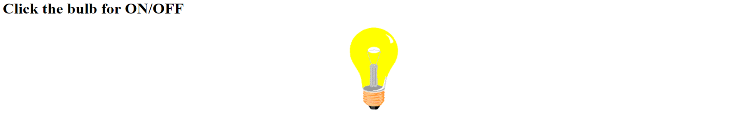
Example 10
<html><head>
<script>
function changeImage() {
var image = document.getElementById('myImage');
if (image.src.match("bulbon")) {
image.src = "pic_bulboff.gif";
} else {
image.src = "pic_bulbon.gif";
}
}
</script>
</head>
<body>
<h1>Click the bulb for ON/OFF</h1>
<center><img id="myImage" onclick="changeImage()" src="pic_bulboff.gif" width="100" height="180">
</center>
</body>
</html>

Slide 16
Events in Javascript (some)
Event | Description
onchange | An HTML element has been changed
onclick | The user clicks an HTML element
onmouseover | The user moves the mouse over an HTML element
onmouseout | The user moves the mouse away from an HTML element
onkeydown | The user pushes a keyboard key
onload | The browser has finished loading the page
onsubmit | On submitting the form
onblur | Triggers when the window/element loses focus
onfocus | Triggers when the window/element gets focus
onunload | Triggers when the user leaves the document
ondblclick | Triggers on a mouse double-click

Slide 17
Pop up Boxes in Javascript
Alert box with text and [OK] button
Just a message shown in a dialog box:
Confirmation box
Contains text, [OK] button and [Cancel] button:
Prompt box
Contains text, input field with default value:
alert("Some text here");
var inp = confirm("Are you sure?");
var inp = prompt ("enter amount", 10);

Slide 18
Form Validation
Form validation is checking the format of each of the element in the form at client side before sending the data to the server.
Form validation can be done using Javascript.
Some of the form validations are:
Checking whether the fields are filled or not.
Mobile number is of 10 digits.
Email ID must be in correct format.
Password and confirm password should be same.
Checking password for certain rules.
Mobile number should start with +91.

Slide 19


