Slide 1


Real Time Face Mask Detection
PROJECT BY:
AGAM MADAN, PIYUSH KATARIYA, ROHAN ARORA
SUPERVISED BY:
Dr. RACHNA JAIN
ASSISTANT PROFESSOR
DEPT. OF COMPUTER SCIENCE AND ENGINEERING
BHARATI VIDYAPEETH’S COLLEGE OF ENGINEERING, NEW DELHI

Slide 2
Motivation for the work
Our Story
In the rapid developing world, with increase in technology so is increasing diseases such as Covid-19.
To prevent the spread of disease it is absolutely compulsory to wear mask.
There is a need for Mask Detection technique as checking mask for every person by a person is not feasible, therefore we need a deep learning algorithm which will ease the work of human workforce.

Slide 3

Table of Contents
Abstract
Introduction
Proposed Framework/ Problem Statement
Data set
Methodology
Result
Comparison with other model
Conclusion and Future scope
References

Slide 4


Abstract
This paper is concerned with the detection of face masks.
There are two phrases of our project:
Training - Detect face mask on images (using Keras/TensorFlow)
Deployment - Detect face mask on real time video stream
Dataset consist of 11,042 images combined manually.
MobileNetV2 architecture is used for fine tuning on the dataset.
Adam is used as optimizer and Binary Cross Entropy is used as a loss function.
Our proposed model gives an accuracy of 92.53%.

Slide 5

INTRODUCTION
Face Mask detection has become a very trending application due to Covid-19 pandemic, which demands for a person to wear face masks, keep social distancing and use hand sanitizers to wash your hands.
While other problems of social distancing and sanitization have been addressed up till now, the problem of face mask detection has not been addressed yet.
This paper proposes a model for face detection using OpenCV DNN, TensorFlow, Keras and MobileNetV2 architecture which is used as an image classifier.
This dataset could be used for developing new face mask detectors and performing several applications.

Slide 6
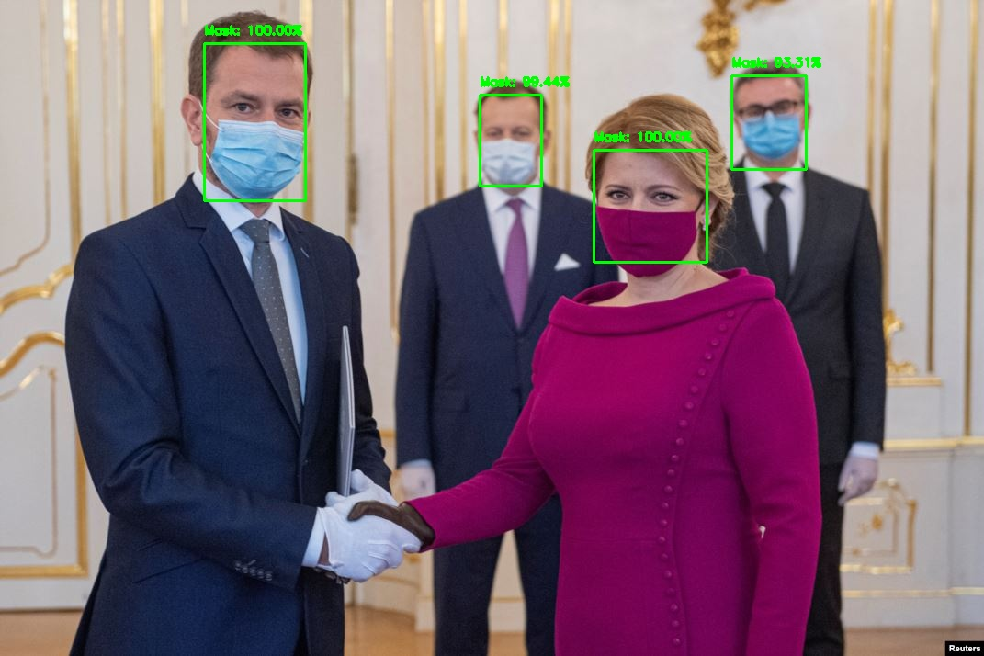
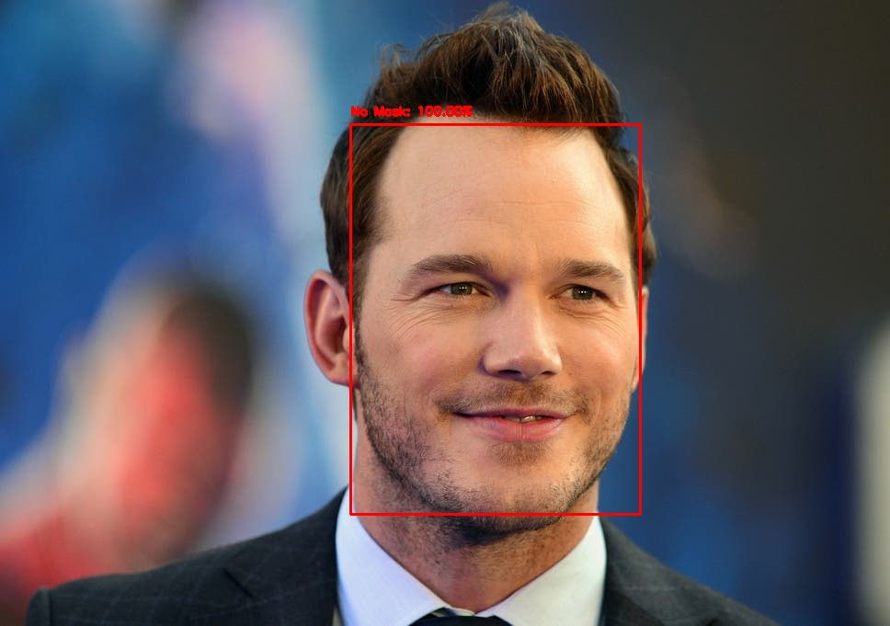
PROBLEM STATEMENT
The goal is to predict whether the person is wearing a mask or not.
Since this is an issue of binary classification, the model if predicts correctly then a green rectangular box appears on person wearing mask.
If the person is not wearing mask, the model predicts red rectangular box on his face along with accuracy score.
Figure 1: Mask Found
Figure 2: Mask not found

Slide 7
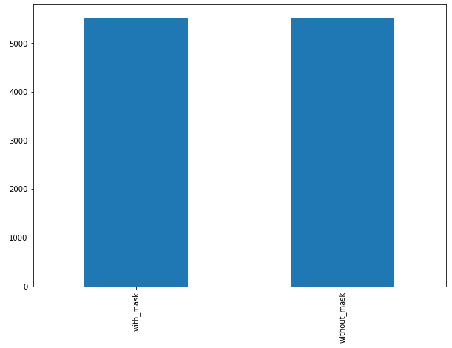
DATASET
The data set consist of 11,042 total images out of which 80 percent of images used for training data set, and the rest 20 percent have been used for testing.
The following figure 2 shows the bar graph which represents equal 5521 images distribution between two classes, with_mask and without_mask.
This accounts for approximately 8,833 images and 2,209 images, which have been used for training and testing respectively.
Bar graph with class:
"with mask" and "without mask"

Slide 8
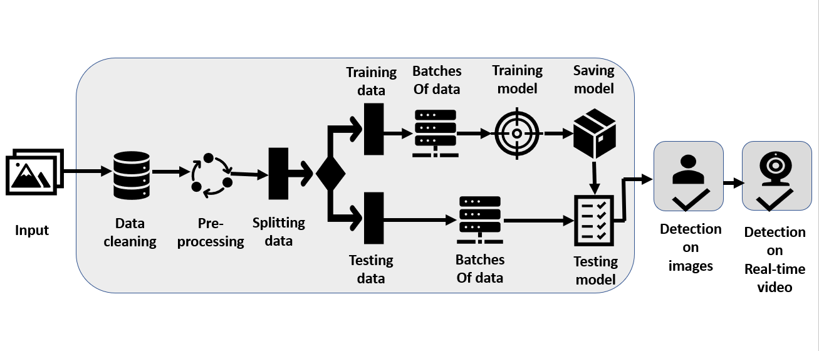
DATA PIPELINE

Slide 9
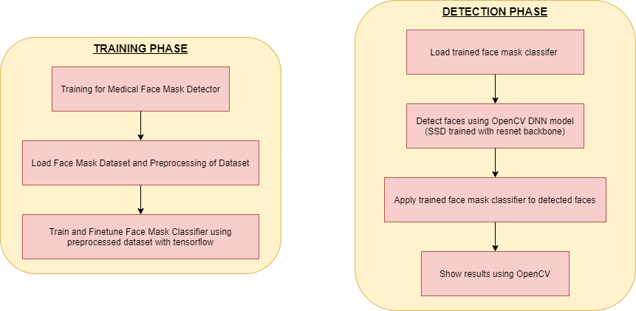
METHODOLOGY

Slide 10


EVALUATION MEASURE
Accuracy – It is a good measure to start with if classes are balanced.
$Accuracy=\frac{\left( TP+TN \right)}{(TP+FP+FN+TN)}$
Precision - It is the measure of positive predicted values.
$Precision=\frac{TP}{TP+FP}$
Recall – It is the ability of a classifier to find all positive samples.
$$Recall=\frac{TP}{TP+FN}$$
F1 score – It is a measure of test accuracy.
$F1 score=\frac{2∗\left(Recall∗Precision\right)}{Recall+Precision}$

Slide 11
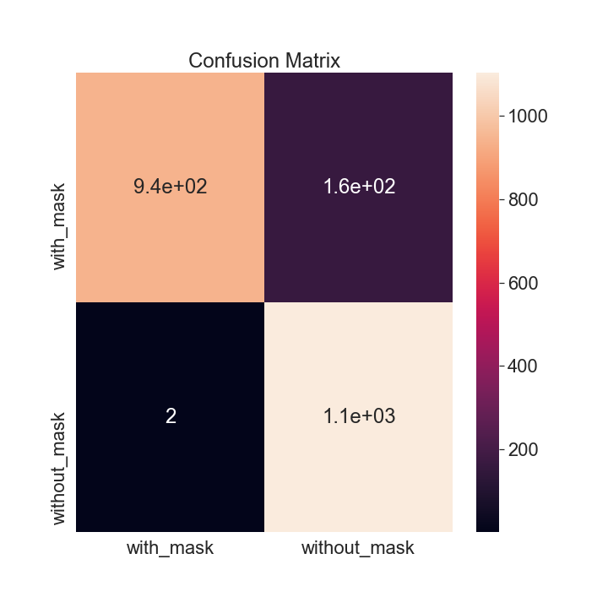
RESULT AND ANALYSIS
Heatmap Respresenting Confusion Matrix
The confusion matrix is plotted with help of heatmap showing two dimensional matrix data in graphical format.
It has successfully identified 941 true positives, 1103 true negatives, 2 false positive and 163 false negatives.

Slide 12
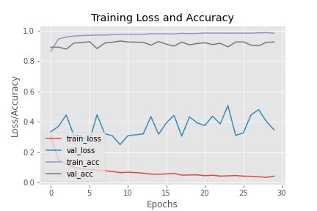
RESULT AND ANALYSIS
Training Accuracy/Loss Curve
The plots are based on model accuracy/loss, the pyplot command style function that makes matplotlib work like Matlab.
In this figure the violet curve shows the training accuracy which is nearly equal to 98%, the grey curve represents training accuracy on the validation dataset.
Training loss where the red curve shows loss in training dataset less than 0.1, whereas the blue curve shows training loss on the validation dataset.
Training accuracy/loss on train and validation dataset

Slide 13
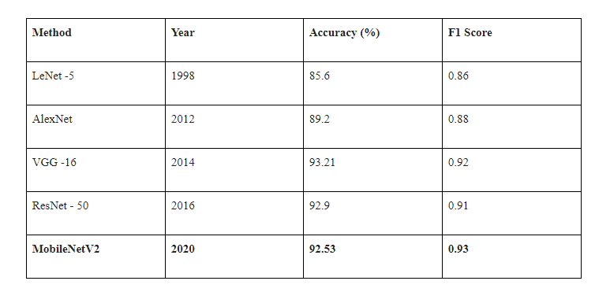
COMPARISON WITH OTHER MODEL

Slide 14
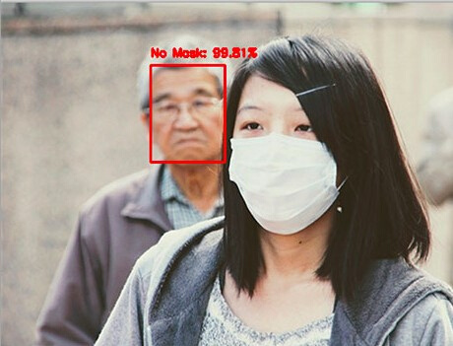
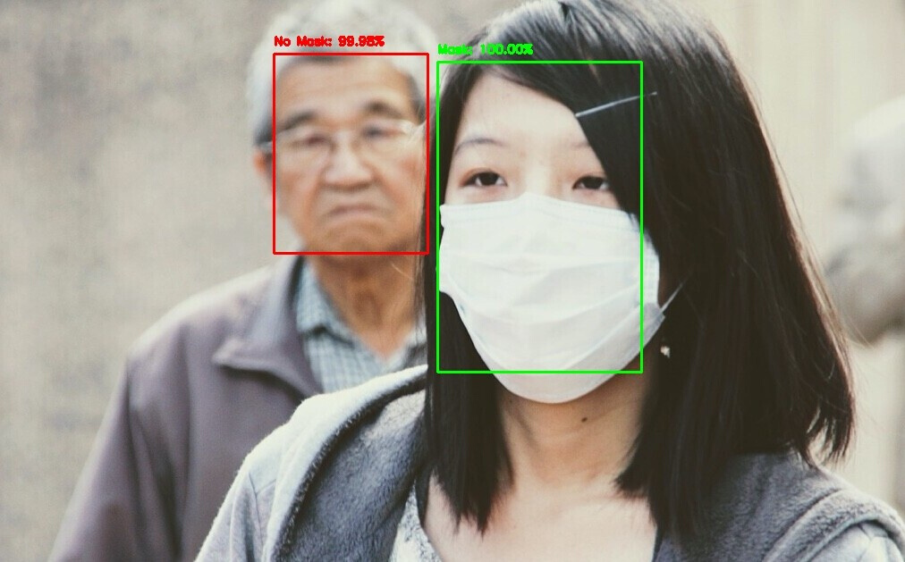
COMPARISON WITH OTHER IMPLEMENTATIONS
Predicted by similar methodology
used by PyImageSearch
Predicted by our methodology

Slide 15
CONCLUSION
In our face mask detection model we successfully performed both the training and development of the image dataset which were divided into categories of people having masks and people not having masks.
We were able to classify our images accurately using MobileNetV2 image classifier which is one of the uniqueness of our model.
The technique of Object detection using OpenCV deep neural networks in our approach generated fruitful results.
The real time face detection model has an accuracy of 92.53% and produces a highest F1 score with 0.93.

Slide 16
REFERENCES
[1] Lawrence, Steve, C. Lee Giles, Ah Chung Tsoi, and Andrew D. Back. "Face recognition: A convolutional neural-network approach." IEEE transactions on neural networks 8, no. 1 (1997): 98-113.
[2] Velasco-Montero, Delia, Jorge Fernández-Berni, Ricardo Carmona-Galán, and Ángel Rodríguez-Vázquez. "Performance analysis of real-time DNN inference on Raspberry Pi." In Real-Time Image and Video Processing 2018, vol. 10670, p. 106700F. International Society for Optics and Photonics, 2018.
[3] NGUYEN, HOANH. "FAST OBJECT DETECTION FRAMEWORK BASED ON MOBILENETV2 ARCHITECTURE AND ENHANCED FEATURE PYRAMID." Journal of Theoretical and Applied Information Technology 98, no. 05 (2020).
[4] Chen, Dong, Gang Hua, Fang Wen, and Jian Sun. "Supervised transformer network for efficient face detection." In European Conference on Computer Vision, pp. 122-138. Springer, Cham, 2016.
[5] Ranjan, Rajeev, Vishal M. Patel, and Rama Chellappa. "Hyperface: A deep multi-task learning framework for face detection, landmark localization, pose estimation, and gender recognition." IEEE Transactions on Pattern Analysis and Machine Intelligence 41, no. 1 (2017): 121-135.
[6] Zhu, Chenchen, Yutong Zheng, Khoa Luu, and Marios Savvides. "Cms-rcnn: contextual multi-scale region-based cnn for unconstrained face detection." In Deep learning for biometrics, pp. 57-79. Springer, Cham, 2017.
[7] Li, Yunzhu, Benyuan Sun, Tianfu Wu, and Yizhou Wang. "Face detection with end-to-end integration of a convnet and a 3d model." In European Conference on Computer Vision, pp. 420-436. Springer, Cham, 2016.
[8] Zhang, Kaipeng, Zhanpeng Zhang, Zhifeng Li, and Yu Qiao. "Joint face detection and alignment using multitask cascaded convolutional networks." IEEE Signal Processing Letters 23, no. 10 (2016): 1499-1503.
[9] Huang, Chang, Haizhou Ai, Yuan Li, and Shihong Lao. "High-performance rotation invariant multiview face detection." IEEE Transactions on pattern analysis and machine
intelligence 29, no. 4 (2007): 671-686.
[10] Jun, Bongjin, Inho Choi, and Daijin Kim. "Local transform features and hybridization for accurate face and human detection." IEEE transactions on pattern analysis and machine intelligence 35, no. 6 (2012): 1423-1436.

Slide 17
REFERENCES
[[11] I. Shlizerman, E. Shechtman, R. Garg, and S. M. Seitz. Exploring photo-bios. ACM TOG, 30:61, 2011.
[12] Ghiasi, Golnaz, and Charless C. Fowlkes. "Occlusion coherence: Localizing occluded faces with a hierarchical deformable part model." In Proceedings of the IEEE Conference on Computer Vision and Pattern Recognition, pp. 2385-2392. 2014.
[13] Opitz, Michael, Georg Waltner, Georg Poier, Horst Possegger, and Horst Bischof. "Grid loss: Detecting occluded faces." In European conference on computer vision, pp. 386-402. Springer, Cham, 2016.
[14] Yang, Shuo, Ping Luo, Chen-Change Loy, and Xiaoou Tang. "From facial parts responses to face detection: A deep learning approach." In Proceedings of the IEEE International Conference on Computer Vision, pp. 3676-3684. 2015.
[15] Ojala, Timo, Matti Pietikäinen, and Topi Maenpaa. "Multiresolution gray-scale and rotation invariant texture classification with local binary patterns." IEEE Transactions on pattern analysis and machine intelligence 24, no. 7 (2002): 971-987.
[16] Kim, Tae-Hyun, Dong-Chul Park, Dong-Min Woo, Tae Kyeong Jeong, and Soo-Young Min. "Multi-class classifier-based adaboost algorithm." In International Conference on Intelligent Science and Intelligent Data Engineering, pp. 122-127. Springer, Berlin, Heidelberg, 2011.
[17] Yang, Bin, Junjie Yan, Zhen Lei, and Stan Z. Li. "Fine-grained evaluation on face detection in the wild." In 2015 11th IEEE International Conference and Workshops on Automatic Face and Gesture Recognition (FG), vol. 1, pp. 1-7. IEEE, 2015.
[18] Klare, Brendan F., Ben Klein, Emma Taborsky, Austin Blanton, Jordan Cheney, Kristen Allen, Patrick Grother, Alan Mah, and Anil K. Jain. "Pushing the frontiers of unconstrained face detection and recognition: Iarpa janus benchmark a." In Proceedings of the IEEE conference on computer vision and pattern recognition, pp. 1931-1939. 2015.
[19] Klare, Brendan F., Ben Klein, Emma Taborsky, Austin Blanton, Jordan Cheney, Kristen Allen, Patrick Grother, Alan Mah, and Anil K. Jain. "Pushing the frontiers of unconstrained face detection and recognition: Iarpa janus benchmark a." In Proceedings of the IEEE conference on computer vision and pattern recognition, pp. 1931-1939. 2015.
[20] Yang, Shuo, Ping Luo, Chen-Change Loy, and Xiaoou Tang. "Wider face: A face detection benchmark." In Proceedings of the IEEE conference on computer vision and pattern recognition, pp. 5525-5533. 2016.

Slide 18
REFERENCES
[21] Viola, Paul, and Michael Jones. "Rapid object detection using a boosted cascade of simple features." In Proceedings of the 2001 IEEE computer society conference on computer vision and pattern recognition. CVPR 2001, vol. 1, pp. I-I. IEEE, 2001.
[22] Zhang, Kaipeng, Zhanpeng Zhang, Zhifeng Li, and Yu Qiao. "Joint face detection and alignment using multitask cascaded convolutional networks." IEEE Signal Processing Letters 23, no. 10 (2016): 1499-1503.
[23] Chen, Dong, Shaoqing Ren, Yichen Wei, Xudong Cao, and Jian Sun. "Joint cascade face detection and alignment." In European conference on computer vision, pp. 109-122. Springer, Cham, 2014.
[24] Ren, Shaoqing, Kaiming He, Ross Girshick, and Jian Sun. "Faster r-cnn: Towards real-time object detection with region proposal networks." In Advances in neural information processing systems, pp. 91-99. 2015.
[25] Li, Haoxiang, Zhe Lin, Xiaohui Shen, Jonathan Brandt, and Gang Hua. "A convolutional neural network cascade for face detection." In Proceedings of the IEEE conference on computer vision and pattern recognition, pp. 5325-5334. 2015.

Slide 19
THANK YOU!

