Slide 1

Investigation of the Magnetic Properties of RNiO₃
Sahil Islam
Exam Roll No: MPHD_____________
Registration No:133-136 of 2015-2016
Department of Physics
Jadavpur University
A project submitted for the final semester of
Master of Science
2020

Slide 2
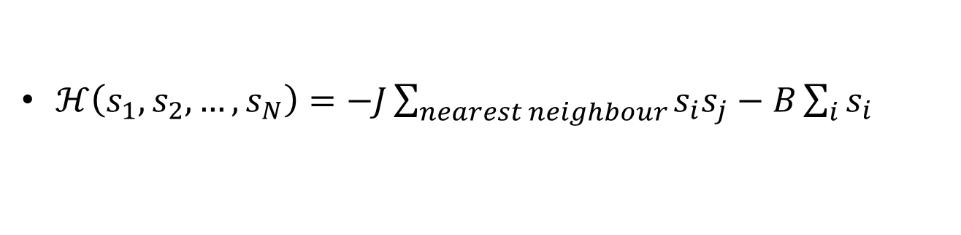
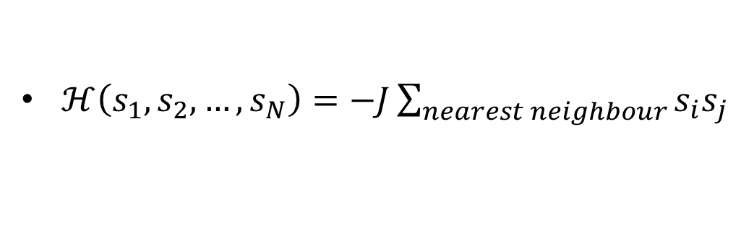
Basic Concepts
The Ising Model
To explain the behaviour of a metal near critical temperature, to observe the nature of magnetization, energy, specific heat or the magnetic susceptibility of a substance we use some models to explain those theoretically. One of those models is Ising Model. This model was proposed by Ernst Ising initially to explain those behaviours in one dimension. He believed this model fails for higher dimensions. But later Lars Onsager proposed a complicated but very nice solution to the two dimensional Ising Model proving that this model can be useful in more than one dimensions. But proper analytic solution of this in 3D is not yet available. In 3D, this is done by some more approximations like Mean Field Theory or computationally using Monte Carlo Method etc.
Hamiltonian
$ℋ\left(s_{1},s_{2},…,s_{N}\right)=−J\sum_{nearest neighbour}{s_{i}s_{j}}$
…. Without external field
$ℋ\left(s_{1},s_{2},…,s_{N}\right)=−J\sum_{nearest neighbour}{s_{i}s_{j}}−B\sum_{i}{s_{i}}$
…. Without external field

Slide 3
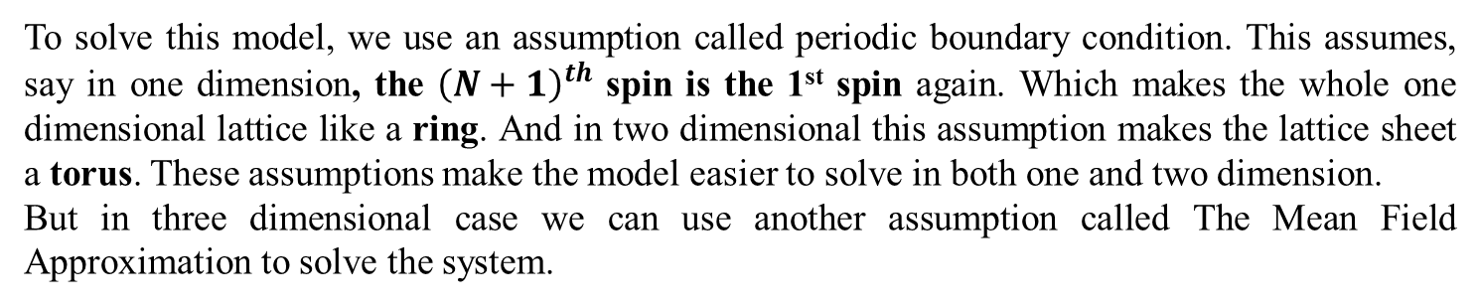


Basic Concepts
Periodic Boundary Condition
To solve this model, we use an assumption called periodic boundary condition. This assumes, say in one dimension, the ${\left(N+1\right)}^{th}$ spin is the 1st spin again. Which makes the whole one dimensional lattice like a ring. And in two dimensional this assumption makes the lattice sheet a torus. These assumptions make the model easier to solve in both one and two dimension.
But in three dimensional case we can use another assumption called The Mean Field Approximation to solve the system.
Mean Field Approximation
In Mean Field Approximation, the basic assumption is that instead of interacting directly with the neighbouring spins, each spin interacts with each other with a ‘mean field’ which follows from the mean orientation of the neighbouring spins.
$$s_{i}s_{j}=\left[\left(s_{i}−m\right)+m\right]\left[\left(s_{j}−m\right)+m\right]$$
$$s_{i}s_{j}=\left(s_{i}−m\right)\left(s_{j}−m\right)+m\left(s_{i}−m\right)+m\left(s_{j}−m\right)+m^{2}$$
$$\left(s_{i}−m\right),$$
$$\left(s_{j}−m\right)$$
…. Fluctuations

Slide 4
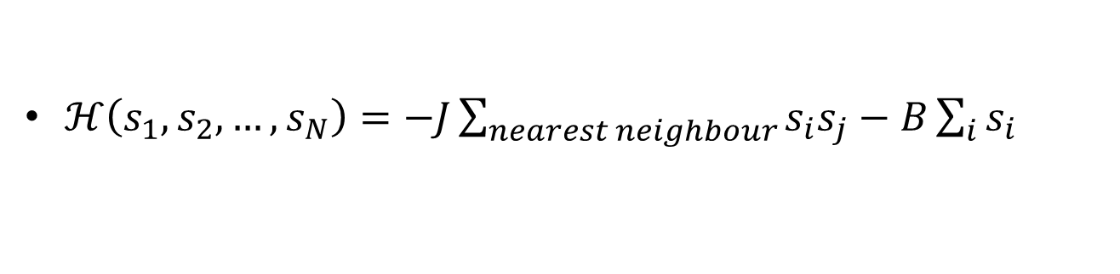

Basic Concepts
Mean Field Hamiltonian
$ℋ\left(s_{1},s_{2},…,s_{N}\right)=−J\sum_{nearest neighbour}{s_{i}s_{j}}−B\sum_{i}{s_{i}}$
$s_{i}s_{j}=\left(s_{i}−m\right)\left(s_{j}−m\right)+m\left(s_{i}−m\right)+m\left(s_{j}−m\right)+m^{2}$
J - Exchange Integral term
N – Total Number of Spins
m – Mean Filed
q – No of Nearest Neighbors
H – External magnetic Filed
$$𝓗_{mf}=\frac{1}{2}JNm^{2}−\left(Jqm+H\right)\sum_{i}{s_{i}}$$

Slide 5
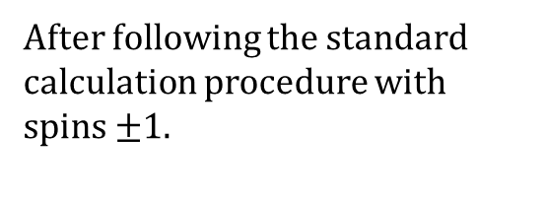
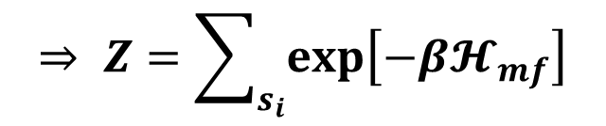
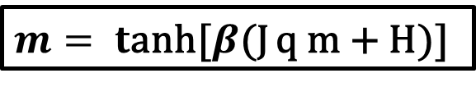
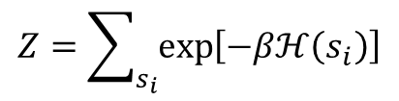
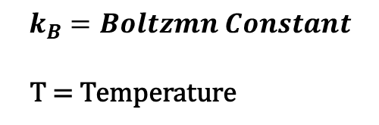
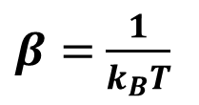

Basic Concepts
Mean Field Approximation
Partition Function
$$Z=\sum_{s_{i}}{\exp\left[−βℋ\left(s_{i}\right)\right]}$$
$$⇒ Z=\sum_{s_{i}}{\exp\left[−β𝓗_{mf}\right]}$$
Magnetization
$β=$ $\frac{1}{k_{B}T}$
$$m=\frac{1}{N}\sum_{i}{s_{i}}=\frac{1}{Nβ}\frac{∂\ln\left(Z\right)}{∂β}$$
Average Magnetization:
$$k_{B}=Boltzmn Constant$$
T = Temperature
$m= t$anh[$β$(J q m + H)]
After following the standard calculation procedure with spins $±1$.

Slide 6


Basic Concepts
Mean Field Approximation
$$M=\sum_{i}{m_{i}}$$
Total Magnetization:
$$χ=\frac{∂M}{∂H}|_{T}$$
Susceptibility
The Sample
Crystal Structure
The sample we are working with is generally denoted by RNiO₃ perovskites. Here R is rare earth elements. This kind of materials has a structure of orthorhombically distorted perovskites. The ideal cubic structure of R and Ni has a 3D array of corner sharing NiO₆ octahedra.

Slide 7
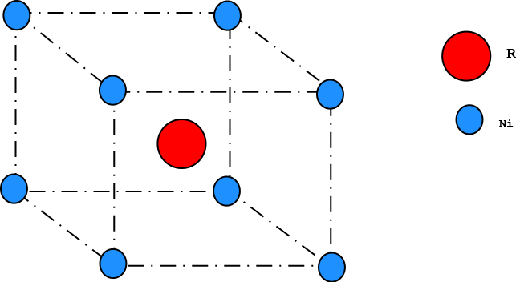
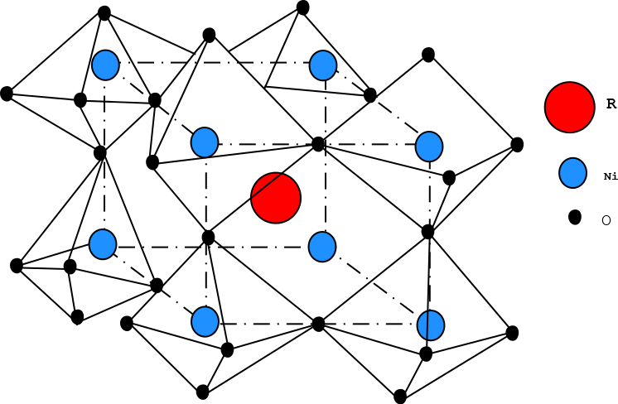
The Sample
Crystal Structure
Ideal cubic structure with R and Ni
Structure of RNiO₃

Slide 8
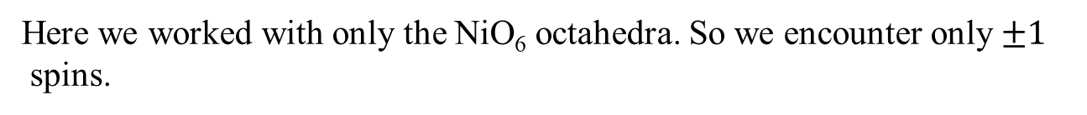
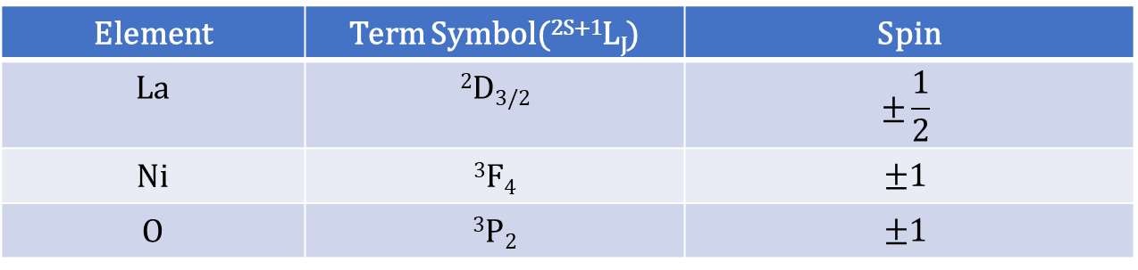
The Sample
Spin Structure
Element | Term Symbol(^{2S+1}L_{J}) | Spin
La | ²D_{3/2} | $$±\frac{1}{2}$$
Ni | ³F₄ | $$±1$$
O | ³P₂ | $$±1$$
Here we worked with only the NiO₆ octahedra. So we encounter only $±1$
spins.

Slide 9
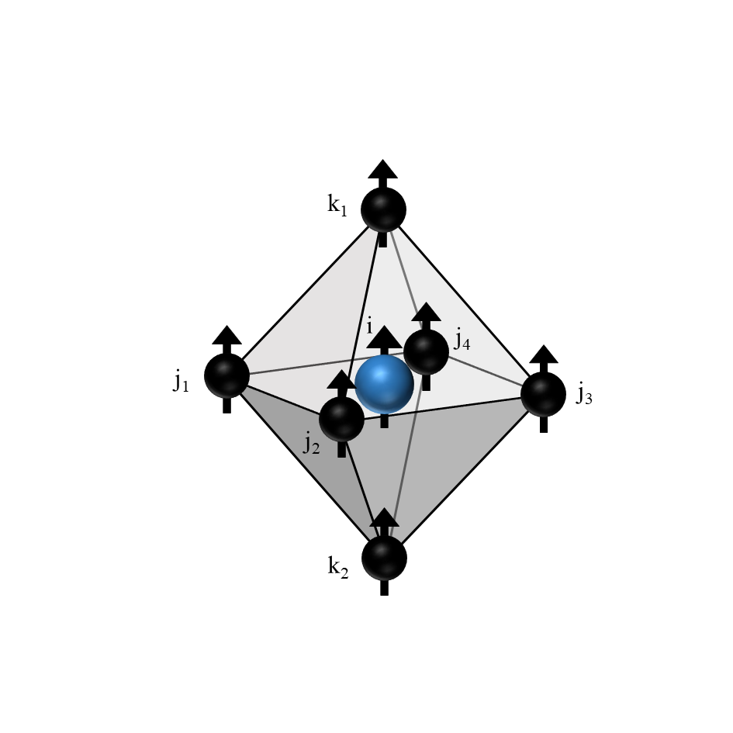
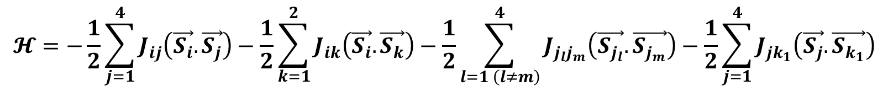
Formulation
The Hamiltonian
$$𝓗=−\frac{1}{2}\sum_{j=1}^{4}{J_{ij}\left(\vec{S_{i}}.\vec{S_{j}}\right)}−\frac{1}{2}\sum_{k=1}^{2}{J_{ik}\left(\vec{S_{i}}.\vec{S_{k}}\right)}−\frac{1}{2}\sum_{l=1 \left(l≠m\right)}^{4}{J_{j_{l}j_{m}}\left(\vec{S_{j_{l}}}.\vec{S_{j_{m}}}\right)}−\frac{1}{2}\sum_{j=1}^{4}{J_{jk_{1}}\left(\vec{S_{j}}.\vec{S_{k_{1}}}\right)}$$
$$−\frac{1}{2}\sum_{j=1}^{4}{J_{jk_{2}}\left(\vec{S_{j}}.\vec{S_{k_{2}}}\right)}−\vec{H}.\vec{S_{i}}−\vec{H}.\sum_{j=1}^{4}{\vec{S_{j}}}−\vec{H}.\sum_{k=1}^{2}{\vec{S_{k}}}$$

Slide 10
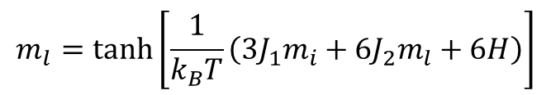


Formulation
Magnetization
$$m_{i}=\tanh\left[\frac{1}{k_{B}T}\left(3J_{1}m_{l}+H\right)\right]$$
$$m_{l}=\tanh\left[\frac{1}{k_{B}T}\left(3J_{1}m_{i}+6J_{2}m_{l}+6H\right)\right]$$
$$M=m_{i}+m_{j_{1}}+m_{j_{2}}+m_{j_{3}}+m_{j_{4}}+m_{k_{1}}+m_{k_{2}}$$
$$M=m_{i}+6m_{l}$$
$$M=\tanh\left[\frac{1}{k_{B}T}\left(3J_{1}m_{l}+H\right)\right]+6\tanh\left[\frac{1}{k_{B}T}\left(3J_{1}m_{i}+6J_{2}m_{l}+6H\right)\right]$$

Slide 11
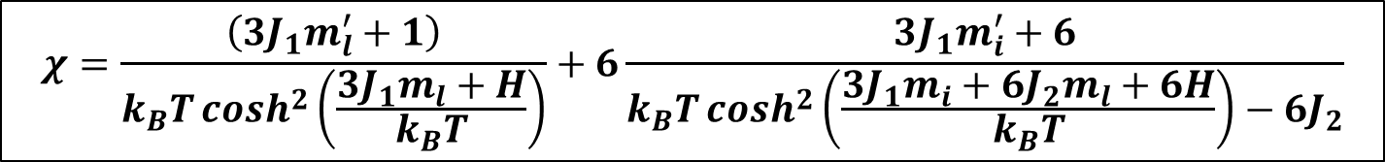
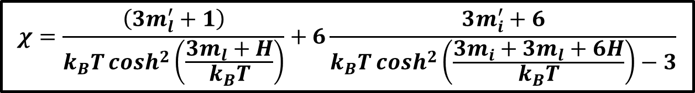
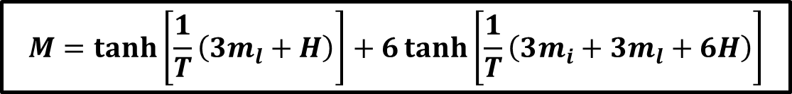
Results
Susceptibility
$$χ=\frac{\left(3J_{1}m_{l}^{′}+1\right)}{k_{B}T\cosh^{2}\left(\frac{3J_{1}m_{l}+H}{k_{B}T}\right)}+6\frac{3J_{1}m_{i}^{′}+6}{k_{B}T\cosh^{2}\left(\frac{3J_{1}m_{i}+6J_{2}m_{l}+6H}{k_{B}T}\right)−6J_{2}}$$
Plotting
For numerical plotting we used $k_{B}$ = 1, $J_{1}$=1, $J_{2}$=0.5
After putting these values we get:
$$M=\tanh\left[\frac{1}{T}\left(3m_{l}+H\right)\right]+6\tanh\left[\frac{1}{T}\left(3m_{i}+3m_{l}+6H\right)\right]$$
$$χ=\frac{\left(3m_{l}^{′}+1\right)}{k_{B}T\cosh^{2}\left(\frac{3m_{l}+H}{k_{B}T}\right)}+6\frac{3m_{i}^{′}+6}{k_{B}T\cosh^{2}\left(\frac{3m_{i}+3m_{l}+6H}{k_{B}T}\right)−3}$$

Slide 12
Results & Discussions
The saturation magnetization is observed for all the temperatures.
As the temperature increases, the thermal energy of the spins increases, therefore higher field is required to polarize all the spins in a particular direction
Variation of magnetization with field at different temperatures.

Slide 13
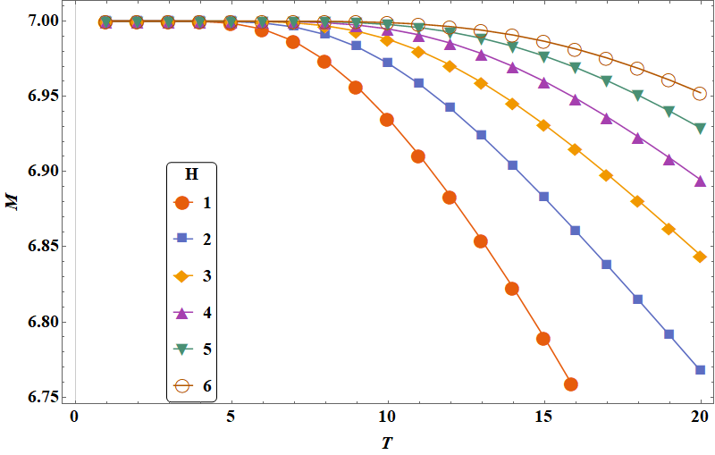
Results & Discussions
In low temperature magnetization asymptotes to a particular value for any given field. Which indicates in low temperature the given external magnetic filed is dominated by the temperature parameters.
In lower value of the temperature, the spins are polarized at a particular direction which gives rise to that particular asymptotic value of magnetization.
After applying very small field, as temperature is being increased, the orientation of the spins breaks and the magnetization decreases monotonically with temperature. As we apply higher fields, more temperature is required to break the orientation of the spins.
Variation of magnetization with temperature at different field.

Slide 14
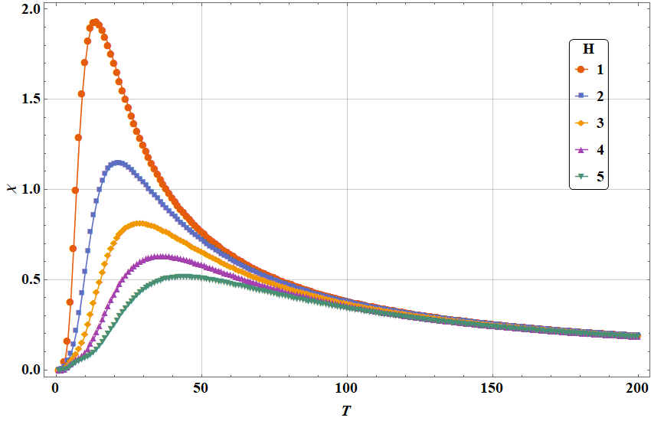
Results & Discussions
There is no discontinuity in the curve. This clearly indicates, the structure we worked with is paramagnetic in nature.
At low temperature, the spins are aligned, so they produce a higher magnetization value that leads to increase susceptibility.
After a certain temperature, the spins become randomly oriented which leads to rapid decrease in susceptibility.
Susceptibility Vs Temperature curve with external field as parameter
As the field is increased we see that the curve flattens so the peak value of susceptibility decreases.

Slide 15
Thank You

